Slide 1
Differentiation
Sin and Cos
Chapter 9
(Part 1 of 10)

Slide 2

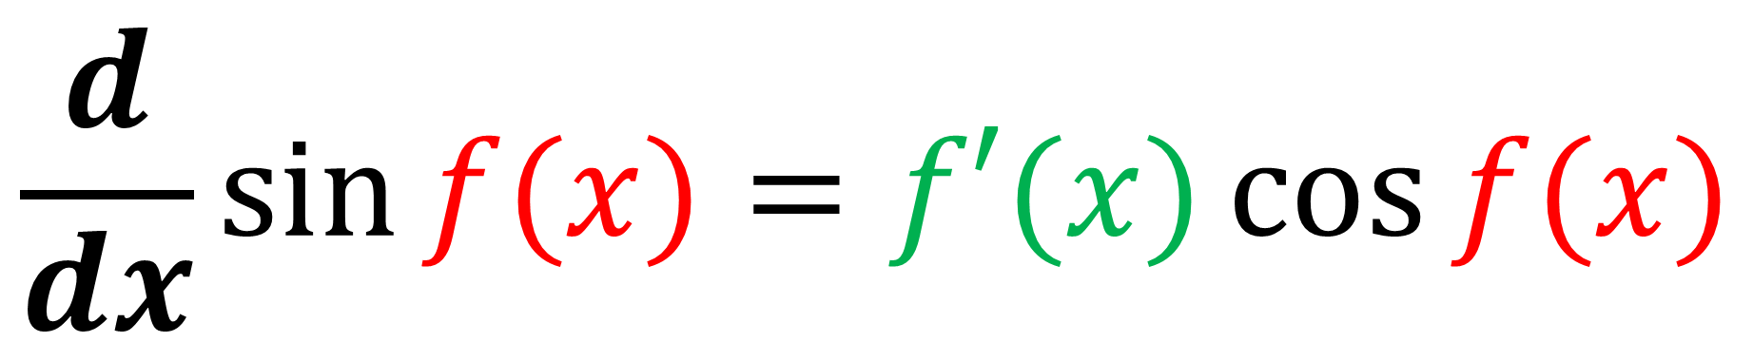
Differentiating sin $x$
$$\frac{d}{dx}\sin{f(x)}=f′(x)\cos{f(x)}$$

Slide 3
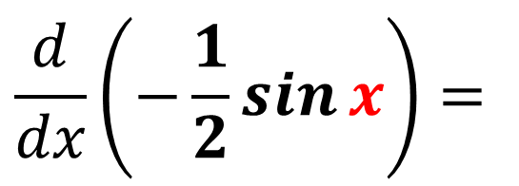
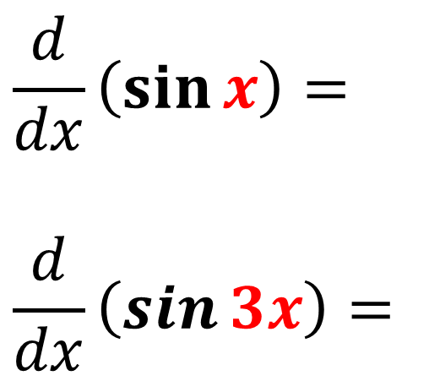
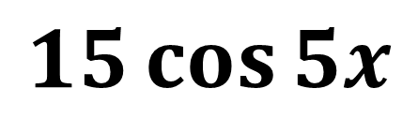

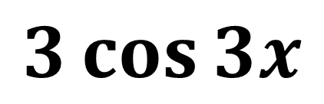
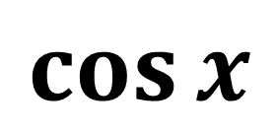
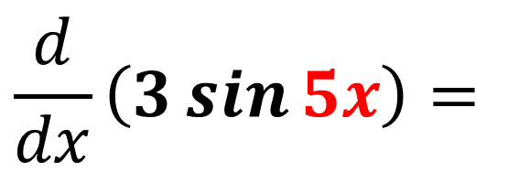
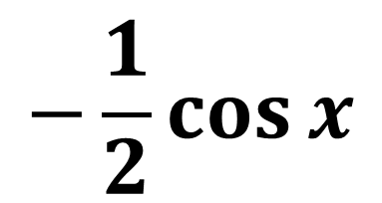
$$\sin{f(x)}=f′(x)\cos{f(x)}$$
$$\frac{d}{dx}\left(\sin{x}\right)=$$
$$\frac{d}{dx}\left(\sin{3x}\right)=$$
$$\cos{x}$$
$$3\cos{3x}$$
$$\frac{d}{dx}\left(3\sin{5x}\right)=$$
$$15\cos{5x}$$
$$\frac{d}{dx}\left(−\frac{1}{2}\sin{x}\right)=$$
$$−\frac{1}{2}\cos{x}$$

Slide 4

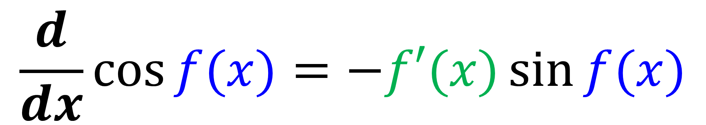
Differentiating cos $x$
$$\frac{d}{dx}\cos{f(x)}=−f′(x)\sin{f(x)}$$
When differentiating to sine change the sign!

Slide 5
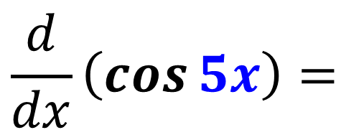
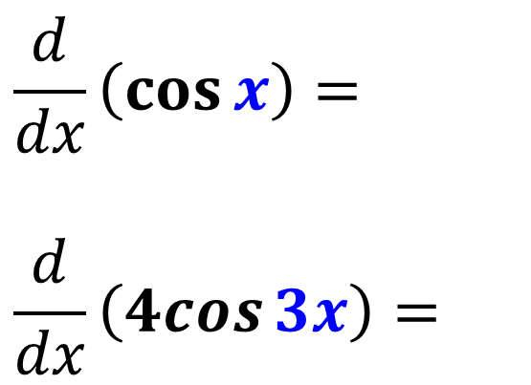
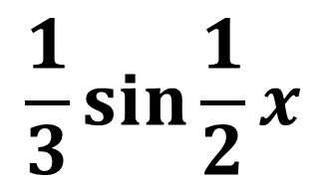
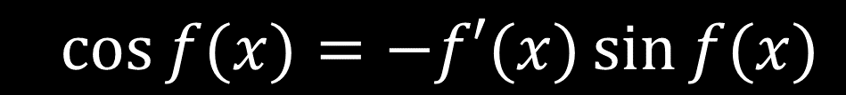
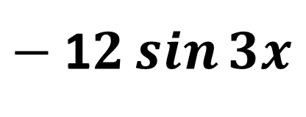
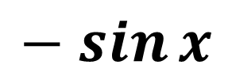
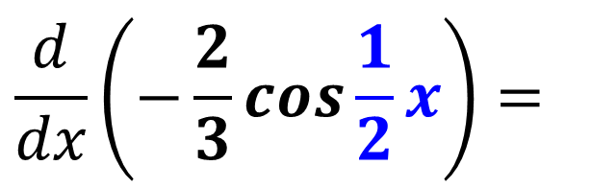
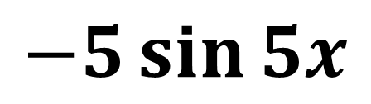
$$\cos{f(x)}=−f′(x)\sin{f(x)}$$
$$\frac{d}{dx}\left(\cos{x}\right)=$$
$$\frac{d}{dx}\left(4cos{3x}\right)=$$
$$− sin{x}$$
$−$1$2\sin{3x}$
$$\frac{d}{dx}\left(\cos{5x}\right)=$$
$$−5\sin{5x}$$
$$\frac{d}{dx}\left(−\frac{2}{3}\cos{\frac{1}{2}x}\right)=$$
$$\frac{1}{3}\sin{\frac{1}{2}x}$$

Slide 6

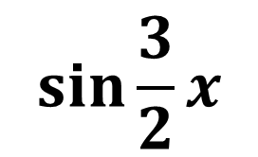
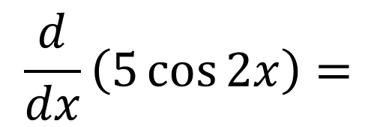
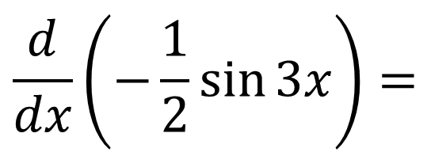
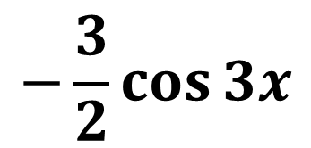
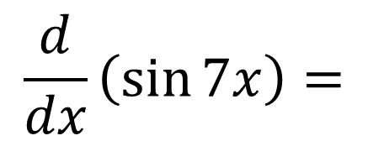
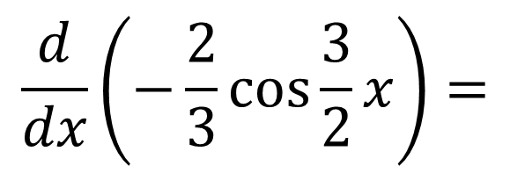

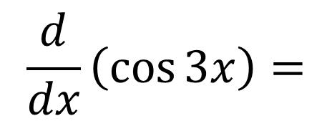

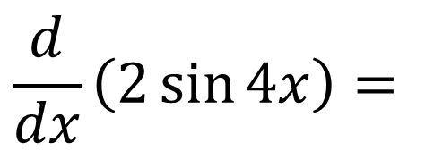

Mix it up!
$$\frac{d}{dx}\left(5\cos{2x}\right)=$$
$$−10\sin{2x}$$
$$\frac{d}{dx}\left(\sin{7x}\right)=$$
$$7cos{7x}$$
$$\frac{d}{dx}\left(−\frac{1}{2}\sin{3x}\right)=$$
$$−\frac{3}{2}\cos{3x}$$
$$\frac{d}{dx}\left(\cos{3x}\right)=$$
$$−3\sin{3x}$$
$$\frac{d}{dx}\left(2\sin{4x}\right)=$$
$$\frac{d}{dx}\left(−\frac{2}{3}\cos{\frac{3}{2}x}\right)=$$
$$\sin{\frac{3}{2}x}$$
$$8\cos{4x}$$

Slide 7
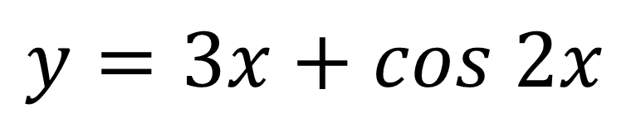
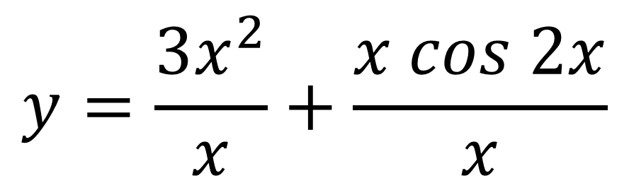
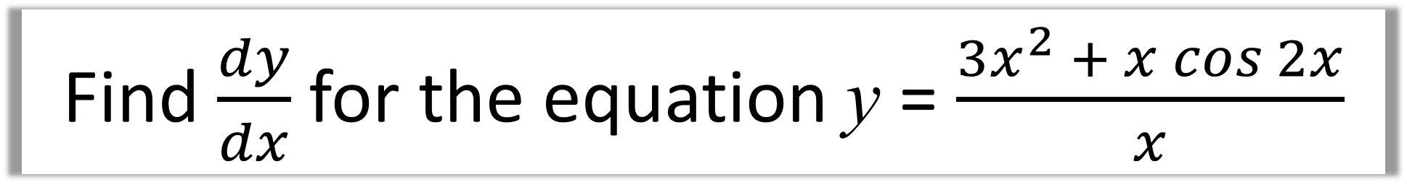
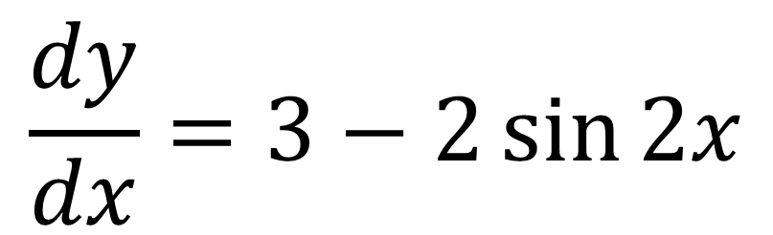
Find $\frac{dy}{dx}$ for the equation y = $\frac{3x^{2} + x cos 2x}{x}$
$$y=\frac{3x^{2}}{x}+\frac{x cos 2x}{x}$$
$$y=3x+cos 2x$$
$$\frac{dy}{dx}=3−2\sin{2x}$$

Slide 8
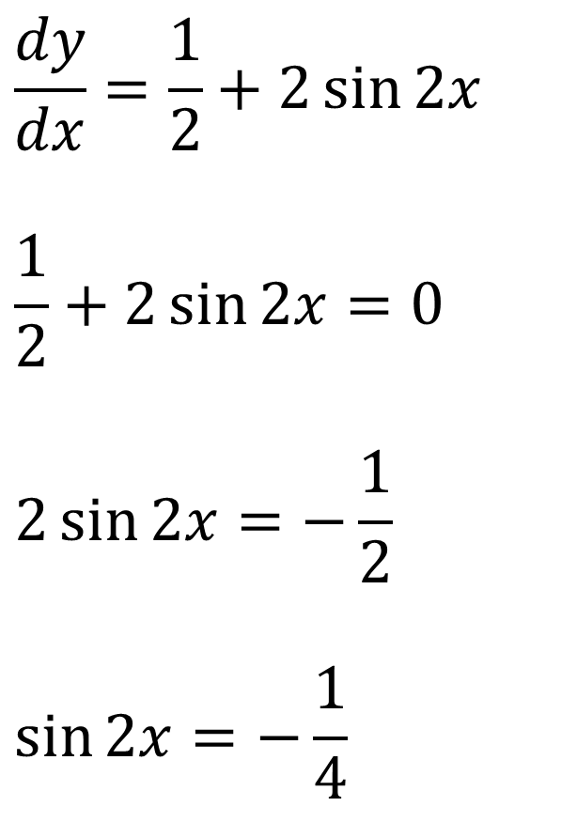
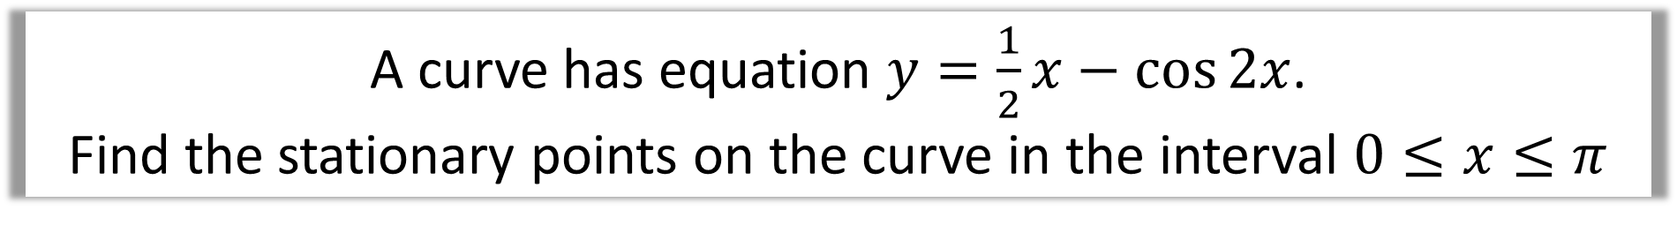
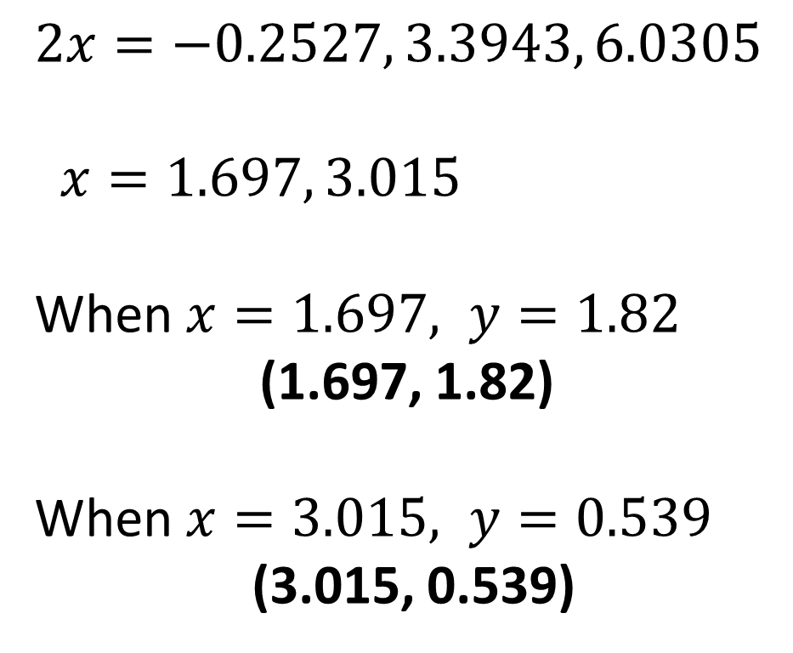
A curve has equation $y=\frac{1}{2}x−\cos{2x}$.
Find the stationary points on the curve in the interval $0≤x≤π$
$$\frac{dy}{dx}=\frac{1}{2}+2\sin{2x}$$
$$\frac{1}{2}+2\sin{2x}=0$$
$$2\sin{2x}=−\frac{1}{2}$$
$$\sin{2x}=−\frac{1}{4}$$
$$2x=−0.2527, 3.3943, 6.0305$$
$x=1.697, 3.015$
When $x=1.697, y=1.82$
(1.697, 1.82)
When $x=3.015, y=0.539$
(3.015, 0.539)

Slide 9

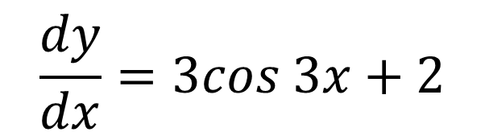
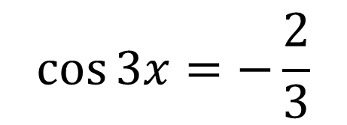
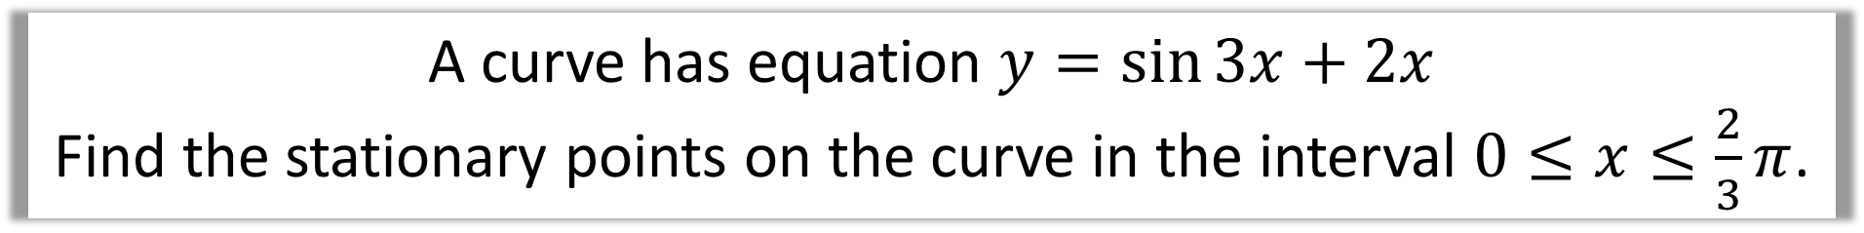





A curve has equation $y=\sin{3x}+2x$
Find the stationary points on the curve in the interval $0≤x≤\frac{2}{3}π$.
$$\frac{dy}{dx}=3cos 3x+2$$
$$3x=2.3005, 3.9827$$
$$x=0.7668, 1.3276$$
$$3cos 3x+2=0$$
$$3\cos{3x}=−2$$
$$(0.7668 , 2.279)$$
$$\cos{3x}=−\frac{2}{3}$$
$$(1.3276 , 1.910)$$

Slide 10
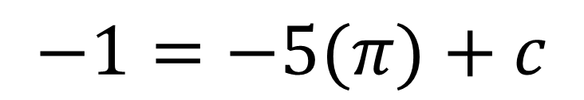
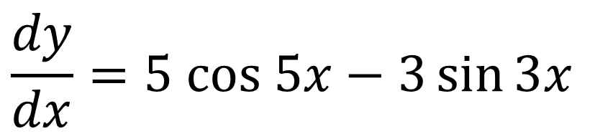
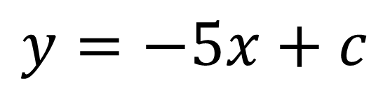
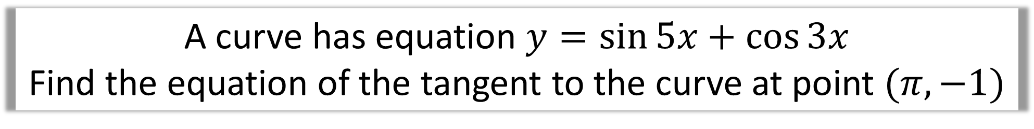
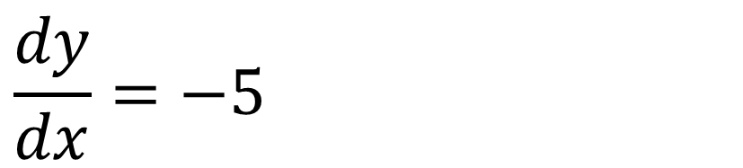
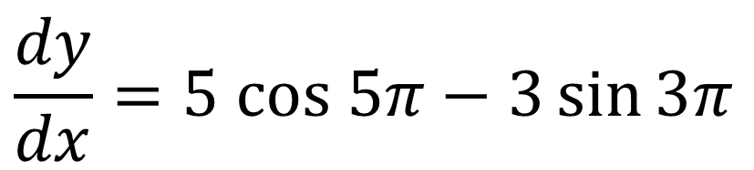
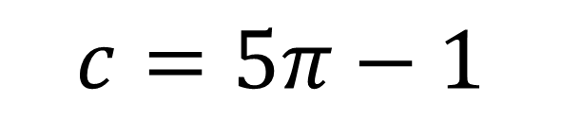
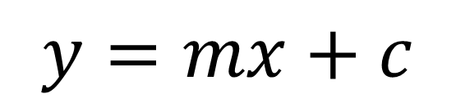
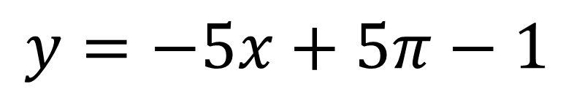
A curve has equation $y=\sin{5x}+\cos{3x}$
Find the equation of the tangent to the curve at point $(π, −1)$
$$\frac{dy}{dx}=5 cos 5x−3\sin{3x}$$
$$y=mx+c$$
$$y=−5x+c$$
$$\frac{dy}{dx}=5 cos 5π−3\sin{3π}$$
$$−1=−5(π)+c$$
$$c=5π−1$$
$$\frac{dy}{dx}=−5$$
$$y=−5x+5π−1$$

