Slide 1
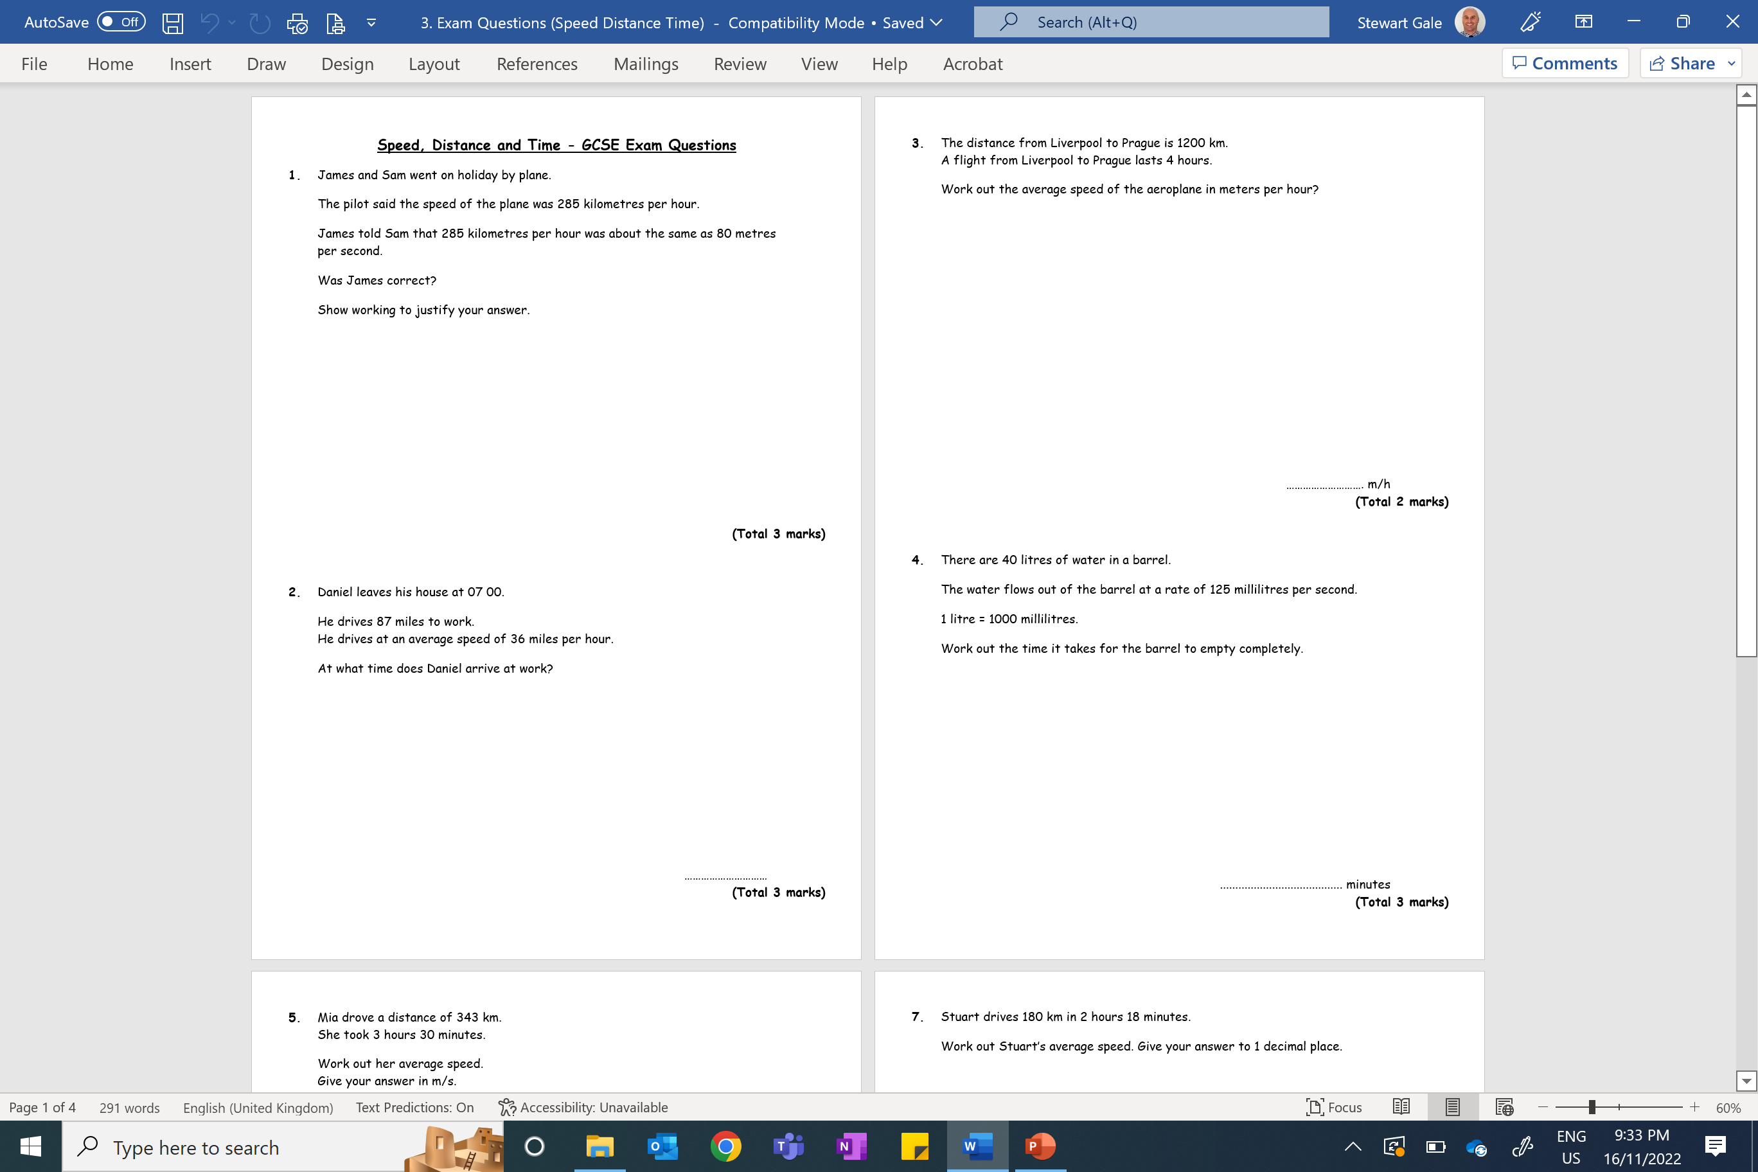

Slide 2
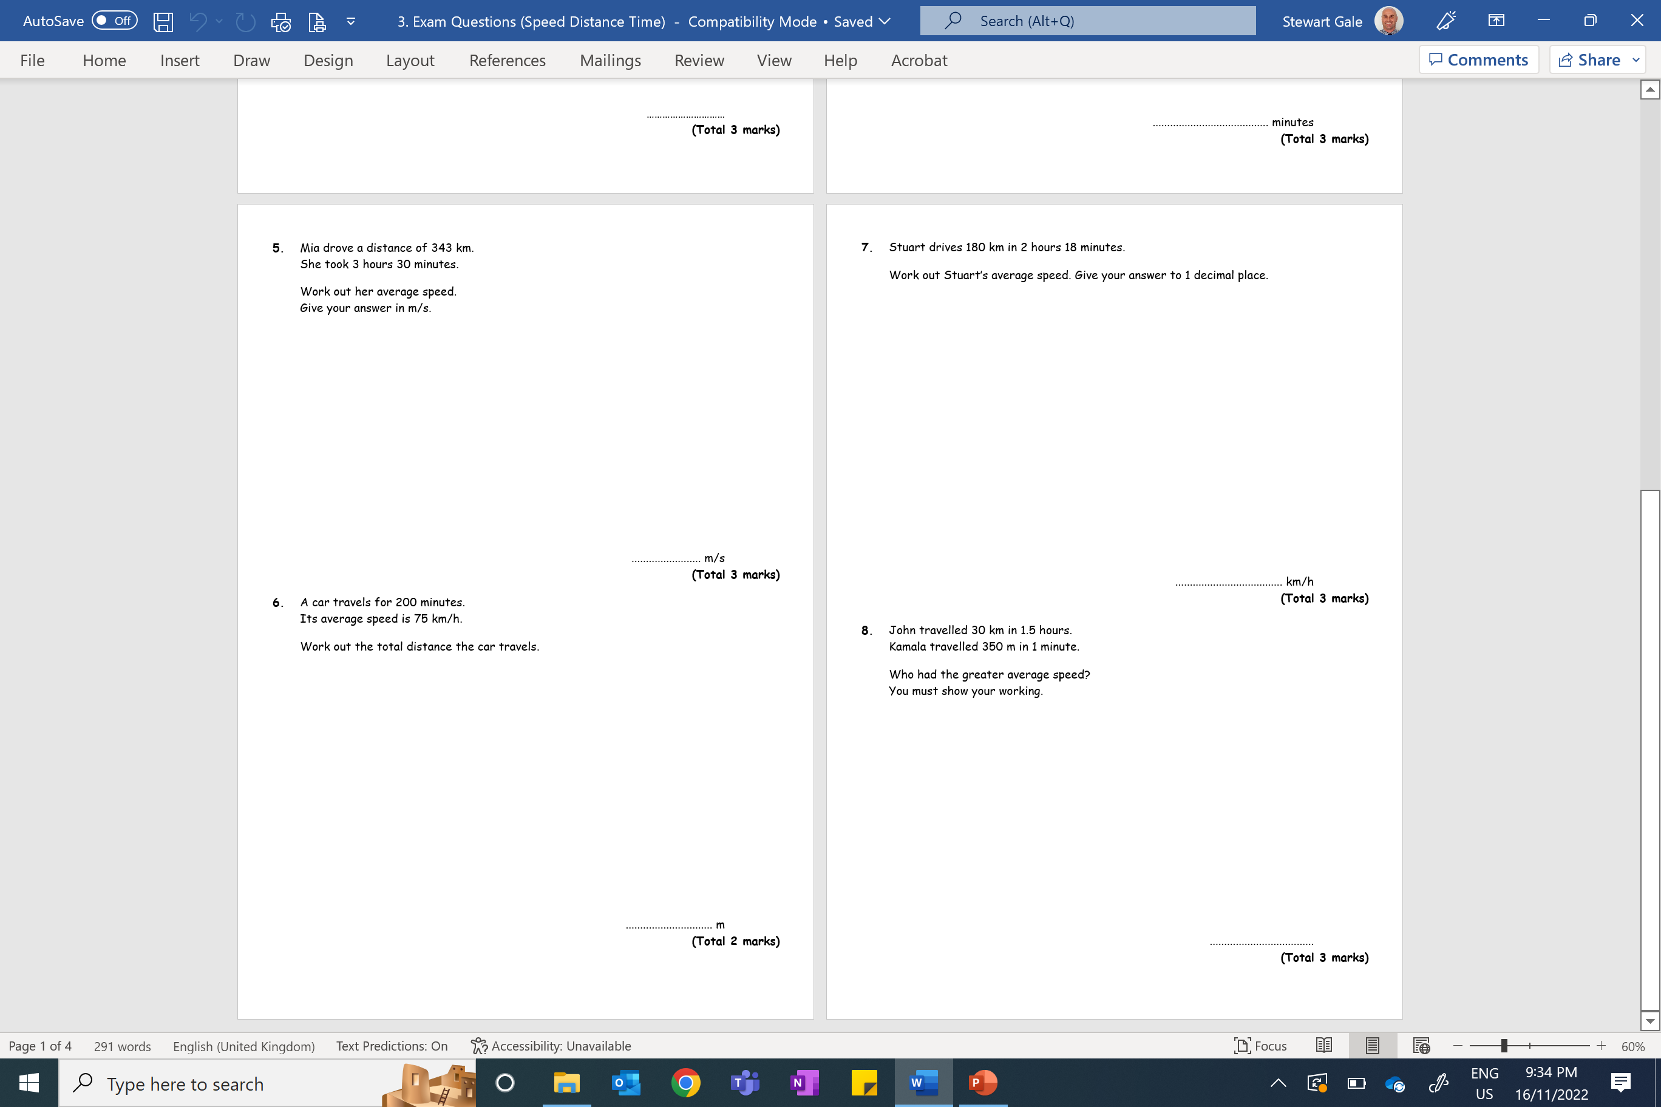

Slide 3
ANSWERS

Slide 4
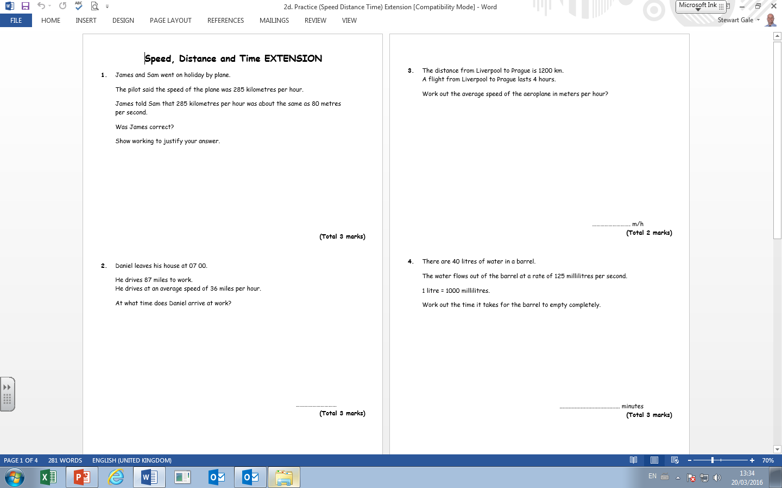
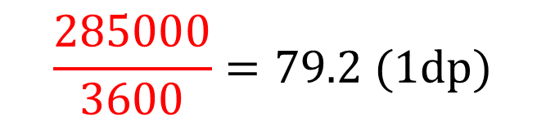
285 km in 1 hour
285000 m in 3600 seconds
$$\frac{285000}{3600}=79.2 (1dp)$$
Yes, James is correct it is about 80m/s

Slide 5
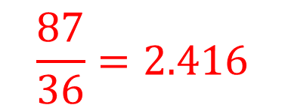
$$\frac{87}{36}=2.416$$
= 2 hours 25 minutes
09 25

Slide 6
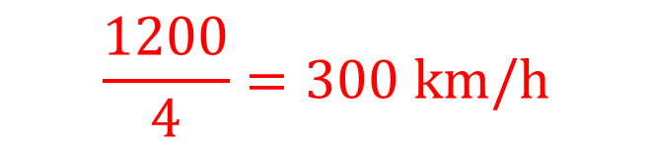
$$\frac{1200}{4}=300 km/h$$
300000

Slide 7
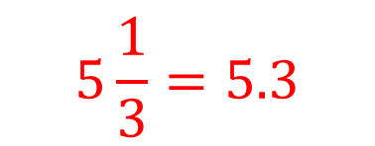
40000 ÷ 125 = 320 seconds
$$5\frac{1}{3}=5.3$$

Slide 8
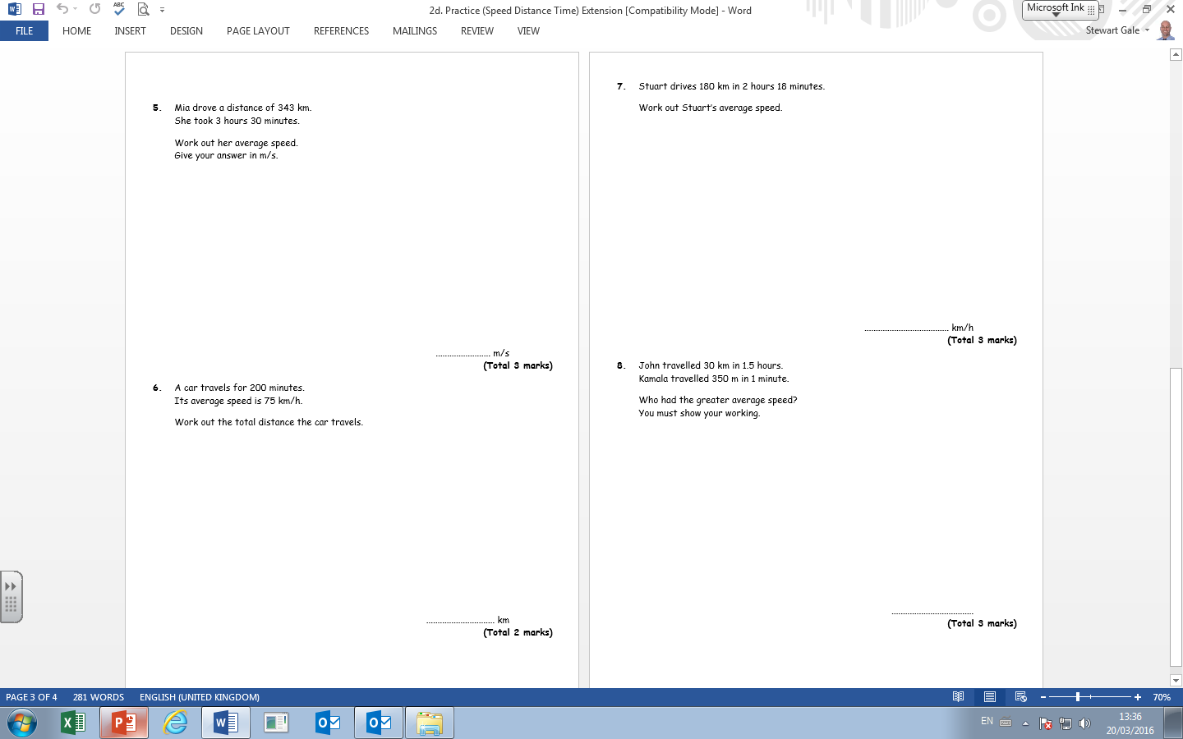
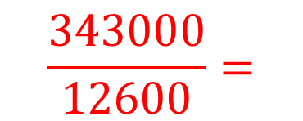
$$\frac{343000}{12600}=$$
27.2

Slide 9

75 x 3.3 $=250 km$
250000
m

Slide 10
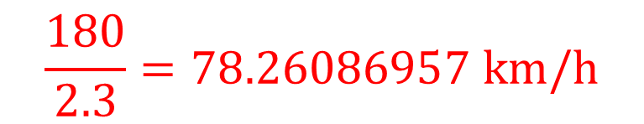
$$\frac{180}{2.3}=78.26086957 km/h$$
78.3

Slide 11

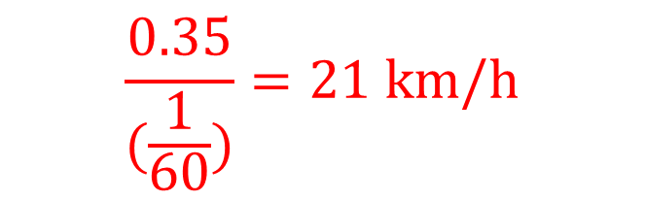
$$\frac{30}{1.5}=20 km/h$$
$$\frac{0.35}{(\frac{1}{60})}=21 km/h$$
Kamala had the greater average speed

