Slide 1
LO: Vector Problems

Slide 2
B
b
C
Find the vector
in terms of a and b
a
ABCD is a parallelogram
a + b
AC =
A
M
D
M is the mid-point of AD.

Slide 3
B
b
C
Find the vector
in terms of a and b
a
ABCD is a parallelogram
-a + b
BD =
A
M
D
M is the mid-point of AD.

Slide 4
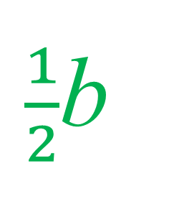
B
b
C
Find the vector
in terms of a and b
a
ABCD is a parallelogram
$\frac{1}{2}$b
AM =
A
M
D
M is the mid-point of AD.

Slide 5
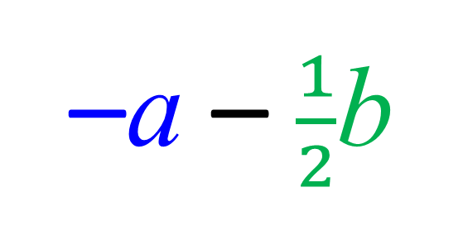
B
b
C
Find the vector
in terms of a and b
a
ABCD is a parallelogram
–a – $\frac{1}{2}$b
CM =
A
M
D
M is the mid-point of AD.

Slide 6
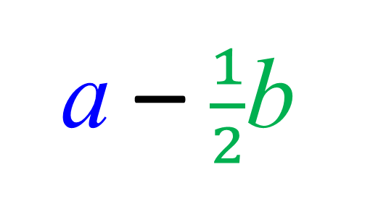
B
b
C
Find the vector
in terms of a and b
a
ABCD is a parallelogram
a – $\frac{1}{2}$b
MB =
A
M
D
M is the mid-point of AD.

Slide 7
Ratios
B
b
C
a
ABCD is a parallelogram
What is the ratio of
AM:MD?
A
M
D
1:1
M is the mid-point of AD.

Slide 8
B
C
ABCD is a parallelogram
What is the ratio of
AM:MD?
A
M
D
3:1
M is ¾ from A.

Slide 9
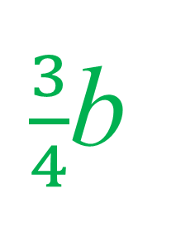
B
b
C
a
ABCD is a parallelogram
Find the vector
in terms of a and b
A
M
D
$\frac{3}{4}$b
AM =
AM:MD
is in the ratio
3:1

Slide 10
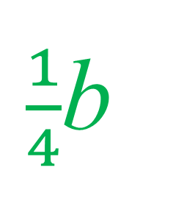
B
b
C
a
ABCD is a parallelogram
Find the vector
in terms of a and b
A
M
D
$\frac{1}{4}$b
MD =
AM:MD
is in the ratio
3:1

Slide 11
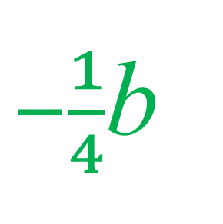
B
b
C
a
ABCD is a parallelogram
Find the vector
in terms of a and b
A
M
D
$−\frac{1}{4}$b
DM =
AM:MD
is in the ratio
3:1

Slide 12
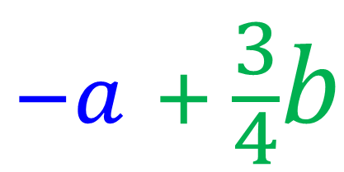
B
b
C
a
ABCD is a parallelogram
Find the vector
in terms of a and b
A
M
D
$$−a + \frac{3}{4}b$$
BM =
AM:MD
is in the ratio
3:1

Slide 13
Parallel
Vectors

Slide 14
What can you say about the set of vectors?
They are all parallel.

Slide 15
What can your learn from the notation of the parallel vectors?
5a
4a
3a
2a
a
They are all multiples of a.

Slide 16


Are the two vectors parallel?
8a + 4b
24a + 12b
8a + 4b
YES
3(8a + 4b)

Slide 17
Are the two vectors parallel?
2a + 4b
2a + 6b
2(a + 2b)
NO
2(a + 3b)

Slide 18
Are the two vectors parallel?
15a - 25b
10a – 15b
5(2a - 3b)
NO
5(3a - 5b)

Slide 19
Are the two vectors parallel?
24a – 36b
8a – 12b
8a – 12b
YES
3(8a – 12b)

Slide 20
COLLINEAR

Slide 21
C
A, B and C are collinear
because they are
in a straight line.
B
A

Slide 22
X, Y and Z are not collinear.
Z
Y
X

Slide 23
Proving Collinear
A, B and C are
Collinear
if AB and AC
are parallel.
C
B
A

Slide 24
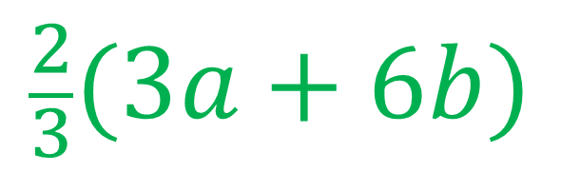
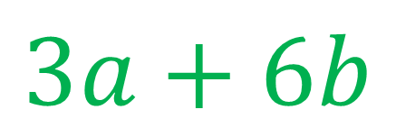
Prove that A, B and C are collinear.
C
AC =
$$3a+6b$$
AB =
$$\frac{2}{3}(3a+6b)$$
B
6b
A, B and C are Collinear
because AB and AC are parallel
A
3a
AB:BC is in the ratio 2:1

