Slide 1
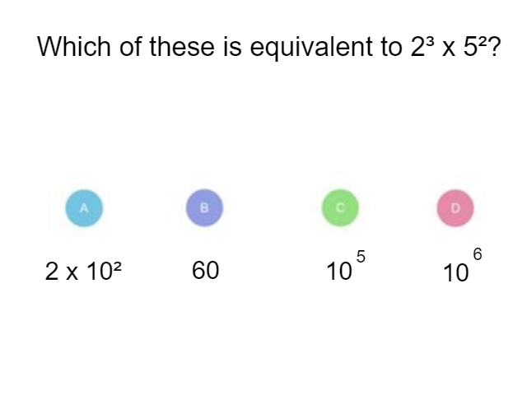
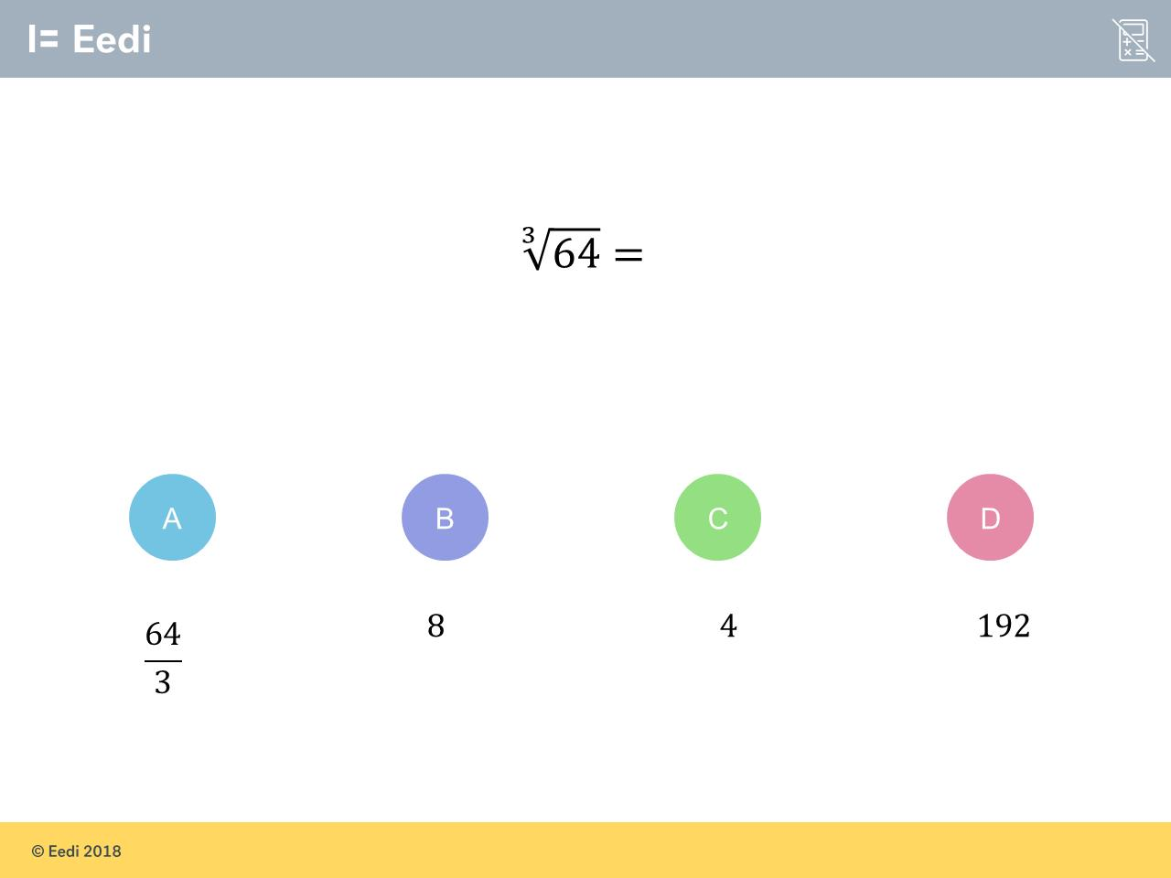
Worst answered question?
Most common wrong answer?

Slide 2
ANSWERS

Slide 3
Worst answered question?

Slide 4
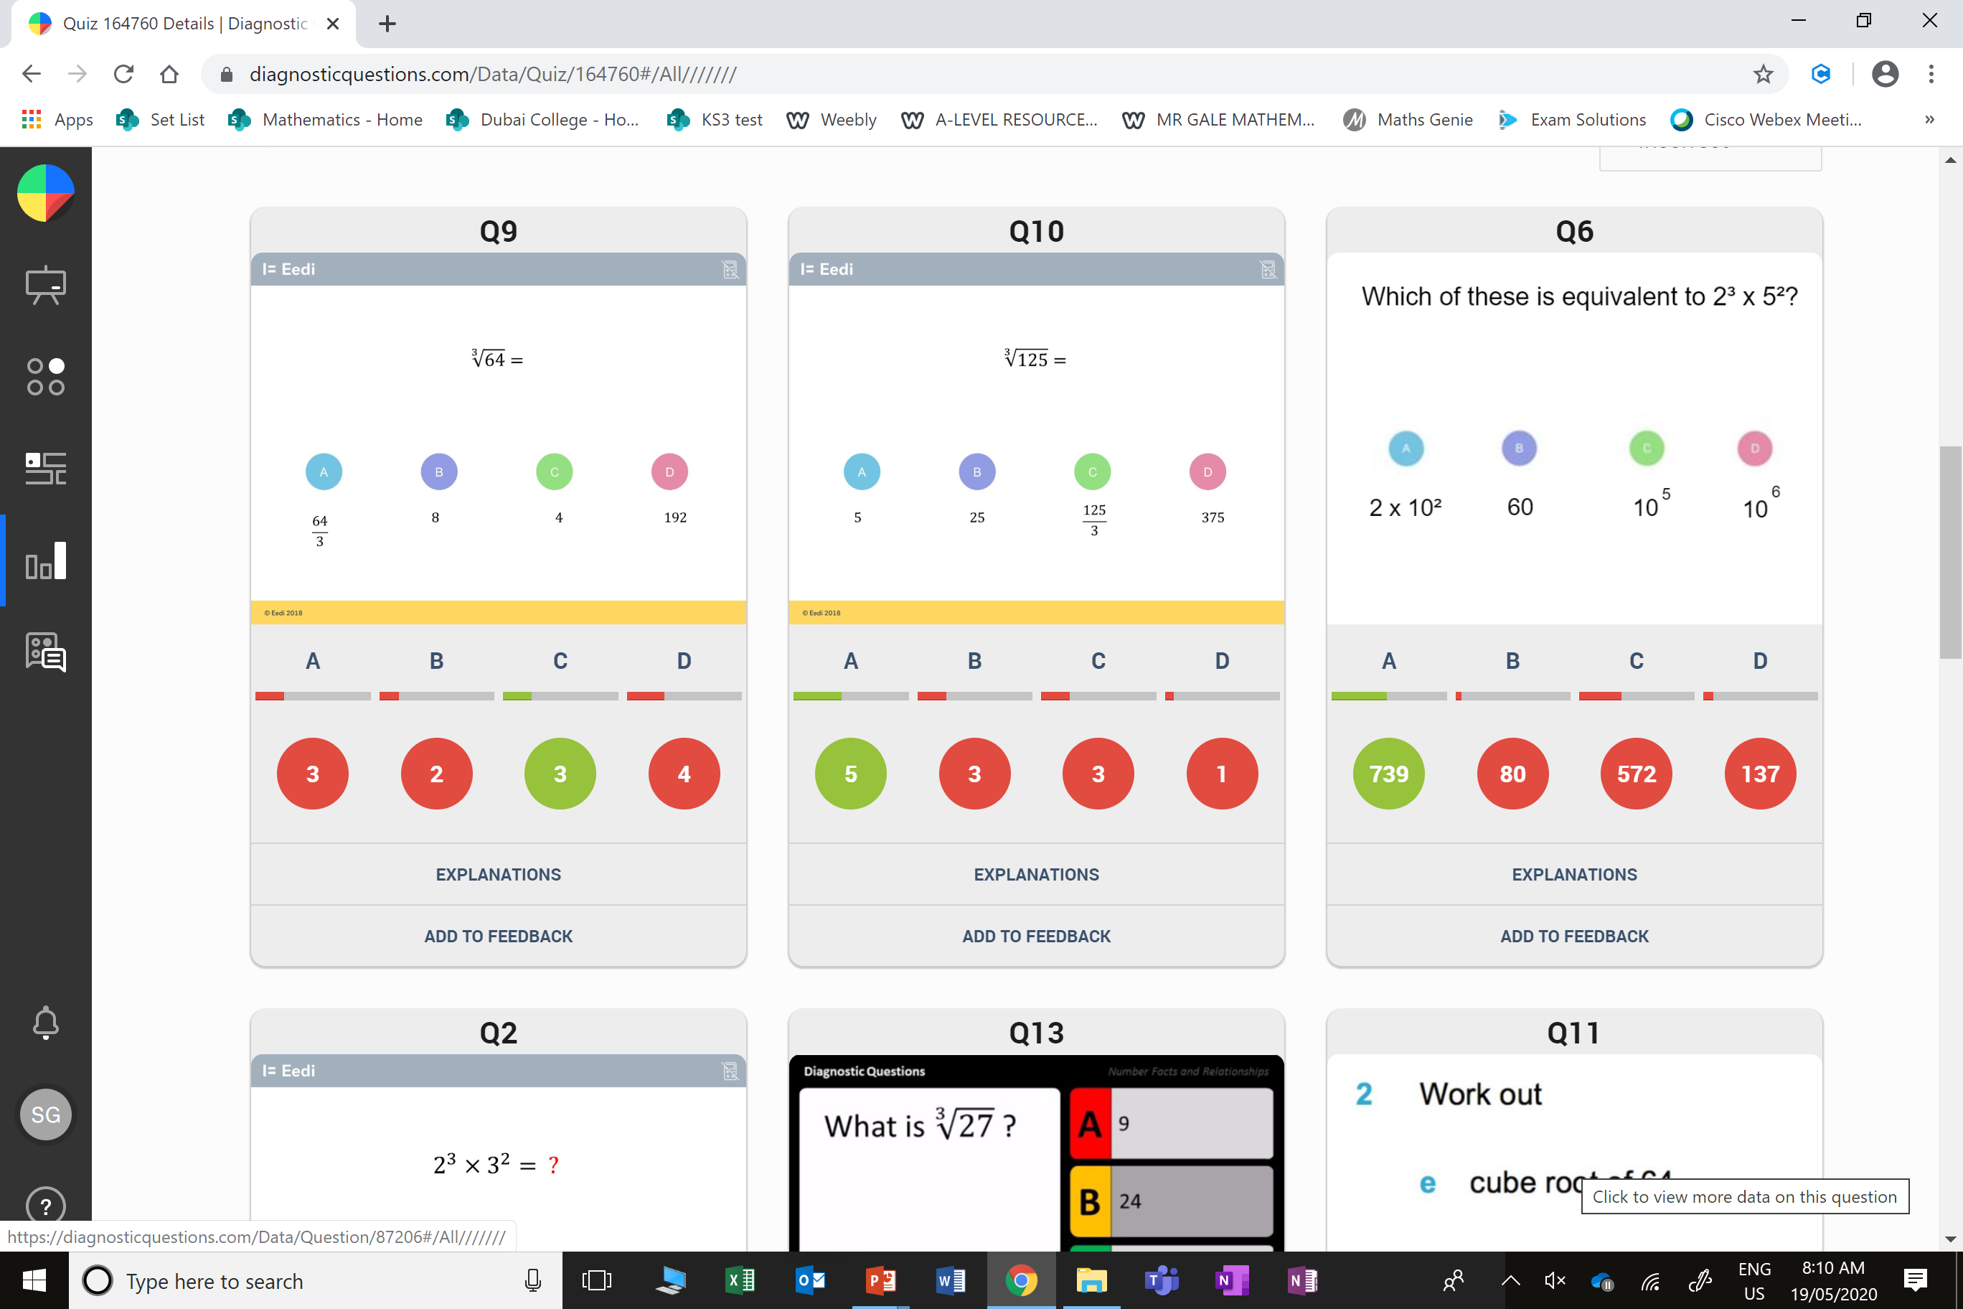
D
They simple multiplied 64 by 3.

Slide 5
C
They added the powers and multiplied the base values.

