Slide 1
Radians
Introduction
Chapter 5
(Part 1 of 5)

Slide 2
Radians
So far you’ve used degrees
as the unit to measure angles.
But outside geometry, mathematicians pretty much always use radians.

Slide 3
What is 1 degree?
1°
1 Degree

Slide 4
1 radian is the movement of one radius’ around the circumference of the circle
r
r
1 rad
1 Radian

Slide 5
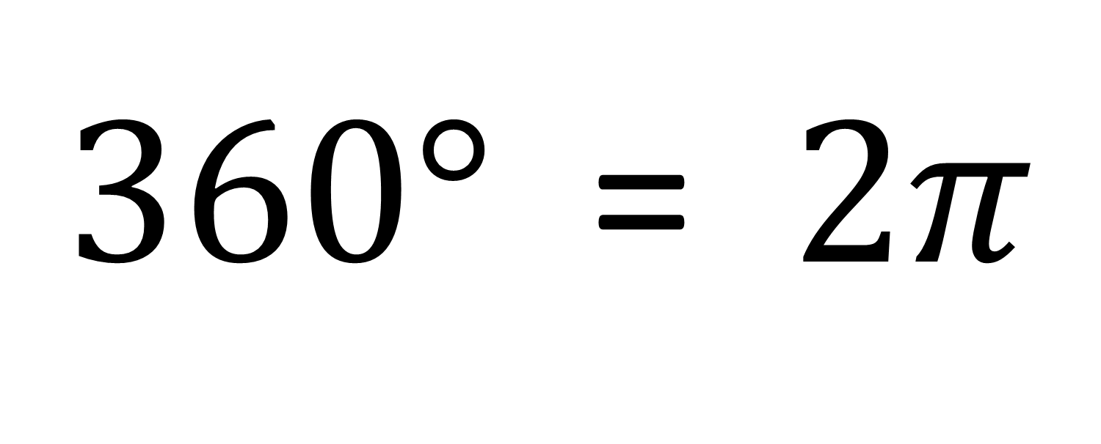
Radians - Converting
$360°$ = $2π$

Slide 6
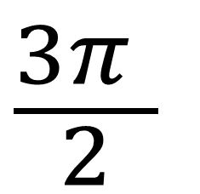
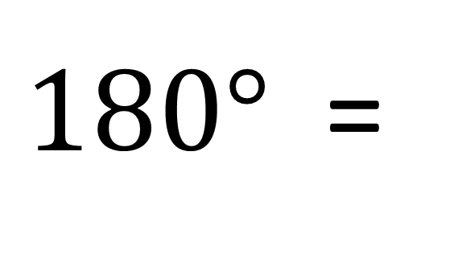
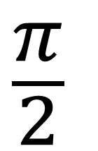
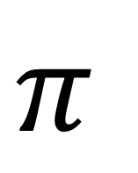
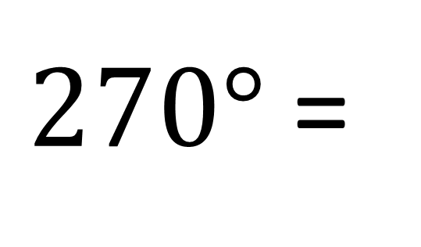
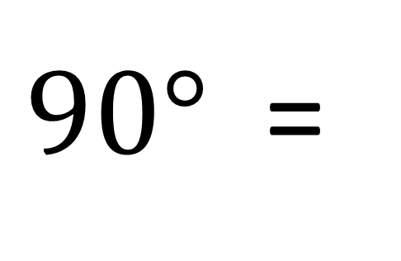

Learn $360°$ = $2π$ and you get generate the following in terms of radians.
$180°$ =
$$π$$
$90°$ =
$$\frac{π}{2}$$
$270°$ =
$$\frac{3π }{2}$$

Slide 7

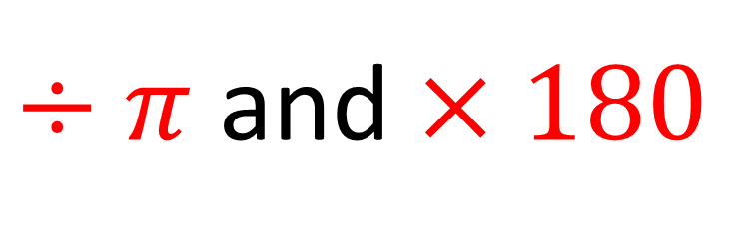
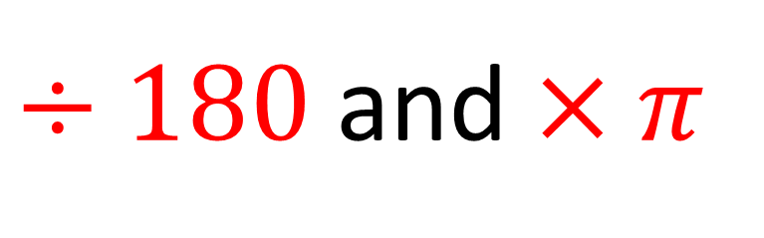
$÷180$ and $×π$
$Degrees$= $Radian$
$÷π$ and $×180$

Slide 8
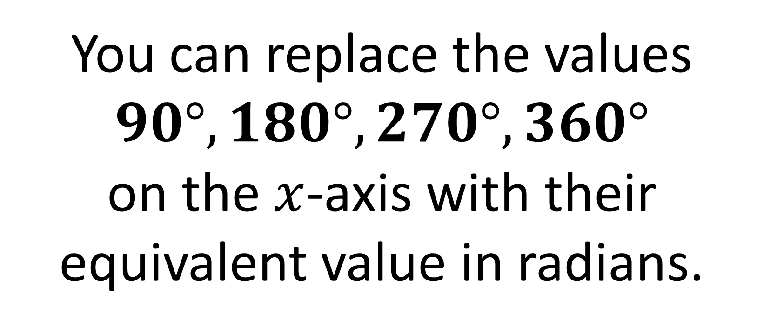
Radians - Graph Sketching
You can replace the values $90°, 180°, 270°, 360°$
on the $x$-axis with their equivalent value in radians.

Slide 9

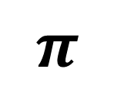
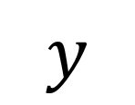
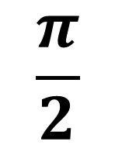
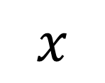
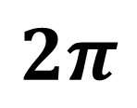
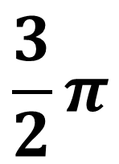
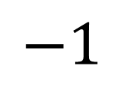
$$y$$
$$1$$
$$π$$
$$x$$
$$\frac{π}{2}$$
$$\frac{3}{2}π$$
$$2π$$
$$−1$$

Slide 10

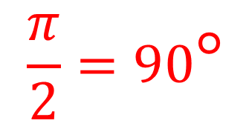









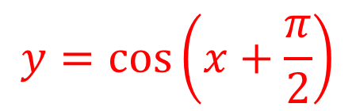
Sketch the graph of $y=\cos\left(x+\frac{π}{2}\right)$ for $0≤x<2π$
$$y$$
$$\frac{π}{2}=90°$$
$$y=cos\left(x+\frac{π}{2}\right)$$
$$1$$
$$y=cos\left(x\right)$$
$$x$$
$$\frac{π}{2}$$
$$π$$
$$\frac{3}{2}π$$
$$2π$$
$$−1$$

Slide 11
…but WHY use radians?
it helps makes certain
calculations easier.

