Slide 1
Elastic, Strings and Springs
Elastic Energy
Chapter 3
(Part 5 of 5)

Slide 2
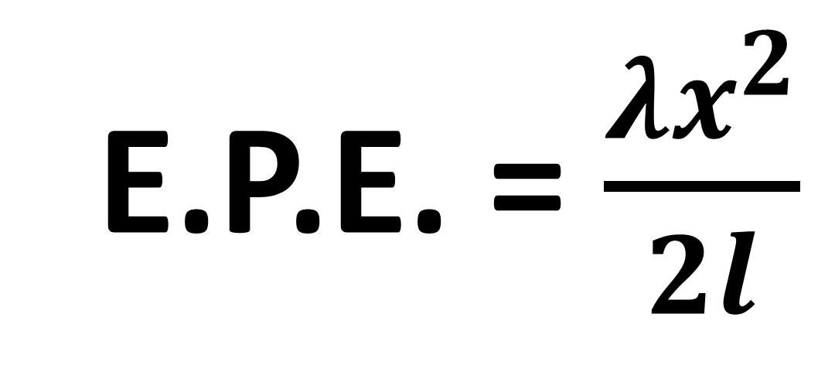
The Elastic Potential Energy
stored in a spring or string
is equal to the work done
in stretching /compressing it.
E.P.E. = $\frac{λx^{2}}{2l}$

Slide 3
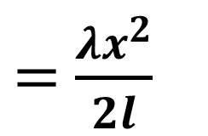
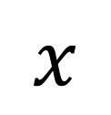
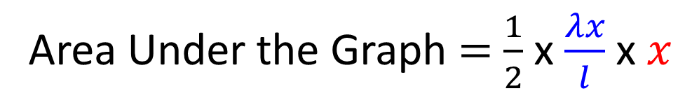
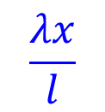
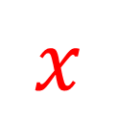

Derivation Using Area Under a Graph
Tension in the spring is linear
to the extension of the spring.
$$T$$
The area under the graph is
equal to work done and therefore the Energy in the Spring.
$$\frac{λx}{l}$$
Area Under the Graph $=$ $\frac{1}{2}$ x $\frac{λx}{l}$ x$x$
Tension in the Spring
$=$ $\frac{λx^{2}}{2l}$
Elastic Potential Energy
$$x$$
$$x$$
Extension Length of the String

Slide 4
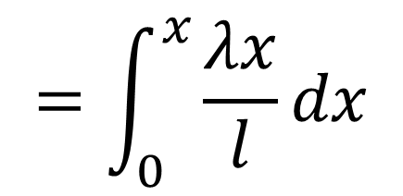
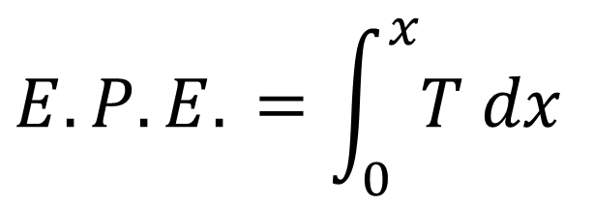
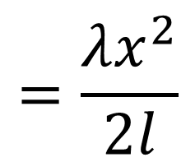
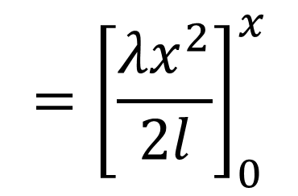
$$E.P.E. =\int_{0}^{x}{T dx}$$
Derivation Using Integration
$$T$$
$$=\int_{0}^{x}{\frac{λx}{l}dx}$$
$$\frac{λx}{l}$$
$$={\left[\frac{λx^{2}}{2l}\right]}_{0}^{x}$$
Tension in the Spring
$$=\frac{λx^{2}}{2l}$$
$$x$$
Extension Length of the String

Slide 5
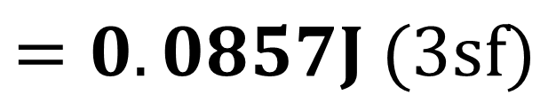
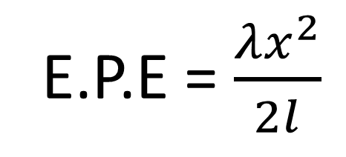

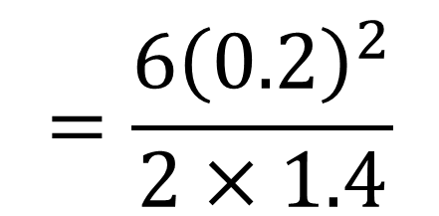
An elastic string has natural length 1.4m and
modulus of elasticity 6N.
Find the energy stored in the string when its length is 1.6m
E.P.E = $\frac{λx^{2}}{2l}$
E.P.E = $\frac{λx^{2}}{2l}$
$$=\frac{6{\left(0.2\right)}^{2}}{2×1.4}$$
$$=0.0857J (3sf)$$

Slide 6

The law of Conservation of Energy
Initial Energy $=$ Final Energy
Work in
+ Initial K.E.
+ Initial G.P.E.
+ Initial E.P.E
Work out
+ Final K.E.
+ Final G.P.E.
+ Final E.P.E

Slide 7
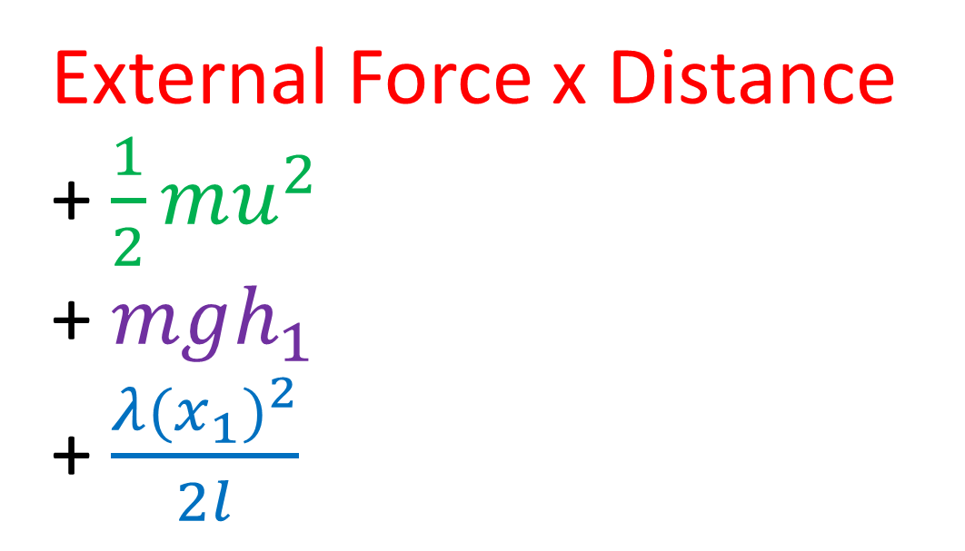

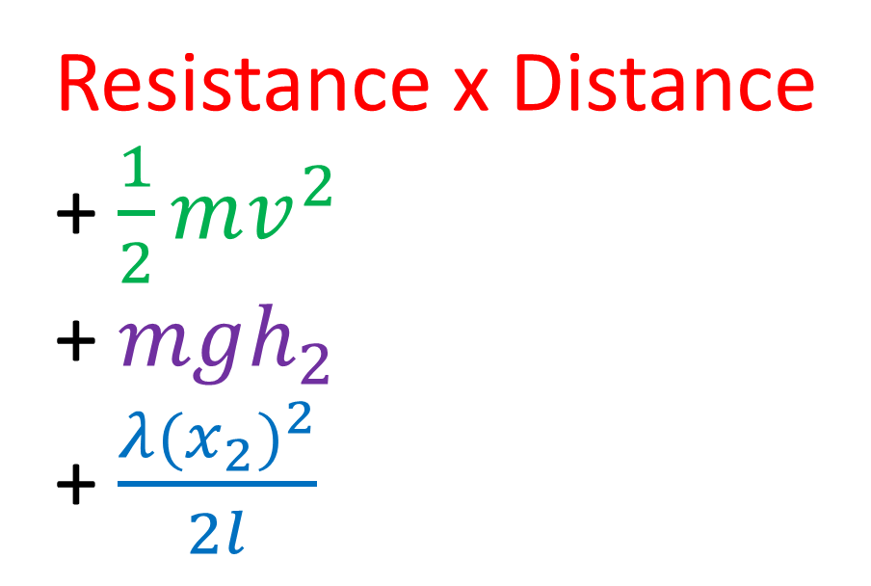
The law of Conservation of Energy
Initial Energy $=$ Final Energy
External Force x Distance
+ $\frac{1}{2}mu^{2}$
+ $mgh_{1}$
+ $\frac{λ{(x_{1})}^{2}}{2l}$
Resistance x Distance + $\frac{1}{2}mv^{2}$
+ $mgh_{2}$
+ $\frac{λ{(x_{2})}^{2}}{2l}$

Slide 8
Springs and Strings
Problem Solving Considerations
Approach 1: Hooke’s Law and F=ma
  Most equilibrium problems
  Problems linked to acceleration and forces
Approach 2: Energy
  Most problems linked to distance travelled and velocity

Slide 9
Example A: Horizontal
A particle of mass 0.5kg is attached to one end of an elastic string, of natural length 2m and modulus of elasticity 19.6N.
The other end of the elastic string is attached to a point O.
The particle is released from the point O.
Find the greatest distance it will reach below O.

Slide 10

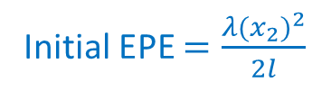








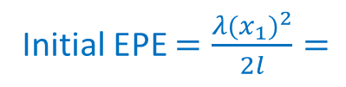



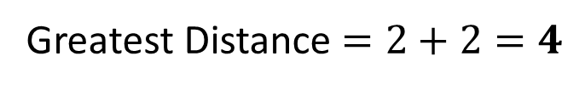

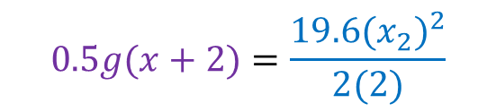




A particle of mass 0.5kg is attached to one end of an elastic string, of natural length 2m and modulus of elasticity 19.6N.
The other end of the elastic string is attached to a point O.
The particle is released from the point O.
Find the greatest distance it will reach below O.
O
O
Initial Energy $=$ Final Energy
0.5
$$mgh_{1}=\frac{λ{(x_{2})}^{2}}{2l}$$
Work in $=$
$$0$$
2
$$0.5g(x+2)=\frac{19.6{(x_{2})}^{2}}{2(2)}$$
KE $=\frac{1}{2}mu^{2}=$
$$0$$
Initial EPE $=\frac{λ{(x_{1})}^{2}}{2l}=$
$$0$$
Work Out $=$
$$0$$
x
KE $=\frac{1}{2}mu^{2}=$
$$4.9x+9.8= {19.6x}^{2}$$
$$0$$
Initial GPE $=mgh_{1}$
$0= {19.6x}^{2}$ $− 4.9x−9.8$
0.5
Initial EPE $=\frac{λ{(x_{2})}^{2}}{2l}$
$$x=2 or x=−1$$
Initial GPE $=mgh_{1}=$
$$0$$
Greatest Distance $=2+2=4$

Slide 11
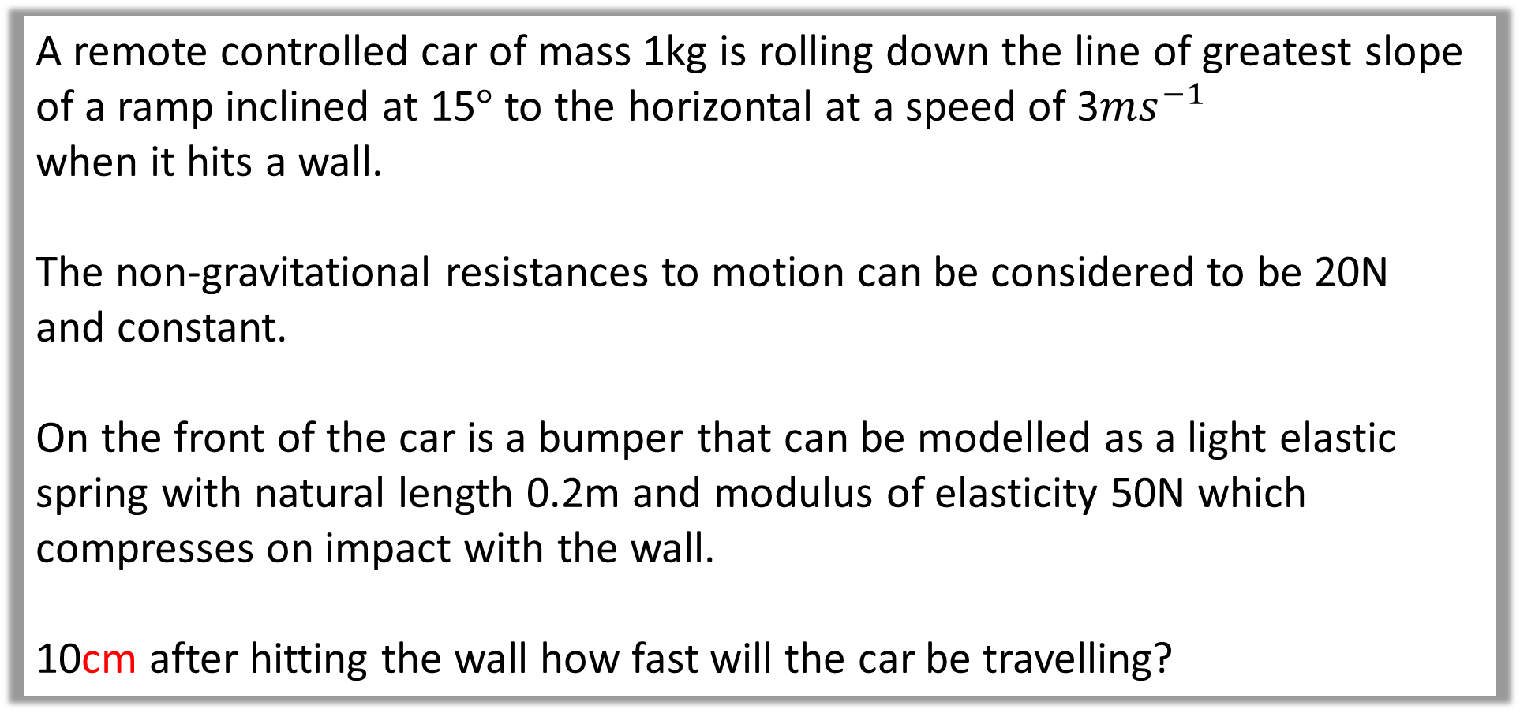
Example B: Slope
A remote controlled car of mass 1kg is rolling down the line of greatest slope of a ramp inclined at 15$°$ to the horizontal at a speed of 3$ms^{−1}$
when it hits a wall.
The non-gravitational resistances to motion can be considered to be 20N
and constant.
On the front of the car is a bumper that can be modelled as a light elastic spring with natural length 0.2m and modulus of elasticity 50N which compresses on impact with the wall.
10cm after hitting the wall how fast will the car be travelling?

Slide 12
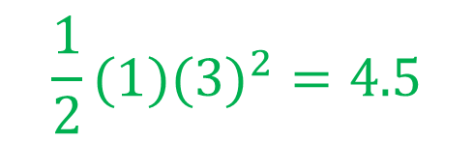

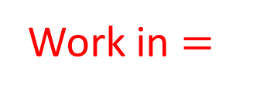


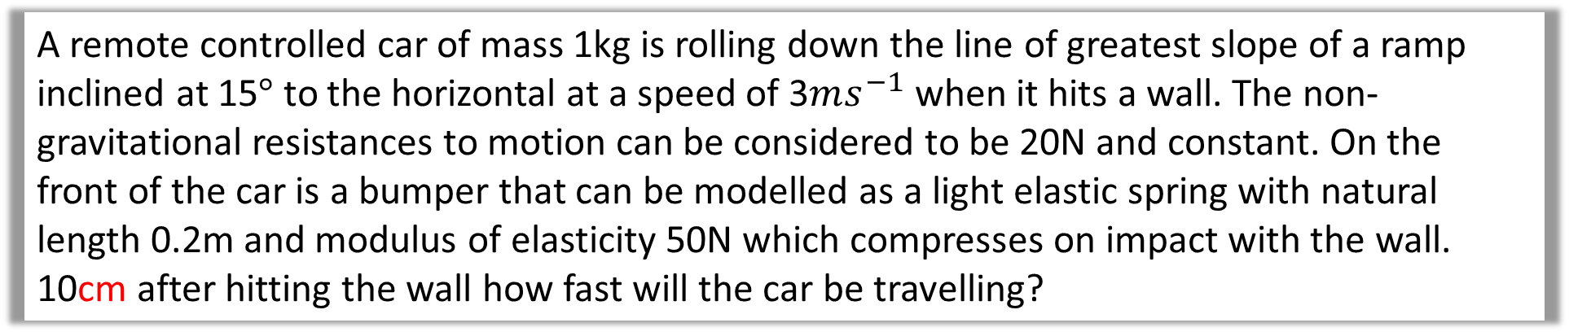



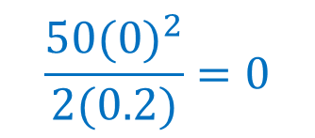



A remote controlled car of mass 1kg is rolling down the line of greatest slope of a ramp inclined at 15$°$ to the horizontal at a speed of 3$ms^{−1}$ when it hits a wall. The non-gravitational resistances to motion can be considered to be 20N and constant. On the front of the car is a bumper that can be modelled as a light elastic spring with natural length 0.2m and modulus of elasticity 50N which compresses on impact with the wall. 10cm after hitting the wall how fast will the car be travelling?
$$20N$$
Initial Energy
$$3m^{2}$$
1
Work in $=$
$$0$$
Initial KE $=\frac{1}{2}mu^{2}=$
$$\frac{1}{2}(1)(3)^{2}=4.5$$
1
0.1m
0.1 sin 15
Initial GPE $=mgh_{1}=$
$$\left(1\right)\left(9.8\right)(0.1\sin{15)}$$
$$= 0.98\sin{15}$$
$$15°$$
Initial EPE $=\frac{λ{(x_{1})}^{2}}{2l}=$
$$\frac{50{(0)}^{2}}{2(0.2)}=0$$

Slide 13
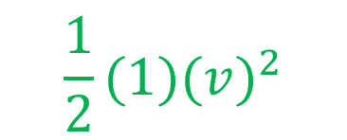

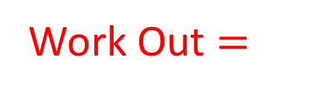






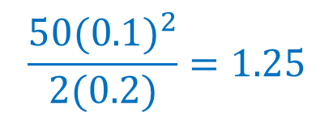



A remote controlled car of mass 1kg is rolling down the line of greatest slope of a ramp inclined at 15$°$ to the horizontal at a speed of 3$ms^{−1}$ when it hits a wall. The non-gravitational resistances to motion can be considered to be 20N and constant. On the front of the car is a bumper that can be modelled as a light elastic spring with natural length 0.2m and modulus of elasticity 50N which compresses on impact with the wall. 10cm after hitting the wall how fast will the car be travelling?
$$20N$$
Final Energy
$$3m^{2}$$
1
Work Out $=$
$$20 \text{x} 0.1=$$
$$2$$
Final KE $=\frac{1}{2}mu^{2}=$
$$\frac{1}{2}(1)(v)^{2}$$
1
0.1m
0.1 sin 15
Final GPE $=mgh_{1}=$
$$0$$
Final EPE $=\frac{λ{(x_{1})}^{2}}{2l}=$
$$\frac{50{(0.1)}^{2}}{2(0.2)}=1.25$$
$$15°$$

Slide 14







A remote controlled car of mass 1kg is rolling down the line of greatest slope of a ramp inclined at 15$°$ to the horizontal at a speed of 3$ms^{−1}$ when it hits a wall. The non-gravitational resistances to motion can be considered to be 20N and constant. On the front of the car is a bumper that can be modelled as a light elastic spring with natural length 0.2m and modulus of elasticity 50N which compresses on impact with the wall. 10cm after hitting the wall how fast will the car be travelling?
$$20N$$
Initial Energy = Final Energy
$$3m^{2}$$
1
$4.5+0.98\sin{15=2+\frac{1}{2}v^{2}+1.25}$
1
0.1 sin 15
$$4.7536…=0.5v^{2}+3.25$$
0.1m
$v=1.73ms^{−1}$
$$15°$$

