Slide 1
LO: Reflecting Shapes
(Co-ordinate Grids)

Slide 2
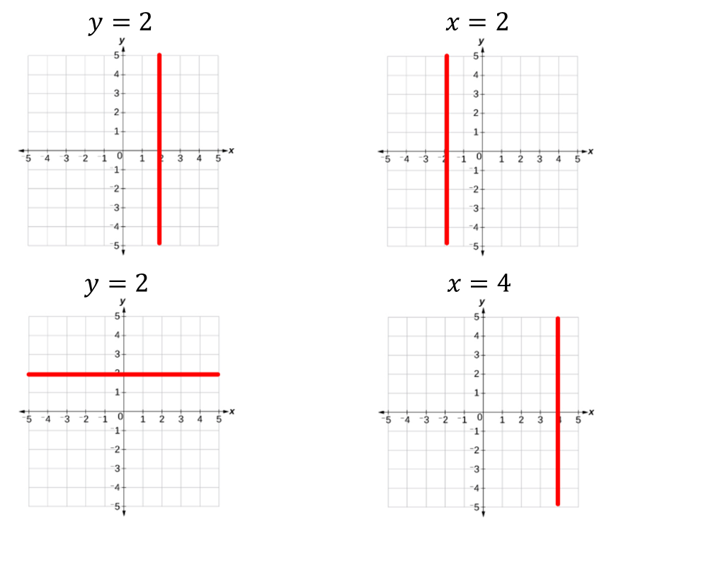
True
or
False

Slide 3
True
or
False

Slide 4
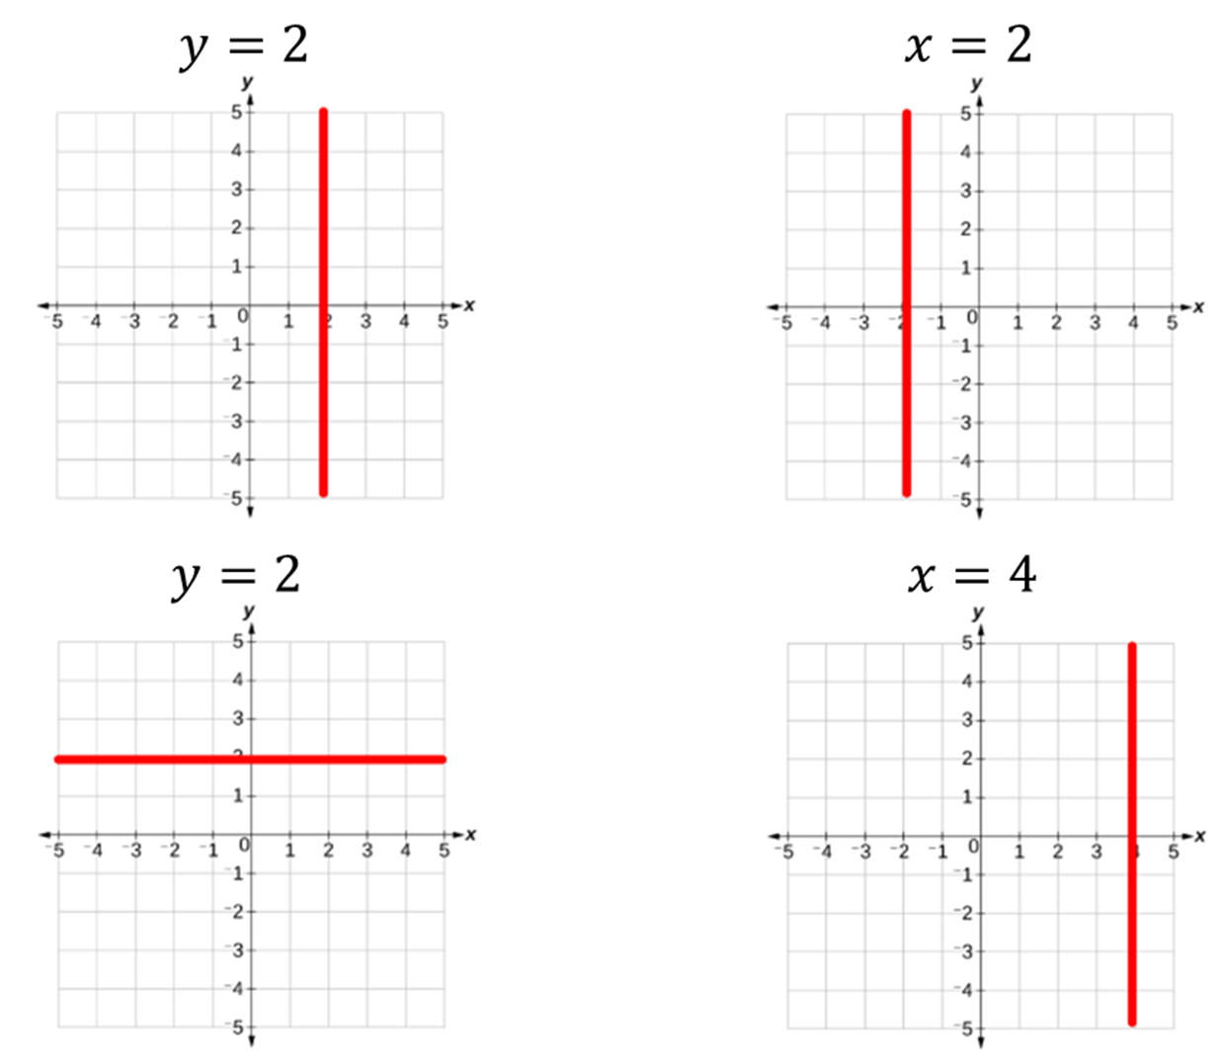
True
or
False

Slide 5
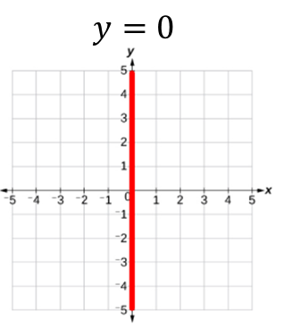
True
or
False

Slide 6
True
or
False

Slide 7
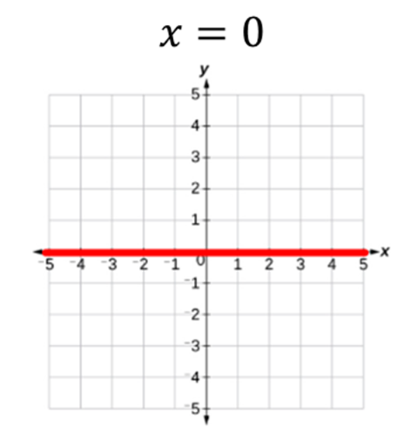
True
or
False

Slide 8
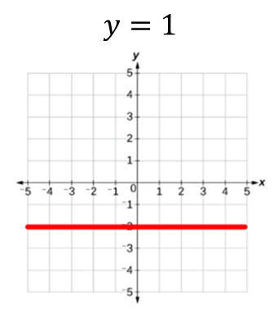
True
or
False

Slide 9
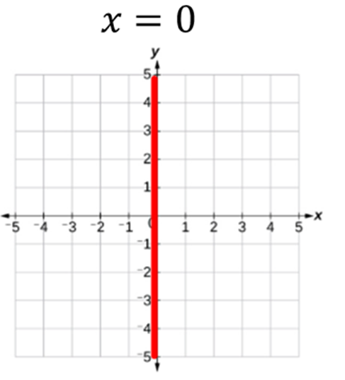
True
or
False

Slide 10
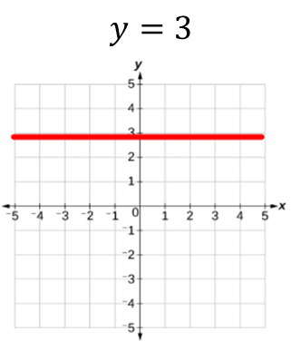
True
or
False

Slide 11
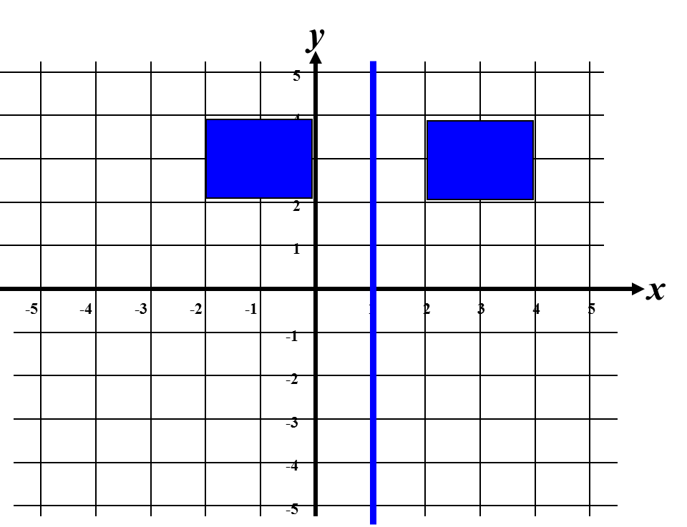
Reflections using Co-ordinate Grids
What is the equation of the line of reflection?
x = 1

Slide 12
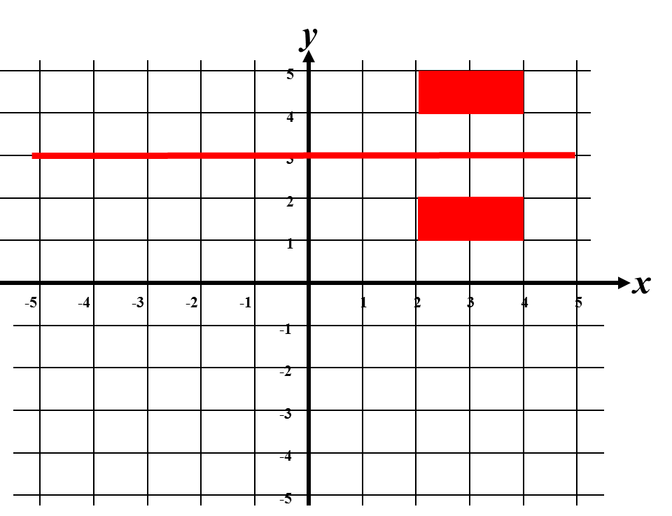
What is the equation of the line of reflection?
y = 3

Slide 13
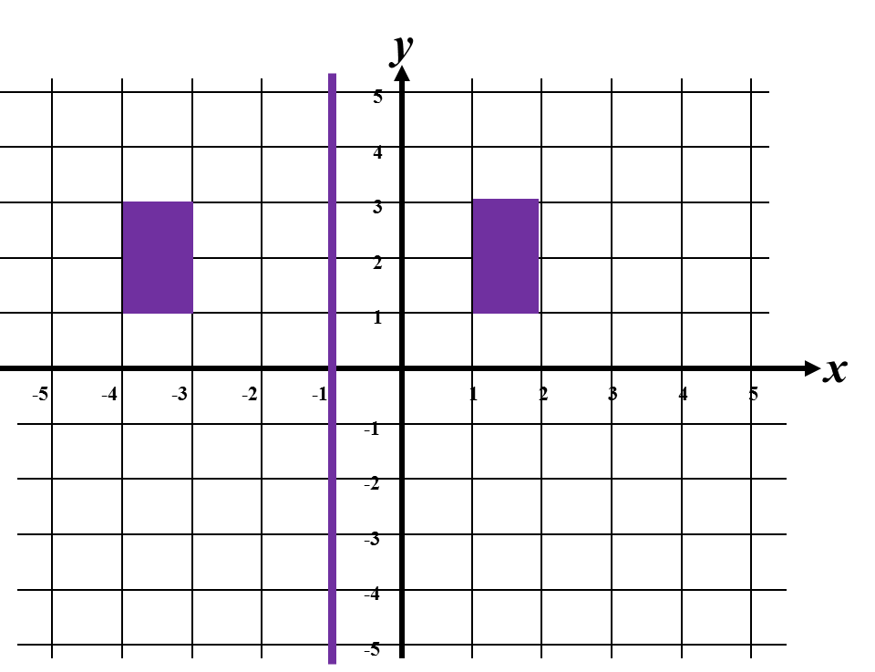
What is the equation of the line of reflection?
x = -1

Slide 14
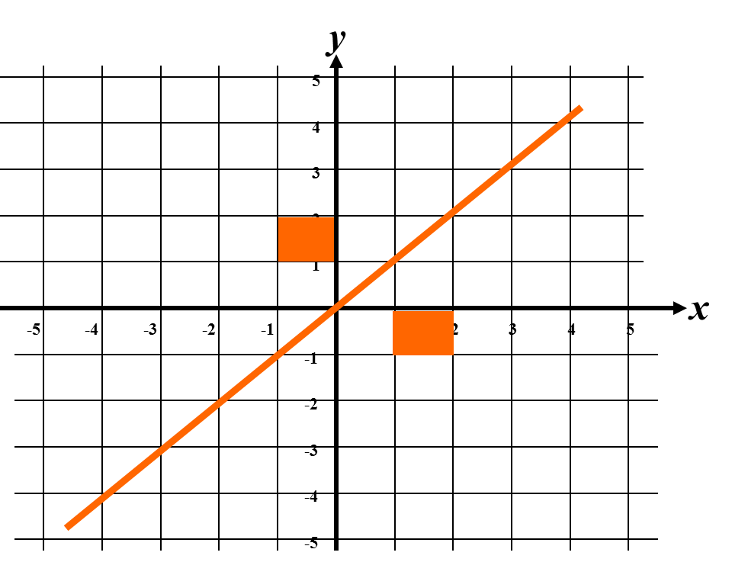
What is the equation of the
line of reflection?
y = x

Slide 15
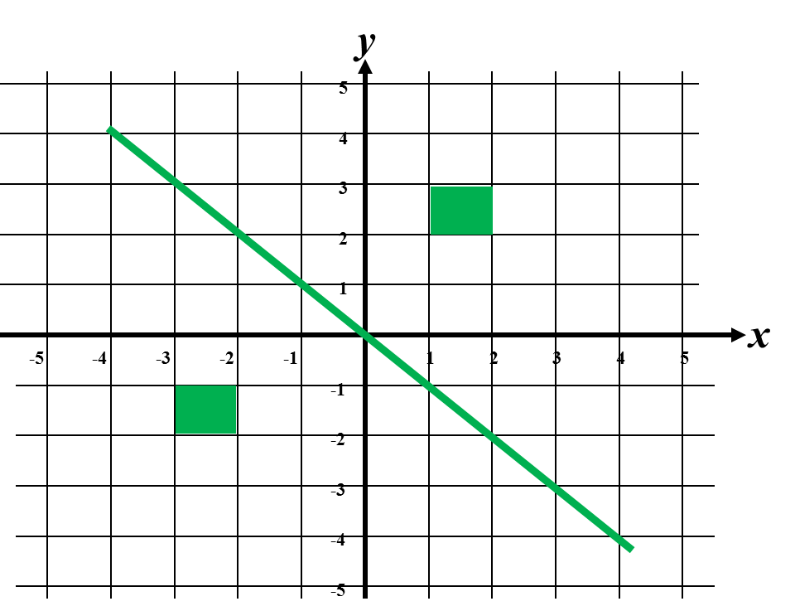
What is the equation of the line of reflection?
y = -x

Slide 16
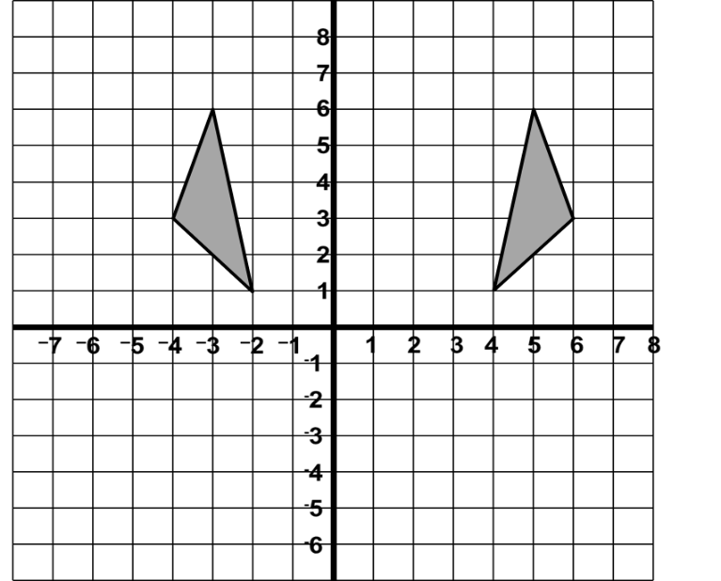
Describe the transformation
y
Reflection in
the line x = 1
x

Slide 17
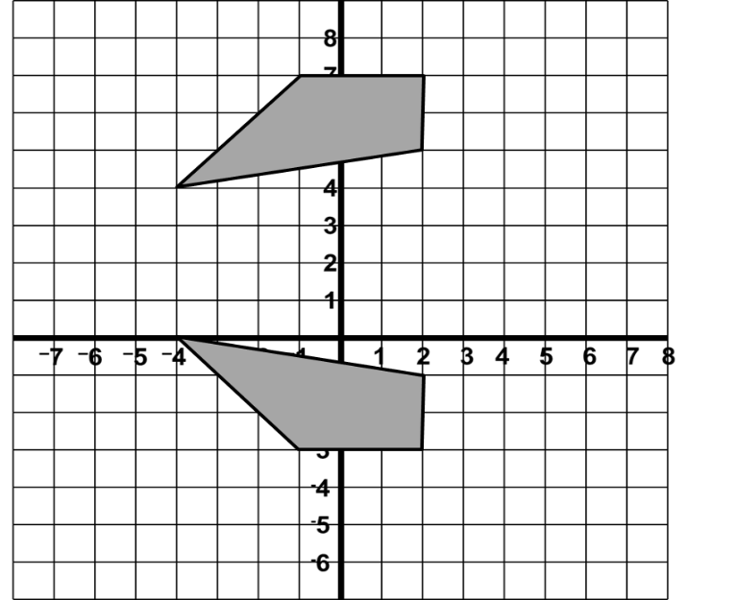
Describe the transformation
y
Reflection in
the line y = 2
x

Slide 18
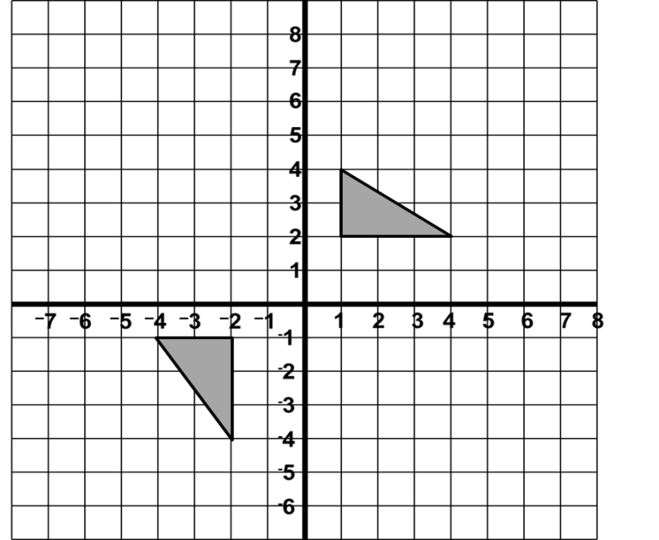
Describe the transformation
Reflection in the line y = -x

Slide 19
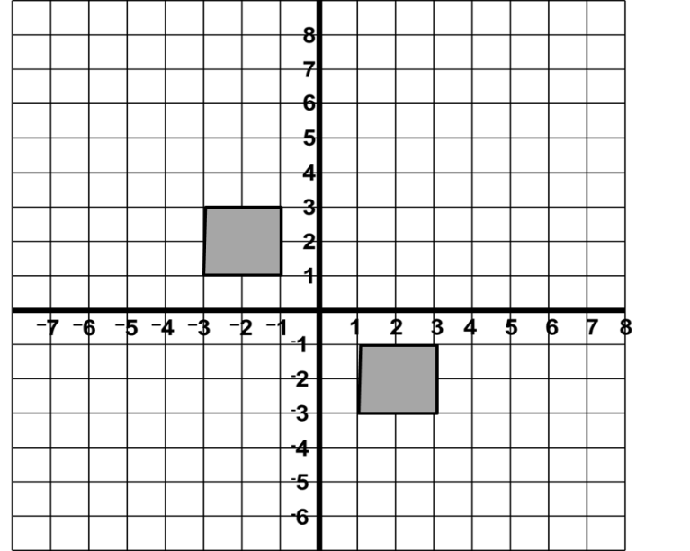
Describe the transformation
Reflection in the line y = x

Slide 20
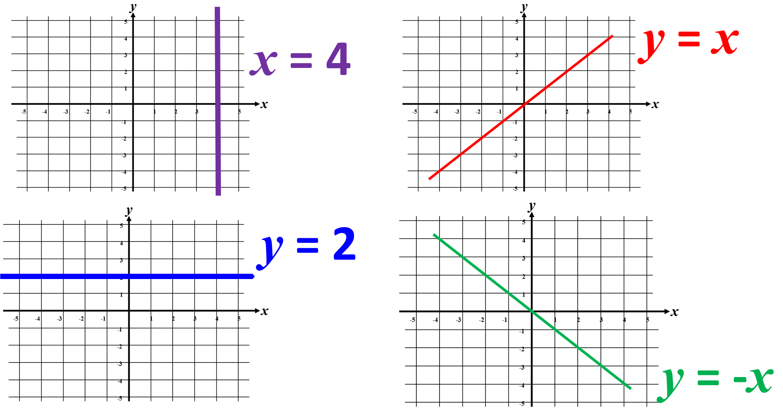
Recap of the types of equations for lines of reflection.

Slide 21
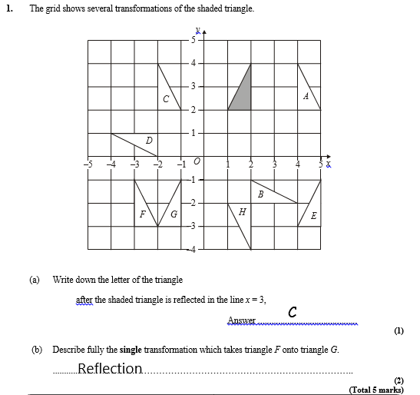
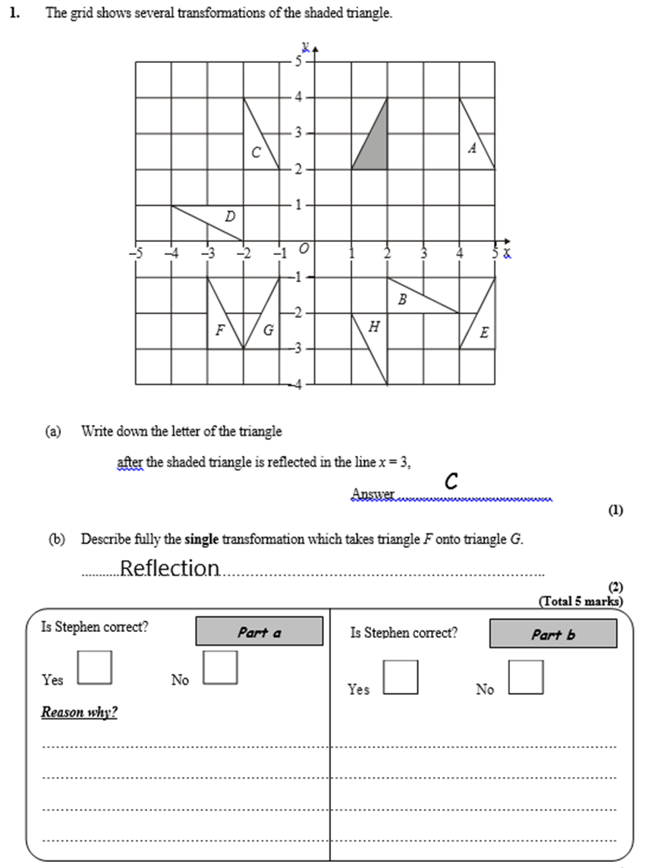

SPOT THE MISTAKE
He need to state the line of reflection. x = -2
C is reflected in the y axis.
A is the correct answer.

Slide 22
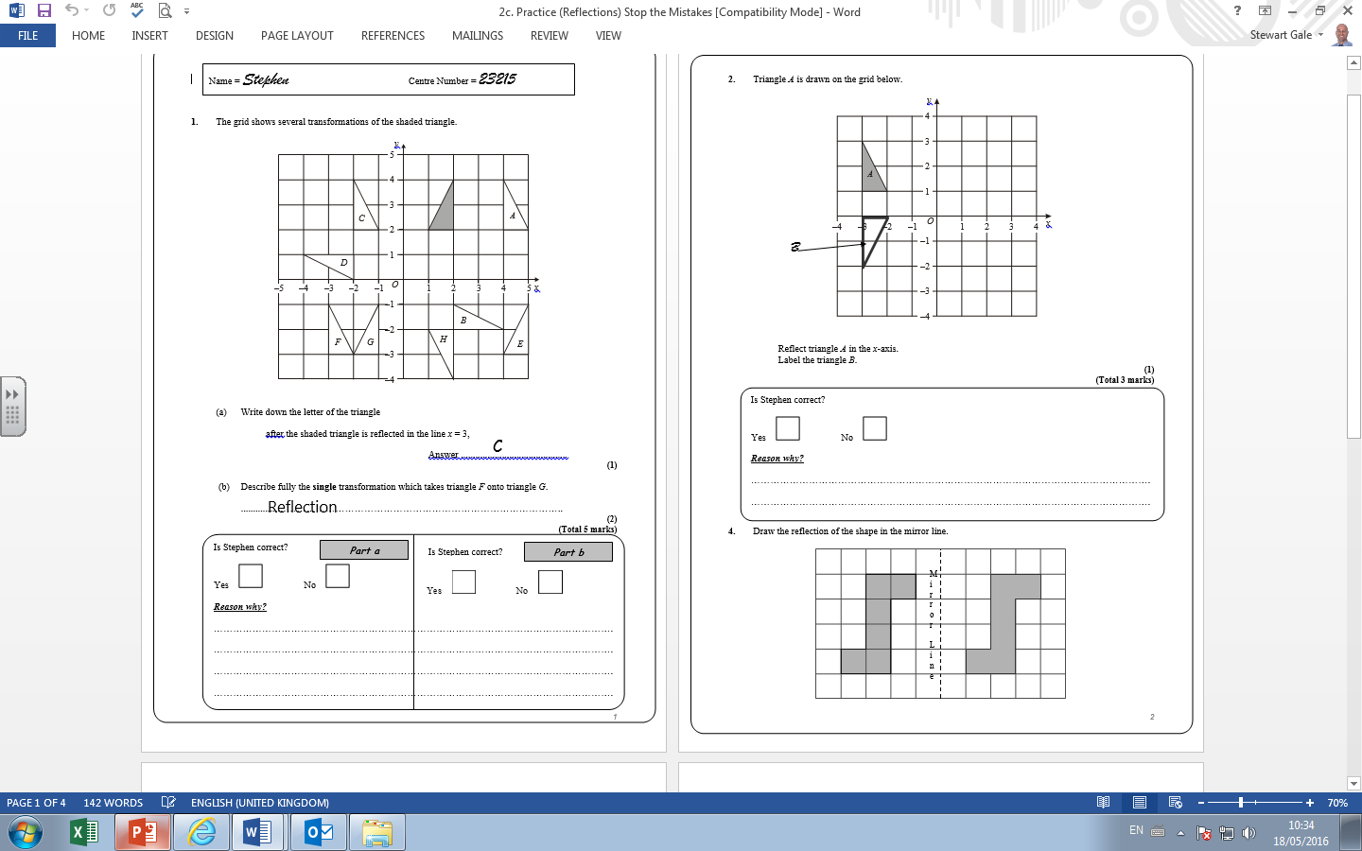
SPOT THE MISTAKE
He has reflected A in
the line y = ½.

Slide 23
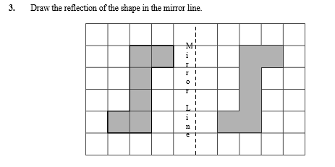
SPOT THE MISTAKE
He has translated the shape.

Slide 24
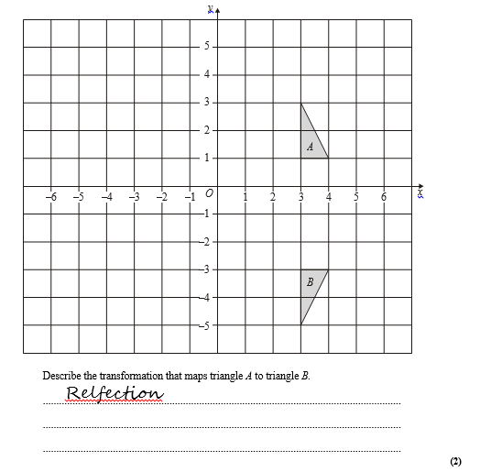
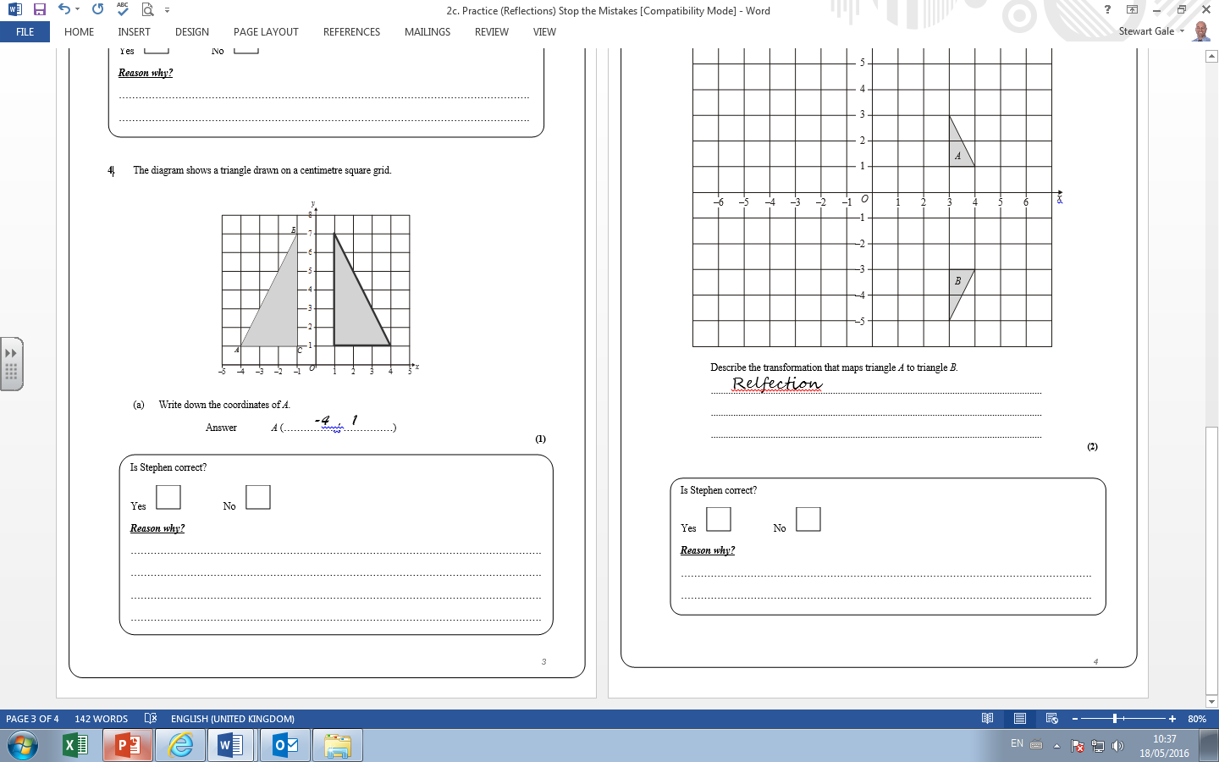
SPOT THE MISTAKE
He has not stated the line of reflection. y = -1

