Slide 1
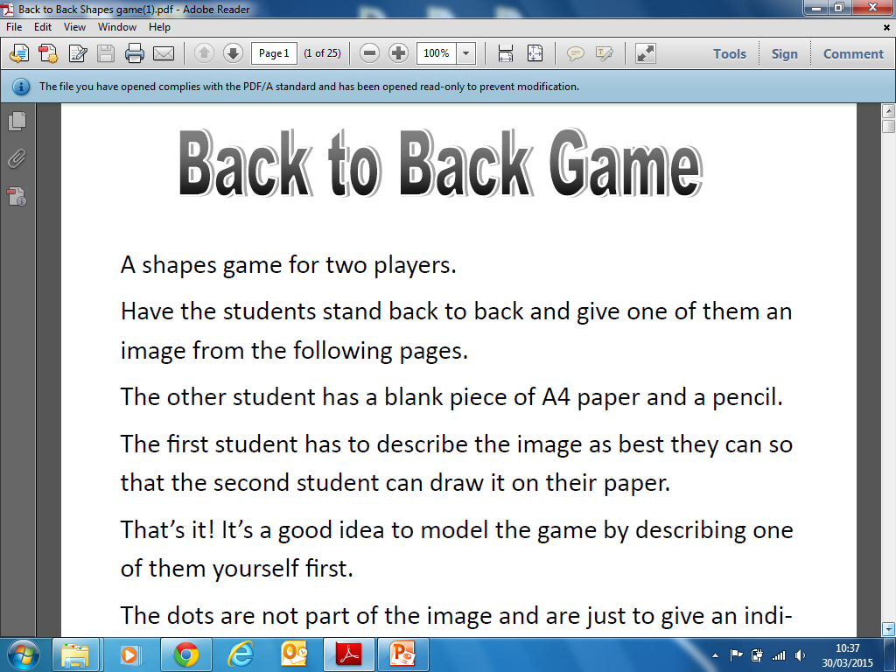
Back to Back Game

Slide 2
Key words you could use:
Segment
Circumference
Chord
Arc
Sector
Diameter
Tangent
Radius

