Slide 1
FM: Multiplying and Dividing
Algebraic Fractions
(with Factorising)

Slide 2
How do you multiply fractions?
Numerator multiply numerator
Denominator multiply denominator
Do you need a common denominator?
No

Slide 3
How do you divide fractions?
Flip the dividing fraction and then multiply the fractions.

Slide 4
Before
multiplying or dividing
always see if you can
factorise any terms.

Slide 5
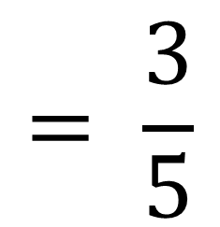
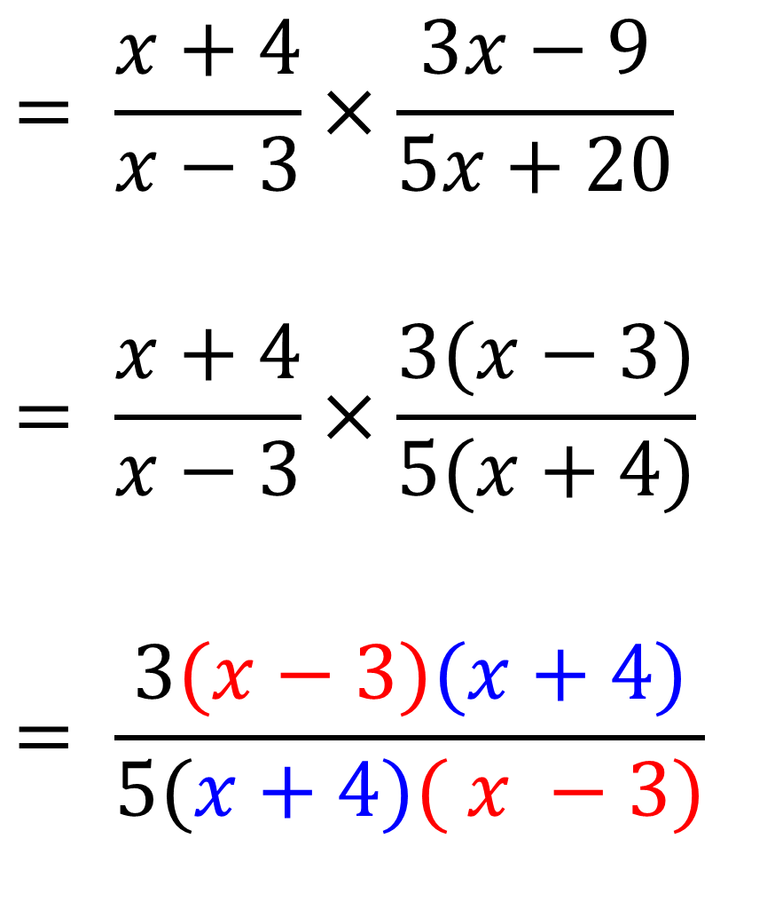
$$= \frac{x+4}{x−3}×\frac{3x−9}{5x+20}$$
$$= \frac{x+4}{x−3}×\frac{3(x−3)}{5(x+4)}$$
$$= \frac{3(x−3)(x+4)}{5(x+4)( x −3)}$$
$$= \frac{3}{5}$$

Slide 6
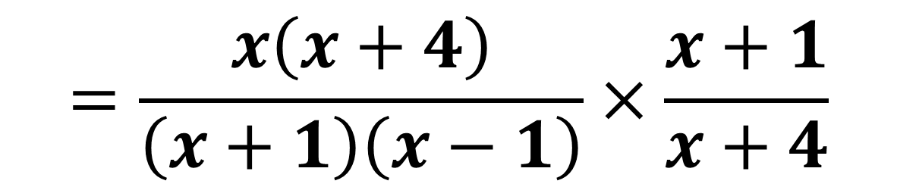
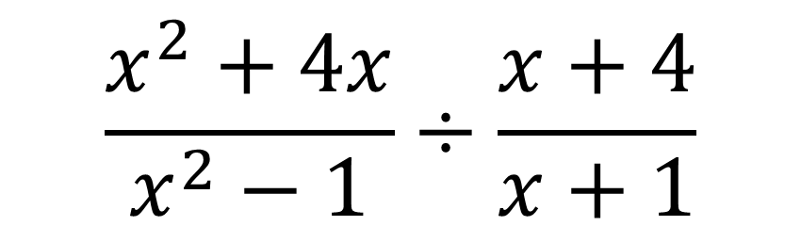
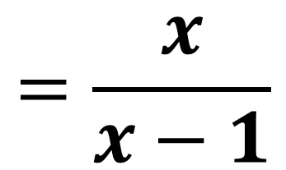
$$\frac{x^{2}+4x}{x^{2}−1}÷\frac{x+4}{x+1}$$
$$=\frac{x\left(x+4\right)}{\left(x+1\right)\left(x−1\right)}×\frac{x+1}{x+4}$$
$$=\frac{x}{x−1}$$

Slide 7
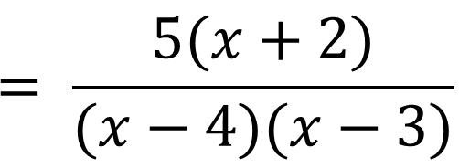
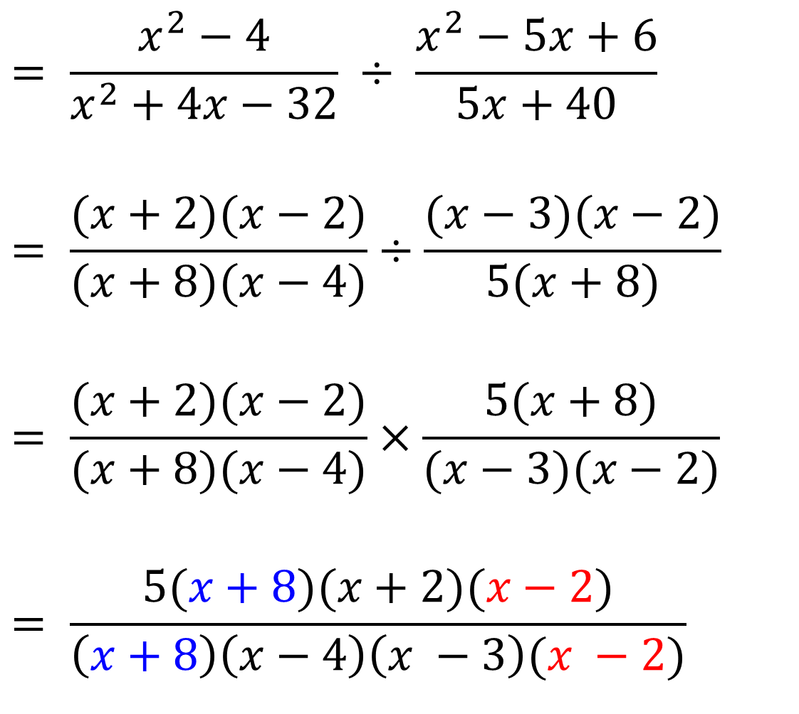
$$= \frac{x^{2}−4}{x^{2}+4x−32} ÷ \frac{x^{2}−5x+6}{5x+40}$$
$$= \frac{(x+2)(x−2)}{(x+8)(x−4)}÷\frac{(x−3)(x−2)}{5(x+8)}$$
$$= \frac{(x+2)(x−2)}{(x+8)(x−4)}×\frac{5(x+8)}{(x−3)(x−2)}$$
$$= \frac{5(x+8)(x+2)(x−2)}{\left(x+8\right)\left(x−4\right)\left(x −3\right)(x −2)}$$
$$= \frac{5(x+2)}{(x−4)(x−3)}$$

Slide 8
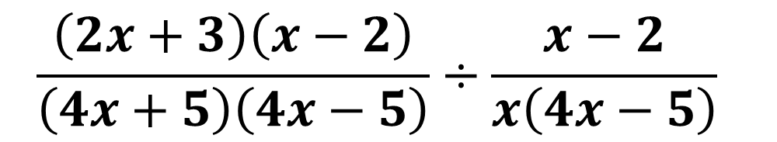
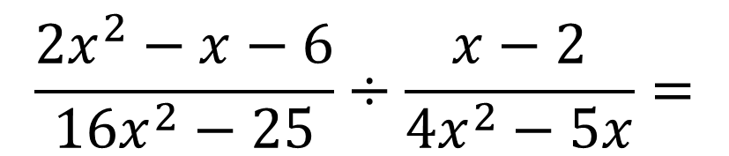
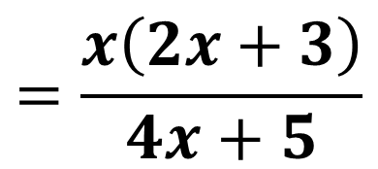
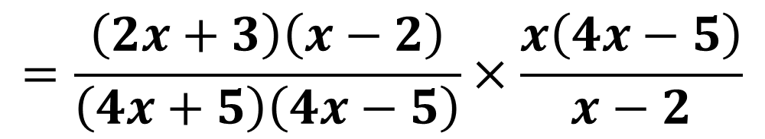
$$\frac{2x^{2}−x−6}{16x^{2}−25}÷\frac{x−2}{4x^{2}−5x}=$$
$$\frac{\left(2x+3\right)\left(x−2\right)}{\left(4x+5\right)\left(4x−5\right)}÷\frac{x−2}{x\left(4x−5\right)}$$
$$=\frac{\left(2x+3\right)\left(x−2\right)}{\left(4x+5\right)\left(4x−5\right)}×\frac{x\left(4x−5\right)}{x−2}$$
$$=\frac{x\left(2x+3\right)}{4x+5}$$

