Slide 1
Sketching Graphs
Transformations
Chapter 4
(Part 5 of 5)

Slide 2
Transformations of Functions
There are 8 transformations that you can perform
to all types of graphs.

Slide 3
What happens to the graph
with the function f(x) + a ?
The graph moves up

Slide 4
What happens to the graph
with the function f(x) – a ?
The graph moves down

Slide 5
What happens to the graph
with the function f(x – a) ?
The graph moves right

Slide 6
What happens to the graph
with the function f(x + a) ?
The graph moves left

Slide 7
What happens to the graph
with the function af(x) ?
The co-ordinates
becomes (x , ay)
and the graph stretches.

Slide 8
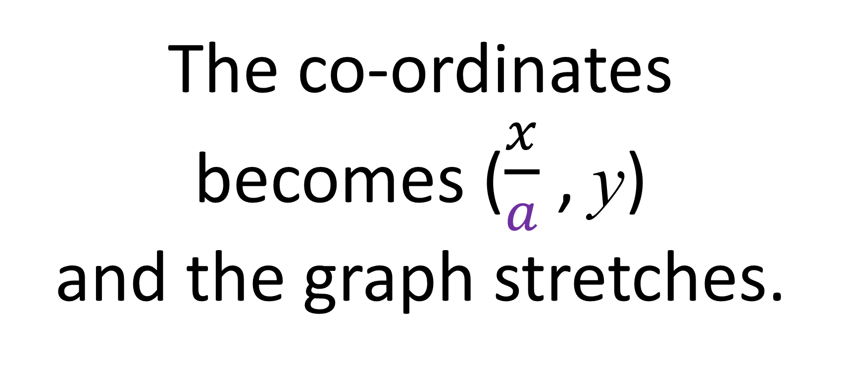
What happens to the graph
with the function f(ax) ?
The co-ordinates
becomes ($\frac{x}{a}$ , y)
and the graph stretches.

Slide 9
What happens to the graph
with the function –af(x) ?
(x , –ay)
The graph reflects in the
x axis

Slide 10
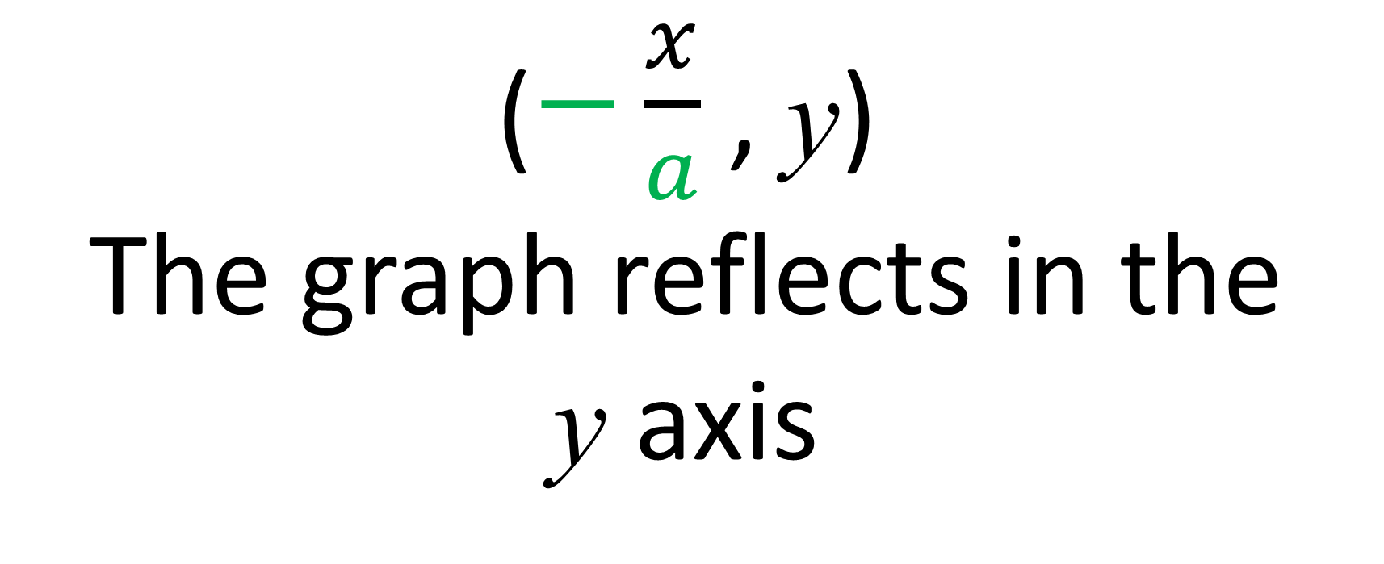
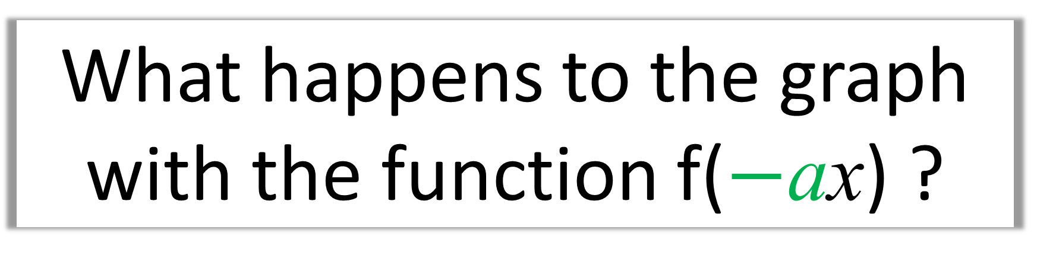
What happens to the graph
with the function f($−$ax) ?
($−\frac{x}{a}$ , y)
The graph reflects in the
y axis

Slide 11
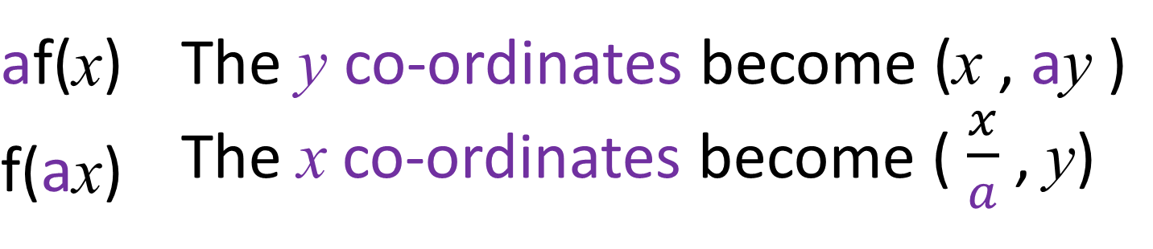
f(x) + a | The graph moves up
f(x) – a | The graph moves down
f(x + a) | The graph moves left
f(x – a) | The graph moves right
af(x) | The y co-ordinates become (x , ay )
f(ax) | The x co-ordinates become ( $\frac{x}{a}$ , y)
–f(x) | The graph is reflected in the x axis
f(–x) | The graph is reflected in the y axis

Slide 12
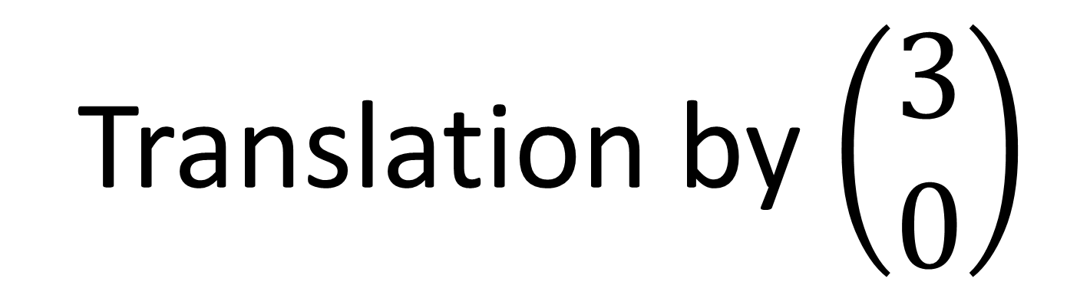
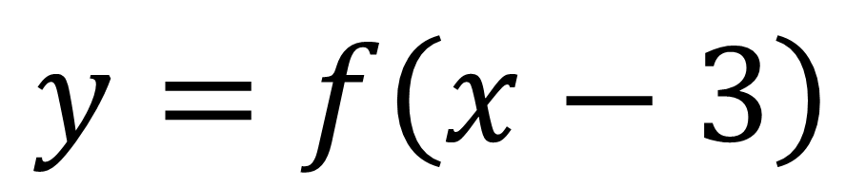
$$y=f\left(x−3\right)$$
What is the transformations?
Translation by $\left(\begin{matrix}3 \\ 0\end{matrix}\right)$

Slide 13
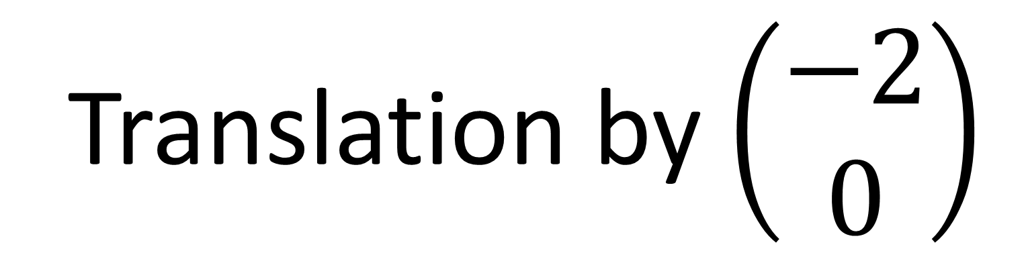
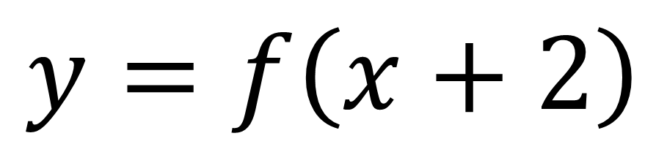
$$y=f\left(x+2\right)$$
What is the transformations?
Translation by $\left(\begin{matrix}−2 \\ 0\end{matrix}\right)$

Slide 14
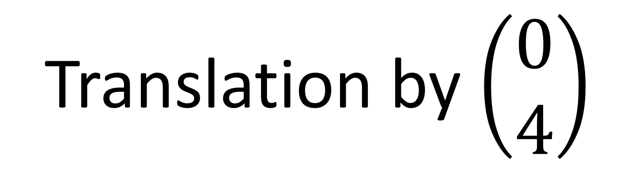
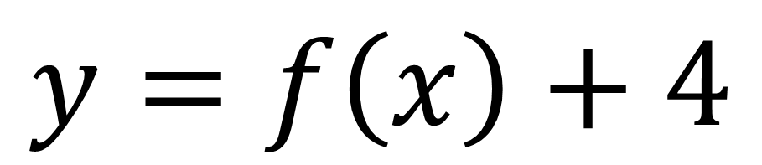
$$y=f\left(x\right)+4$$
What is the transformations?
Translation by $\left(\begin{matrix}0 \\ 4\end{matrix}\right)$

Slide 15
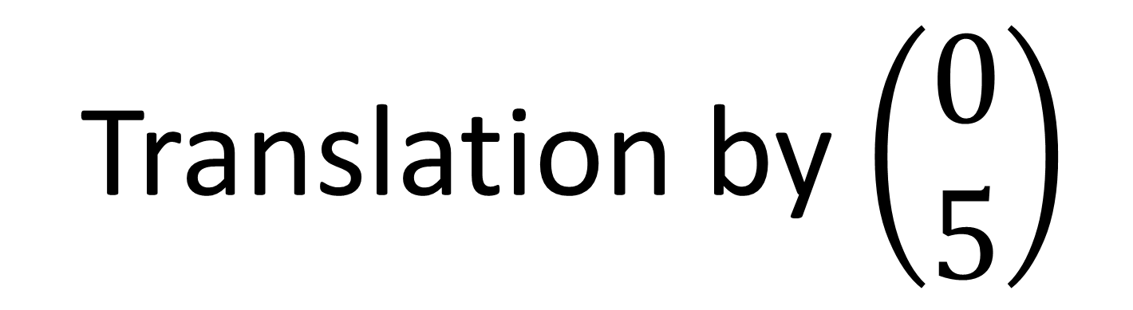
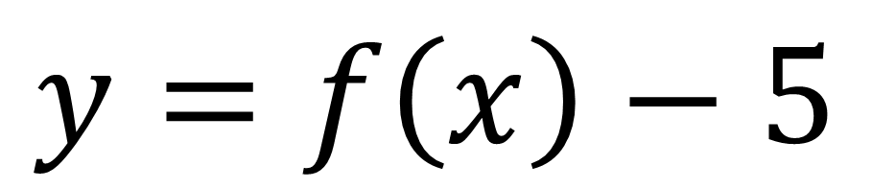
$$y=f\left(x\right)−5$$
What is the transformations?
Translation by $\left(\begin{matrix}0 \\ 5\end{matrix}\right)$

Slide 16
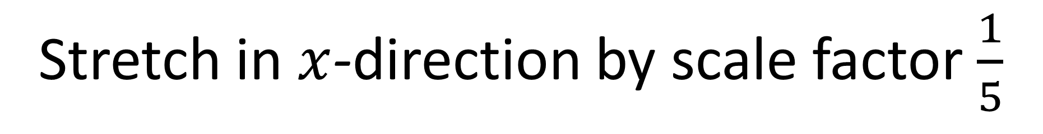
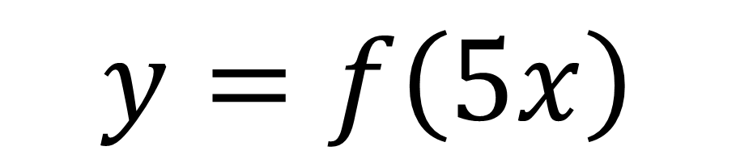
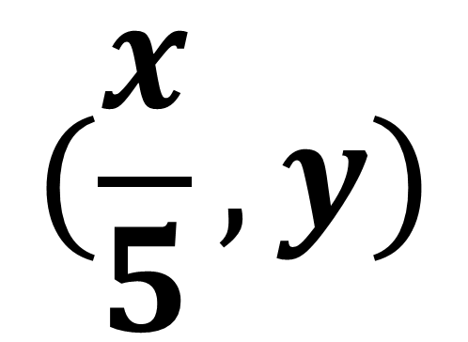
$$y=f\left(5x\right)$$
What is the transformations?
Stretch in $x$-direction by scale factor $\frac{1}{5}$
$$(\frac{x}{5}, y)$$

Slide 17

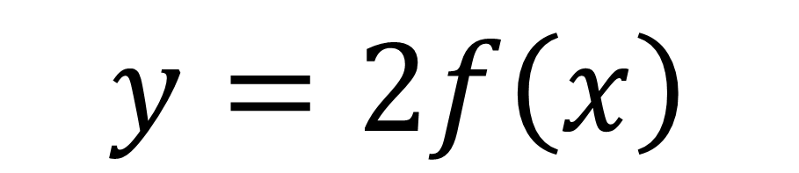
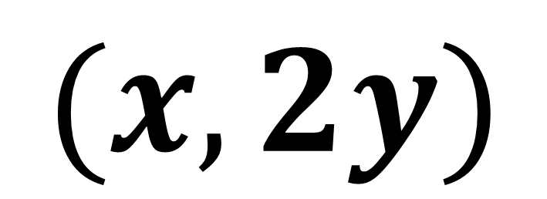
$$y=2f\left(x\right)$$
What is the transformations?
Stretch in $x$-direction by scale factor $2$
$$(x, 2y)$$

Slide 18
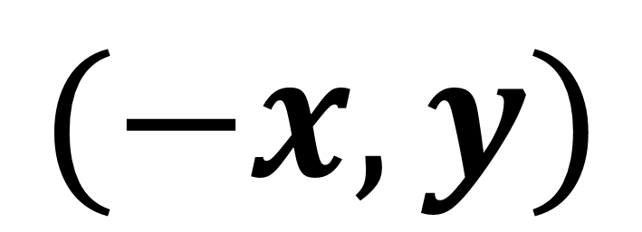
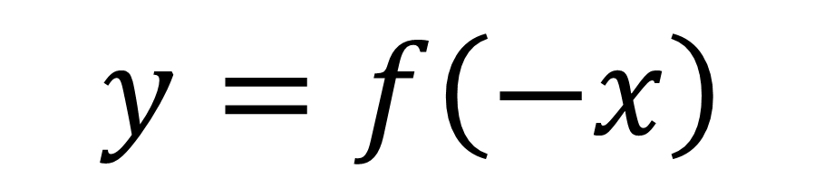
$$y=f\left(−x\right)$$
What is the transformations?
Reflect in the y axis.
$$(−x, y)$$

Slide 19
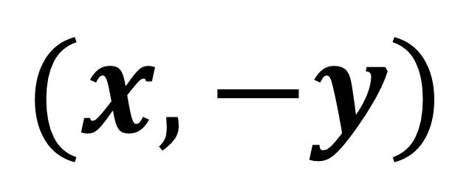
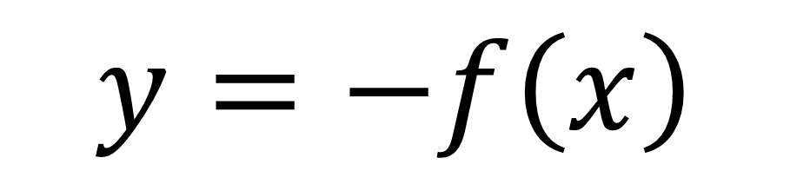
$$y=−f\left(x\right)$$
What is the transformations?
Reflect in the x axis.
$$(x, −y)$$

Slide 20



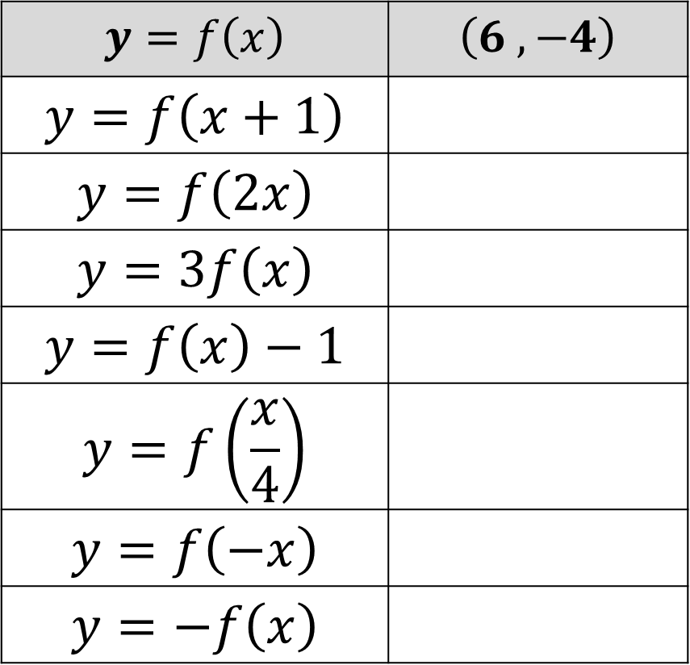




Where would each of these points end up?
$$y=f\left(x\right)$$ | $$\left(6 ,−4\right)$$
$$y=f\left(x+1\right)$$
$$y=f\left(2x\right)$$
$$y=3f\left(x\right)$$
$$y=f\left(x\right)−1$$
$$y=f\left(\frac{x}{4}\right)$$
$$y=f\left(−x\right)$$
$$y=−f\left(x\right)$$
$$\left(5 ,−4\right)$$
$$\left(3 , −4\right)$$
$$\left(6 ,−12\right)$$
$$\left(6 ,−5\right)$$
$$\left(24 ,−4\right)$$
$$\left(−6 ,−4\right)$$
$$\left(6 ,4\right)$$

Slide 21

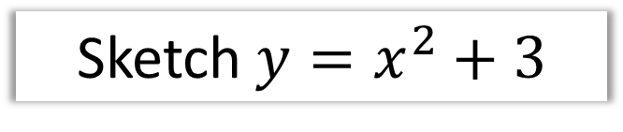
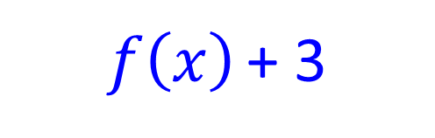

$$y=x^{2}$$
Sketch $y=x^{2}+3$
$$f\left(x\right)$$
$f\left(x\right)$ + 3
y
y
3
x
x

Slide 22

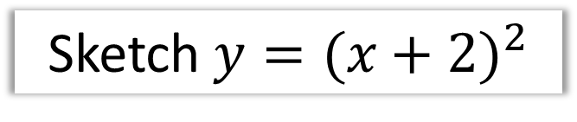


$$y=x^{2}$$
Sketch $y={(x+2)}^{2}$
$$f\left(x\right)$$
$f\left(x+2\right)$
y
y
x
x
2

Slide 23






$$f\left(x\right)$$
Sketch $−f\left(x\right)$
$$y$$
$$y$$
$$x$$
$$x$$
-2
-2

Slide 24






$$f\left(x\right)$$
Sketch $f$($\frac{x}{3}$)
$$y$$
$$y$$
-1
2
$$x$$
-3
6
$$x$$
-2
-2

Slide 25






$$f\left(x\right)$$
Sketch $f$($2x$)
$$y$$
$$y$$
$$x$$
$$x$$
4
2

Slide 26







$$f\left(x\right)$$
Sketch $f$($x$) + 2
$$y$$
$$y$$
$$y=2$$
$$x$$
$$x$$

Slide 27









$$y=\frac{2}{x}$$
Sketch $y=\frac{2}{x+1}$
$$f\left(x\right)$$
$f\left(x+1\right)$
$$y$$
$$y$$
$$x=−1$$
2
$$x$$
$$x$$

Slide 28
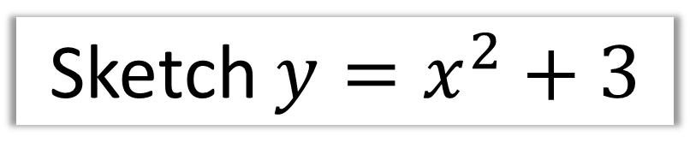
Sketch $y=x^{2}+3$
y
3
x

Slide 29

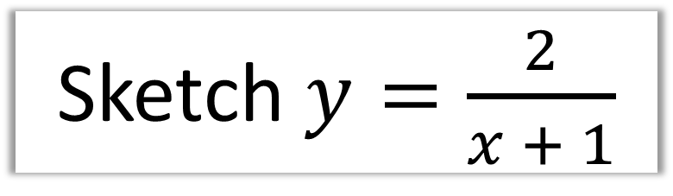


Sketch $y=\frac{2}{x + 1}$
f(x + 1) | The graph moves left
$$y$$
$$x=−1$$
2
$$x$$

Slide 30
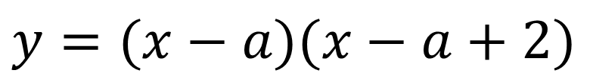


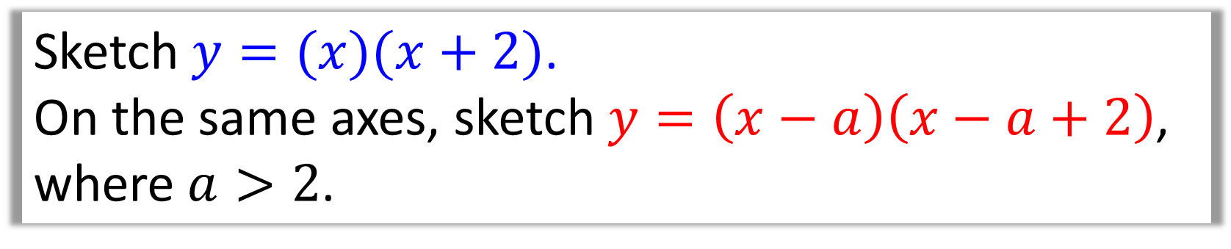



Sketch $y=(x)(x+2)$.
On the same axes, sketch $y=\left(x−a\right)\left(x−a+2\right)$, where $a>2$.
f(x – a) | The graph moves right
$$y$$
$$−2$$
$$a−2$$
$$a$$
$$x$$
$y=(x−a)(x−a+2)$

Slide 31

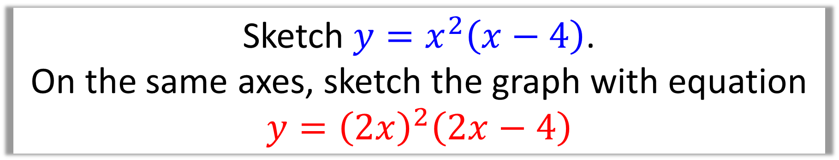
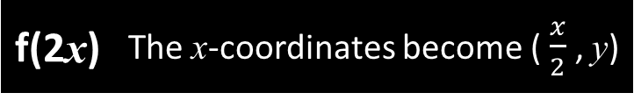


Sketch $y=x^{2}\left(x−4\right)$.
On the same axes, sketch the graph with equation
$$y={\left(2x\right)}^{2}\left(2x−4\right)$$
$$y$$
f(2x) | The x-coordinates become ( $\frac{x}{2}$ , y)
$$x$$
2
4
$$y={\left(2x\right)}^{2}\left(2x−4\right)$$

Slide 32

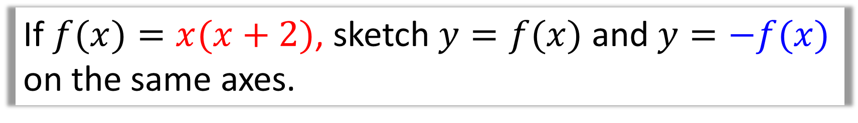

If $f(x)=x(x+2)$, sketch $y=f(x)$ and $y=−f(x)$
on the same axes.
–f(x) | The graph is reflected in the x axis
$$y$$
-2
$$x$$

Slide 33

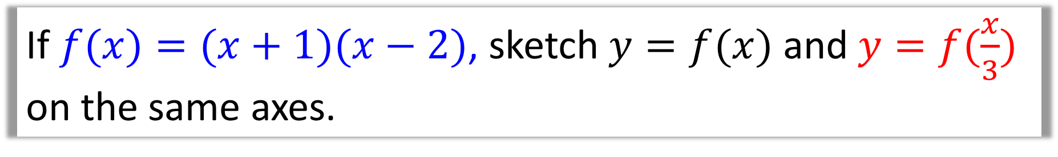
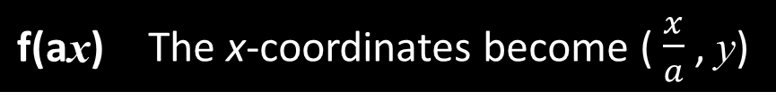

If$f(x)=(x+1)(x−2)$, sketch $y=f(x)$ and $y=f(\frac{x}{3})$ on the same axes.
f(ax) | The x-coordinates become ( $\frac{x}{a}$ , y)
$$y$$
-3
-1
2
6
$$x$$
-2

Slide 34
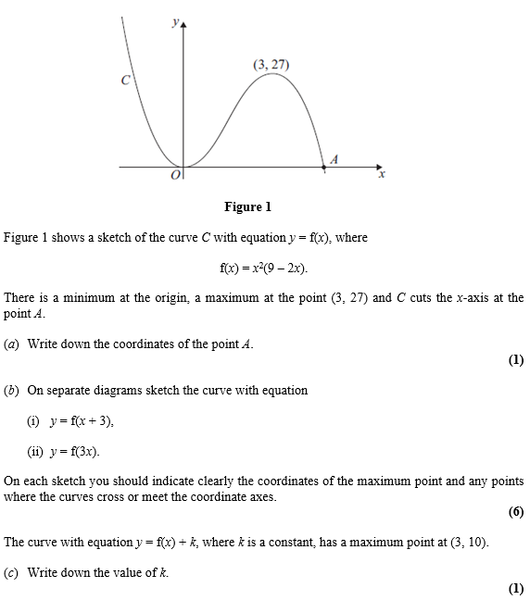

Slide 35
