Slide 1
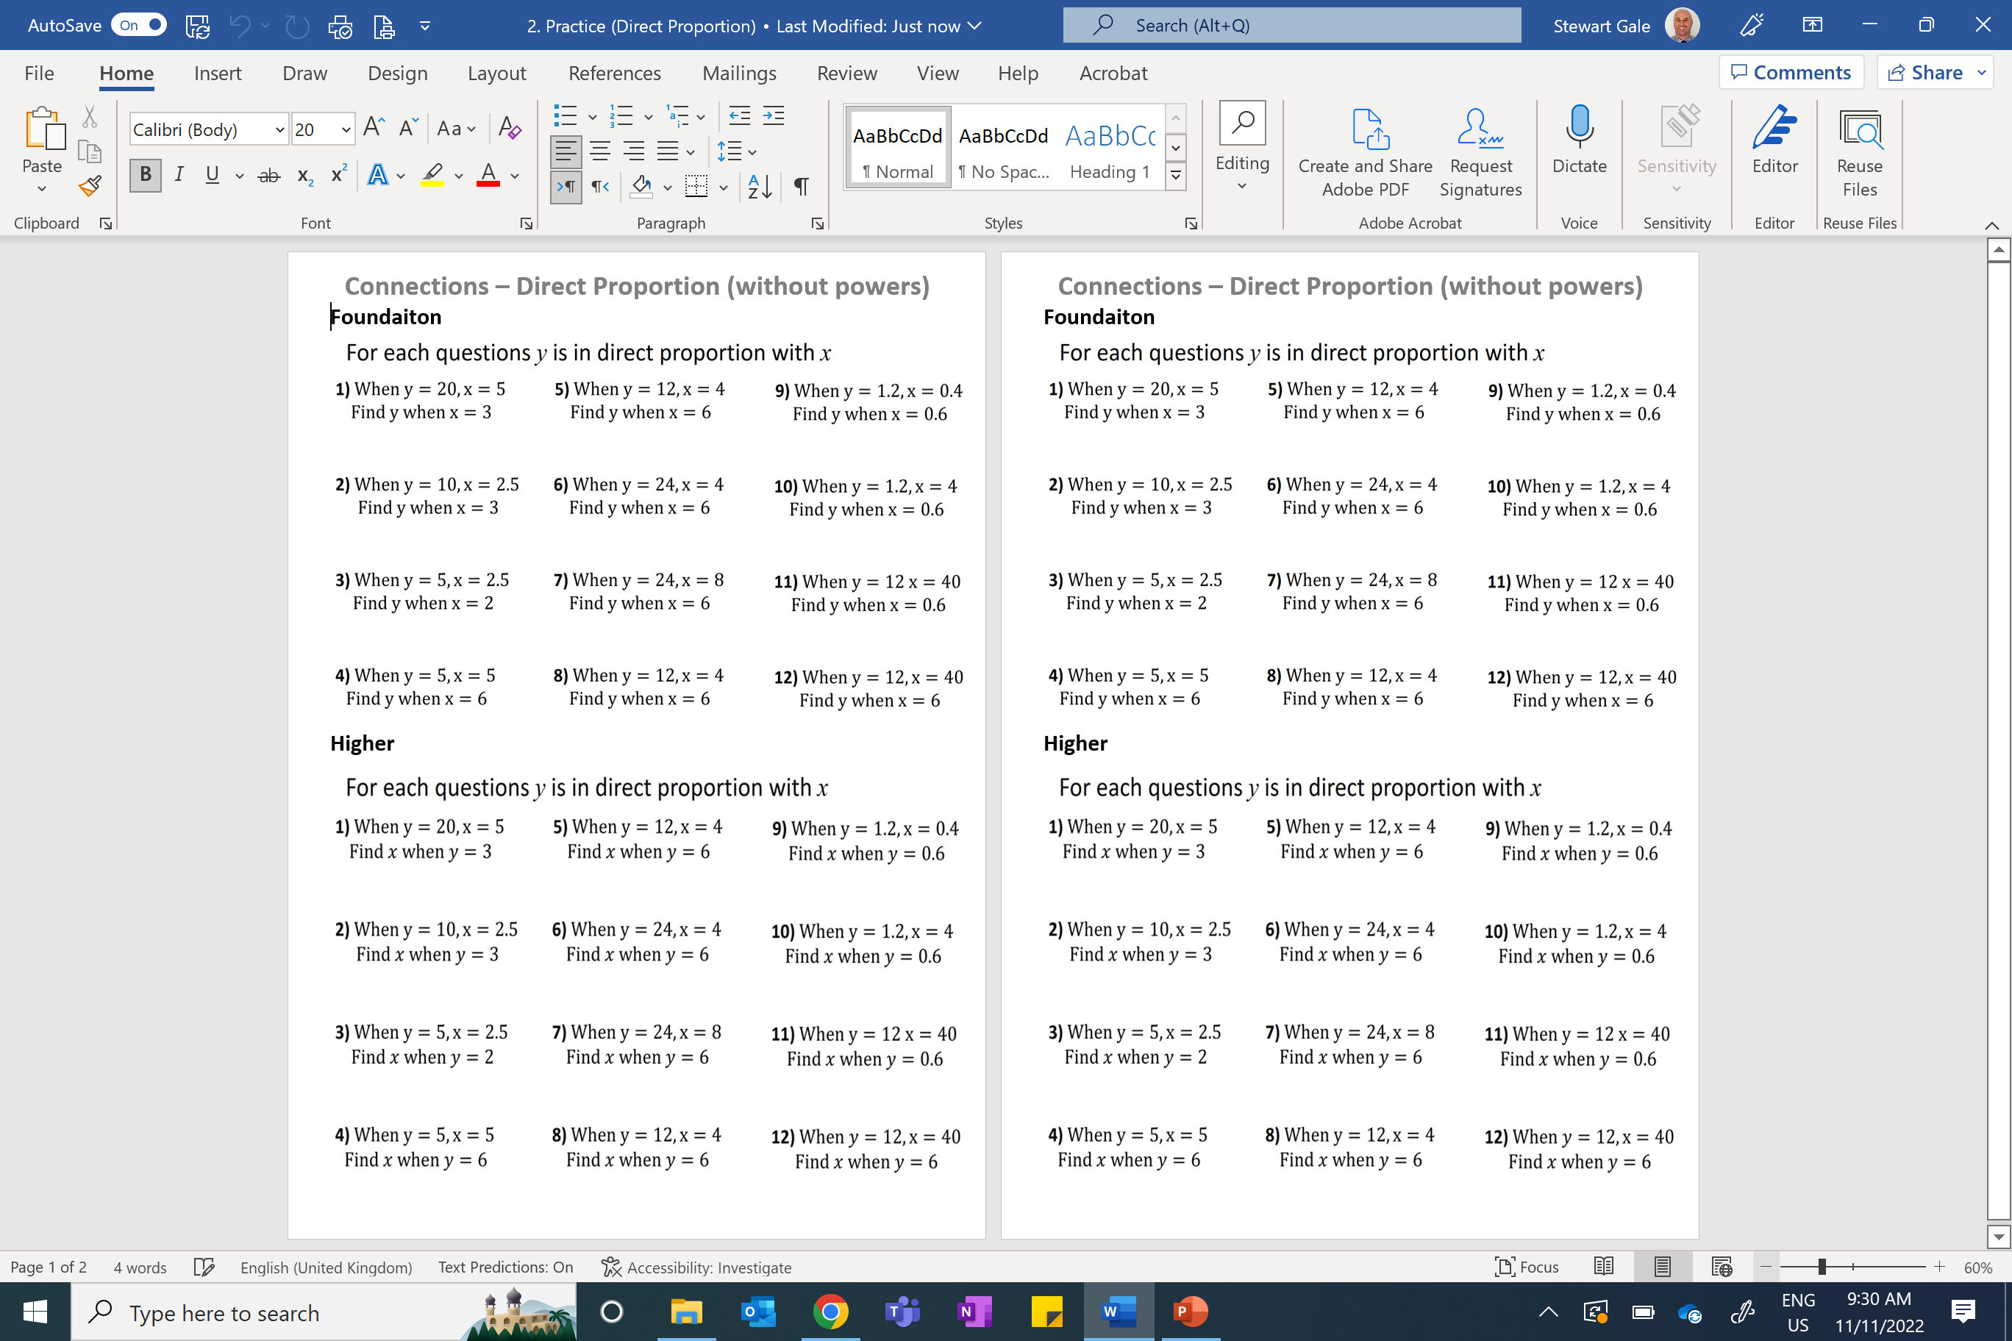

Slide 2
ANSWERS

Slide 3


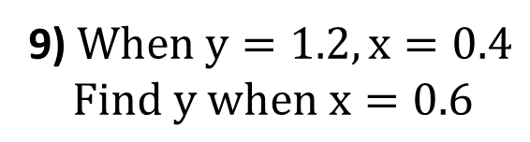


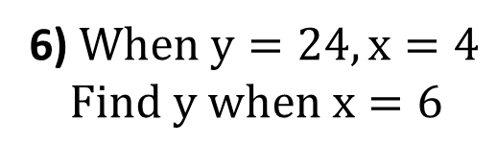




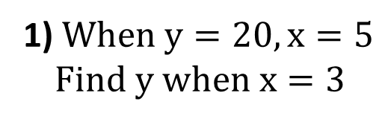


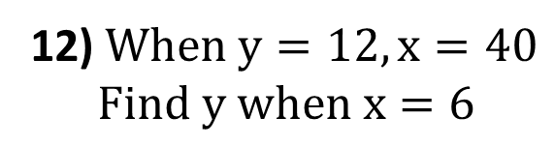
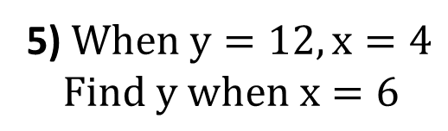




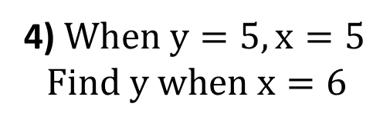


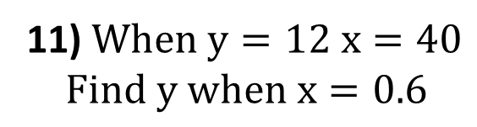




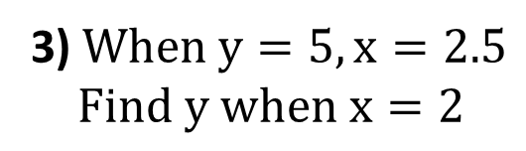
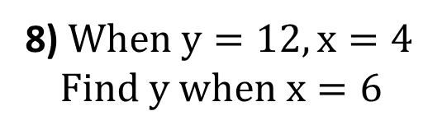


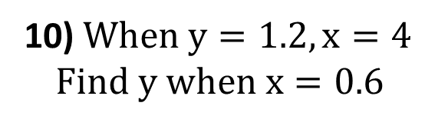


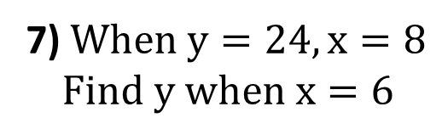
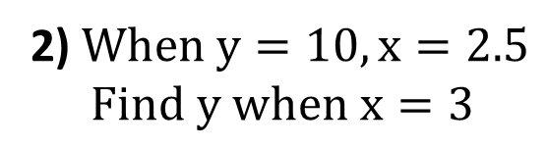
For each question y is in direct proportion with x
1) $When y=20, x=5$
$$Find y when x=3$$
5) $When y=12, x=4$
$$Find y when x=6$$
9) $When y=1.2, x=0.4$
$$Find y when x=0.6$$
$$y=4x$$
$$y=12$$
$$y=3x$$
$$y=18$$
$$y=3x$$
$$y=1.8$$
2) $When y=10, x=2.5$
$$Find y when x=3$$
6) $When y=24, x=4$
$$Find y when x=6$$
10) $When y=1.2, x=4$
$$Find y when x=0.6$$
$$y=4x$$
$$y=12$$
$$y=6x$$
$$y=36$$
$$y=0.3x$$
$$y=0.18$$
3) $When y=5, x=2.5$
$$Find y when x=2$$
7) $When y=24, x=8$
$$Find y when x=6$$
11) $When y=12 x=40$
$$Find y when x=0.6$$
$$y=2x$$
$$y=4$$
$$y=3x$$
$$y=18$$
$$y=0.3x$$
$$y=0.18$$
4) $When y=5, x=5$
$$Find y when x=6$$
8) $When y=12, x=4$
$$Find y when x=6$$
12) $When y=12, x=40$
$$Find y when x=6$$
$$y=x$$
$$y=6$$
$$y=3x$$
$$y=18$$
$$y=0.3x$$
$$y=1.8$$

Slide 4


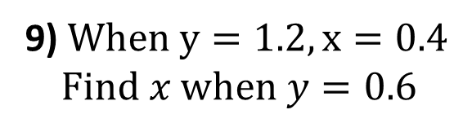


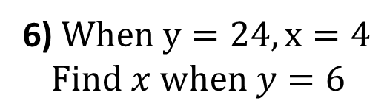




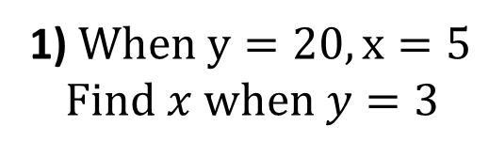


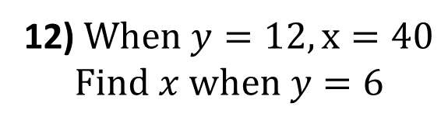
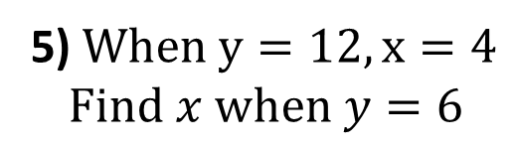




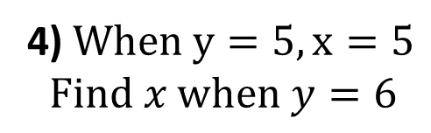


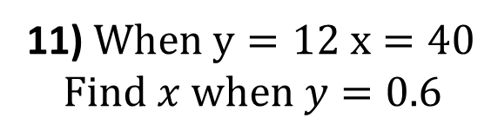




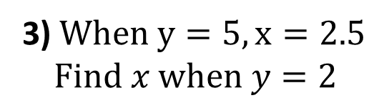
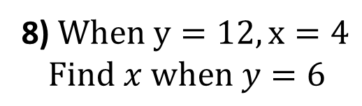


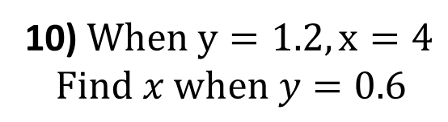


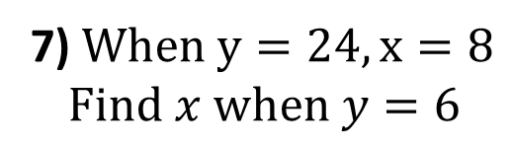
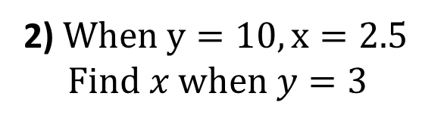
For each question y is in direct proportion with x
1) $When y=20, x=5$
$$Find x when y=3$$
5) $When y=12, x=4$
$$Find x when y=6$$
9) $When y=1.2, x=0.4$
$$Find x when y=0.6$$
$$y=4x$$
$$x=0.75$$
$$y=3x$$
$$x=2$$
$$y=3x$$
$$x=0.2$$
2) $When y=10, x=2.5$
$$Find x when y=3$$
6) $When y=24, x=4$
$$Find x when y=6$$
10) $When y=1.2, x=4$
$$Find x when y=0.6$$
$$y=4x$$
$$x=0.75$$
$$y=6x$$
$$x=1$$
$$y=0.3x$$
$$x=2$$
3) $When y=5, x=2.5$
$$Find x when y=2$$
7) $When y=24, x=8$
$$Find x when y=6$$
11) $When y=12 x=40$
$$Find x when y=0.6$$
$$y=2x$$
$$x=1$$
$$y=3x$$
$$x=2$$
$$y=0.3x$$
$$x=2$$
4) $When y=5, x=5$
$$Find x when y=6$$
8) $When y=12, x=4$
$$Find x when y=6$$
12) $When y=12, x=40$
$$Find x when y=6$$
$$y=x$$
$$x=6$$
$$y=3x$$
$$x=2$$
$$y=0.3x$$
$$x=20$$

