Slide 1
Integration
Integration as the Limit of a Sum
Chapter 10
(Part 12 of 12)

Slide 2








You can approximate the area under a curve as thin rectangular strips.
$$∂x$$
$$∂x$$
$$∂x$$
$$∂x$$
$$∂x$$
$$∂x$$
$$∂x$$
$$∂x$$
As the strips become thinner your answer becomes more accurate.

Slide 3



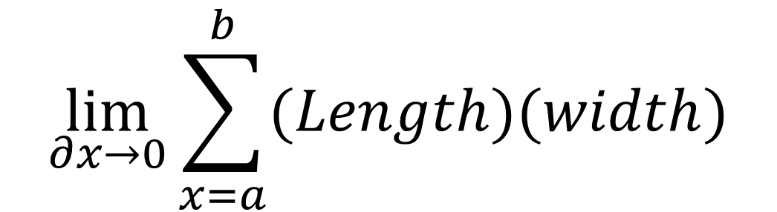
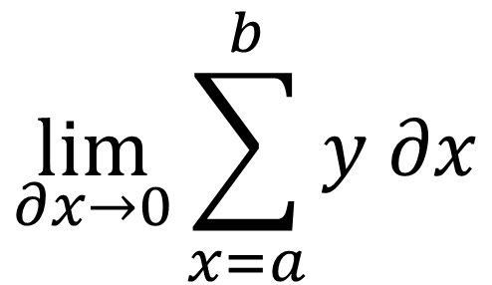
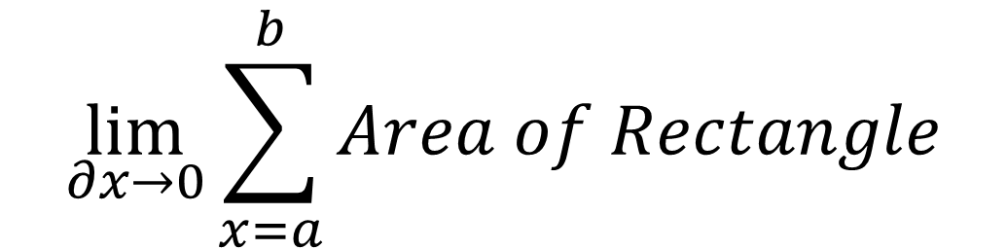

$$\lim_{∂x→0}{\sum_{x=a}^{b}{Area of Rectangle}}$$
$$\lim_{∂x→0}{\sum_{x=a}^{b}{(Length)(width)}}$$
$$a$$
$$b$$
$$\lim_{∂x→0}{\sum_{x=a}^{b}{y ∂x}}$$
$$y$$
$$∂x$$

Slide 4
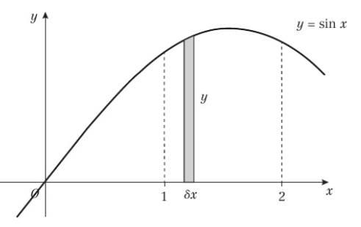
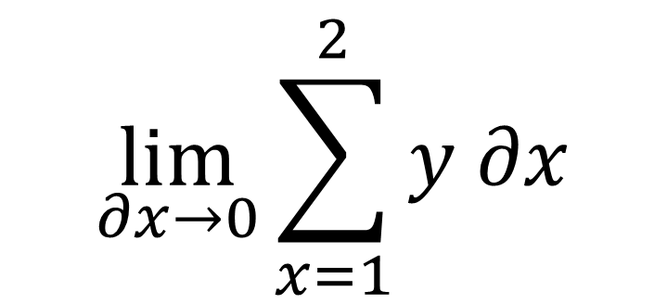
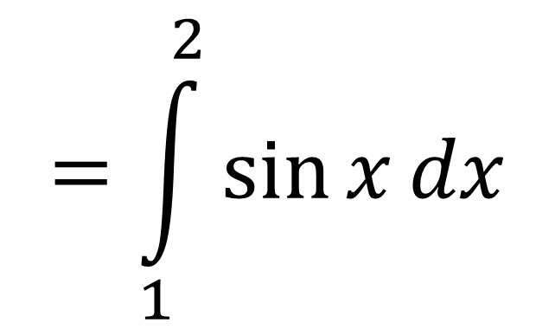
$$\lim_{∂x→0}{\sum_{x=1}^{2}{y ∂x}}$$
$$=\int_{1}^{2}{\sin{x}dx}$$

Slide 5

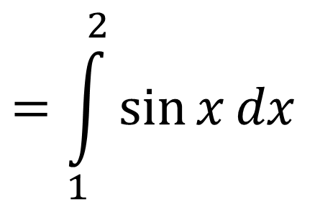
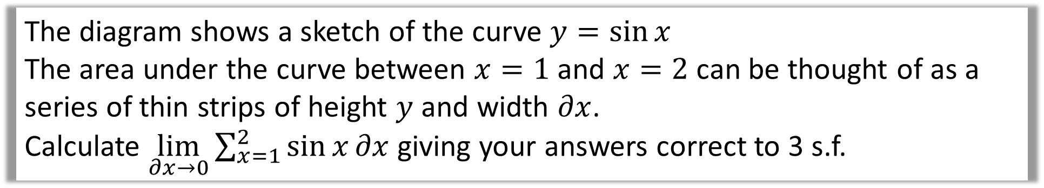
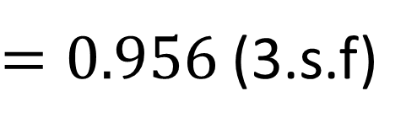

The diagram shows a sketch of the curve $y=\sin{x}$
The area under the curve between $x=1$ and $x=2$ can be thought of as a series of thin strips of height $y$ and width $∂x$.
Calculate $\lim_{∂x→0}{\sum_{x=1}^{2}{\sin{x}∂x}}$ giving your answers correct to 3 s.f.
$$=\int_{1}^{2}{\sin{x}dx}$$
$$={\left[−\cos{x}\right]}_{1}^{2}$$
$$=(−\cos{2) −(−\cos{1)}}$$
$=0.956$(3.s.f)

Slide 6
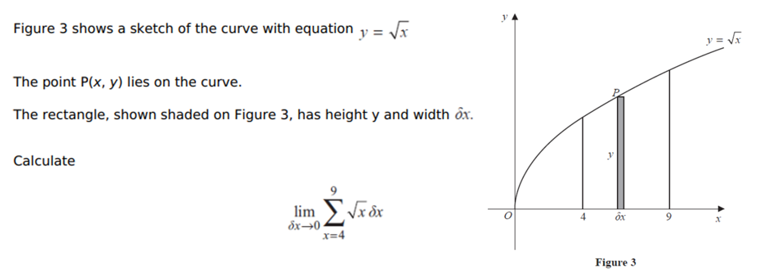
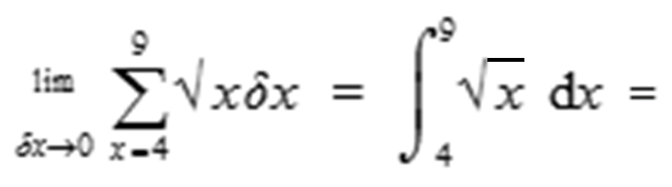
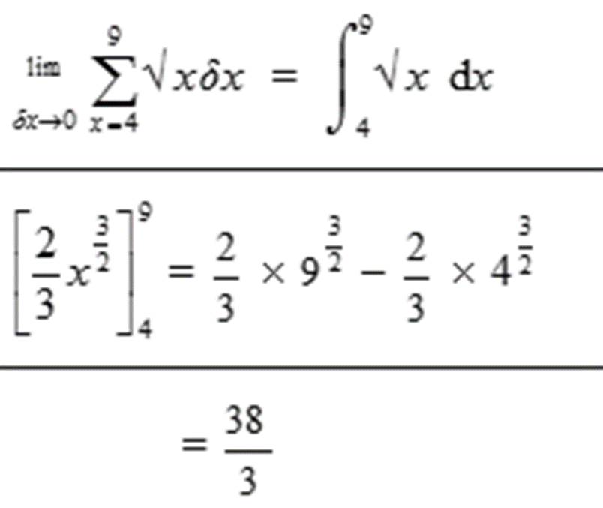

Slide 7
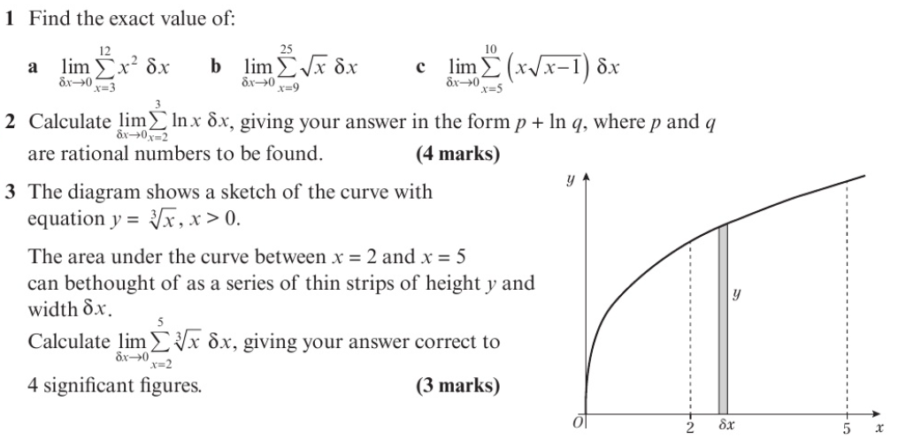



$$\frac{196}{3}$$
$$\frac{1456}{15}$$
567
$$−1+ln⁡[\frac{27}{4}]$$
4.523

