Slide 1
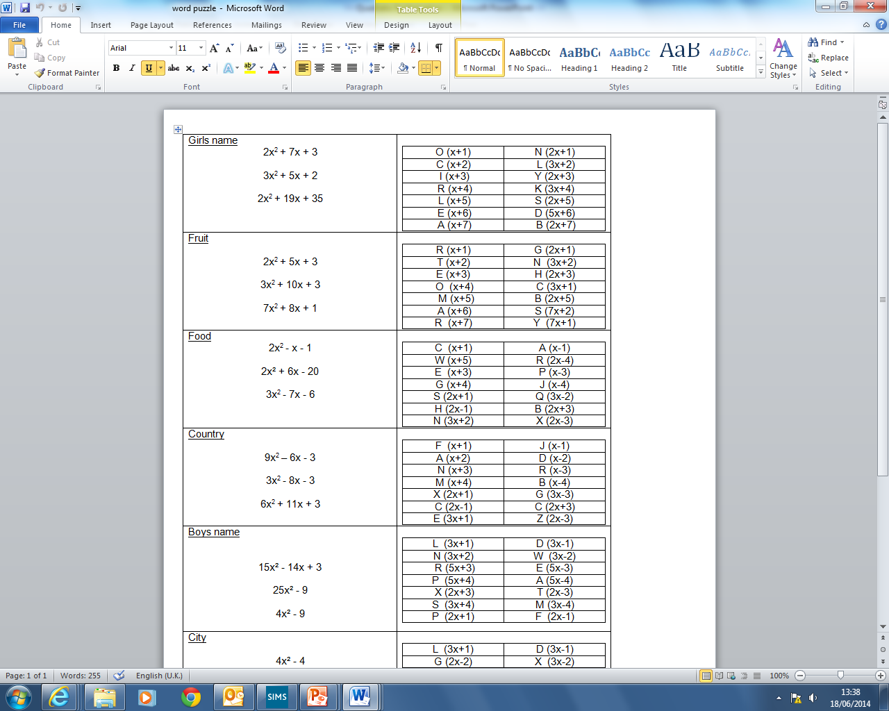

Slide 2
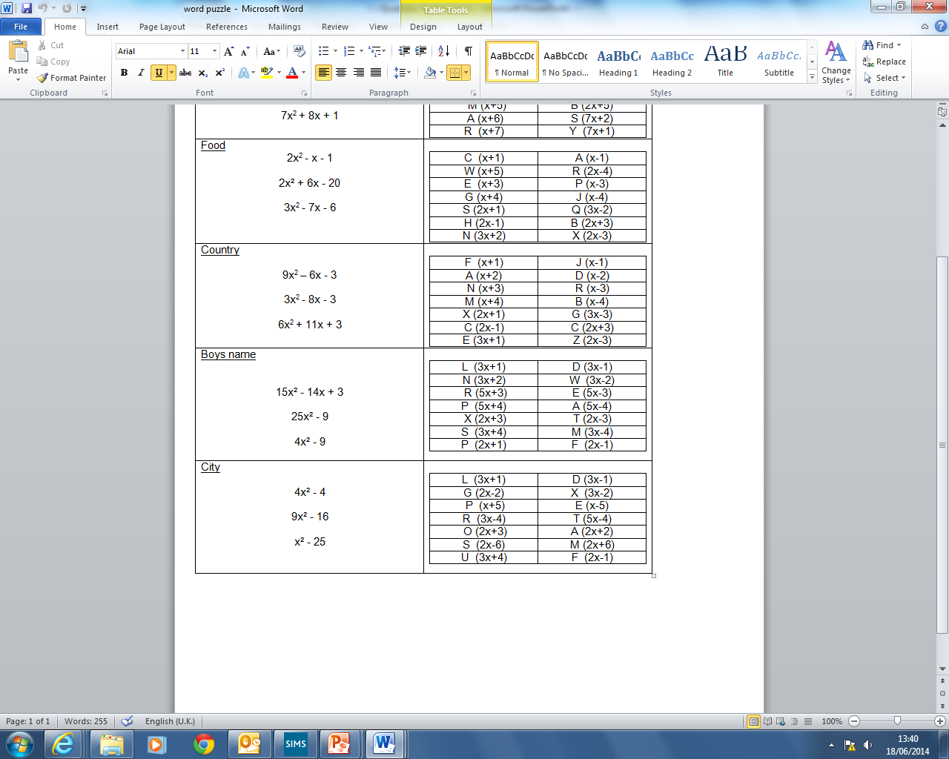

Slide 3
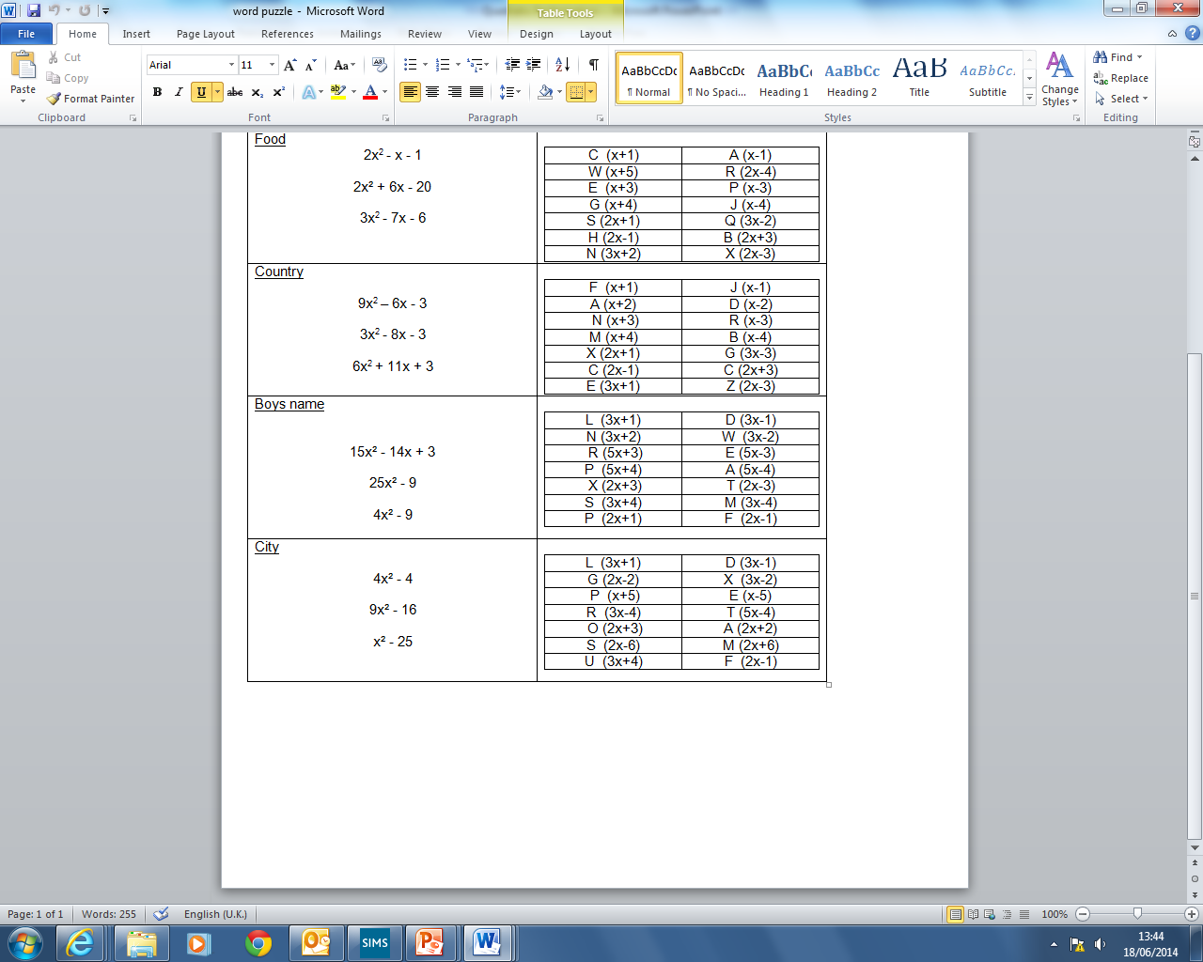

Slide 4
ANSWERS

Slide 5
(2x + 1)(x + 3)
N I
(3x + 2)(x + 1)
L O
ALISON
(2x + 5)(x + 7)
S A

Slide 6
(2x + 3)(x + 1)
H R
CHERRY
(3x + 1)(x + 3)
C E
(7x + 1)(x + 1)
Y R

Slide 7
(2x + 1)(x – 1)
S A
PRAWNS
(2x – 4)(x + 5)
R W
(3x + 2)(x – 3)
N P

Slide 8
(3x + 1)(3x – 3)
E G
GREECE
(3x + 1)(x – 3)
E R
(3x + 1)(2x + 3)
E C

Slide 9
(5x – 3)(3x – 1)
E D
DEXTER
(5x + 3)(5x – 3)
R E
(2x + 3)(2x – 3)
X T

Slide 10
(2x + 2)(2x – 2)
A G
PRAGUE
(3x + 4)(3x – 4)
R U
(x + 5)(x – 5)
P E

