Slide 1
LO: Inverse Proportion

Slide 2
What is inverse Proportion?
As one value increases the other decreases.

Slide 3

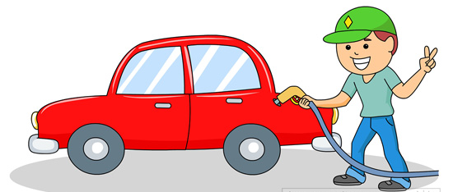

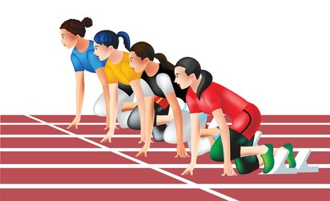
Can you think of any situations where inverse proportion occurs?

Slide 4

It takes 2 people 20 minutes to wash a car.
How long does it take 4 people?
People : Time
2 : 20
4 : 10

Slide 5

It takes 2 people 20 minutes to wash a car.
How long does it take 1 person?
People : Time
2 : 20
1 : 40

Slide 6
