Slide 1
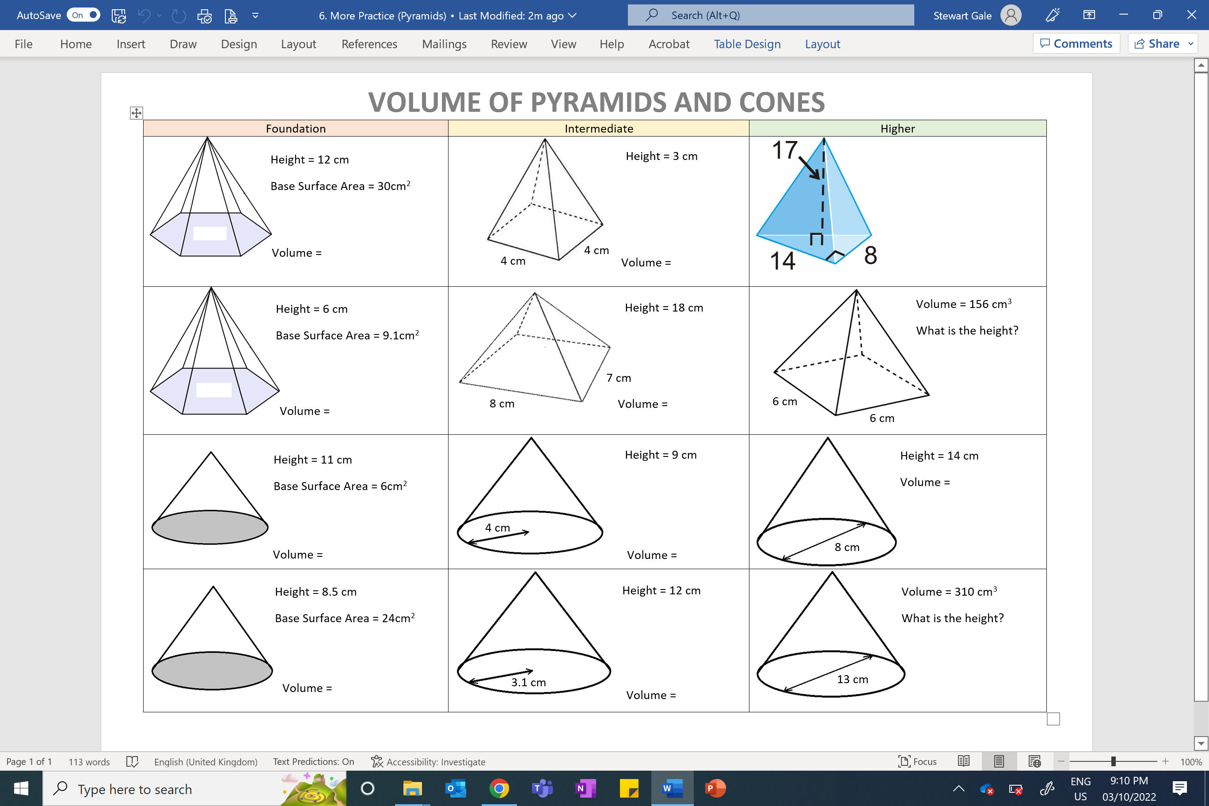
What is the volume?

Slide 2
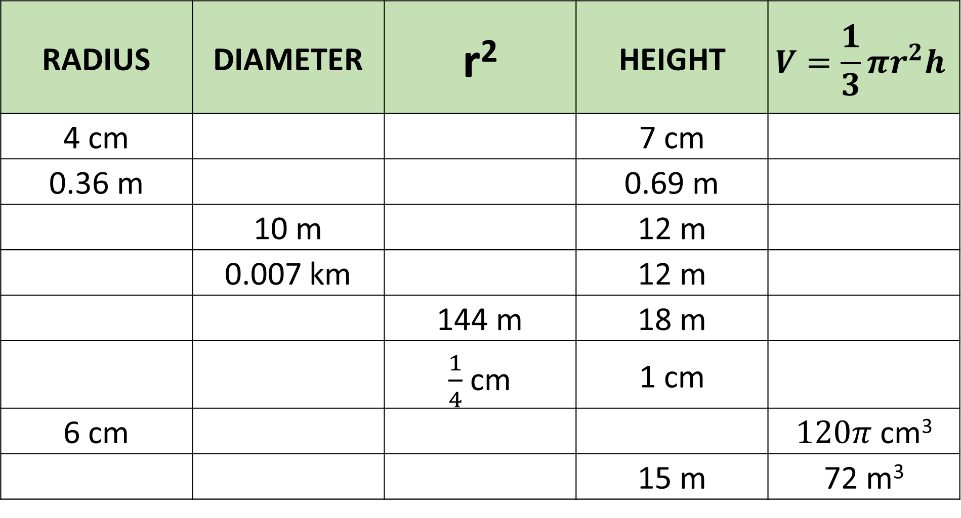
RADIUS | DIAMETER | r² | HEIGHT | $$V=\frac{1}{3}πr^{2}h$$
4 cm |  |  | 7 cm
0.36 m |  |  | 0.69 m
 | 10 m |  | 12 m
 | 0.007 km |  | 12 m
 |  | 144 m | 18 m
 |  | $\frac{1}{4}$ cm | 1 cm
6 cm |  |  |  | $120π$ cm³
 |  |  | 15 m | 72 m³

Slide 3
ANSWERS

Slide 4
Volume = 120 cm³
Volume = 16 cm³
Volume = 317 cm³
Volume = 18.2 cm³
Volume = 336 cm³
Height = 13 cm
Volume = 22 cm³
Volume = 151 cm³
Volume = 235 cm³
Volume = 68 cm³
Volume = 121 cm³
Height = 7 cm

Slide 5
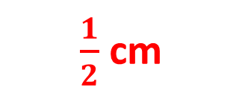

RADIUS | DIAMETER | r² | HEIGHT | $$V=\frac{1}{3}πr^{2}h$$
4cm |  |  | 7cm
0.36m |  |  | 0.69m
 | 10m |  | 12m
 | 0.007km |  | 12km
 |  | 144m | 18m
 |  | $\frac{1}{4}$cm | 1cm
6 cm |  |  |  | $120π$ cm³
 |  |  | 15m | 72 m³
8 cm
16 cm
117.29 cm³
0.72 m
0.1296 m
0.0936 m³
5 m
25 m
314 m³
0.0035 km
0.00001225 km
0.000154 km³
12 m
24 m
2713.8 m³
$\frac{1}{2}$ cm
1 cm
0.262 cm³
12 cm
36 cm
10 cm
2.14 m
4.28 m
4.5796 m

