Slide 1
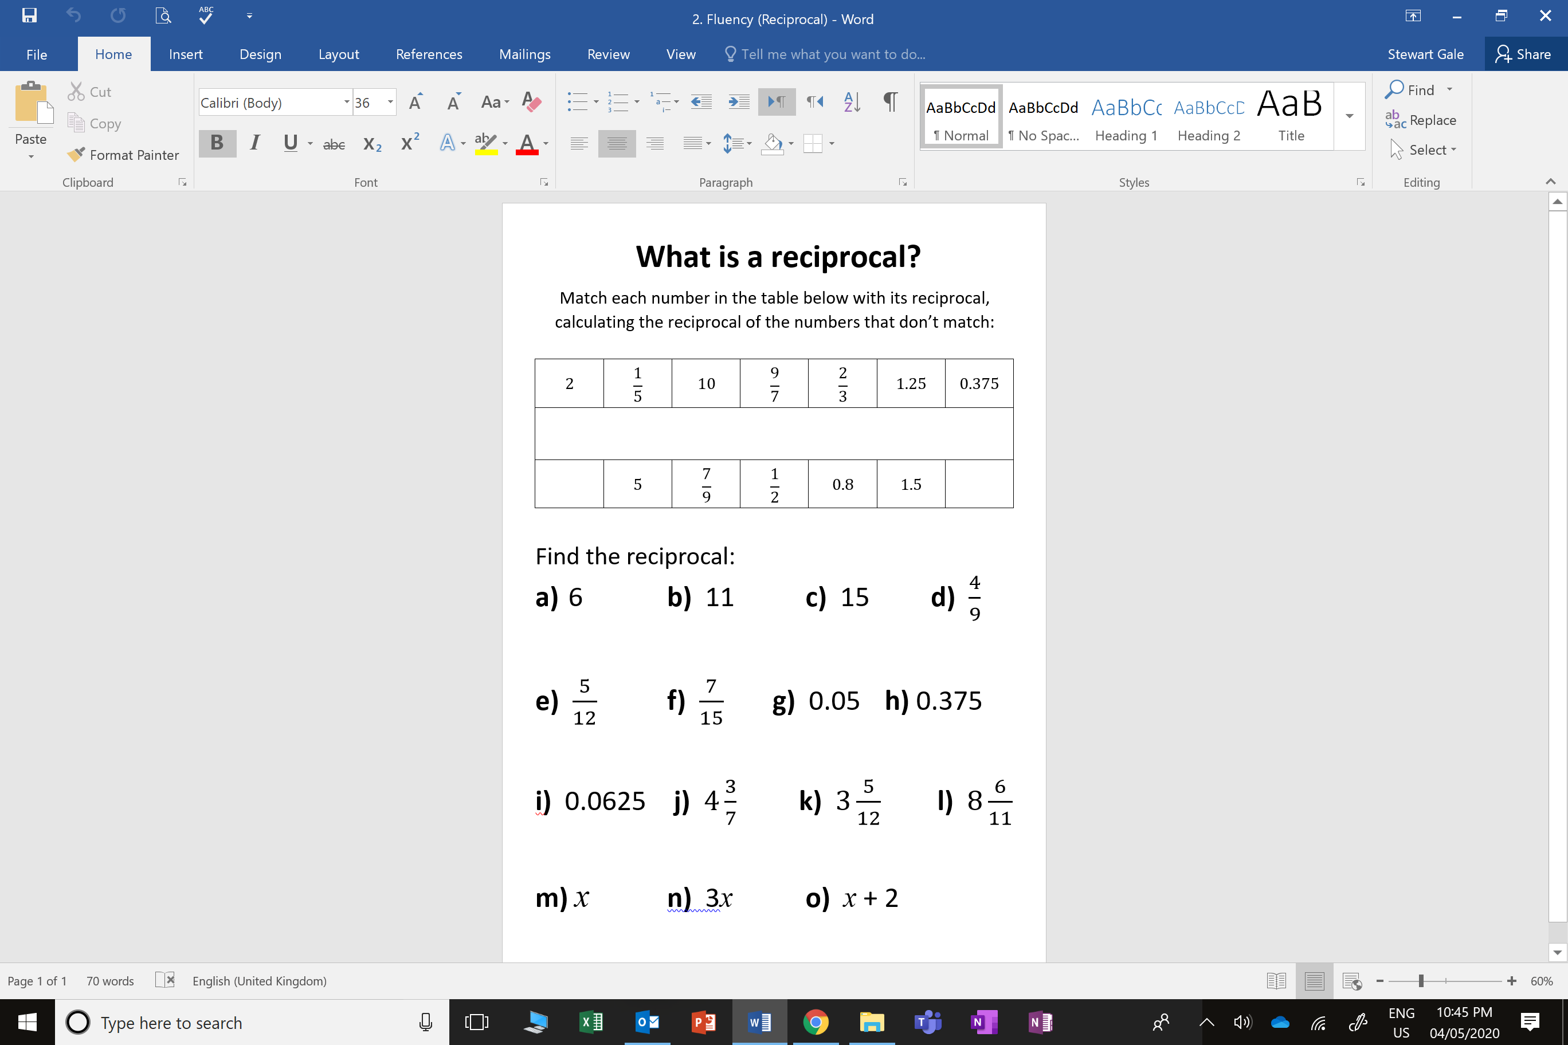

Slide 2
ANSWERS

Slide 3
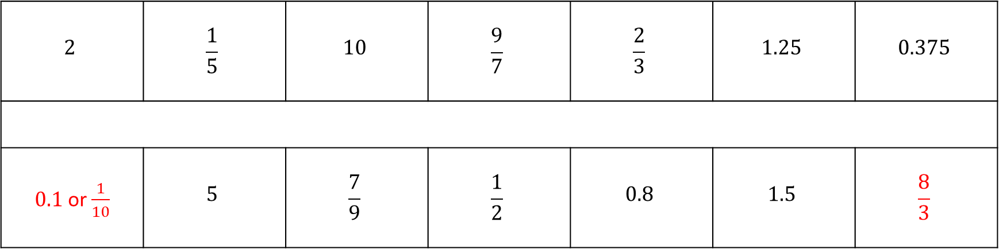
$$2$$ | $$\frac{1}{5}$$ | $$10$$ | $$\frac{9}{7}$$ | $$\frac{2}{3}$$ | $$1.25$$ | $$0.375$$
$0.1$ or $\frac{1}{10}$ | $$5$$ | $$\frac{7}{9}$$ | $$\frac{1}{2}$$ | $$0.8$$ | $$1.5$$ | $$\frac{8}{3}$$

Slide 4
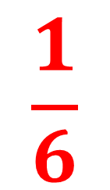
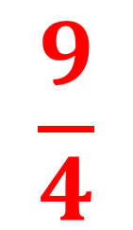


$$\frac{1}{6}$$
$$\frac{1}{11}$$
$$\frac{1}{15}$$
$$\frac{9}{4}$$

Slide 5
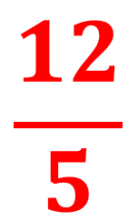
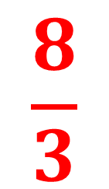
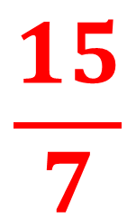
$$\frac{15}{7}$$
$$\frac{8}{3}$$
$$\frac{12}{5}$$
20

Slide 6
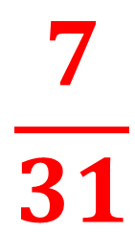
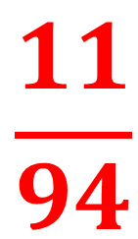
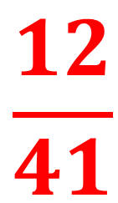
$$\frac{7}{31}$$
$$\frac{12}{41}$$
$$\frac{11}{94}$$
16

Slide 7
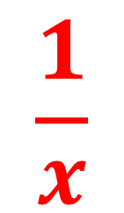
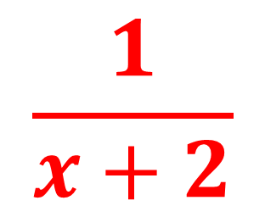
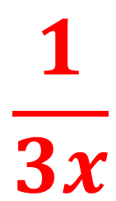
$$\frac{1}{x}$$
$$\frac{1}{3x}$$
$$\frac{1}{x+2}$$

