Slide 1
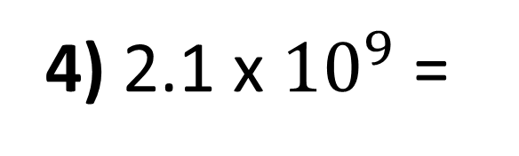
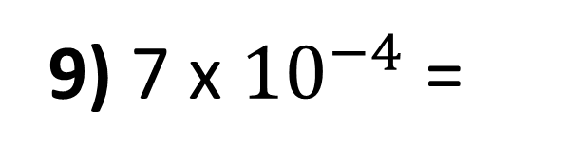
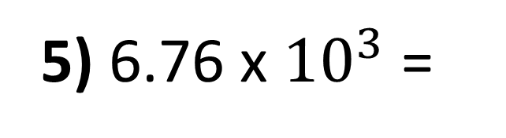
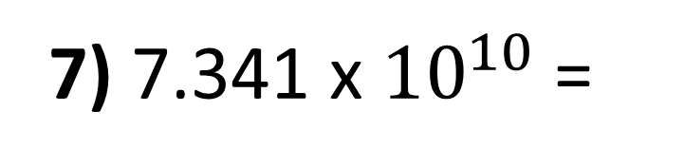
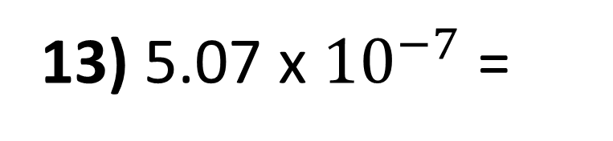
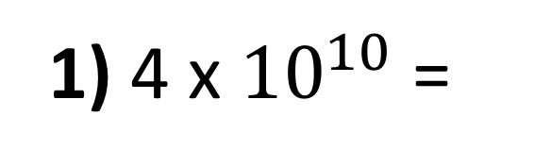
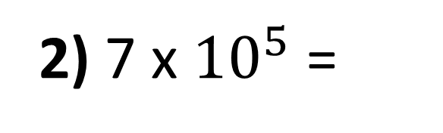
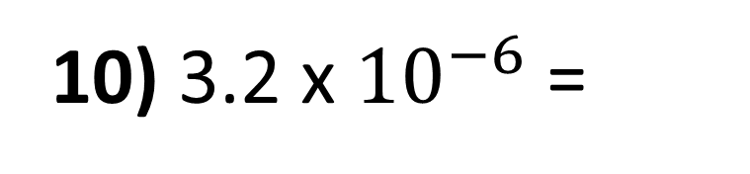
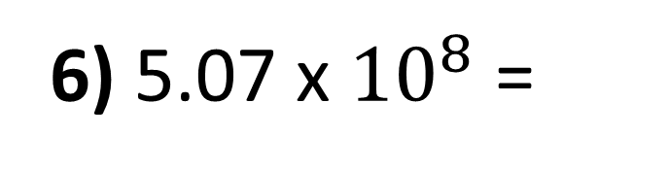
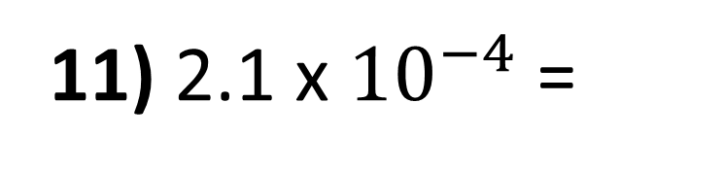
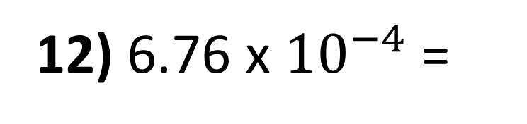
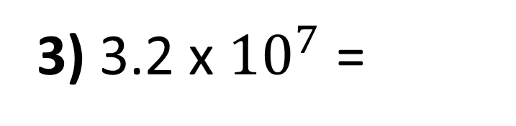
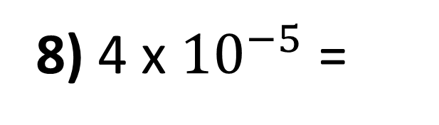
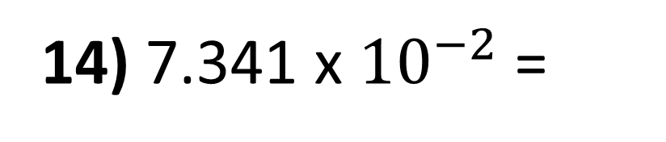
Convert to original numbers.
1) 4 x ${10}^{10}$ =
8) 4 x ${10}^{−5}$ =
2) 7 x ${10}^{5}$ =
9) 7 x ${10}^{−4}$ =
3) 3.2 x ${10}^{7}$ =
10) 3.2 x ${10}^{−6}$ =
4) 2.1 x ${10}^{9}$ =
11) 2.1 x ${10}^{−4}$ =
5) 6.76 x ${10}^{3}$ =
12) 6.76 x ${10}^{−4}$ =
6) 5.07 x ${10}^{8}$ =
13) 5.07 x ${10}^{−7}$ =
7) 7.341 x ${10}^{10}$ =
14) 7.341 x ${10}^{−2}$ =

Slide 2
Convert to standard form.
1) 0.0005 =
8) 400 =
2) 0.000007 =
9) 7000 =
3) 0.000056 =
10) 32000 =
4) 0.0000323 =
11) 21600000 =
5) 0.000405 =
12) 67600000 =
6) 0.0004923 =
13) 507200 =
7) 0.0774 =
14) 1230000 =

Slide 3
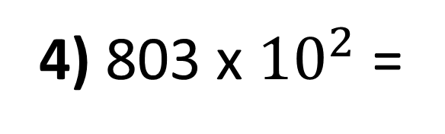
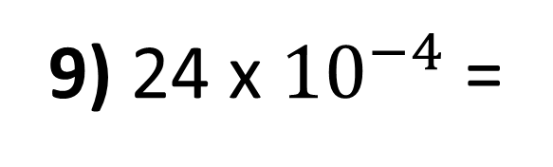
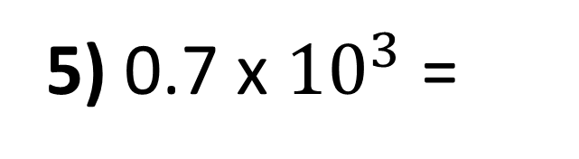
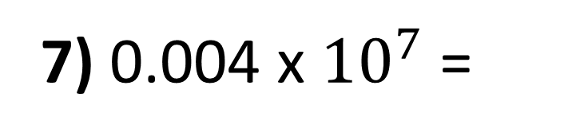
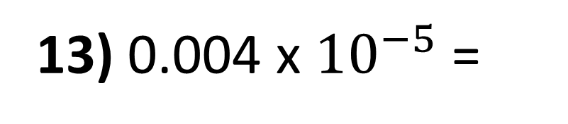
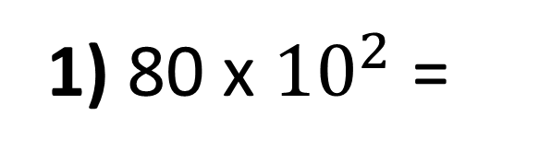
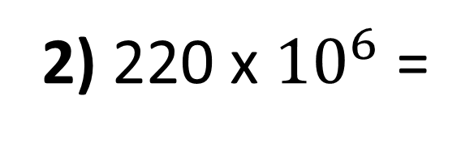
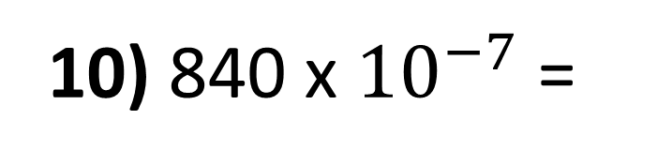
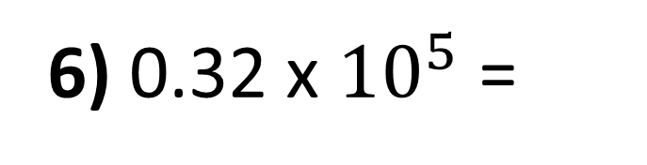
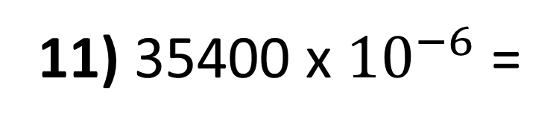
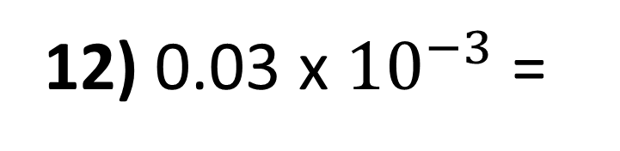
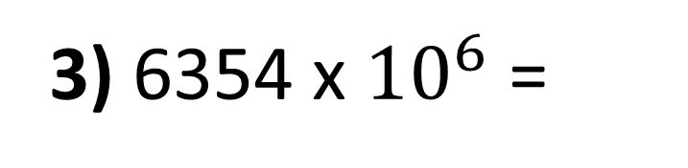
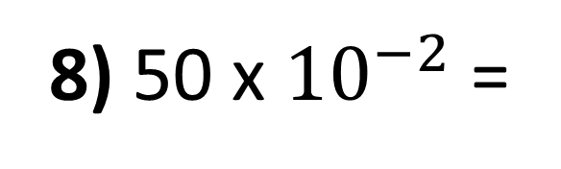
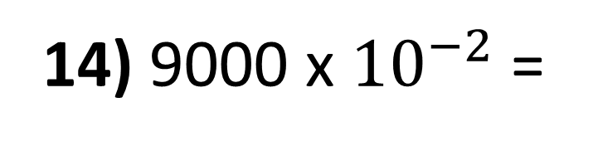
Convert to correct standard form.
1) 80 x ${10}^{2}$ =
8) 50 x ${10}^{−2}$ =
2) 220 x ${10}^{6}$ =
9) 24 x ${10}^{−4}$ =
3) 6354 x ${10}^{6}$ =
10) 840 x ${10}^{−7}$ =
4) 803 x ${10}^{2}$ =
11) 35400 x ${10}^{−6}$ =
5) 0.7 x ${10}^{3}$ =
12) 0.03 x ${10}^{−3}$ =
6) 0.32 x ${10}^{5}$ =
13) 0.004 x ${10}^{−5}$ =
7) 0.004 x ${10}^{7}$ =
14) 9000 x ${10}^{−2}$ =

Slide 4
ANSWERS

Slide 5
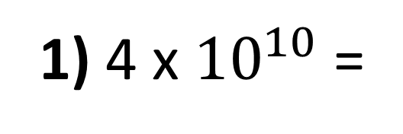
Convert to original numbers.
1) 4 x ${10}^{10}$ =
40, 000, 000, 000
2) 7 x ${10}^{5}$ =
700, 000
3) 3.2 x ${10}^{7}$ =
32, 000, 000
4) 2.1 x ${10}^{9}$ =
2, 100, 000, 000
5) 6.76 x ${10}^{3}$ =
6760
6) 5.07 x ${10}^{8}$ =
507, 000, 000
7) 7.341 x ${10}^{10}$ =
73,410,000,000

Slide 6
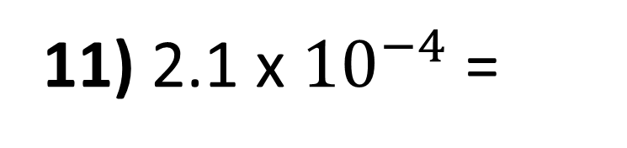
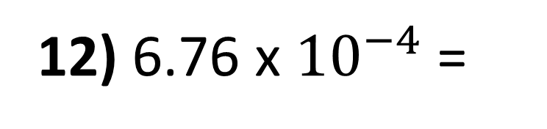
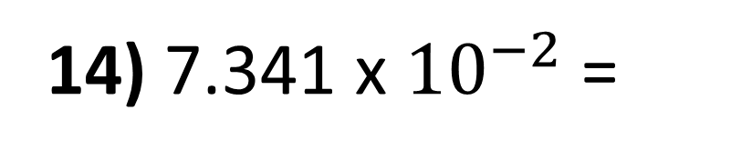
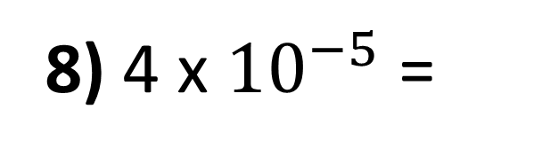
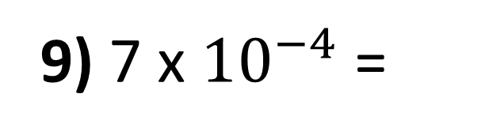
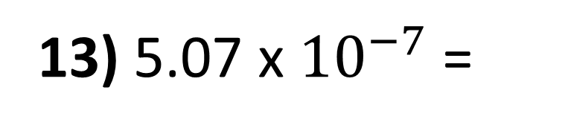
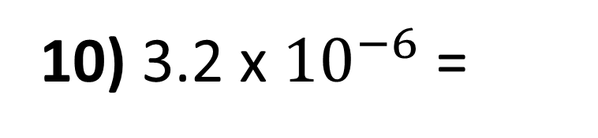
8) 4 x ${10}^{−5}$ =
0.00004
9) 7 x ${10}^{−4}$ =
0.0007
10) 3.2 x ${10}^{−6}$ =
0.0000032
11) 2.1 x ${10}^{−4}$ =
0.00021
12) 6.76 x ${10}^{−4}$ =
0.000676
13) 5.07 x ${10}^{−7}$ =
0.000000507
14) 7.341 x ${10}^{−2}$ =
0.07341

Slide 7
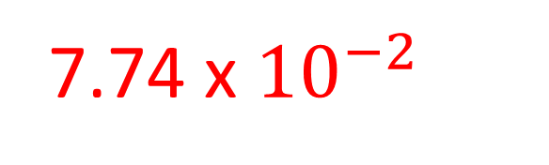
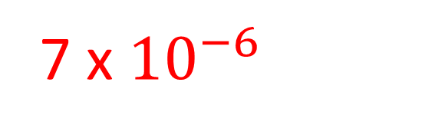
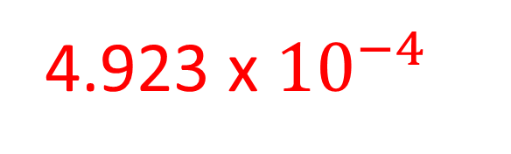
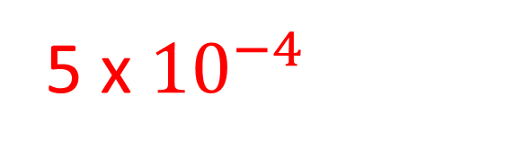
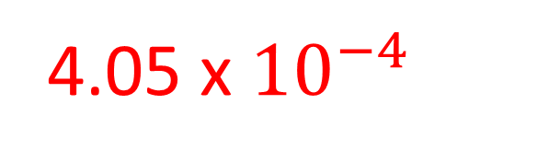
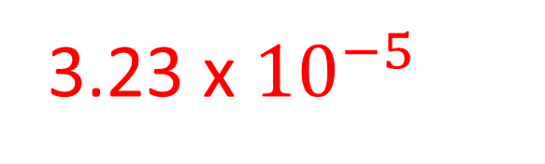
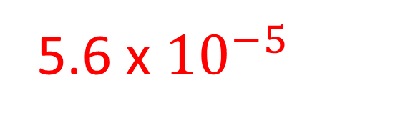
Convert to standard form.
1) 0.0005 =
5 x ${10}^{−4}$
2) 0.000007 =
7 x ${10}^{−6}$
3) 0.000056 =
5.6 x ${10}^{−5}$
4) 0.0000323 =
3.23 x ${10}^{−5}$
5) 0.000405 =
4.05 x ${10}^{−4}$
6) 0.0004923 =
4.923 x ${10}^{−4}$
7) 0.0774 =
7.74 x ${10}^{−2}$

Slide 8
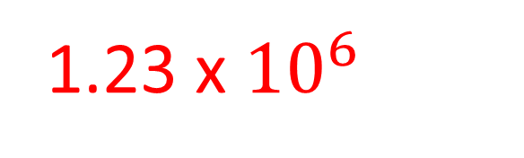
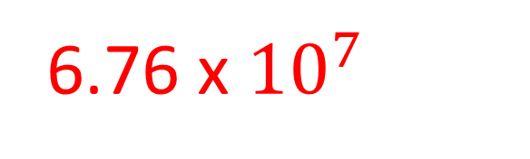
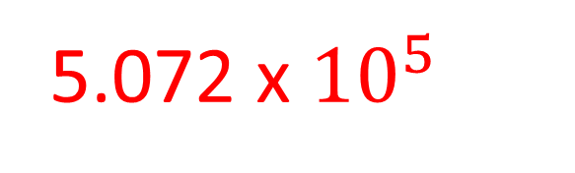
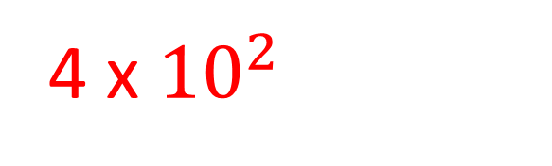
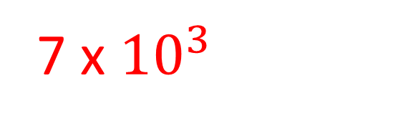
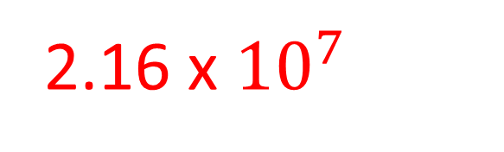
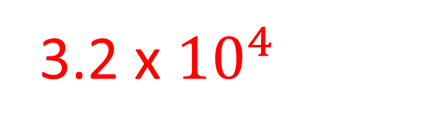
8) 400 =
4 x ${10}^{2}$
9) 7000 =
7 x ${10}^{3}$
10) 32000 =
3.2 x ${10}^{4}$
11) 21600000 =
2.16 x ${10}^{7}$
12) 67600000 =
6.76 x ${10}^{7}$
13) 507200 =
5.072 x ${10}^{5}$
14) 1230000 =
1.23 x ${10}^{6}$

Slide 9










Convert to correct standard form.
1) 80 x ${10}^{2}$ = 8 x ${10}^{3}$
2) 220 x ${10}^{6}$ = 2.2 x ${10}^{8}$
3) 6354 x ${10}^{6}$ = 6.354 x ${10}^{9}$
4) 803 x ${10}^{2}$ = 8.03 x ${10}^{4}$
5) 0.7 x ${10}^{3}$ =
7 x ${10}^{2}$
6) 0.32 x ${10}^{5}$ =
3.2 x ${10}^{4}$
7) 0.004 x ${10}^{7}$ =
4 x ${10}^{6}$

Slide 10







8) 50 x ${10}^{−2}$ = 5 x ${10}^{−1}$
9) 24 x ${10}^{−4}$ = 2.4 x ${10}^{−3}$
10) 840 x ${10}^{−7}$ = 8.4 x ${10}^{−5}$
11) 35400 x ${10}^{−6}$ = 3.54 x ${10}^{−2}$
12) 0.03 x ${10}^{−3}$ = 3 x ${10}^{−5}$
13) 0.004 x ${10}^{−5}$ = 4 x ${10}^{−8}$
14) 9000 x ${10}^{−2}$ = 9 x ${10}^{1}$

