Slide 1

Junior Challenge 1
BRONZE

Slide 2
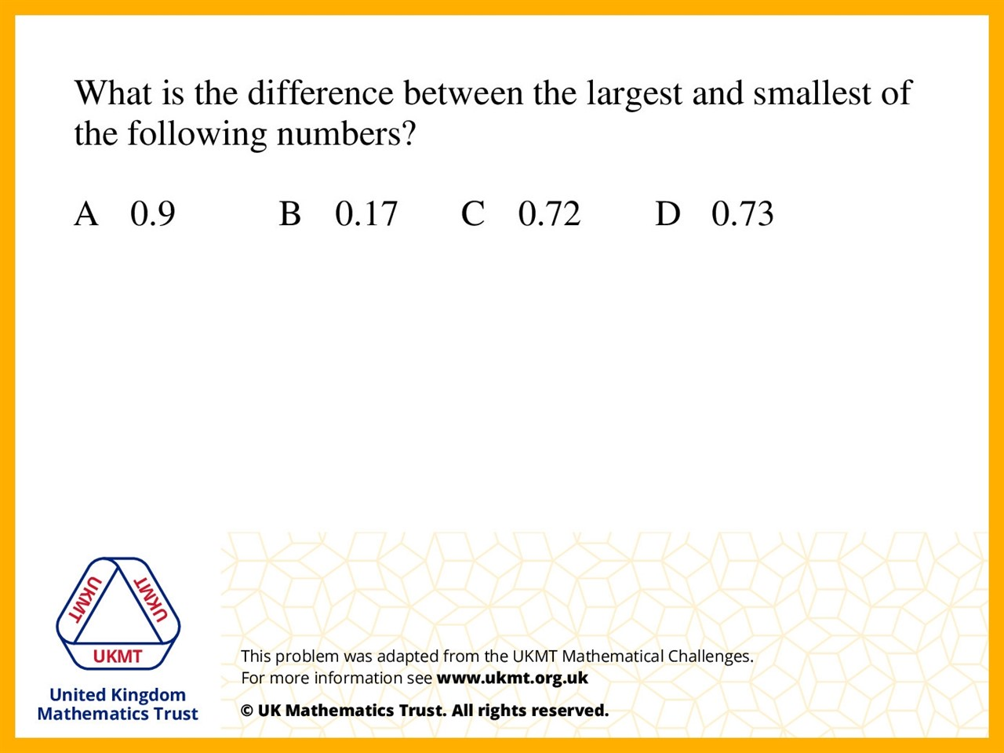
Q1.
Take away A and B due to the fact 0.9 was the highest number and 0.17 was the lowest.

Slide 3
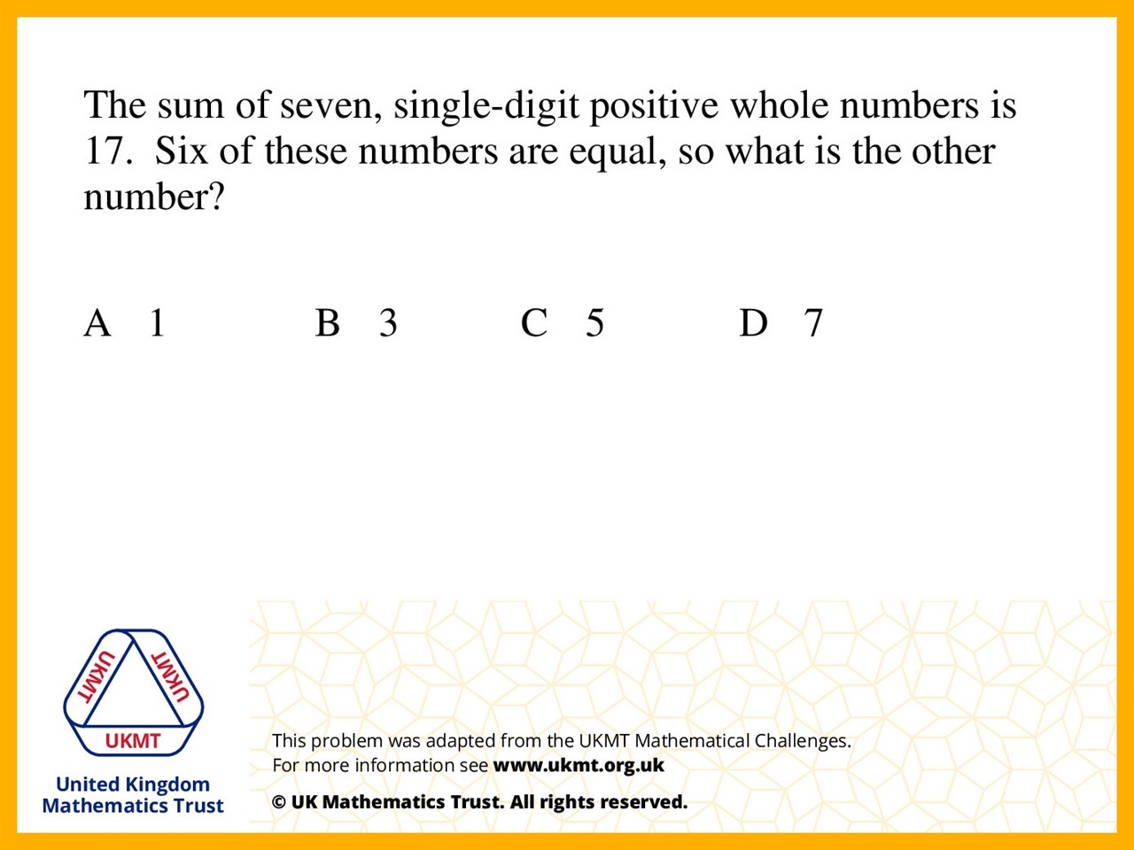
Q2.
Because 2 multiplied by 6 is 12.
Then take 12 from 17 to get 5.

Slide 4
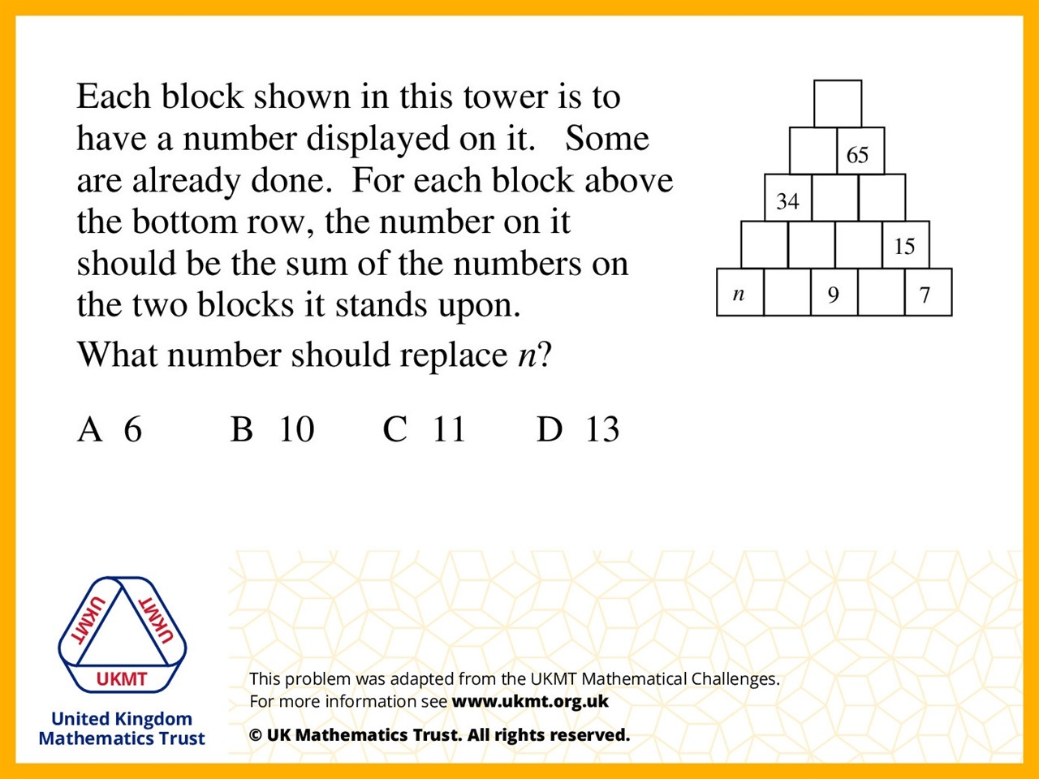
Q3.
Because 15 – 7 = 8 and 8 + 9 = 17 leading to 15 + 17 = 32 then 65 – 32 = 33 so the number below to the left has to be 16, 16 – 9 = 7 and 34 – 16 = 18 so finally 18 – 7 = 11.

Slide 5
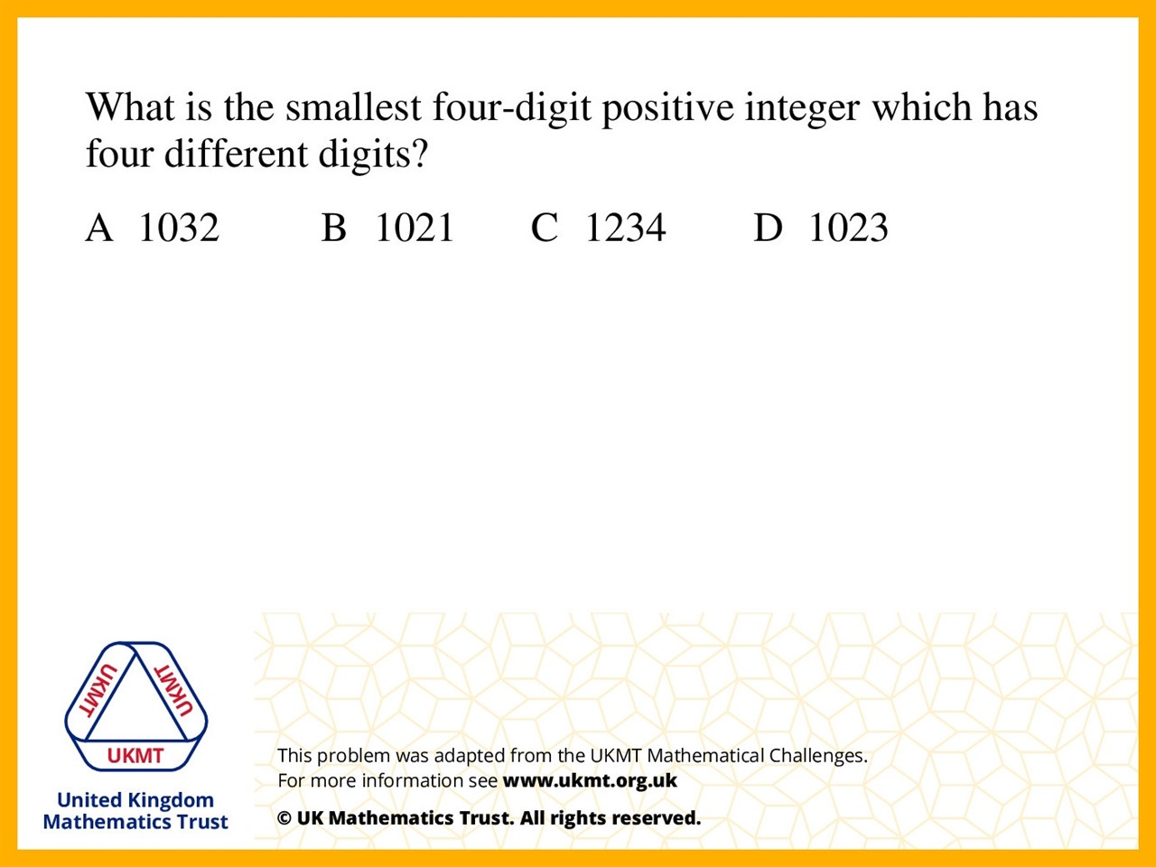
Q4.
Because the smallest number is 1021 however it has a repeated digit in the number so the smallest number is 1023 and it doesn't have a repeated digit and also is a four-digit positive integer.

Slide 6
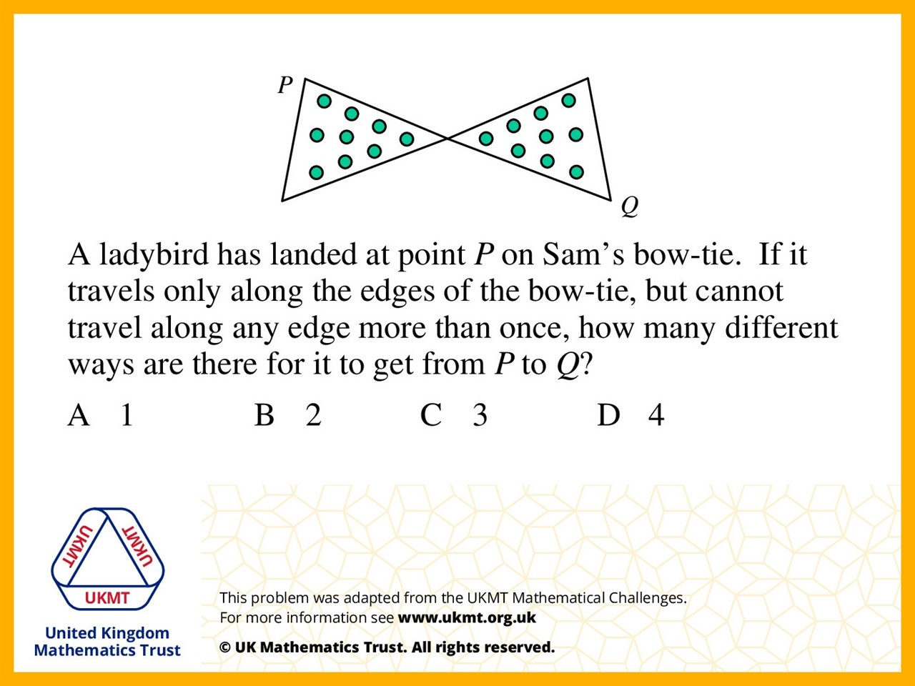
Q5.
1. Down from P to the middle then across to Q
2. Down from p all the way across then down to Q
3. All the way across from P to Q
4. From P to the middle then up then down

