Slide 1
LO: Equations
of a Circle

Slide 2
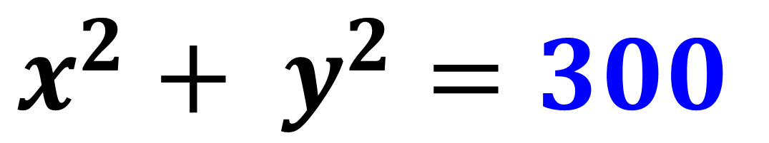
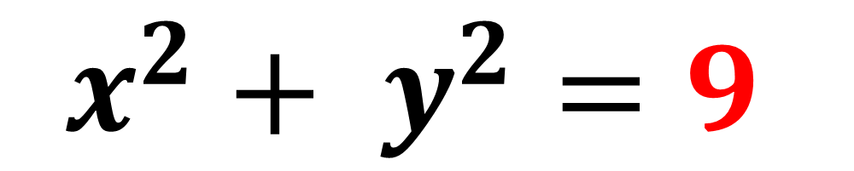
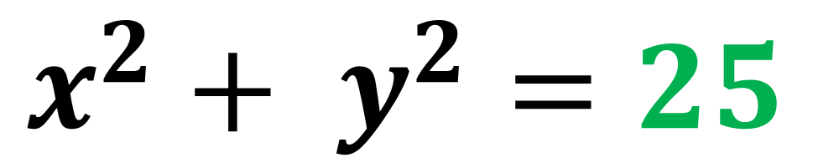
Examples of
Equations of a Circle
$$x^{2}+ y^{2}=9$$
$$x^{2}+ y^{2}=25$$
$$x^{2}+ y^{2}=300$$

Slide 3
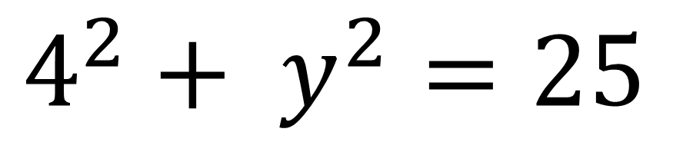
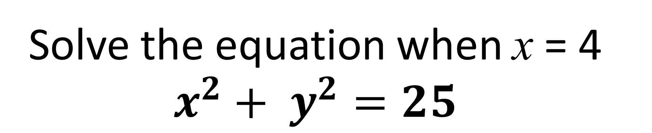
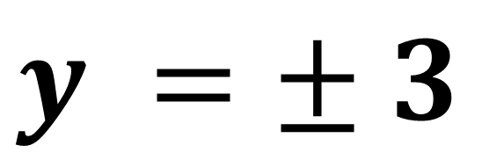
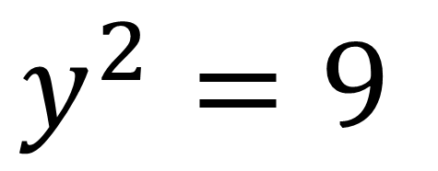
Solve the equation when x = 4
$$x^{2}+ y^{2}=25$$
$$4^{2}+ y^{2}=25$$
$$y^{2}=9$$
$$y =± 3$$

Slide 4
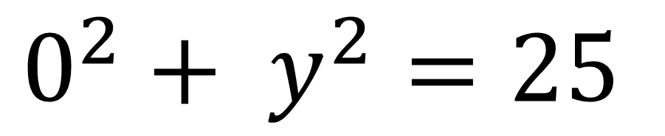
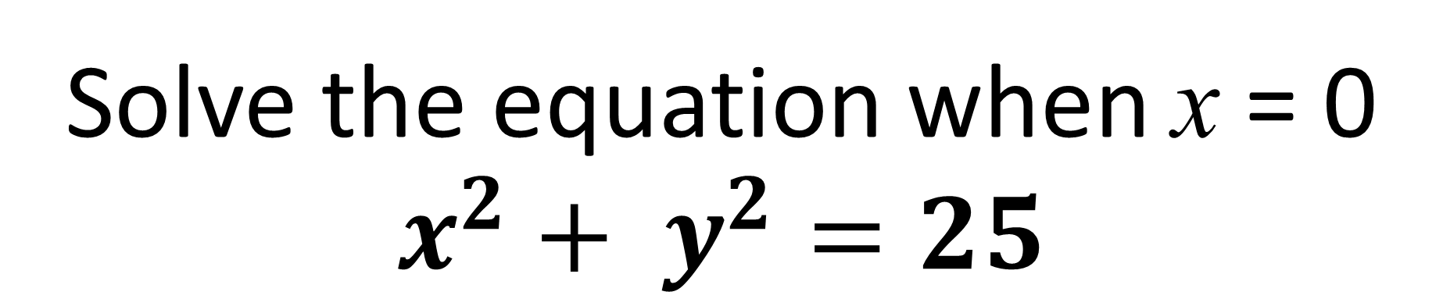
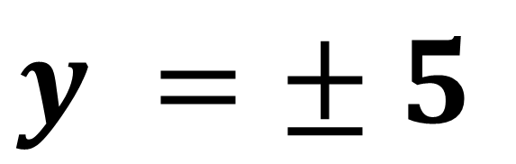
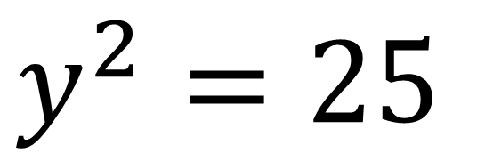
Solve the equation when x = 0
$$x^{2}+ y^{2}=25$$
$$0^{2}+ y^{2}=25$$
$$y^{2}=25$$
$$y =± 5$$

Slide 5
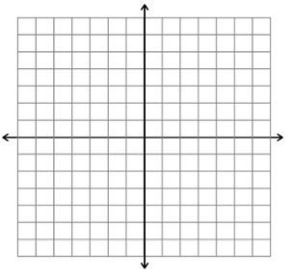
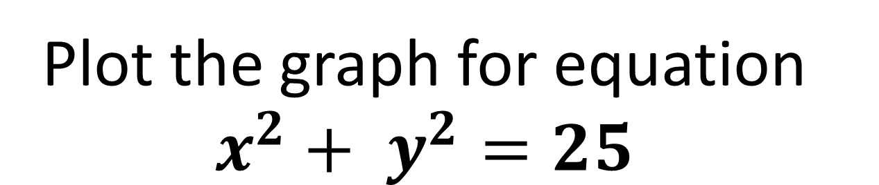
Plot the graph for equation
$$x^{2}+ y^{2}=25$$
x | -5 | -4 | -3 | 0 | 3 | 4 | 5
y
0 | $±$3 | $±$4 | $±$5 | $±$4 | $±$3 | 0

Slide 6
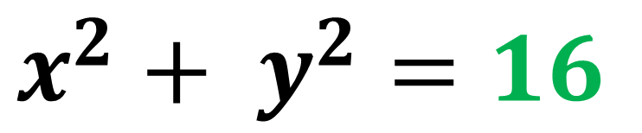
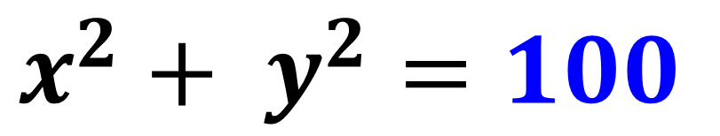
What is the connection between the value of the equation and the circle?
$$x^{2}+ y^{2}=16$$
$$x^{2}+ y^{2}=100$$

Slide 7
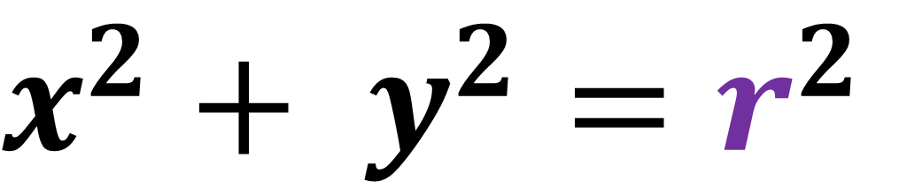

Equations of a Circle
$$r$$
$$x^{2}+ y^{2}=r^{2}$$

Slide 8
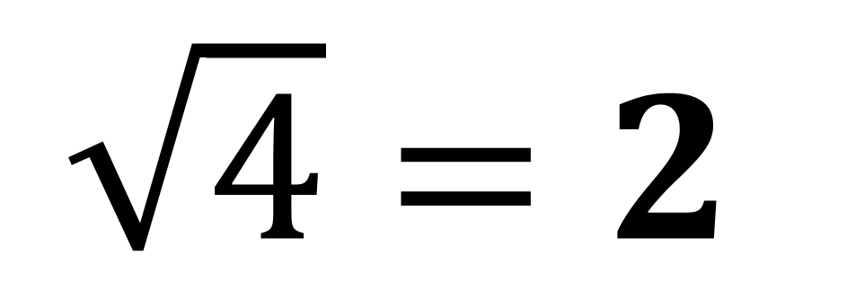
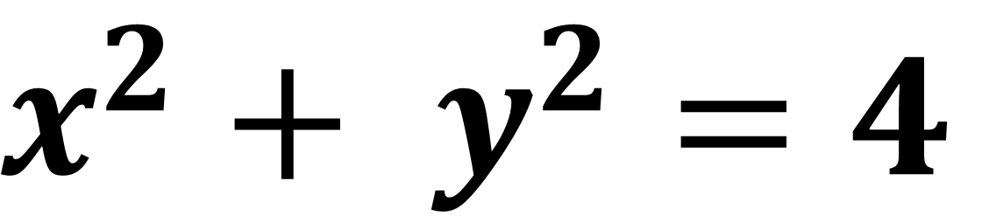
What is the radius of the circle?
$$x^{2}+ y^{2}=4$$
$$\sqrt{4}=2$$

Slide 9
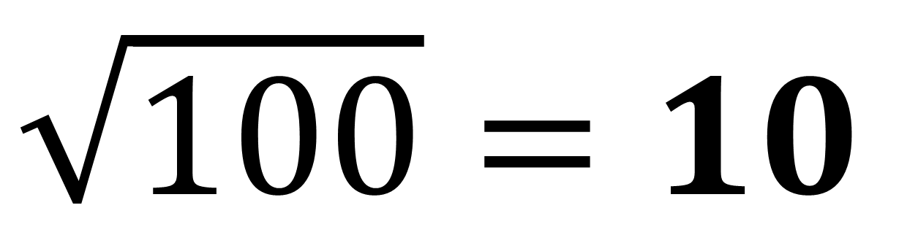
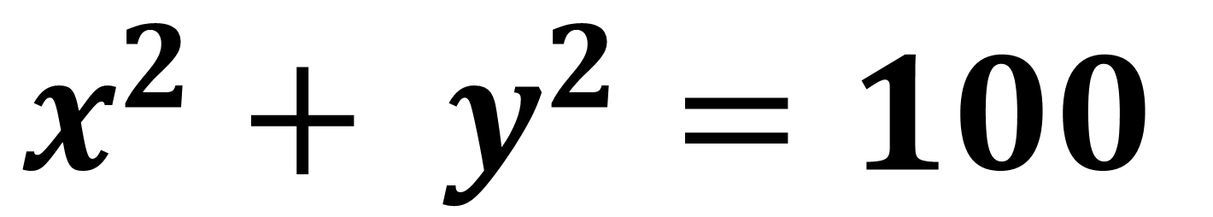
What is the radius of the circle?
$$x^{2}+ y^{2}=100$$
$$\sqrt{100}=10$$

Slide 10
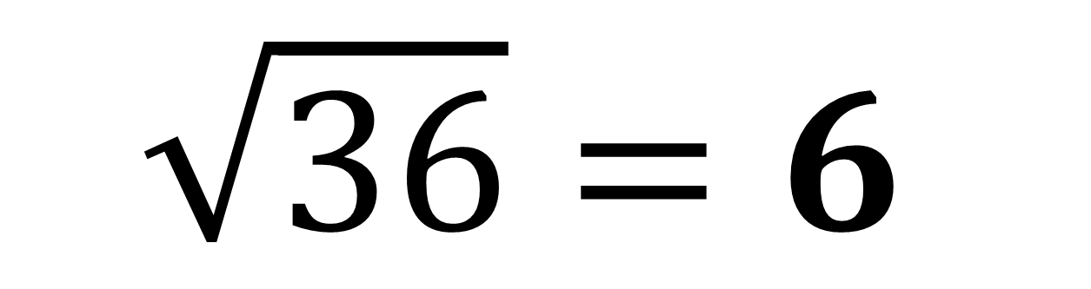
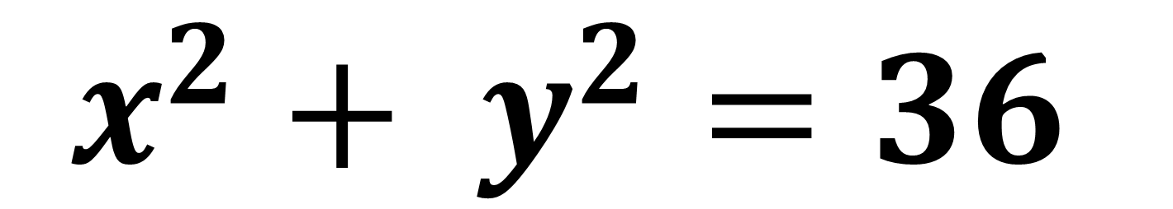
What is the radius of the circle?
$$x^{2}+ y^{2}=36$$
$$\sqrt{36}=6$$

Slide 11
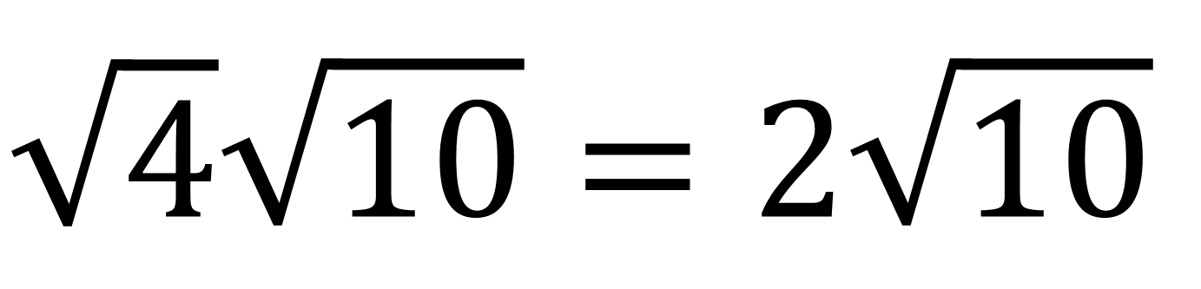
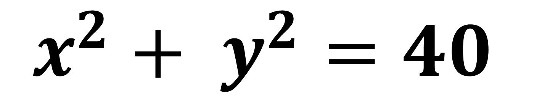
What is the radius of the circle?
Give your answer in simplest surd form.
$$x^{2}+ y^{2}=40$$
$$\sqrt{4}\sqrt{10}=2\sqrt{10}$$

Slide 12
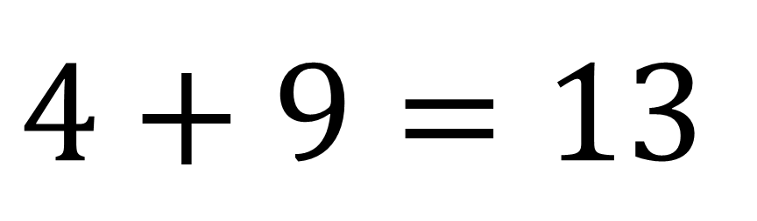
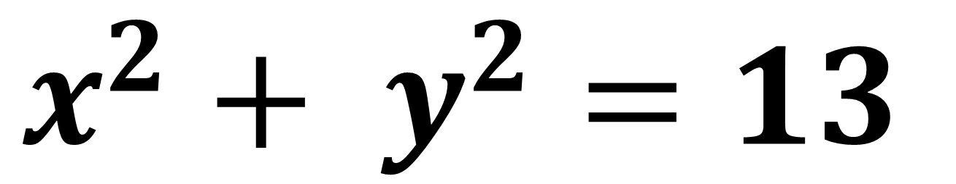
Does the point (2,3)
lie on the circle?
$$x^{2}+ y^{2}=13$$
Yes
$$4+9=13$$

Slide 13
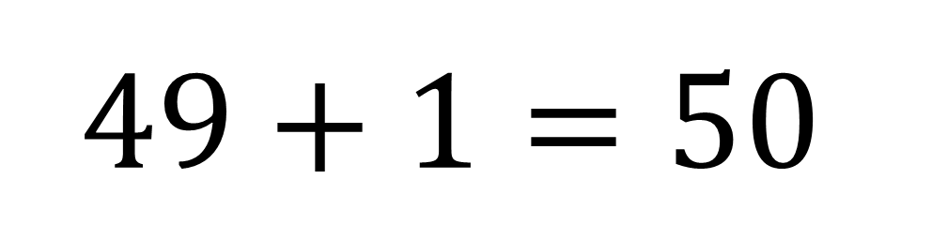
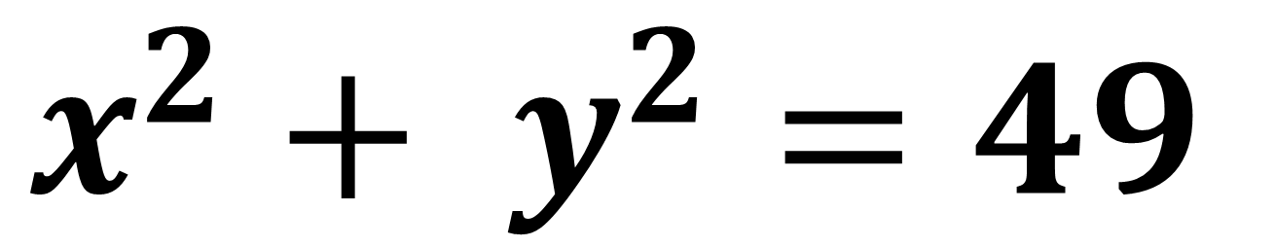
Does the point (7,1)
lie on the circle?
$$x^{2}+ y^{2}=49$$
No
$$49+1=50$$

Slide 14
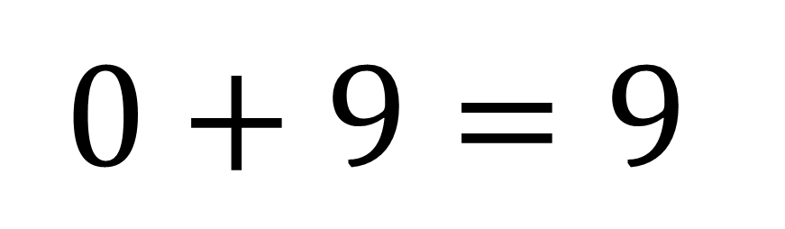
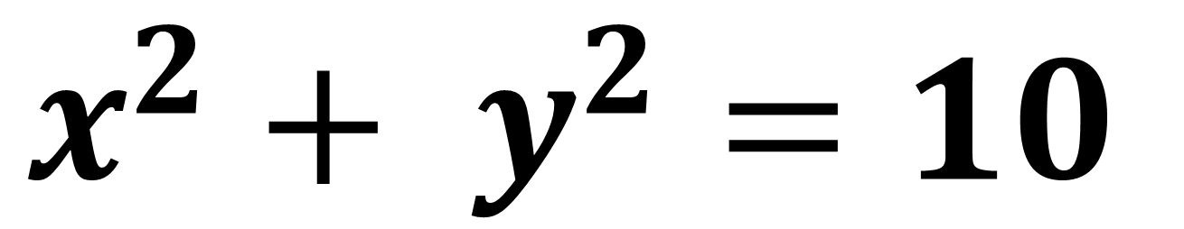
Does the point (0,-3)
lie on the circle?
$$x^{2}+ y^{2}=10$$
No
$$0+9=9$$

Slide 15
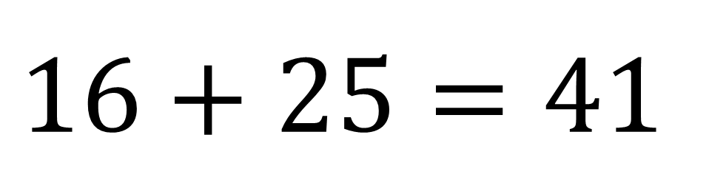
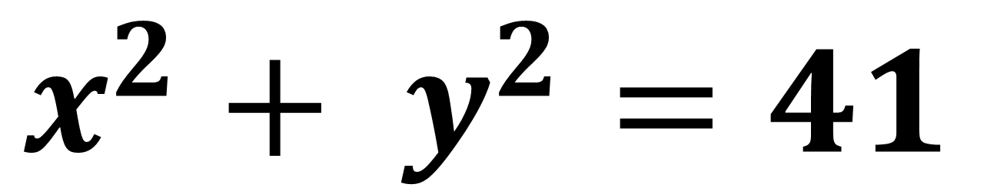
Does the point (4,5)
lie on the circle?
$$x^{2}+ y^{2}=41$$
Yes
$$16+25=41$$

Slide 16
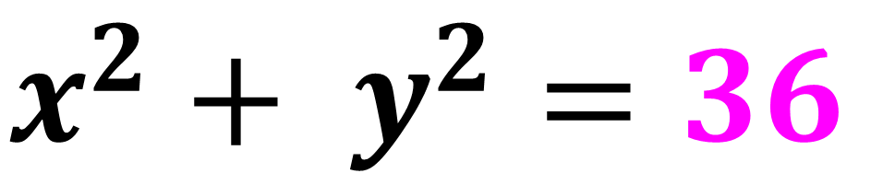
What is the equation of the circle?
$$x^{2}+ y^{2}=36$$

Slide 17
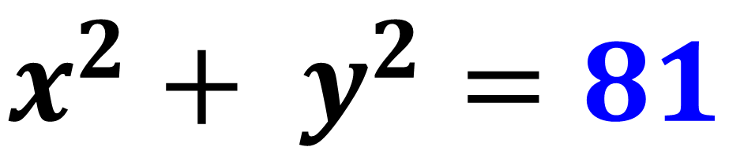
What is the equation of the circle?
$$x^{2}+ y^{2}=81$$

Slide 18
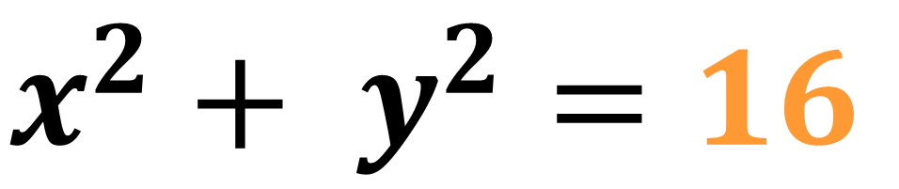
What is the equation of the circle?
$$x^{2}+ y^{2}=16$$

Slide 19
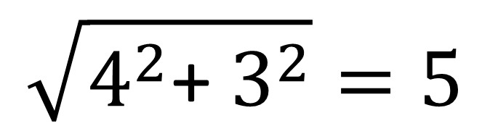
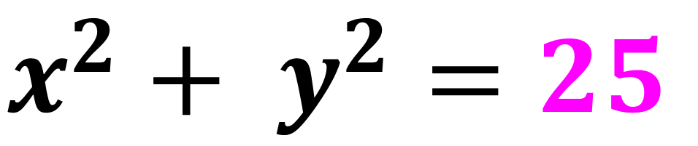
What is the equation of the circle?
(4,3)
3
4
$$\sqrt{4^{2}\text{+ }3^{2}}=5$$
$$x^{2}+ y^{2}=25$$

Slide 20
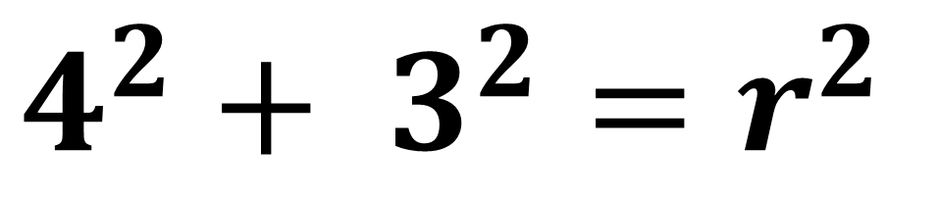
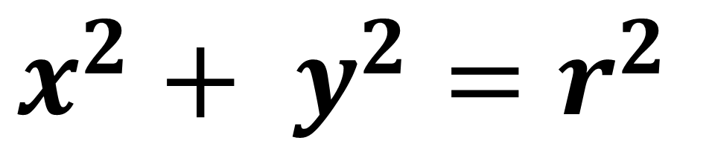
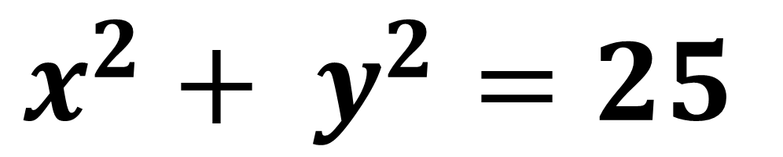
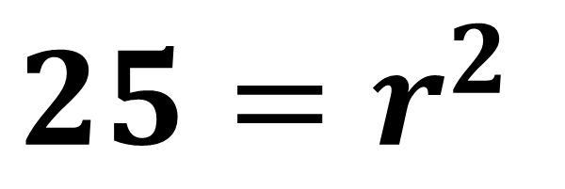
What is the equation of the circle?
$$x^{2}+ y^{2}=r^{2}$$
(4,3)
$$4^{2}+ 3^{2}=r^{2}$$
$$25=r^{2}$$
$$x^{2}+ y^{2}=25$$

Slide 21
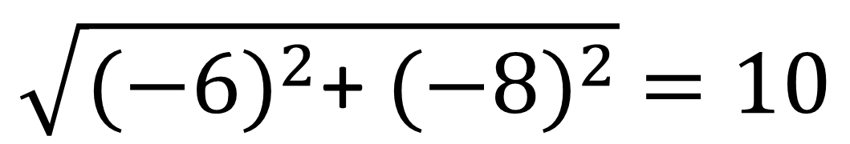
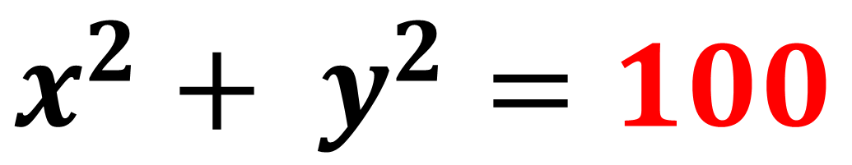
What is the equation of the circle?
-8
-6
$$\sqrt{{(−6)}^{2}\text{+ }{(−8)}^{2}} =10$$
(-6,-8)
$$x^{2}+ y^{2}=100$$

Slide 22
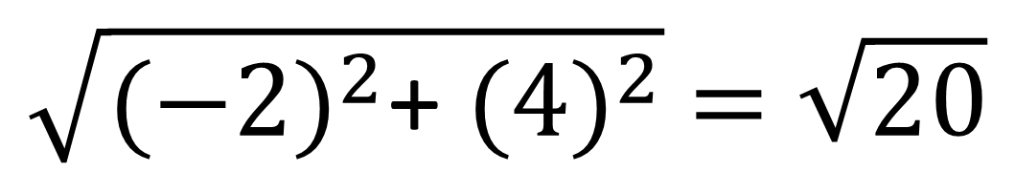
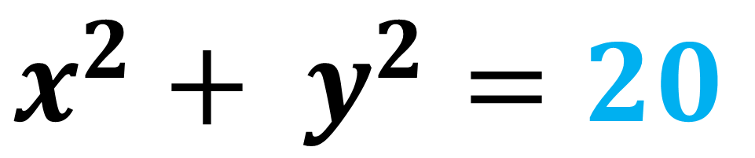
What is the equation of the circle?
4
(-2,4)
-2
$$\sqrt{{(−2)}^{2}\text{+ }{(4)}^{2}} =\sqrt{20}$$
$$x^{2}+ y^{2}=20$$

