Slide 1
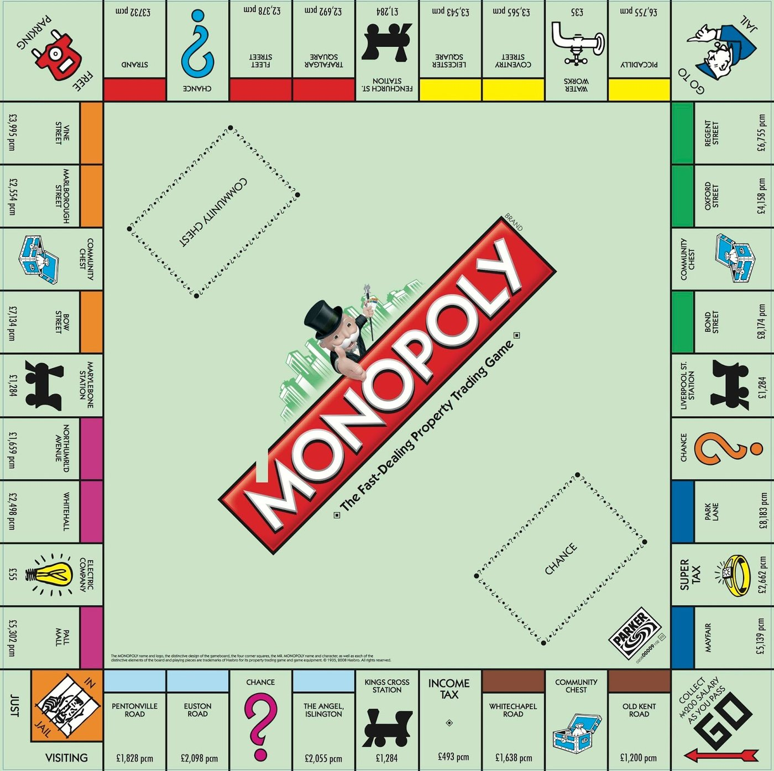
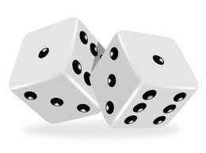
Which is the best
set of houses
to buy?
Why?

Slide 2
ANSWERS

Slide 3
Which is the best
set of houses
to buy?
Why?

