Slide 1
FM: Simultaneous
Equations
(3 Unknowns)

Slide 2
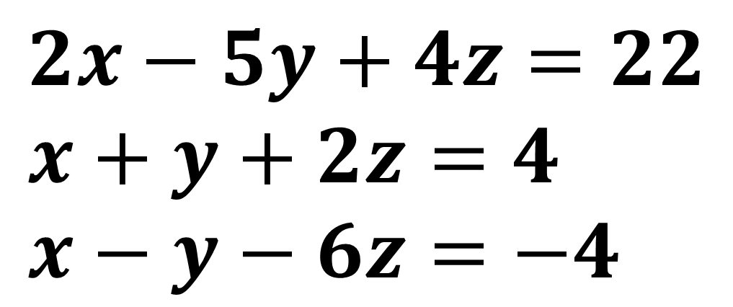
Sometimes you may have 3 equations
with 3 unknowns!
$$2x−5y+4z=22 \\ x+y+2z=4 \\ x−y−6z=−4$$
First eliminate one of the variables to leave
2 equations with two unknowns.

Slide 3
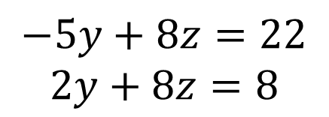
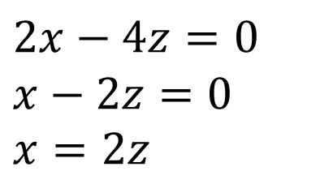

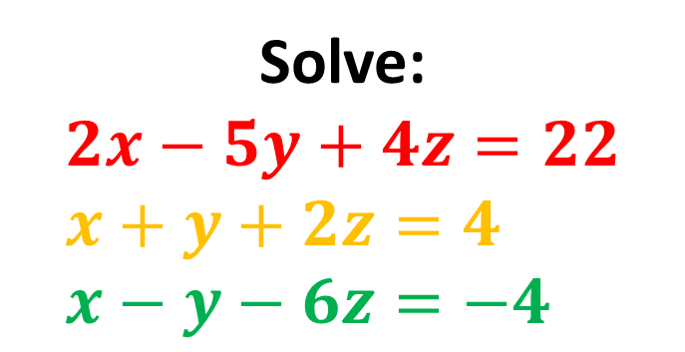
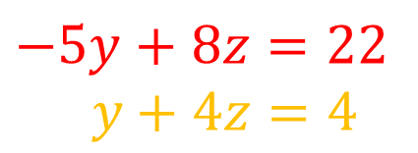


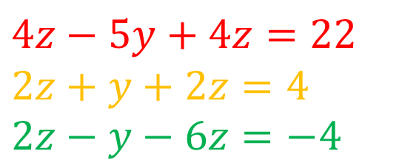
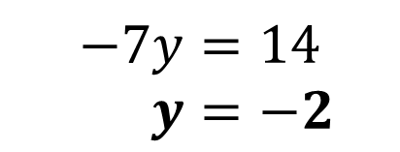
Solve:
$$2x−5y+4z=22 \\ x+y+2z=4 \\ x−y−6z=−4$$
Let’s add the last two equations:
Solve these equations in normal way:
$$2x−4z=0 \\ x−2z=0 \\ x=2z$$
$$−5y+8z=22 \\ y+4z=4$$
$$−5y+8z=22$$
$2y+8z=8$
Eliminate $x$ by substituting into other equations:
$$4z−5y+4z=22 \\ 2z+y+2z=4 \\ 2z−y−6z=−4$$
$$−7y=14$$
$y=−2$
$$z=1.5$$
$$x=3$$

Slide 4
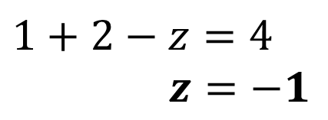

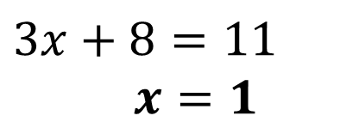
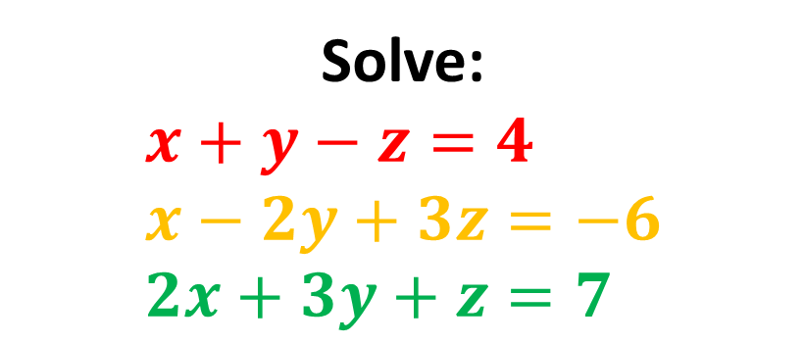
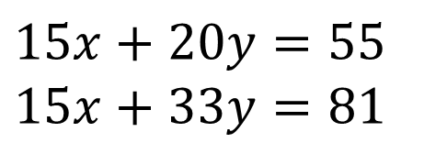
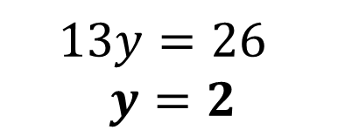

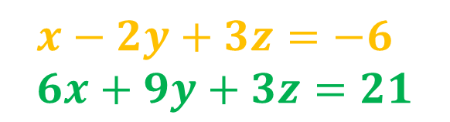

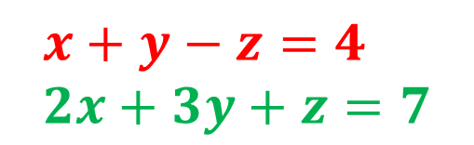
Solve:
$$x+y−z=4 \\ x−2y+3z=−6 \\ 2x+3y+z=7$$
2
3
Let’s attempt to eliminate $z$ to leave two equations in $x$ and $y$:
Solve in usual way:
$$15x+20y=55 \\ 15x+33y=81$$
$$x+y−z=4 \\ 2x+3y+z=7$$
$13y=26$
$$y=2$$
$$3x+4y=11$$
$$x−2y+3z=−6 \\ 6x+9y+3z=21$$
$$3x+8=11$$
$x=1$
$$5x+11y=27$$
$$1+2−z=4$$
$z=−1$

Slide 5
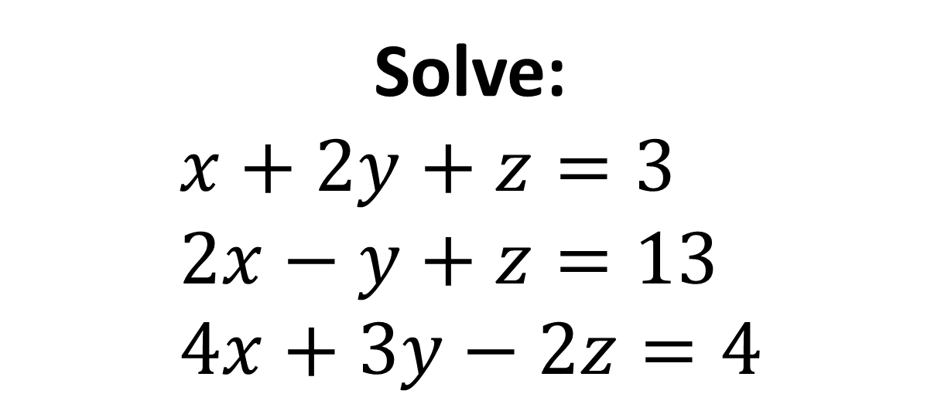
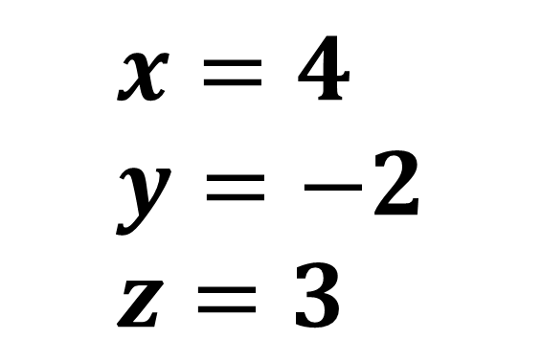
Solve:
$$x+2y+z=3 \\ 2x−y+z=13 \\ 4x+3y−2z=4$$
1
2
3
$$x=4 \\ y=−2 \\ z=3$$

