Slide 1
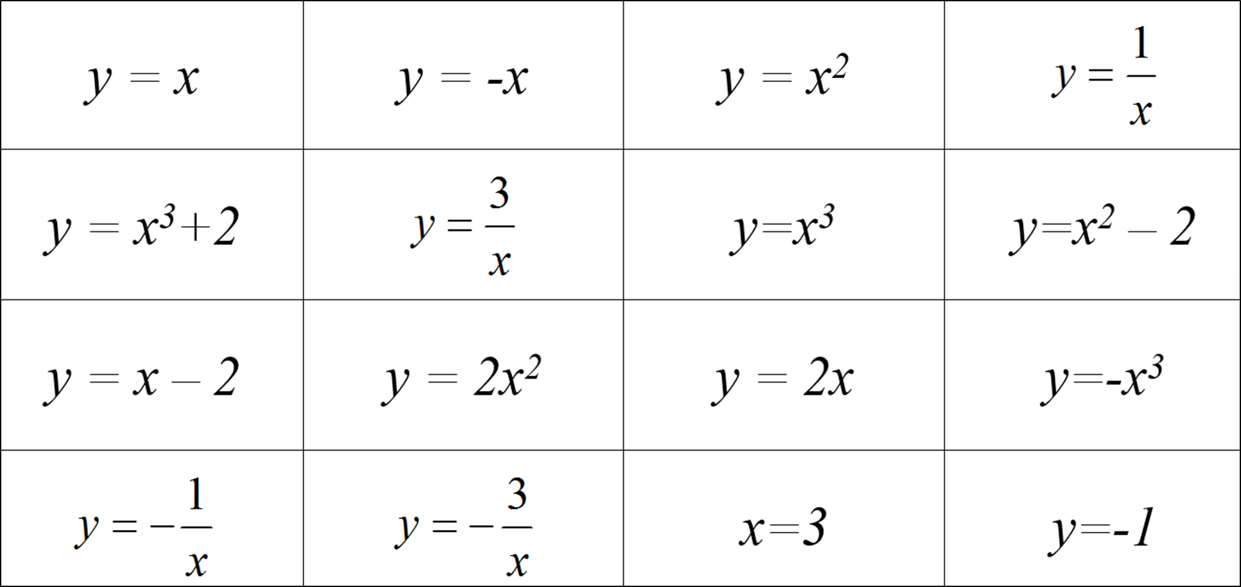
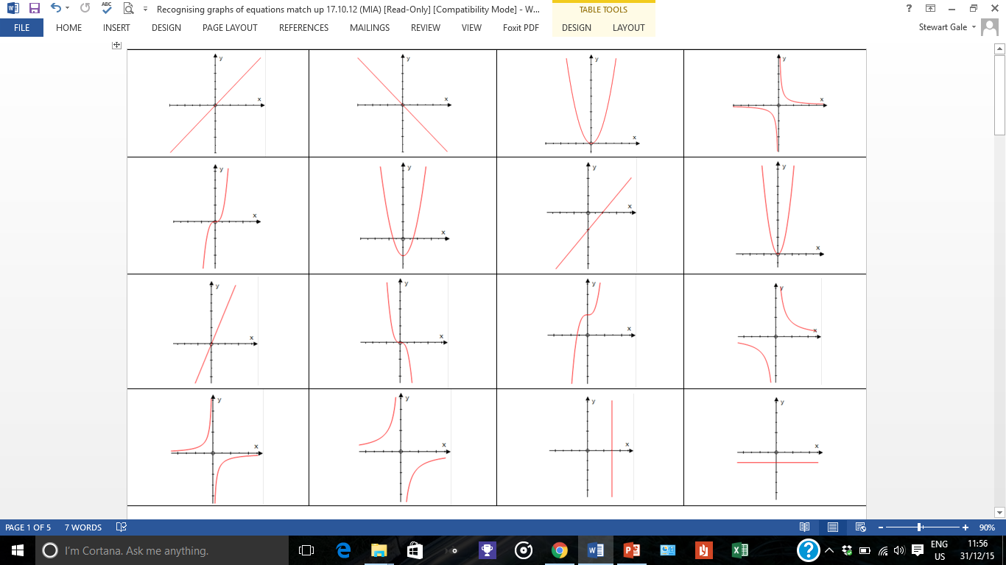
A
B
C
D
E
F
G
H
I
J
K
L
M
N
O
P
y= -x³

Slide 2
ANSWERS

Slide 3
A
B
C
D
E
F
G
H
y = x³
I
J
y=-x³
K
L
M
N
O
P

