Slide 1
FM: 2nd Derivative

Slide 2
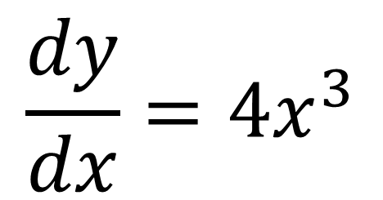
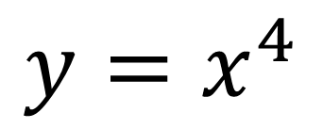
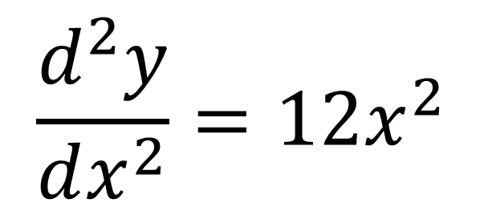
$$y=x^{4}$$
$$\frac{dy}{dx}=4x^{3}$$
First Derivative
$$\frac{d^{2}y}{dx^{2}}=12x^{2}$$
Second Derivative

Slide 3
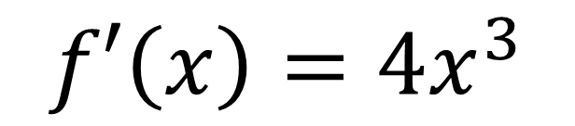
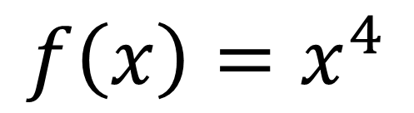
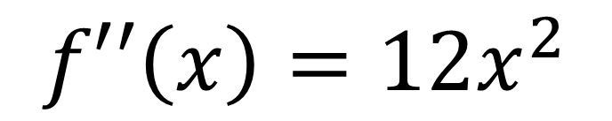
$$f\left(x\right)=x^{4}$$
$$f′\left(x\right)=4x^{3}$$
First Derivative
$$f′′\left(x\right)=12x^{2}$$
Second Derivative

Slide 4
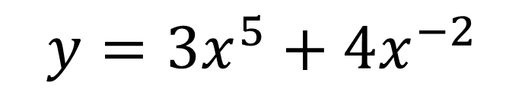
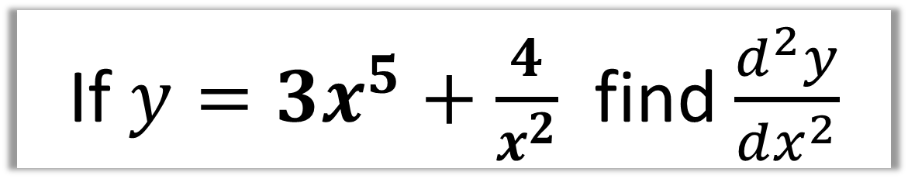
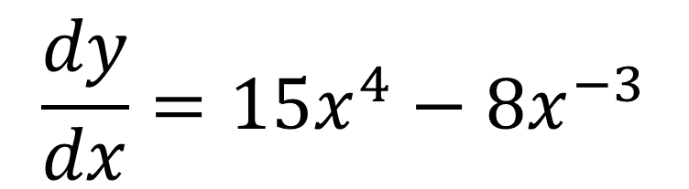
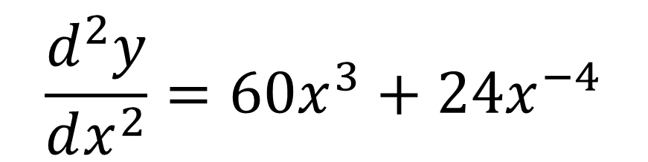
If $y=3x^{5}+\frac{4}{x^{2}}$ find $\frac{d^{2}y}{dx^{2}}$
$$y=3x^{5}+4x^{−2}$$
$$\frac{dy}{dx}=15x^{4}−8x^{−3}$$
$$\frac{d^{2}y}{dx^{2}}=60x^{3}+24x^{−4}$$

Slide 5
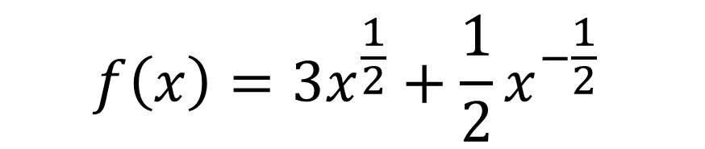
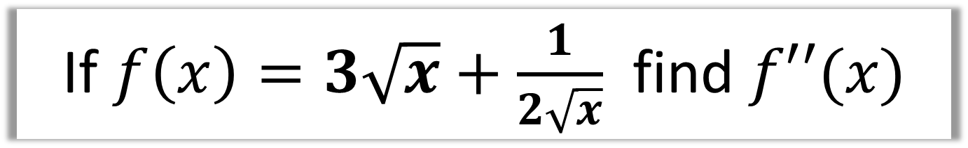
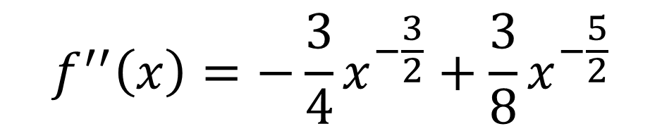
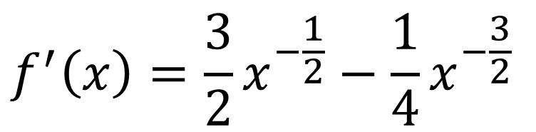
If $f\left(x\right)=3\sqrt{x}+\frac{1}{2\sqrt{x}}$ find $f′′(x)$
$$f\left(x\right)=3x^{\frac{1}{2}}+\frac{1}{2}x^{−\frac{1}{2}}$$
$$f^{′}\left(x\right)=\frac{3}{2}x^{−\frac{1}{2}}−\frac{1}{4}x^{−\frac{3}{2}}$$
$$f^{′′}\left(x\right)=−\frac{3}{4}x^{−\frac{3}{2}}+\frac{3}{8}x^{−\frac{5}{2}}$$

