Slide 1
FM: Fractional and Negative Indices

Slide 2
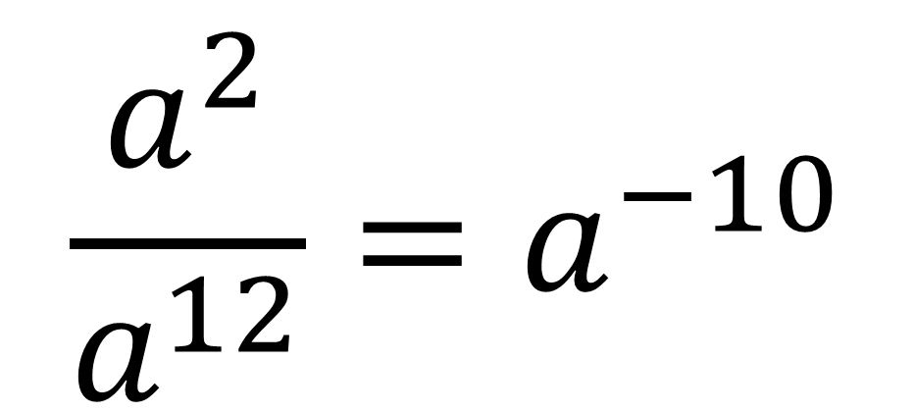

Write $\frac{a^{\frac{1}{2}}×a^{\frac{3}{2}}}{{\left(a^{3}\right)}^{4}}$ as a single power of $a$.
$$\frac{a^{2}}{a^{12}}=a^{−10}$$

Slide 3
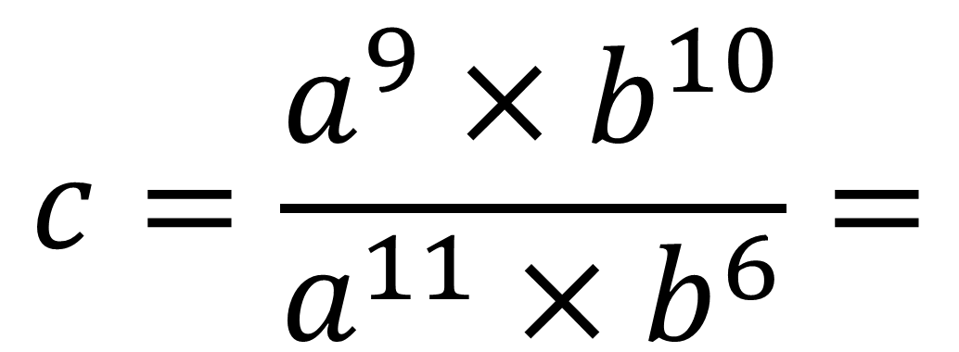
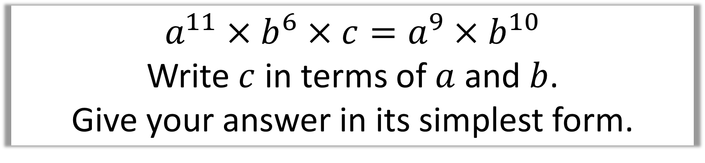
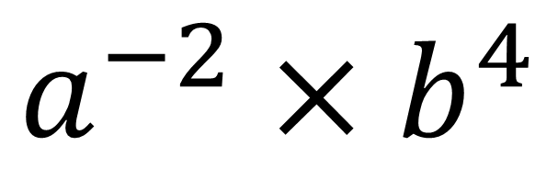
$$a^{11}×b^{6}×c=a^{9}×b^{10}$$
Write $c$ in terms of $a$ and $b$.
Give your answer in its simplest form.
$$c=\frac{a^{9}×b^{10}}{a^{11}×b^{6}}=$$
$$a^{−2}×b^{4}$$

Slide 4
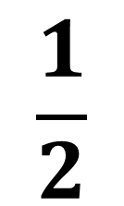

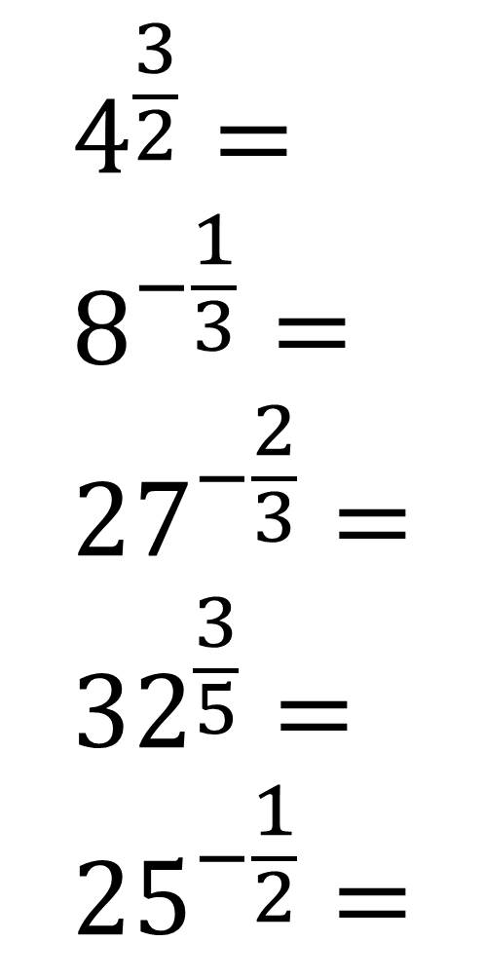
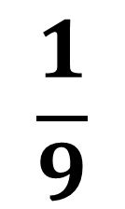




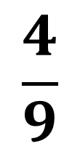
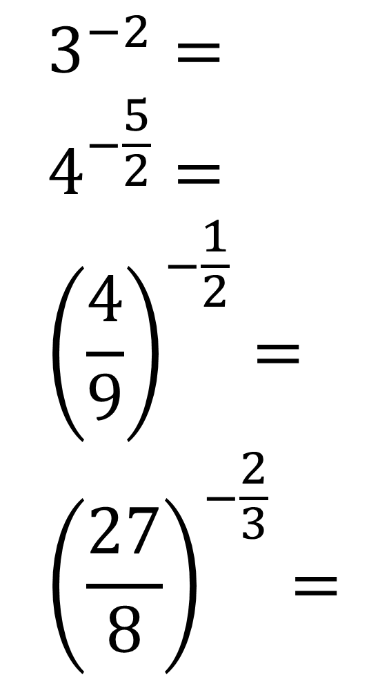

$$4^{\frac{3}{2}}= \\ 8^{−\frac{1}{3}}= \\ {27}^{−\frac{2}{3}}= \\ {32}^{\frac{3}{5}}= \\ {25}^{−\frac{1}{2}}=$$
$$\frac{1}{9}$$
$$3^{−2}= \\ 4^{−\frac{5}{2}}= \\ {\left(\frac{4}{9}\right)}^{−\frac{1}{2}}= \\ {\left(\frac{27}{8}\right)}^{−\frac{2}{3}}=$$
$$8$$
$$\frac{1}{32}$$
$$\frac{1}{2}$$
$$\frac{1}{9}$$
$$\frac{3}{2}$$
$$8$$
$$\frac{4}{9}$$
$$\frac{1}{5}$$

Slide 5
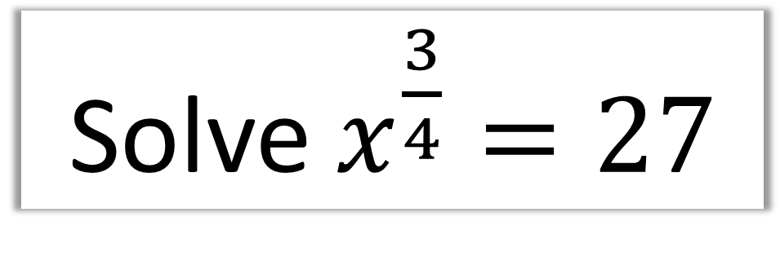
Solve $x^{\frac{3}{4}}=27$
Find the 4th root then cube it.
Cube root of 27 is 3
3 to the power of 4 is 81

Slide 6
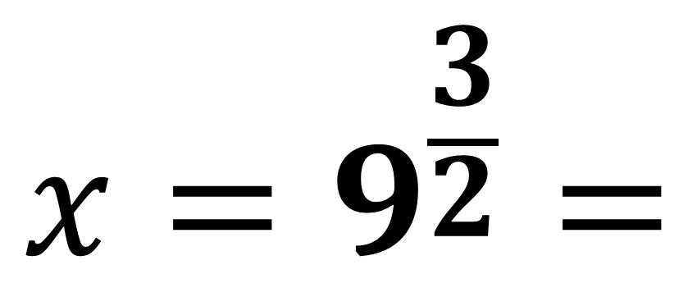
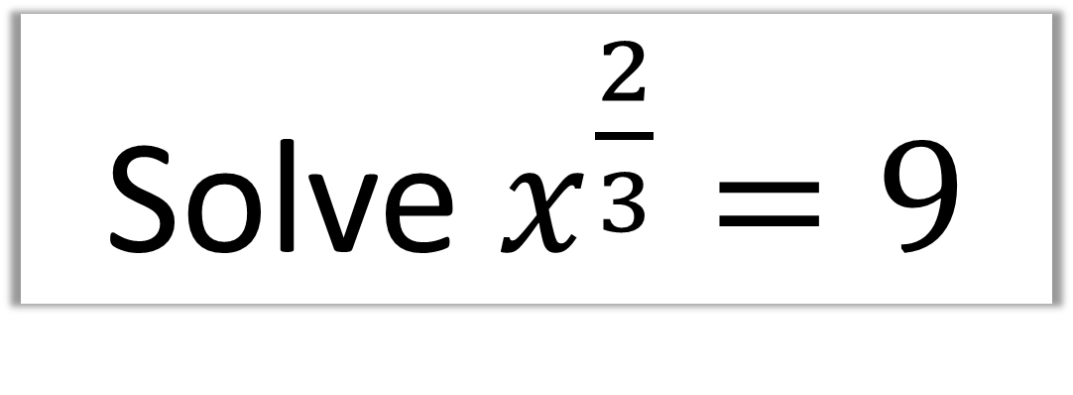
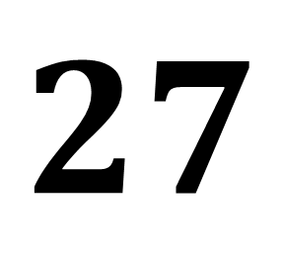
Solve $x^{\frac{2}{3}}=9$
$$x=9^{\frac{3}{2}}=$$
$$27$$

Slide 7
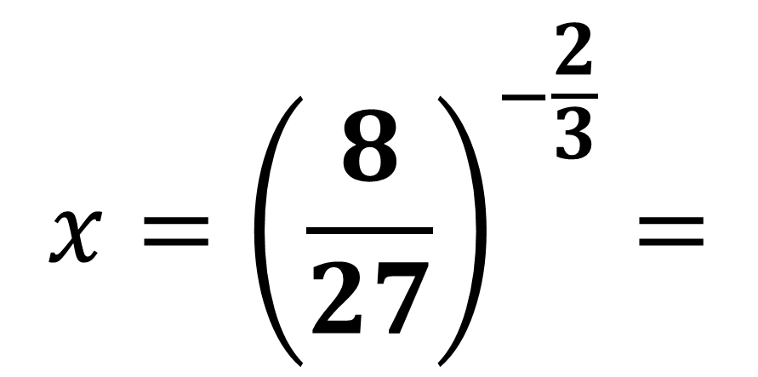
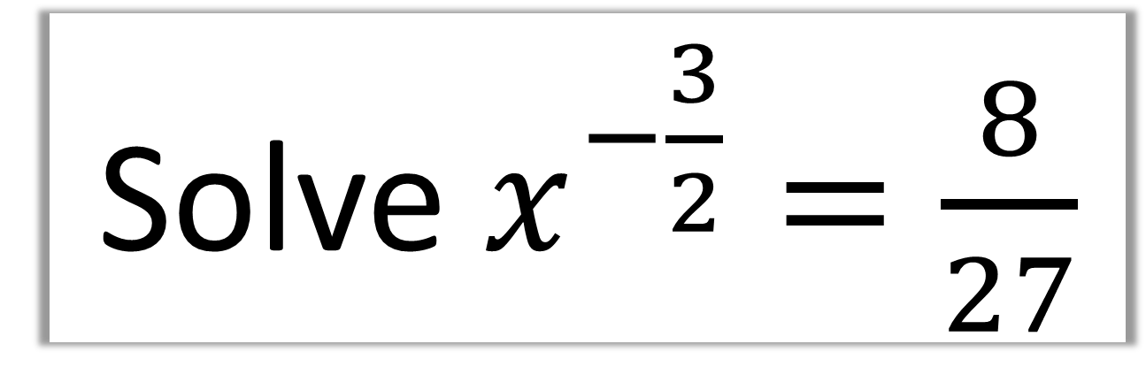
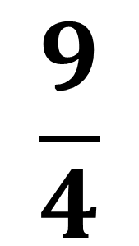
Solve $x^{−\frac{3}{2}}=\frac{8}{27}$
$$x={\left(\frac{8}{27}\right)}^{−\frac{2}{3}}=$$
$$\frac{9}{4}$$

Slide 8

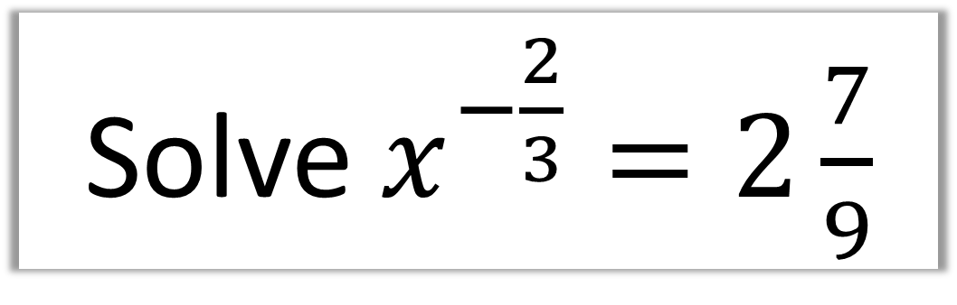
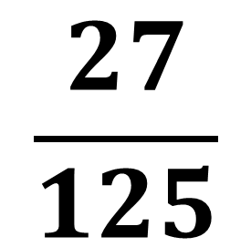
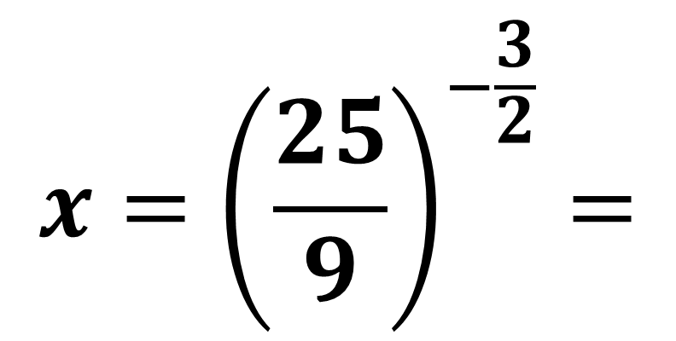
Solve $x^{−\frac{2}{3}}=2\frac{7}{9}$
$$x^{−\frac{2}{3}}=\frac{25}{9}$$
$$x={\left(\frac{25}{9}\right)}^{−\frac{3}{2}}=$$
$$\frac{27}{125}$$

Slide 9
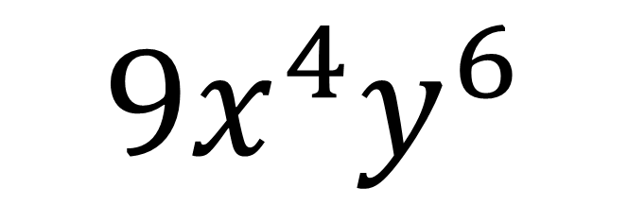
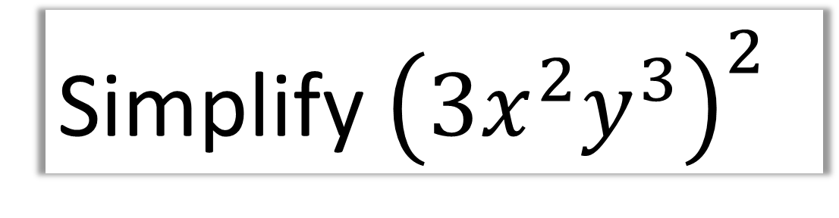
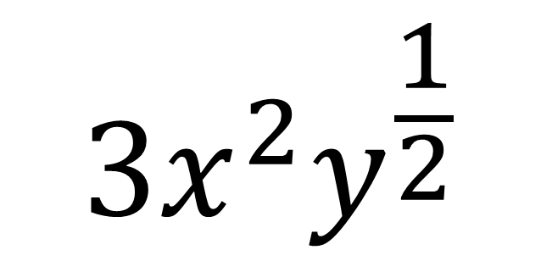
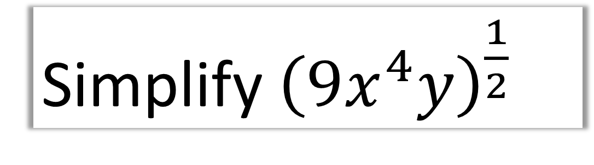
Simplify ${\left(3x^{2}y^{3}\right)}^{2}$
$$9x^{4}y^{6}$$
$$3x^{2}y^{\frac{1}{2}}$$
Simplify ${\left(9x^{4}y\right)}^{\frac{1}{2}}$

