Slide 1
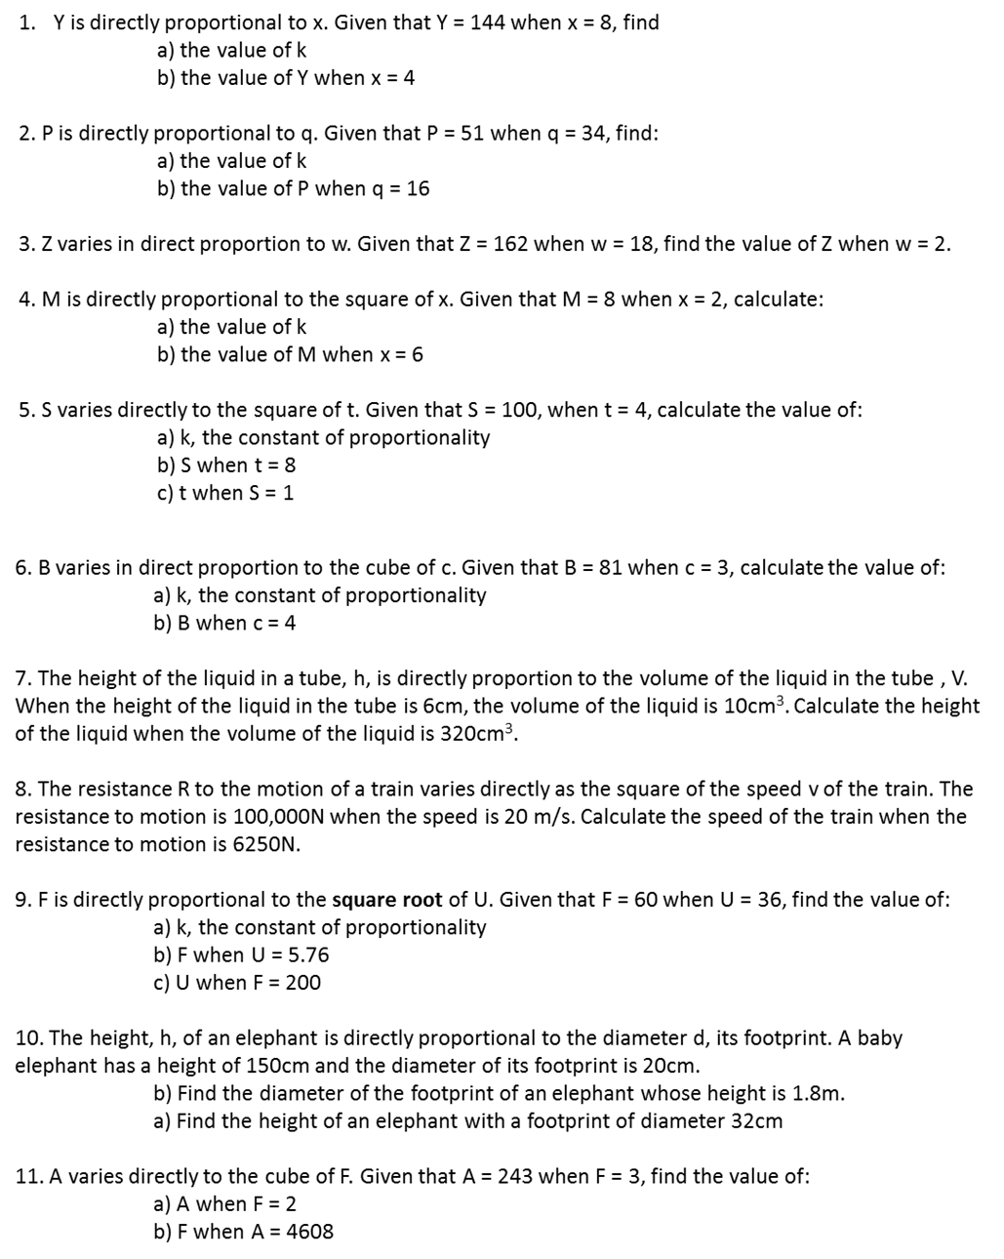

Slide 2
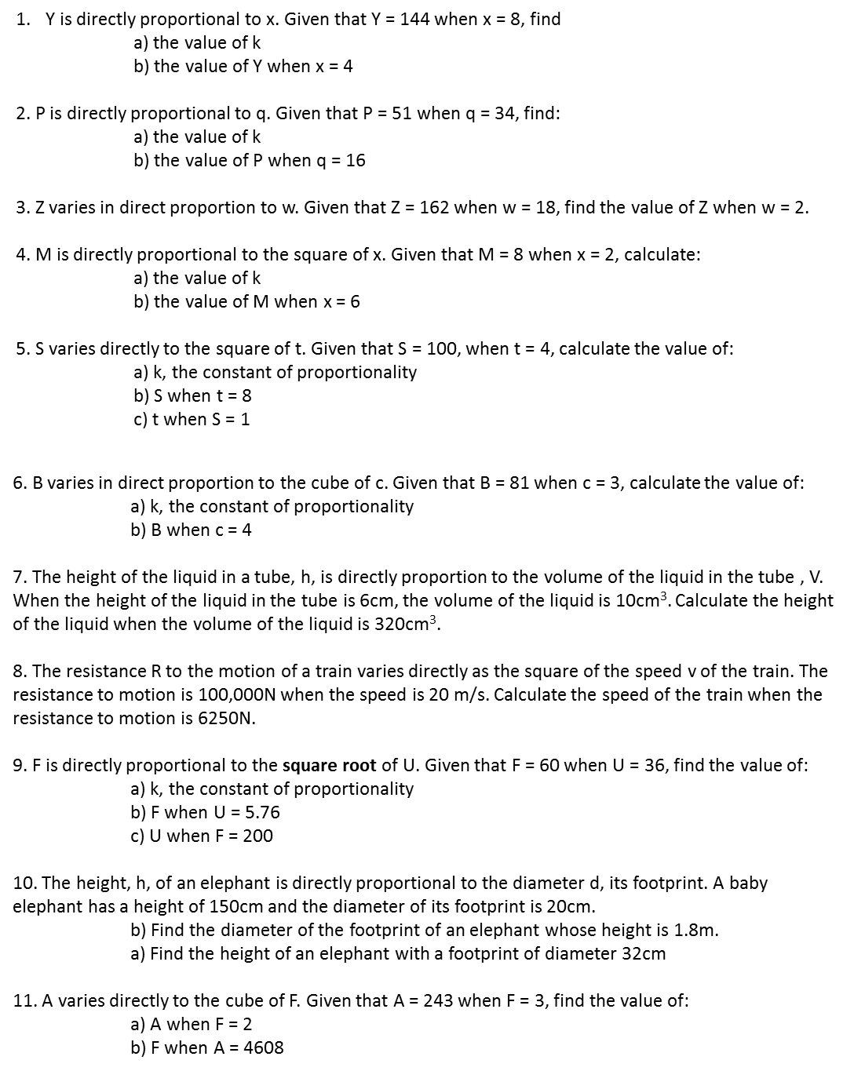

Slide 3
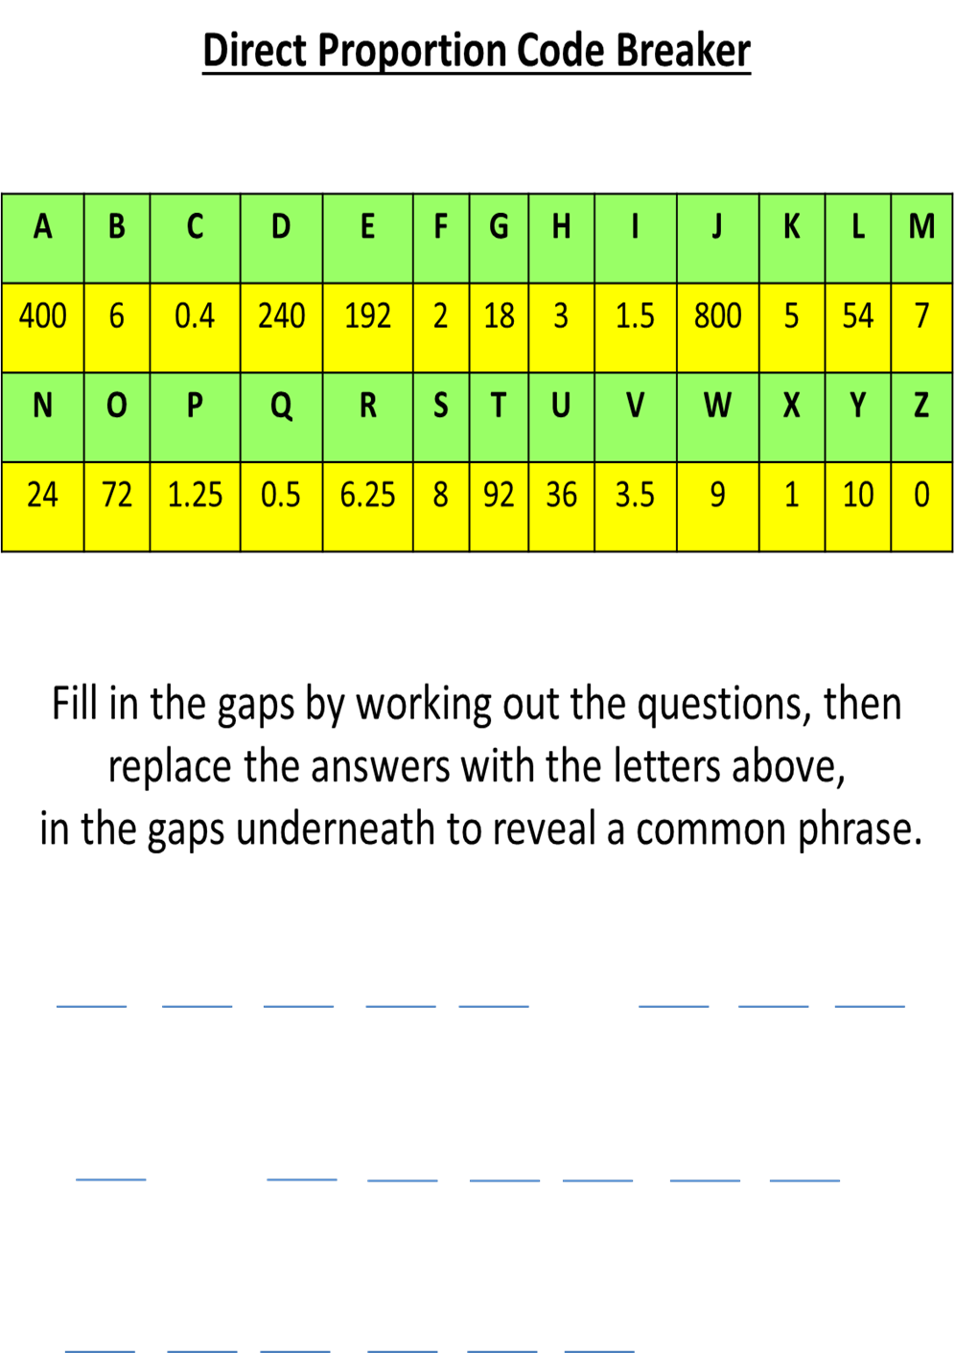

Slide 4
ANSWERS

Slide 5
18
72
1.5
24
18
2
72
6.25
400
0.4

Slide 6
3
192
192
5
10
24
400
24
240
6
8

Slide 7
G
O
I
N
G
F
O
R
A
C
H
E
E
K
Y
N
A
N
D
O
S

