Slide 1
LO: Parallel and
Perpendicular Lines

Slide 2
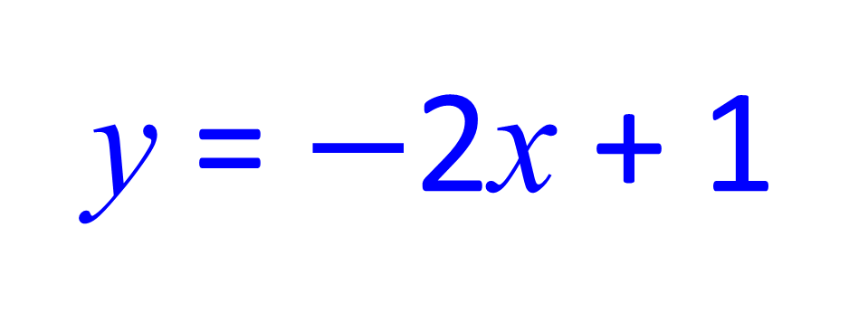
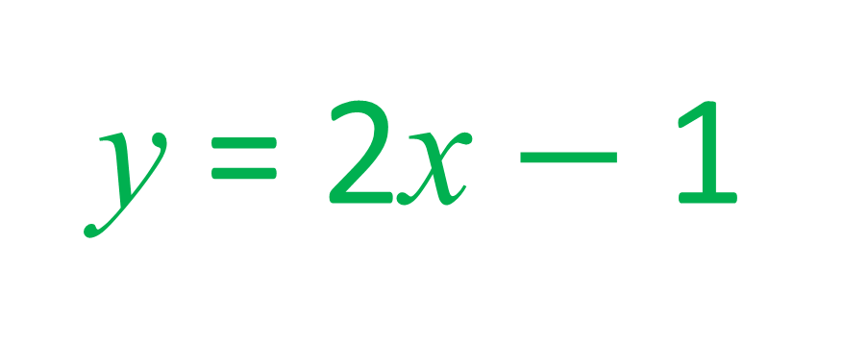
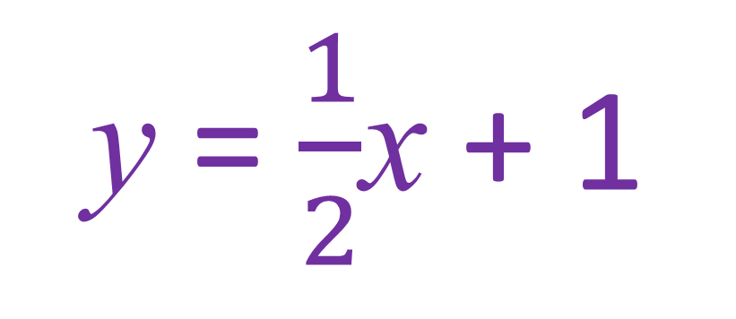
Which two equations are parallel?
y = 2x + 1
y = $−$2x + 1
y = 2x $−$ 1
y = $\frac{1}{2}$x + 1

Slide 3
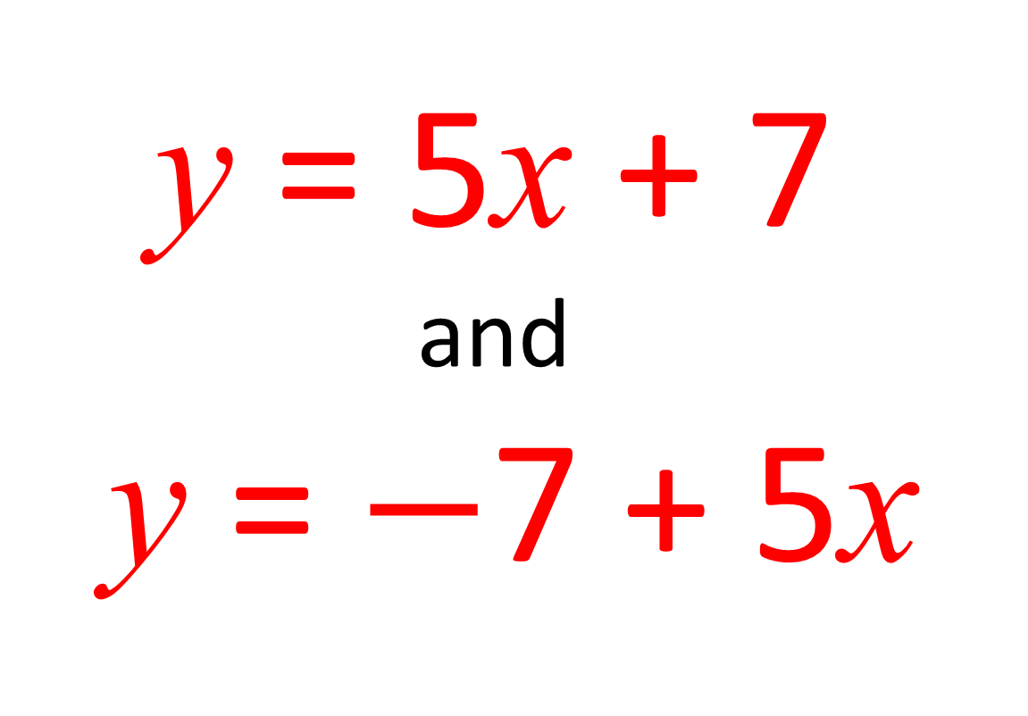
Parallel or Not?
y = 5x + 7
and
y = $−$7 + 5x
Parallel

Slide 4
Parallel or Not?
y = 3x + 2
and
y = 2 – 3x
Not

Slide 5
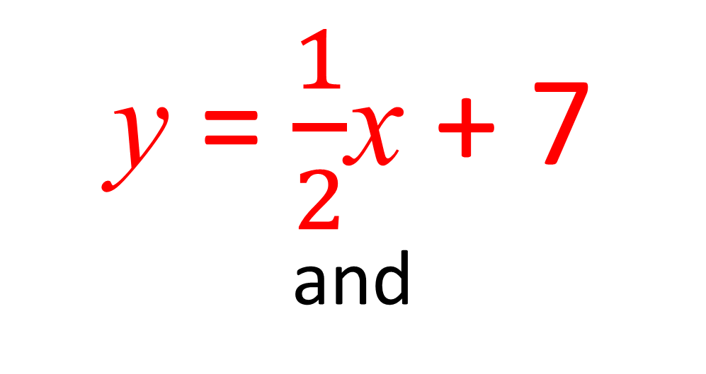
Parallel or Not?
y = $\frac{1}{2}$x + 7
and
y = 0.5x + 3
Parallel

Slide 6
Parallel or Not?
y = 2x + 3
and
2y = 4x + 8
Parallel

Slide 7
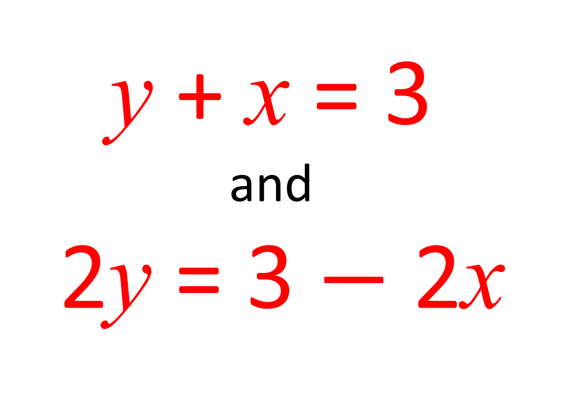
Parallel or Not?
y + x = 3
and
2y = 3 $−$ 2x
Parallel

Slide 8
Which two line are perpendicular?
y
5
4
3
2
1
x
-5
-4
-3
-2
-1
1
2
3
4
5
-1
-2
-3
-4
-5

Slide 9
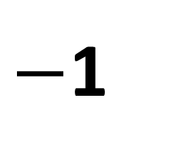
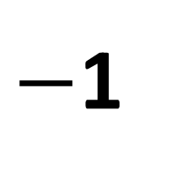
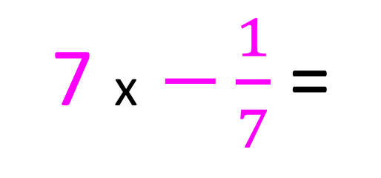
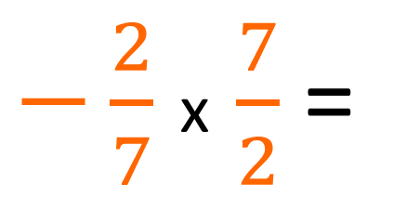
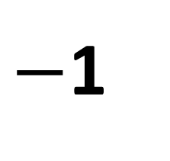
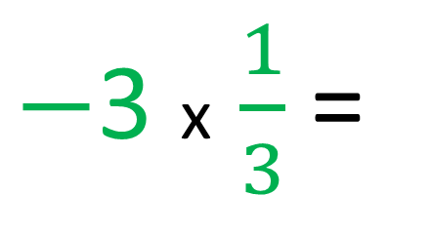
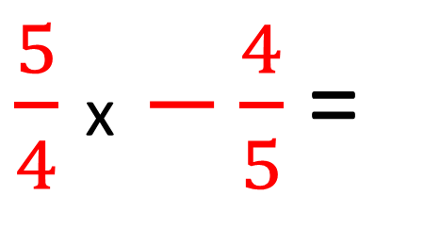
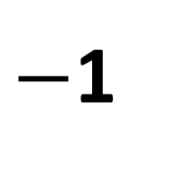
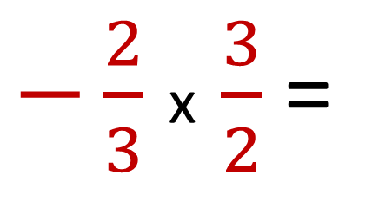
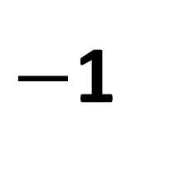
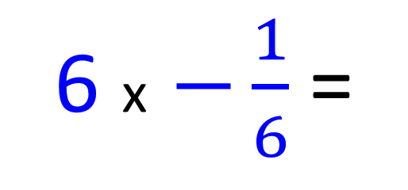
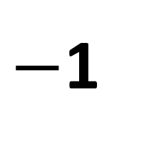
$−$3 x $\frac{1}{3}$ =
$−\frac{2}{3}$ x $\frac{3}{2}$ =
$−$1
$−$1
7 x $−\frac{1}{7}$ =
$\frac{5}{4}$ x $−\frac{4}{5}$ =
$−$1
$−$1
6 x $−\frac{1}{6}$ =
$−\frac{2}{7}$ x $\frac{7}{2}$ =
$−$1
$−$1

Slide 10
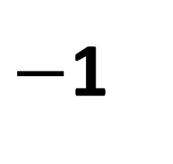
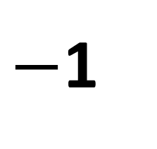

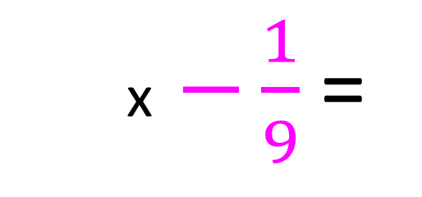
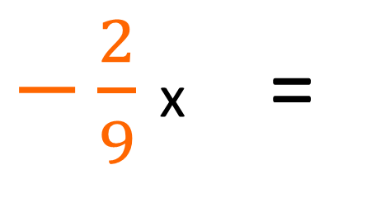
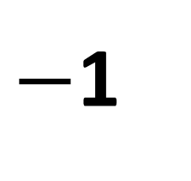

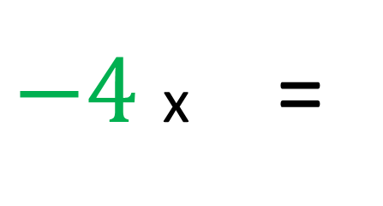

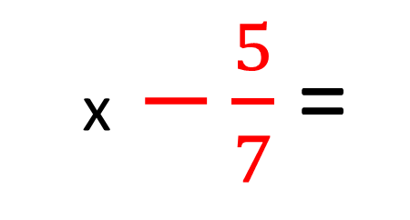
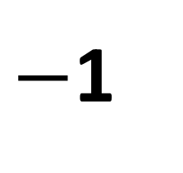
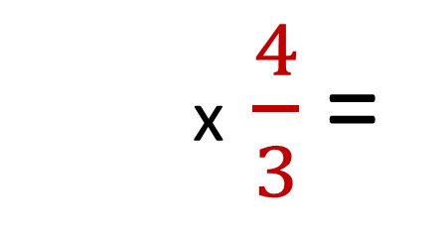

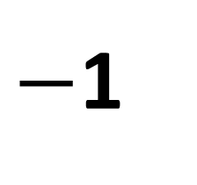
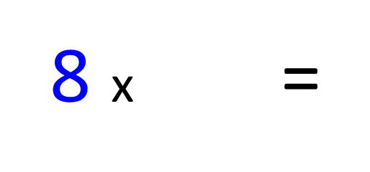
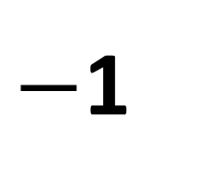

What are the missing numbers?
$−4$ x $\frac{1}{3}$ =
$$\frac{1}{4}$$
$−\frac{3}{4}$
$−\frac{2}{3}$ x $\frac{4}{3}$ =
$−$1
$−$1
7 x $−\frac{1}{9}$ =
$\frac{5}{4}$ x $−\frac{5}{7}$ =
9
$−$1
$$\frac{7}{5}$$
$−$1
$−\frac{2}{9}$ x $\frac{7}{2}$ =
8 x $−\frac{1}{6}$ =
$$\frac{9}{2}$$
$−\frac{1}{8}$
$−$1
$−$1

Slide 11
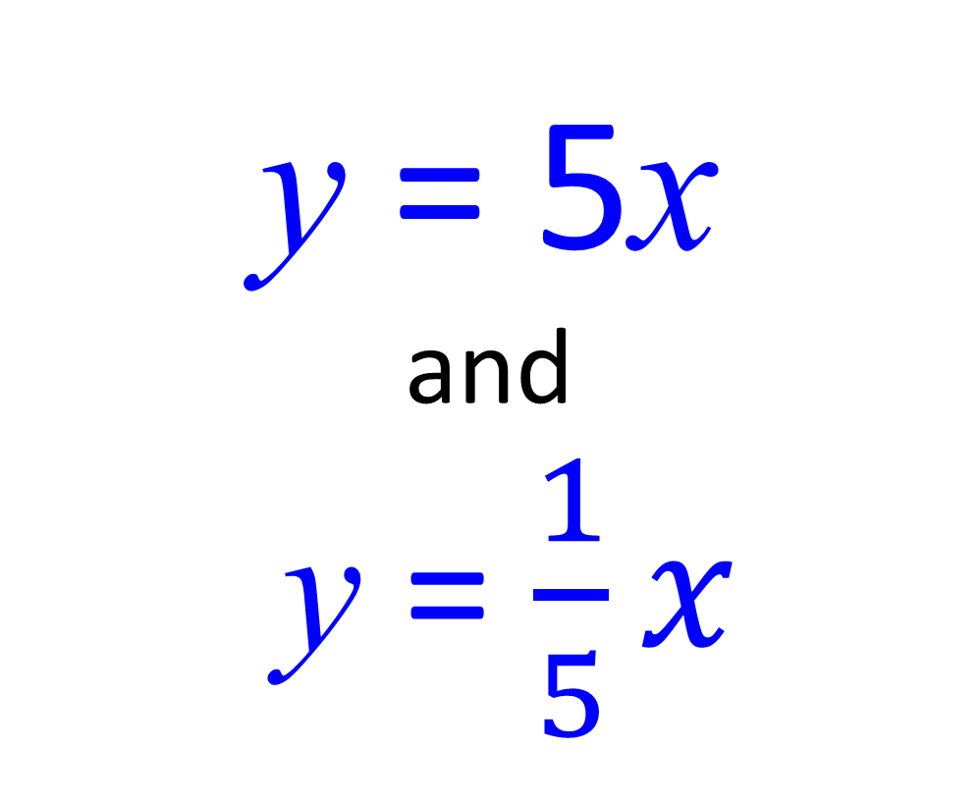
Perpendicular or Not?
y = 5x
and
y = $\frac{1}{5}x$
Not

Slide 12
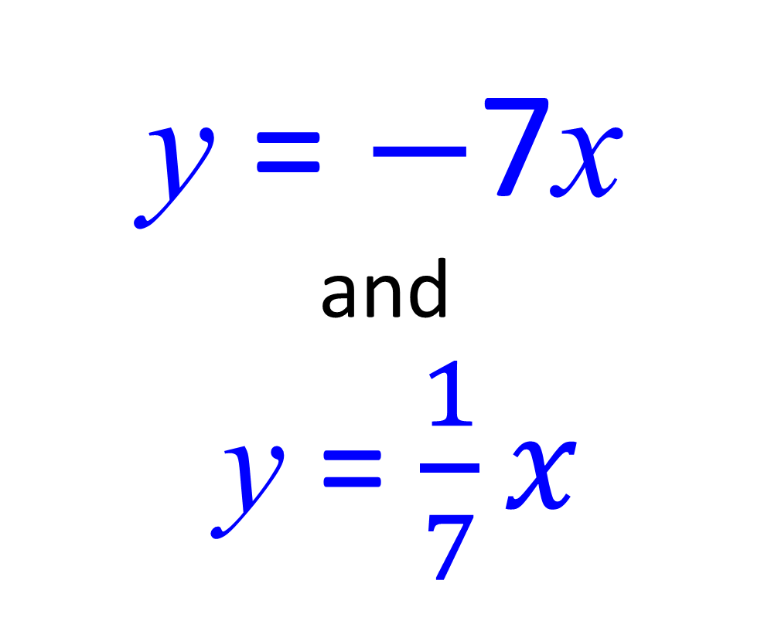
Perpendicular or Not?
y = $−$7x
and
y = $\frac{1}{7}x$
Perpendicular

Slide 13
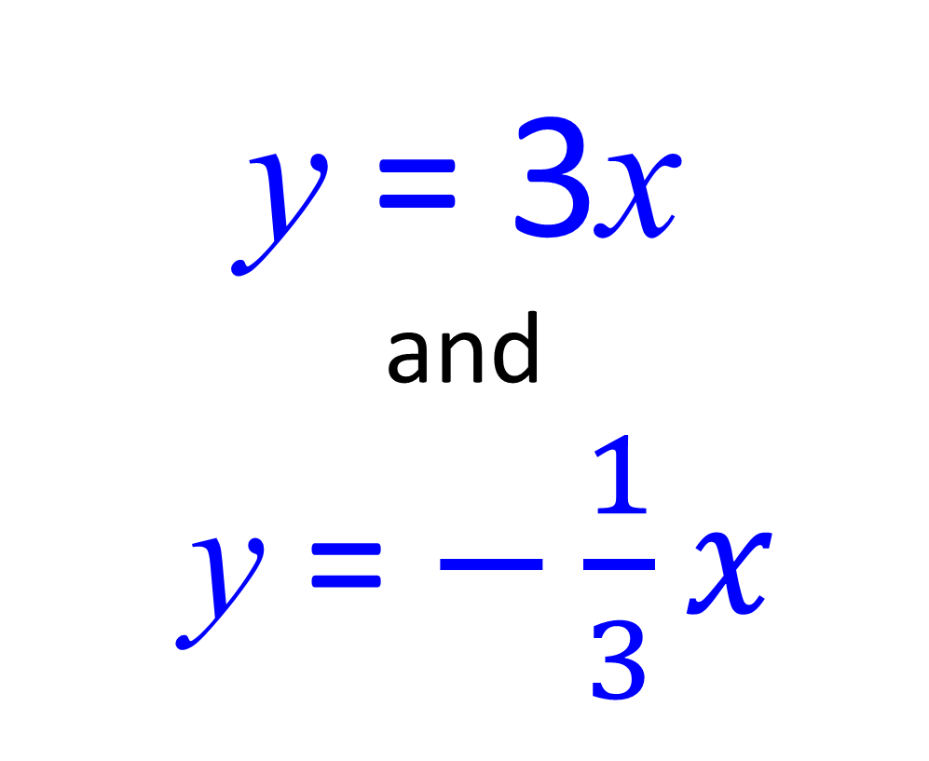
Perpendicular or Not?
y = 3x
and
y = $−\frac{1}{3}x$
Perpendicular

Slide 14
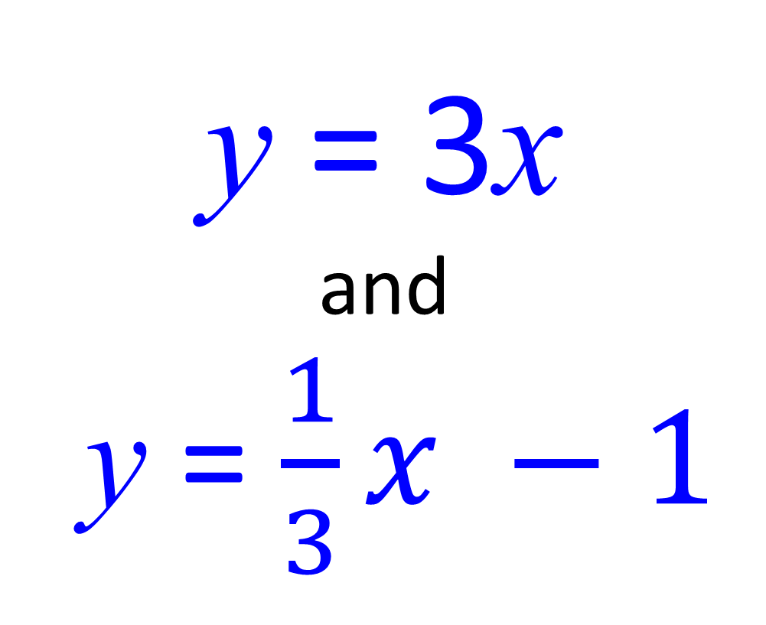
Perpendicular or Not?
y = 3x
and
y = $\frac{1}{3}x −1$
Not

Slide 15
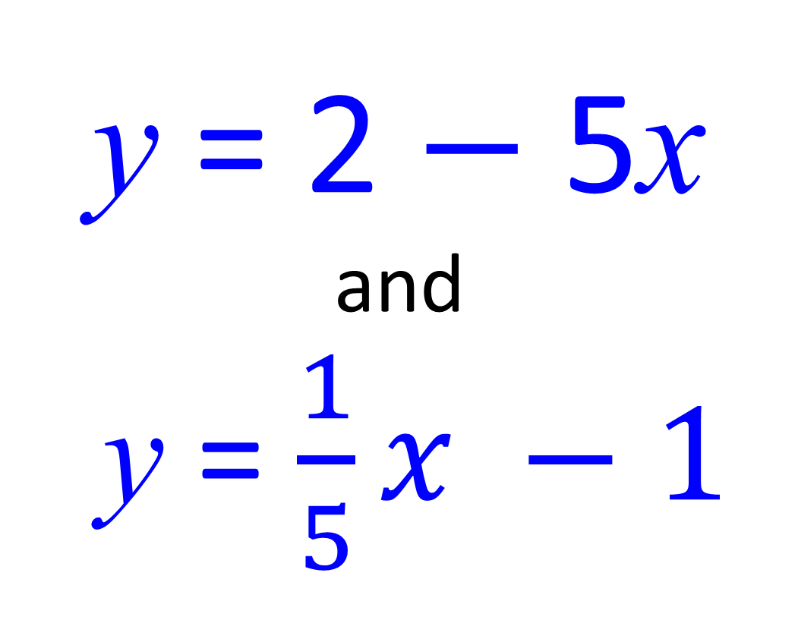
Perpendicular or Not?
y = 2 $−$ 5x
and
y = $\frac{1}{5}x −1$
Perpendicular

Slide 16
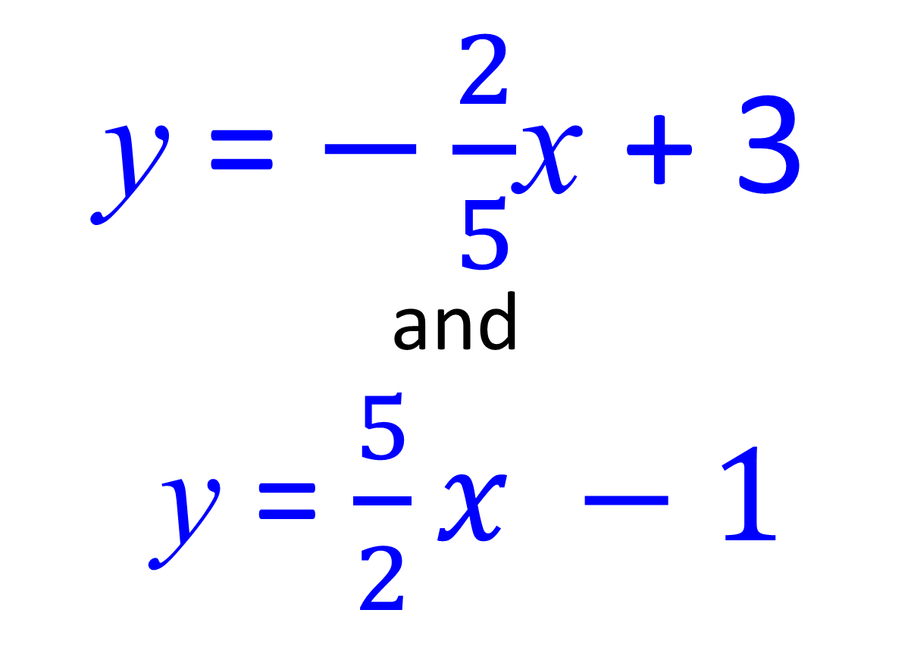
Perpendicular or Not?
y = $−\frac{2}{5}$x + 3
and
y = $\frac{5}{2}x −1$
Perpendicular

Slide 17
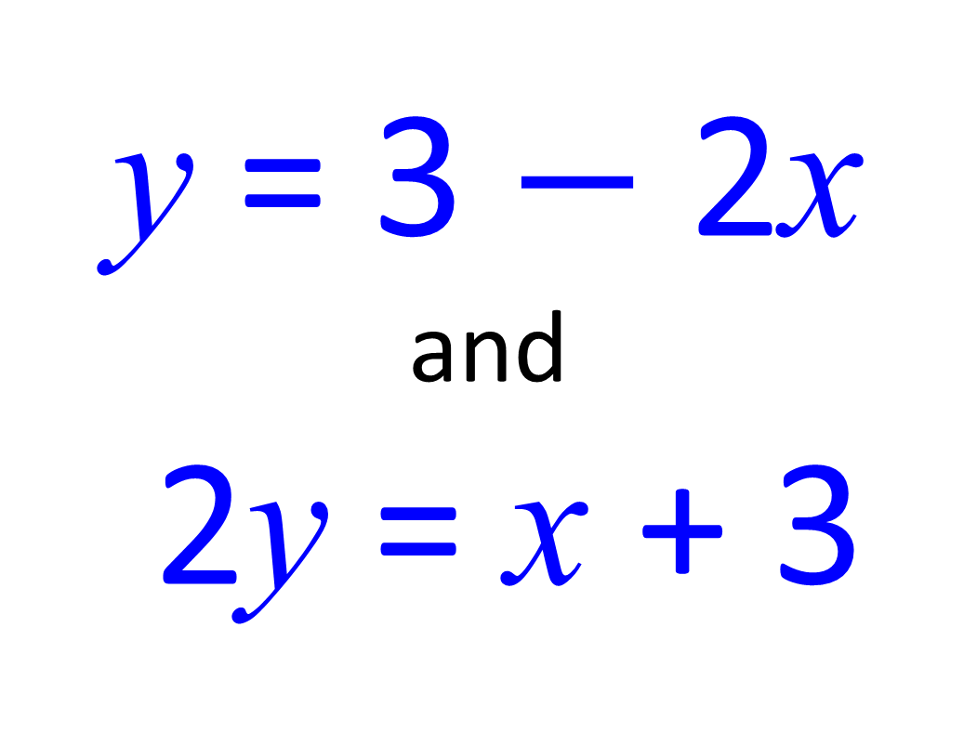
Perpendicular or Not?
y = 3 $−$ 2x
and
2y = x + 3
Perpendicular

Slide 18
Perpendicular or Not?
y + x = 3
and
2y = x + 3
Not

Slide 19
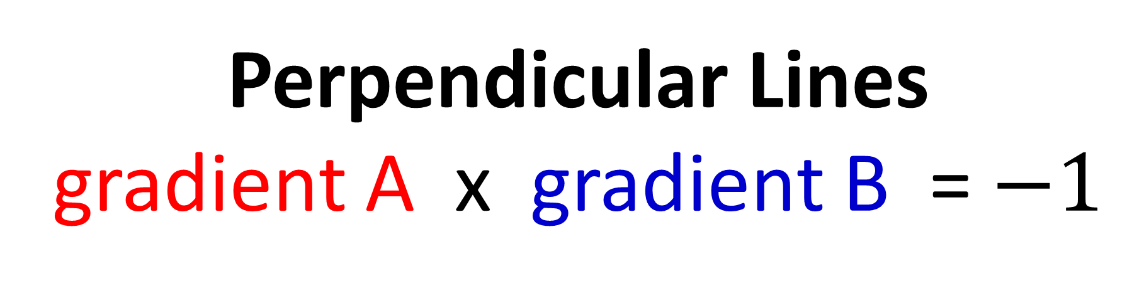
Parallel Lines
gradient A = gradient B
Perpendicular Lines
gradient A x gradient B = $−1$

