Slide 1
Measure of Location and Spread
Coding
Chapter 2
(Part 4 of 4)

Slide 2
The Jist of Coding
You want to find the mean and standard deviation of a set of data.
You transform the values of your data, using a rule,
to make them more user friendly.
You can then easily calculate the mean and standard deviation
of the ‘coded’ data.
Then determine what the mean and standard deviation
would have been for the original uncoded data.

Slide 3
Original Data (x)
£1000 £2000 £3000 £4000 £5000
Coding (÷1000)
Coded Data (y)
£1 £2 £3 £4 £5

Slide 4
What would happen to the mean if you increase every piece of data by 0.5?
1.1 | 1.4 | 1.2 | 1.5 | 1.3 | Mean = 1.3
+0.5 | +0.5 | +0.5 | +0.5 | +0.5
1.6 | 1.9 | 1.7 | 2.0 | 1.8
Mean = 1.8
The mean would increase by 0.5

Slide 5
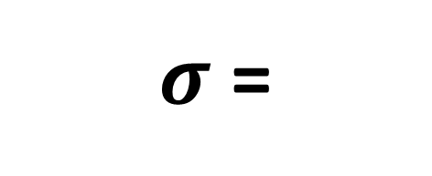
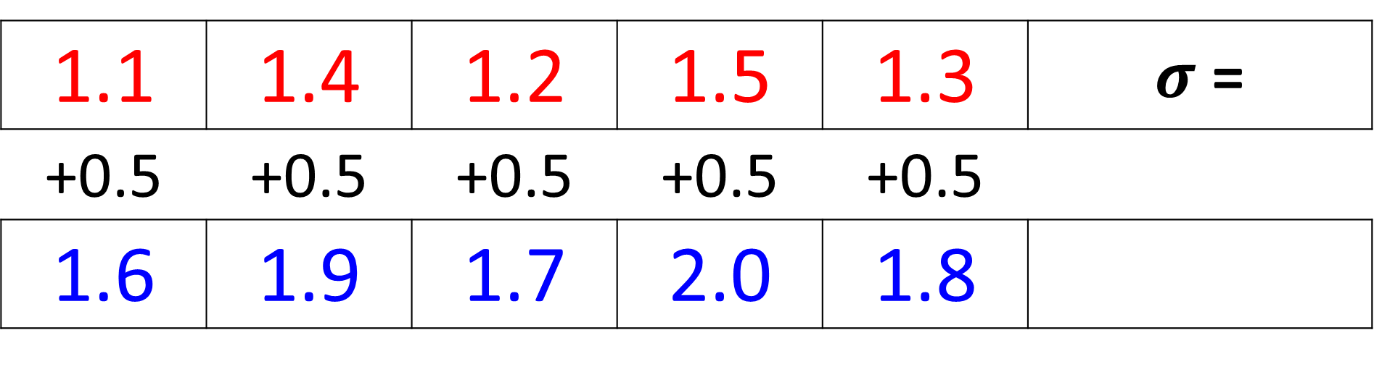
What would happen to the
standard deviation if you
increase every piece of data by 0.5?
1.1 | 1.4 | 1.2 | 1.5 | 1.3 | $σ$ =
+0.5 | +0.5 | +0.5 | +0.5 | +0.5
1.6 | 1.9 | 1.7 | 2.0 | 1.8
$σ$ =
The standard deviation would be the same.

Slide 6
What would happen to the mean if you multiply every piece of data by 3?
1.1 | 1.4 | 1.2 | 1.5 | 1.3 | Mean = 1.3
x 3 | x 3 | x 3 | x 3 | x 3
3.3 | 4.2 | 3.6 | 4.5 | 3.9
Mean = 3.9
The mean would become 3 times bigger.

Slide 7
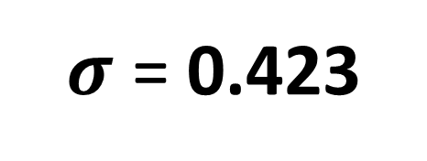
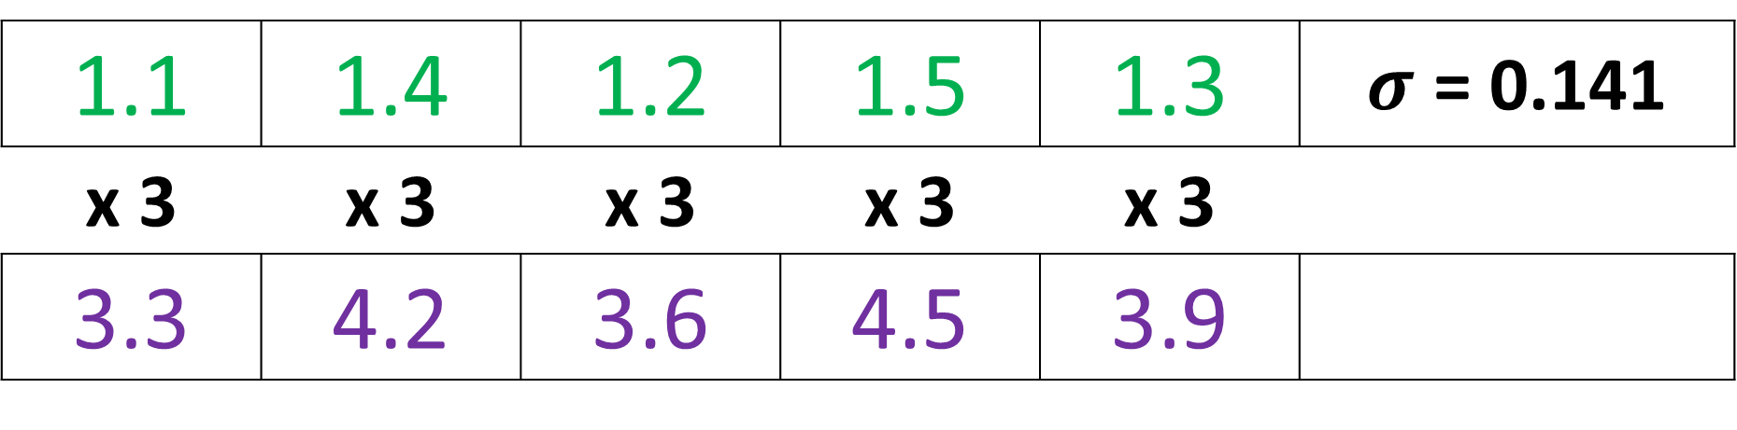
What would happen to the
standard deviation if you
multiplied every piece of data by 3?
1.1 | 1.4 | 1.2 | 1.5 | 1.3 | $σ$ = 0.141
x 3 | x 3 | x 3 | x 3 | x 3
3.3 | 4.2 | 3.6 | 4.5 | 3.9
$σ$ = 0.423
The standard deviation would become 3 times bigger.

Slide 8
Coding effects on
Mean and Standard Deviation
Mean is effect by multipliers, dividers, addition and subtraction.
Standard Deviation is only effect by
multipliers and dividers.

Slide 9
Coding | Mean | Standard Deviation
Add 10
Subtract 10
Multiply by 3
Divide by 3
Multiply by 2 and subtract 5
Increase by 10
Stay’s the same
Subtract 10
Stay’s the same
3 times bigger
3 times bigger
3 times smaller
3 times smaller
Double and decrease by 5
Double

Slide 10

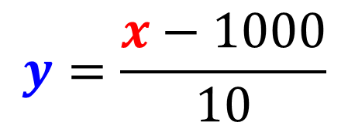
Original Data (x)
£1010 £1020 £1030 £1040 £1050
$$y=\frac{x−1000}{10}$$
$$x=10y+1000$$
Coded Data (y)
£1 £2 £3 £4 £5

Slide 11

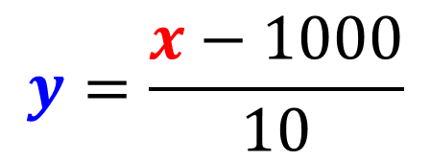
Mean =
3 x 10 + 1000 = 1030
Original Data (x)
£1010 £1020 £1030 £1040 £1050
$$y=\frac{x−1000}{10}$$
$$x=10y+1000$$
Coded Data (y)
£1 £2 £3 £4 £5
Mean = 3

Slide 12
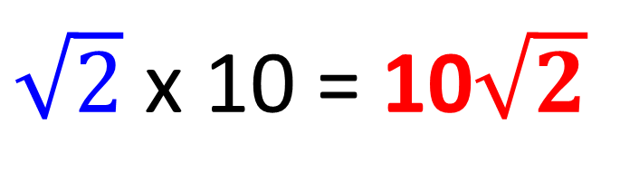
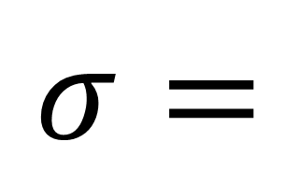

$σ=$
$\sqrt{2}$ x 10 = 10$\sqrt{2}$
Original Data (x)
£1010 £1020 £1030 £1040 £1050
$$y=\frac{x−1000}{10}$$
$$x=10y+1000$$
Coded Data (y)
£1 £2 £3 £4 £5
$$σ=\sqrt{2}$$

Slide 13
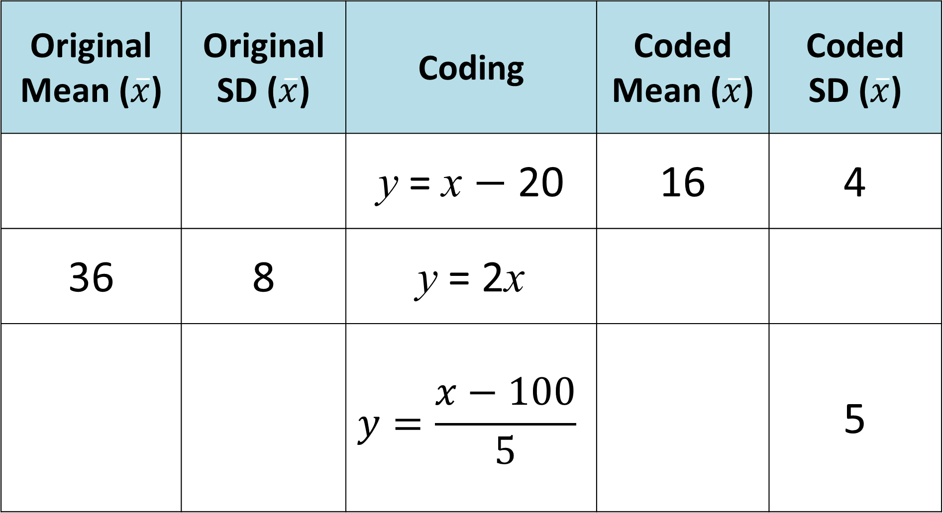
Original Mean ($\overline{x}$) | Original SD ($\overline{x}$) | Coding | Coded Mean ($\overline{x}$) | Coded SD ($\overline{x}$)
 |  | y = x $−$ 20 | 16 | 4
36 | 8 | y = 2x
 |  | $$y=\frac{x−100}{5}$$ |  | 5
36
4
72
16
300
25
40

