Slide 1
LO: Calculating
with Probability

Slide 2
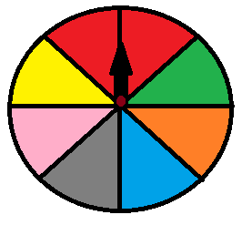
Choose the correct colour and win 1,000,000dhs!
Which colour would you pick?

Slide 3
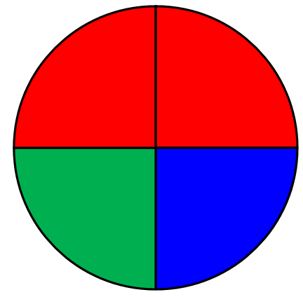
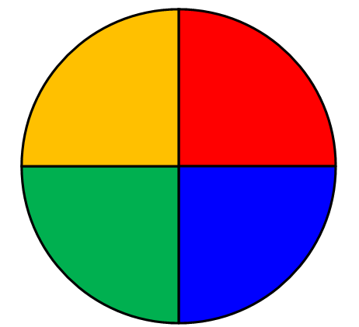
You want Red.
Which spinner would you choose?
Spinner A
Spinner B

Slide 4
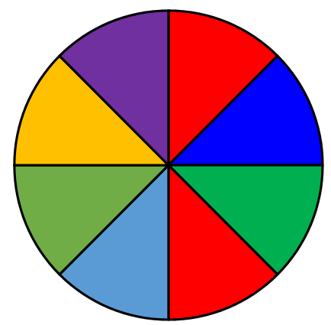
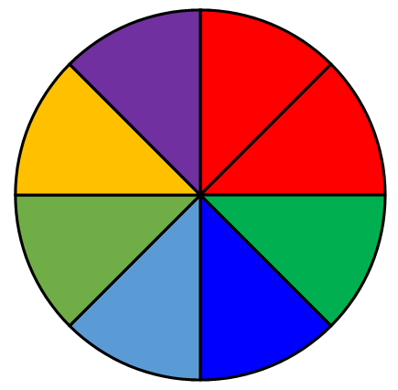
You want Red.
Which spinner would you choose?
Spinner A
Spinner B

Slide 5
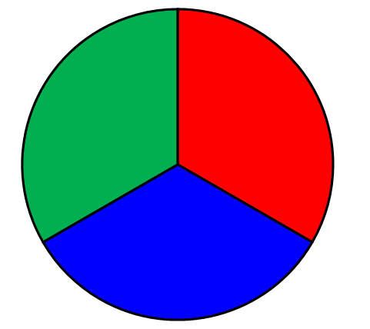
You want Red.
Which spinner would you choose?
Spinner A
Spinner B

Slide 6
Probability is the chance of
an event happening.
How would you describe
to someone the chance of
an event happening?

Slide 7
3 numerical ways
to describe probability:
Percentages
Decimals
Fractions

Slide 8
Probability or Not?
$$0.3$$
Probability

Slide 9
Probability or Not?
$$−0.3$$
Not

Slide 10
Probability or Not?
$$1.3$$
Not

Slide 11
Probability or Not?
$$0.00003$$
Probability

Slide 12
Probability or Not?
$$0$$
Probability

Slide 13
Probability or Not?
$$2$$
Not

Slide 14
Probability or Not?
$$\frac{2}{3}$$
Probability

Slide 15
Probability or Not?
$$−\frac{2}{3}$$
Not

Slide 16
Probability or Not?
$$1\frac{2}{3}$$
Not

Slide 17
Probability or Not?
$$92.5\%$$
Probability

Slide 18
Probability or Not?
$$103\%$$
Not

Slide 19
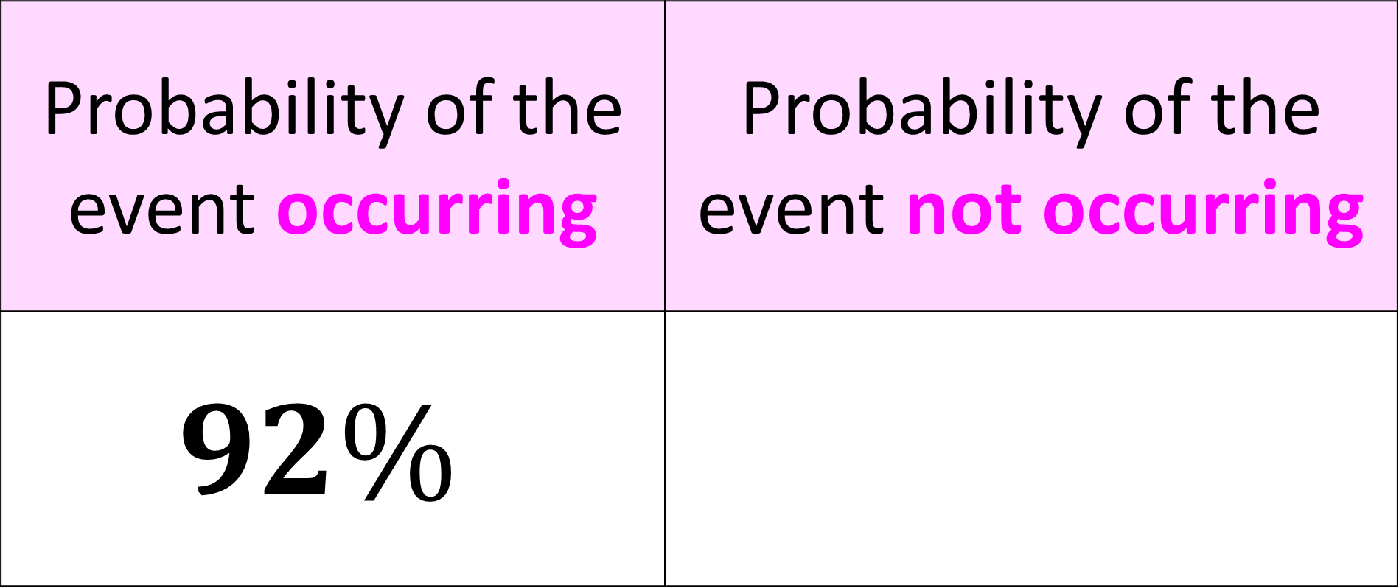

Probability of the event occurring | Probability of the event not occurring
$$92\%$$
$$8\%$$

Slide 20


Probability of the event occurring | Probability of the event not occurring
$$\frac{3}{5}$$
$$\frac{2}{5}$$

Slide 21


Probability of the event occurring | Probability of the event not occurring
$$0.65$$
$$0.35$$

Slide 22
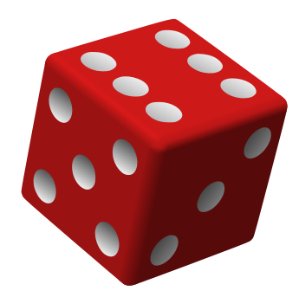
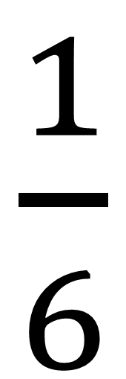
Probability Notation
Probability of rolling a 3 on a dice.
$\frac{1}{6}$
P(3) =

Slide 23
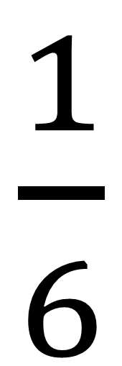
Probability of rolling
a 5 on a dice.
$\frac{1}{6}$
P(5) =

Slide 24
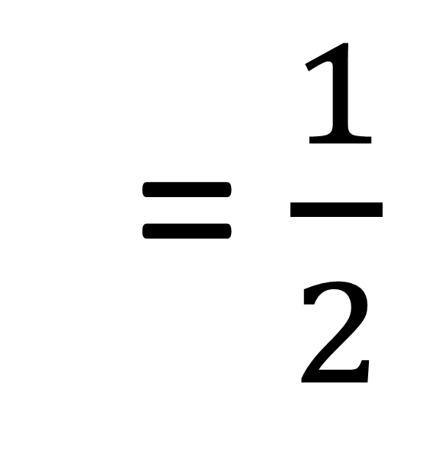
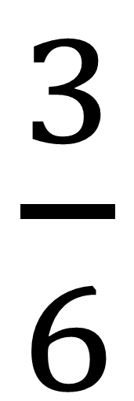
Probability of rolling
a even number on a dice.
$\frac{3}{6}$
= $\frac{1}{2}$
P(even) =

Slide 25
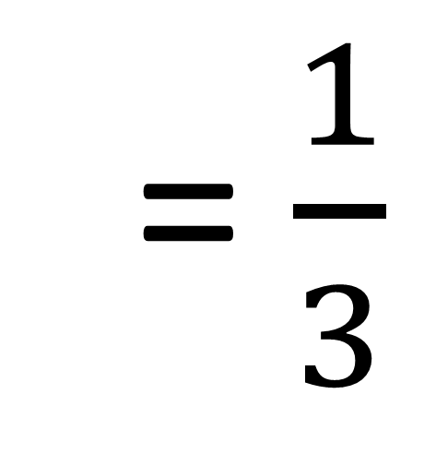
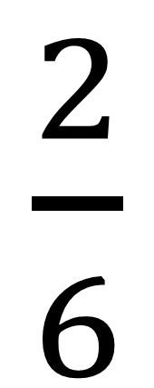
Probability of rolling
a number less than 3
on a dice.
$\frac{2}{6}$
= $\frac{1}{3}$
P(< 3) =

Slide 26
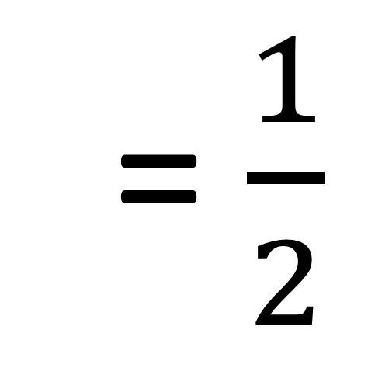
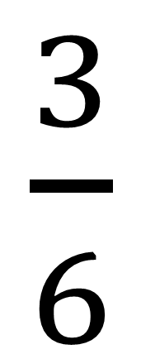
Probability of rolling
a prime number on a dice.
$\frac{3}{6}$
= $\frac{1}{2}$
P(prime) =

Slide 27
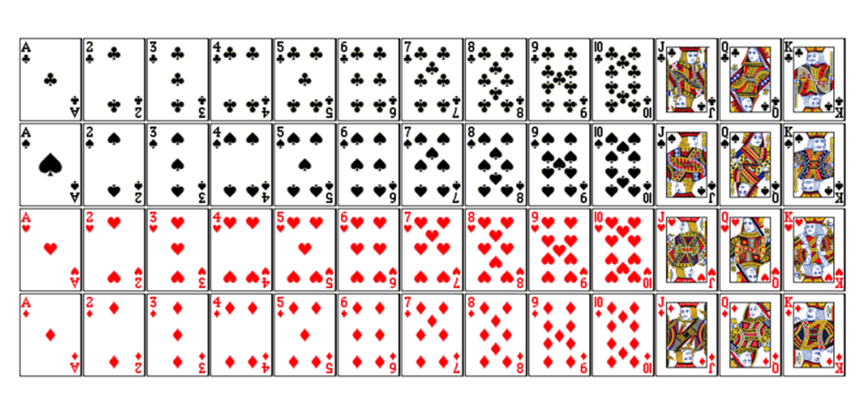
52 Playing Cards
13
Clubs
13
Spades
13
Hearts
13
Diamonds

Slide 28
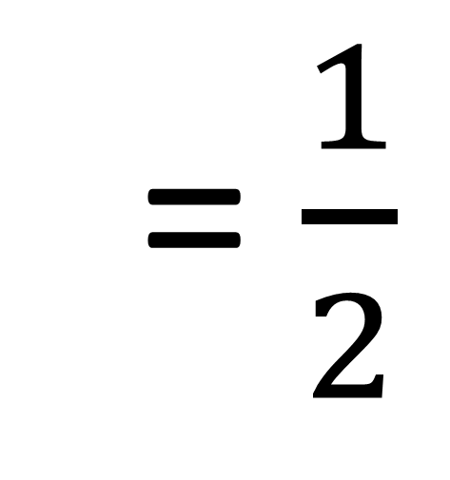
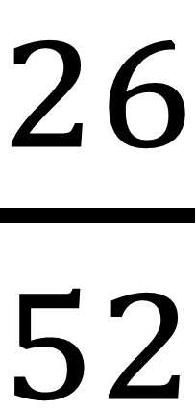
Probability of choosing
a red playing card.
$\frac{26}{52}$
= $\frac{1}{2}$
P(red) =

Slide 29
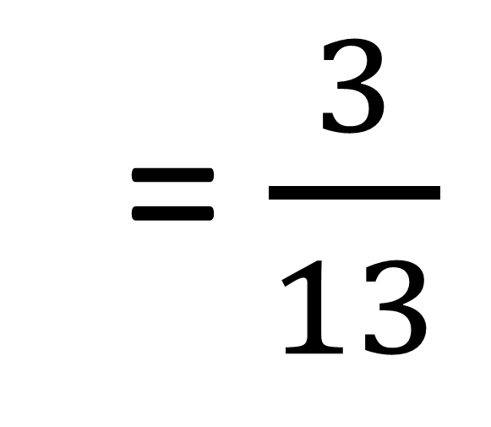
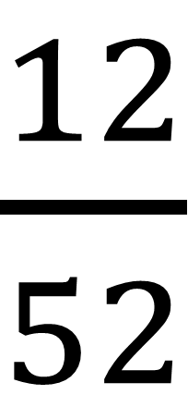
Probability of choosing
a picture playing card.
$\frac{12}{52}$
= $\frac{3}{13}$
P(picture) =

Slide 30
When calculating probability
you need to lookout for the word
OR

Slide 31
When you see the word OR
you can ADD the probabilities.
But only if the events cannot
happen at the same time.

Slide 32
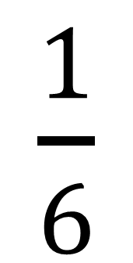
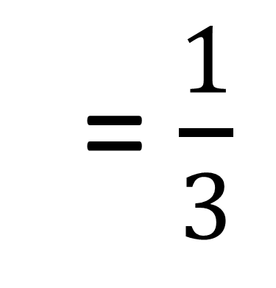
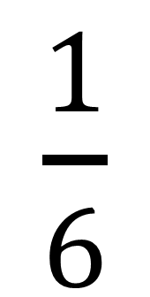
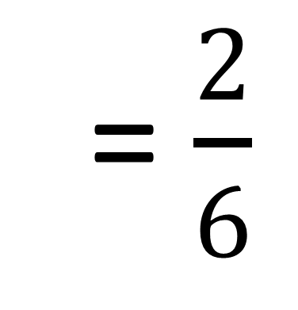
Probability of rolling
a 5 or 6 on a dice.
P(5 or 6) =
P(5) + P(6)
$\frac{1}{6}$
$\frac{1}{6}$
= $\frac{2}{6}$
= $\frac{1}{3}$
+

Slide 33
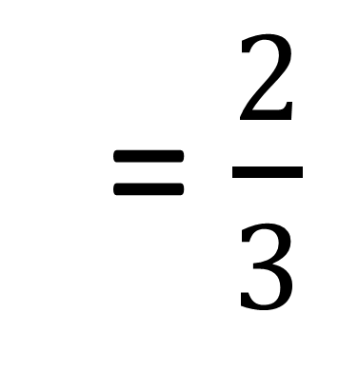
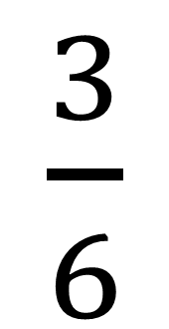
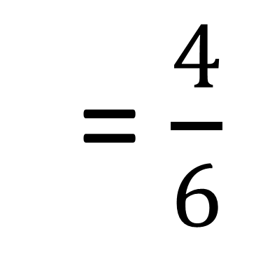
Probability of rolling
a 5 or an even on a dice.
P(5 or even) =
P(5) + P(even)
$\frac{1}{6}$
$\frac{3}{6}$
= $\frac{4}{6}$
= $\frac{2}{3}$
+

Slide 34
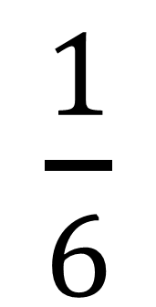
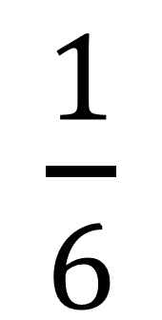
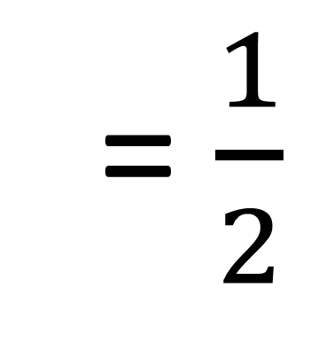
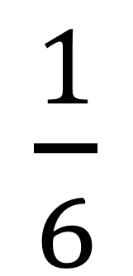
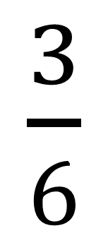
Probability of rolling
a 1, 2 or 5.
P(1 or 2 or 5) =
P(1) + P(2) + P(5)
$\frac{1}{6}$
$\frac{1}{6}$
$\frac{1}{6}$
$\frac{3}{6}$
= $\frac{1}{2}$
+
+
=

Slide 35
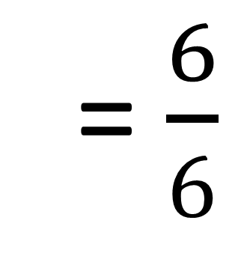
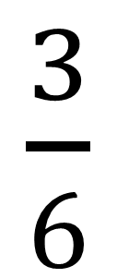
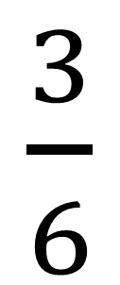
Probability of rolling
a prime number or
an odd number on a dice.
$\frac{3}{6}$
$\frac{3}{6}$
= $\frac{6}{6}$
P(prime or odd) =
+
?
You cannot add the probabilities as the events
can happen at the same time.

Slide 36
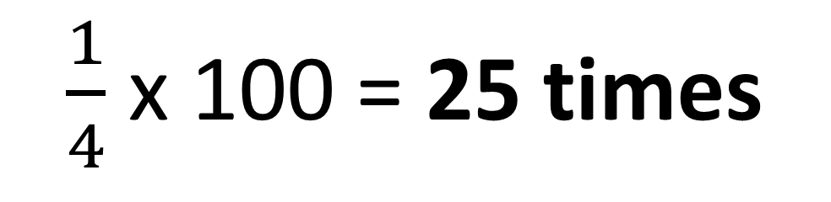
The spinner is spun 100 times.
How many times would you expect
the spinner to
land on blue?
$\frac{1}{4}$ x 100 = 25 times

Slide 37
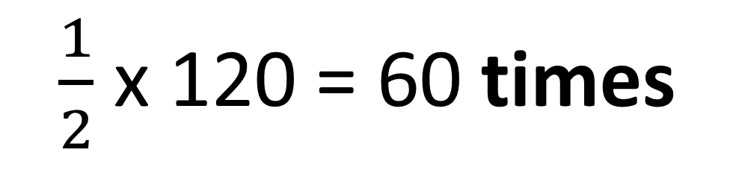
The spinner is spun 120 times.
How many times would you expect
the spinner to
land on red?
$\frac{1}{2}$ x 120 = 60 times

Slide 38
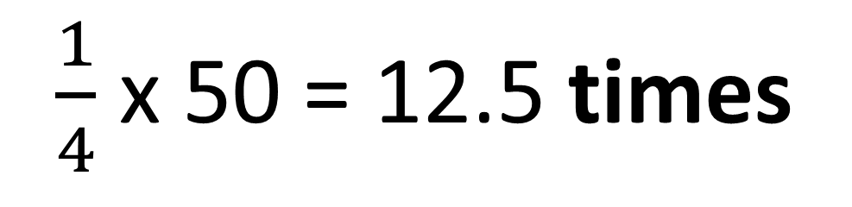
The spinner is spun 50 times.
How many times would you expect
the spinner to
land on red?
$\frac{1}{4}$ x 50 = 12.5 times

