Slide 1
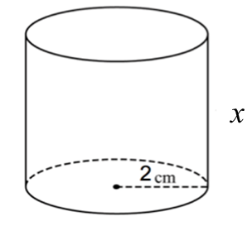
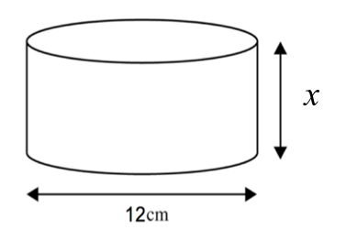
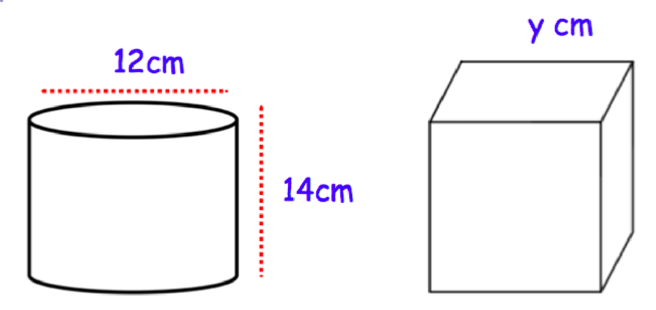




1)
2)
3)
4)
3 cm
7.96 cm
x
12 cm
x
Volume = 63 ${cm}^{3}$
Volume = 679 ${cm}^{3}$
Volume = 71 ${cm}^{3}$
Volume = 100 ${cm}^{3}$
5) A cylinder has a height of 15cm and a volume of 500cm³ Calculate the radius of the cylinder.
6) A cylinder has a volume of 250cm³ and a height of 10cm. Calculate the diameter.
7) A cylinder and a cube have the same volume find y.
8) A cube is 8cm on each side. What is the height of a cylinder having the same volume, if its radius is 4cm.

Slide 2
ANSWERS

Slide 3
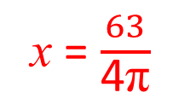
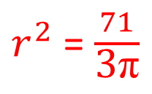


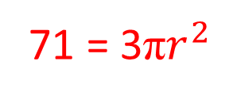
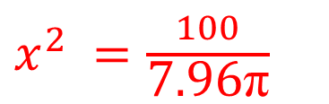
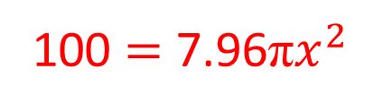

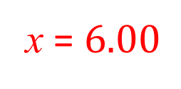
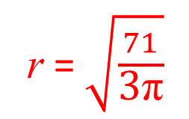
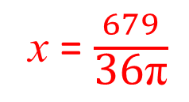
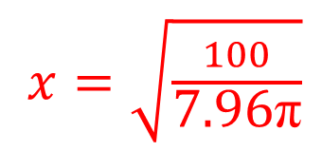
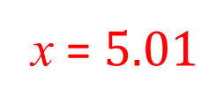

1)
2)
3)
4)
3 cm
7.96 cm
x
12 cm
x
Volume = 63 ${cm}^{3}$
Volume = 679 ${cm}^{3}$
Volume = 100 ${cm}^{3}$
Volume = 71 ${cm}^{3}$
63 = 4πx
679 = 36πx
100 $=$ 7.96π$x^{2}$
71 = 3π$r^{2}$
x = $\frac{63}{\text{4}\text{π}}$
x = $\frac{679}{\text{36}\text{π}}$
$x^{2}$ $=\frac{100}{\text{7.96}\text{π}}$
$r^{2}$ = $\frac{71}{\text{3}\text{π}}$
x = $5.01$
x = $6.00$
$x=\sqrt{\frac{100}{\text{7.96}\text{π}}}$
r = $\sqrt{\frac{71}{\text{3}\text{π}}}$
$$x=1.99$$
$$2r=x=5.49$$

Slide 4
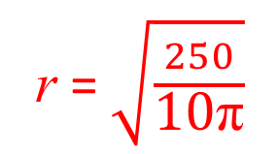
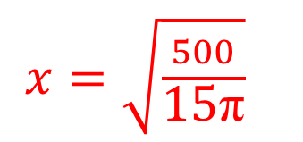



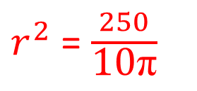
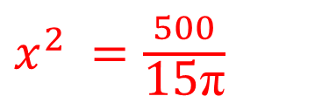
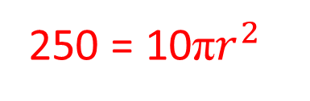
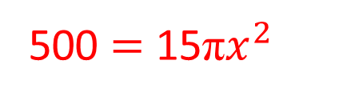

5) A cylinder has a height of 15cm and a volume of 500cm³ Calculate the radius of the cylinder.
500 $=$ 15π$x^{2}$
$x^{2}$ $=\frac{500}{\text{15}\text{π}}$
$x=\sqrt{\frac{500}{\text{15}\text{π}}}$
15 cm
$$x=3.26$$
x
Volume = 500 ${cm}^{3}$
6) A cylinder has a volume of 250cm³ and a height of 10cm. Calculate the diameter.
250 = 10π$r^{2}$
10 cm
r = $\sqrt{\frac{250}{\text{10}\text{π}}}$
$r^{2}$ = $\frac{250}{\text{10}\text{π}}$
$$2r=x=5.64$$
x
Volume = 250 ${cm}^{3}$

Slide 5
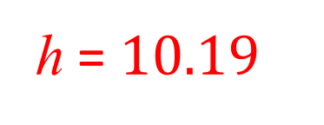

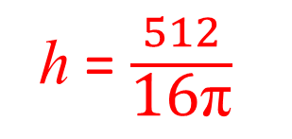
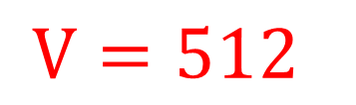
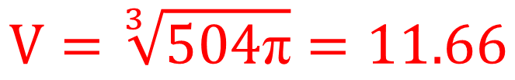

7) A cylinder and a cube have the same volume find y.
$V=36\text{π}(14)$
$V=504\text{π}$
$$V=\sqrt[3]{504\text{π}}=11.66$$
8) A cube is 8cm on each side. What is the height of a cylinder having the same volume, if its radius is 4cm.
$V=512$
512 = 16πh
h = $\frac{512}{\text{16}\text{π}}$
h = $10.19$

