Slide 1
Algebraic Methods
Proofs
Chapter 7
(Part 4 of 5)

Slide 2
Proofs
A proof must show,
a clear sequential list of steps
that logically follow,
and must cover all possible cases.
You should usually make a
concluding statement.

Slide 3
Proof by Deduction
Proof by Exhaustion
Disproof by Counter-Example

Slide 4
Proof by Deduction
Start from known facts
and reach the desired conclusion via deductive steps.

Slide 5
Useful Facts
Writing even and odd numbers
in algebraic form.
Even = 2n
Odd = 2n + 1

Slide 6
Useful Facts
Factorising a number out of an expression will show that it is
a multiple of that number.
12x + 8 =
4(3x + 2)
Multiple of 4

Slide 7
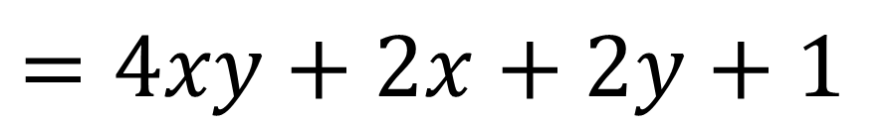
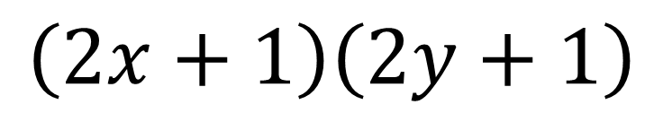
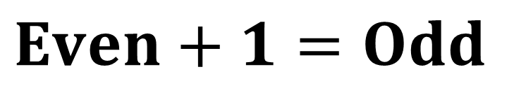
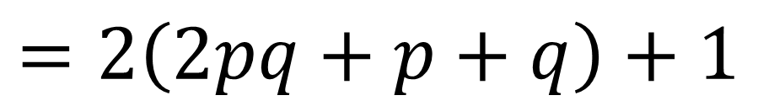
Prove that the product of
two different odd numbers is odd.
$$\left(2x+1\right)\left(2y+1\right)$$
$$=4xy+2x+2y+1$$
$$=2\left(2pq+p+q\right)+1$$
$$Even+1=Odd$$

Slide 8
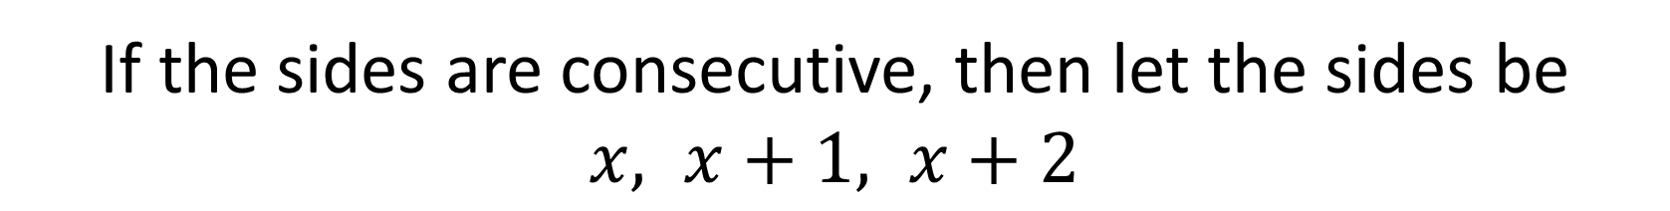
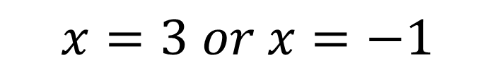


Prove that if three consecutive integers are the sides
of a right-angled triangle, they must be 3, 4 and 5.
If the sides are consecutive, then let the sides be
$x, x+1, x+2$
Then by Pythagoras’ Theorem:
$$x^{2}+{\left(x+1\right)}^{2}={\left(x+2\right)}^{2}$$
$$x^{2}−2x−3=0$$
$$x=3 or x=−1$$
$x=3$ (as $x$ can’t be negative) Thus the sides are 3, 4, 5.

Slide 9
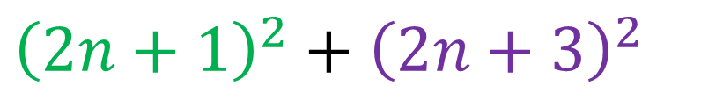
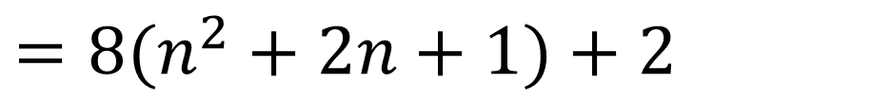
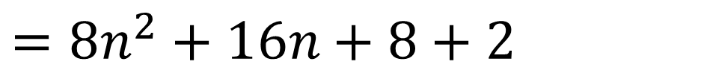
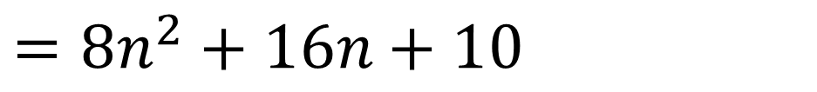
Prove that the sum of the squares of two consecutive
odd numbers is 2 more than a multiple of 8.
$${\left(2n+1\right)}^{2}+{\left(2n+3\right)}^{2}$$
$$=4n^{2}+4n+1+4n^{2}+12n+9$$
$=8n^{2}+16n+10$
$=8n^{2}+16n+8+2$
$=8(n^{2}+2n+1)+2$
Multiple of 8 plus 2

Slide 10
Useful Facts
≡ is the symbol for identical.
After any expanding and simplifying
the LHS will be identical to the RHS.
4x + 8 ≡ 4(x + 2)

Slide 11
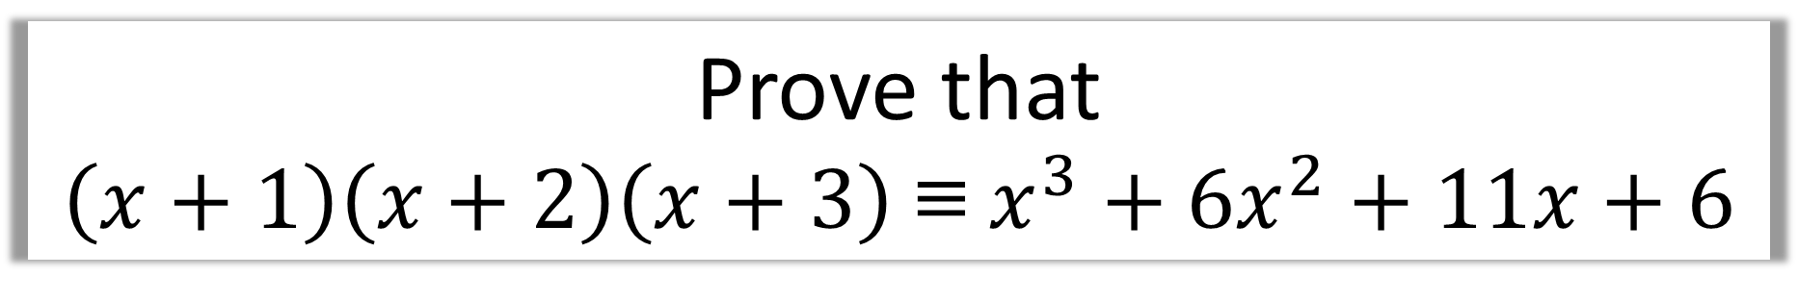
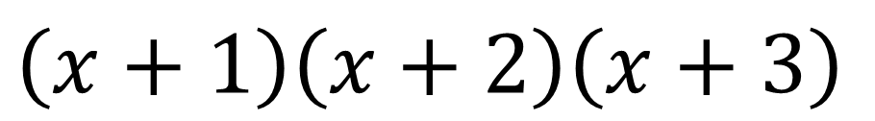
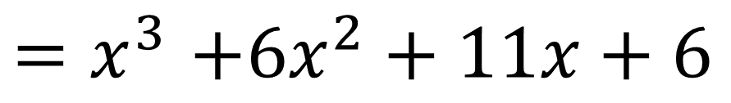
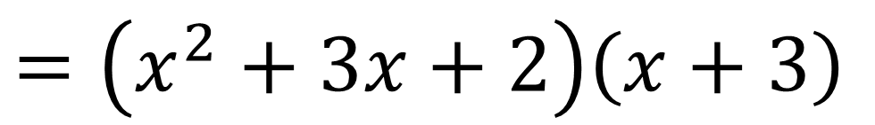
Prove that
$\left(x+1\right)\left(x+2\right)\left(x+3\right)$ ≡ $x^{3}+{6x}^{2}+11x+6$
$$\left(x+1\right)\left(x+2\right)\left(x+3\right)$$
$$=\left(x^{2}+3x+2\right)\left(x+3\right)$$
$${=x}^{3}+3x^{2}+2x+3x^{2}+9x+6$$
$${=x}^{3}+6x^{2}+11x+6$$

Slide 12
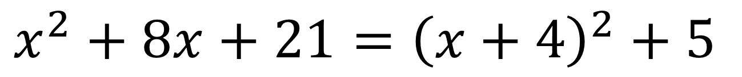
Useful Facts
Completing the square of
an expression is a good way of showing it will always be positive.
$$x^{2}+8x+21={\left(x+4\right)}^{2}+5$$
will always produce a positive number > 0

Slide 13
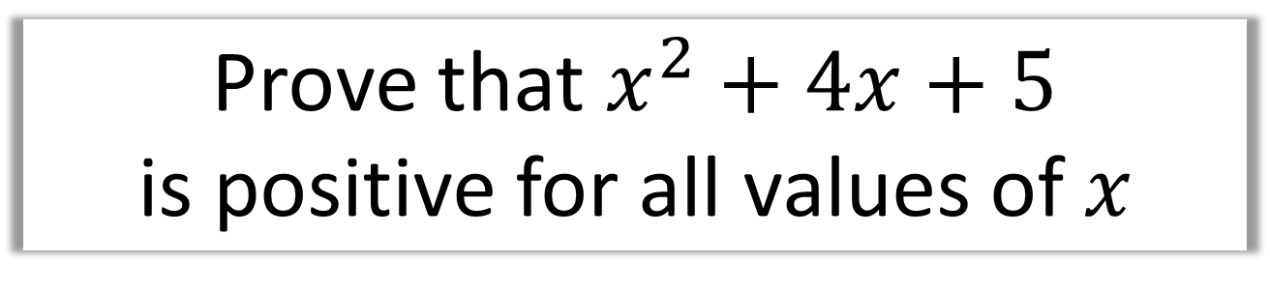

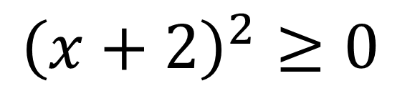
Prove that $x^{2}+4x+5$
is positive for all values of $x$
$$x^{2}+4x+5={\left(x+2\right)}^{2}+1$$
$${\left(x+2\right)}^{2}≥0$$
$$∴{\left(x+2\right)}^{2}+1≥1$$
Hence always positive.

Slide 14
Proof by Exhaustion
This means breaking down the statement into all possible smaller cases, where we prove each individual case.

Slide 15
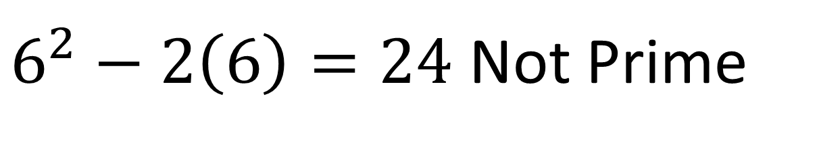
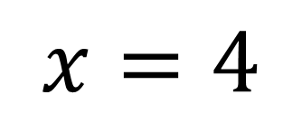
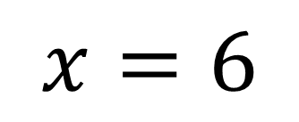
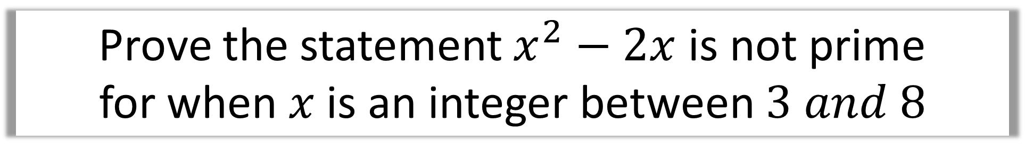
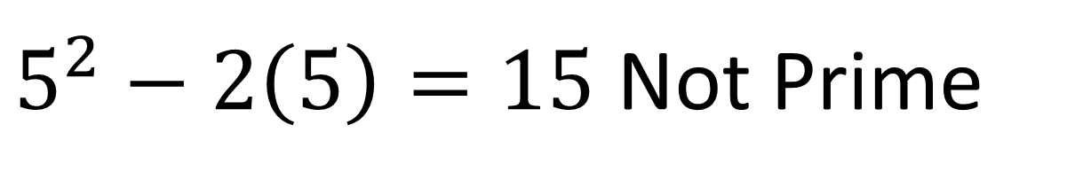
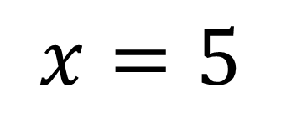
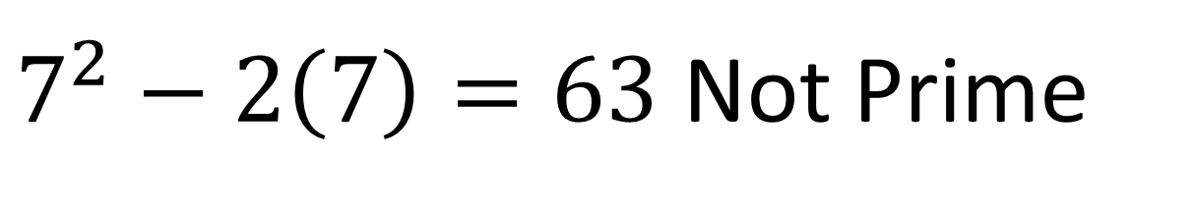
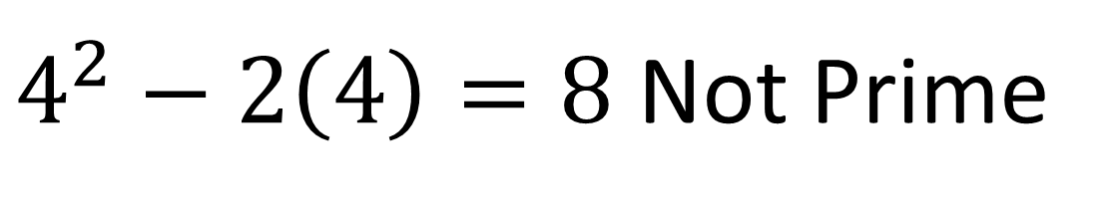
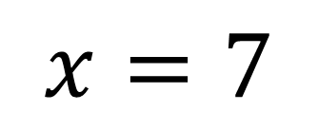
Prove the statement $x^{2}−2x$ is not prime
for when $x$ is an integer between $3 and 8$
$$x=4$$
$4^{2}−2\left(4\right)=8$ Not Prime
$$x=5$$
$5^{2}−2\left(5\right)=15$ Not Prime
$$x=6$$
$6^{2}−2\left(6\right)=24$ Not Prime
$$x=7$$
$7^{2}−2\left(7\right)=63$ Not Prime

Slide 16


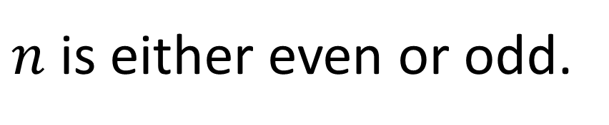


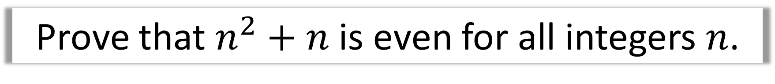
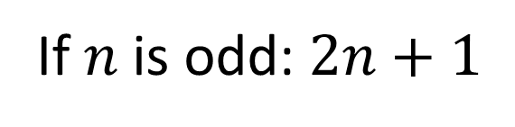

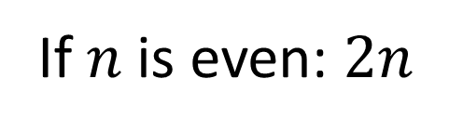


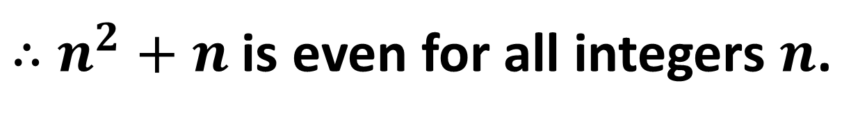


Prove that $n^{2}+n$ is even for all integers $n$.
$n$ is either even or odd.
If $n$ is even: $2n$
If $n$ is odd: $2n+1$
$${(2n)}^{2}+\left(2n\right)$$
$${(2n+1)}^{2}+\left(2n+1\right)$$
$$={4n}^{2}+2n$$
$$={4n}^{2}+2n+1+2n+1$$
$$={2(2n}^{2}+n)$$
$$={4n}^{2}+4n+2$$
$$=even$$
$$={2(n}^{2}+2n+1)$$
$$=even$$
$∴$ $n^{2}+n$ is even for all integers $n$.

Slide 17
Disproof
by Counter-Example
You only need one example
to disprove a statement.

Slide 18
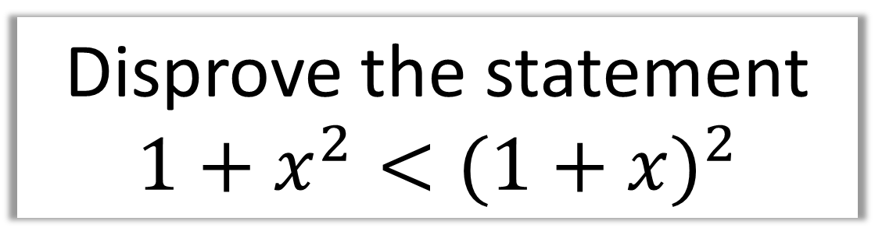
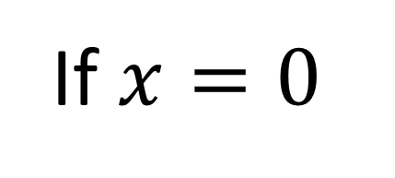
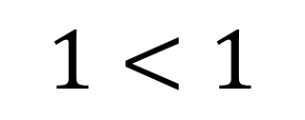
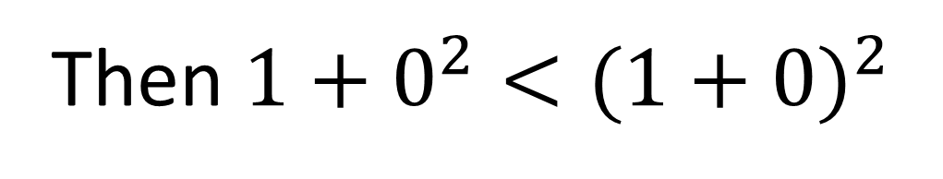
Disprove the statement
$${1+x}^{2}<{(1+x)}^{2}$$
If $x=0$
Then ${1+0}^{2}<{(1+0)}^{2}$
$$1<1$$
Thus the statement is not true.

Slide 19
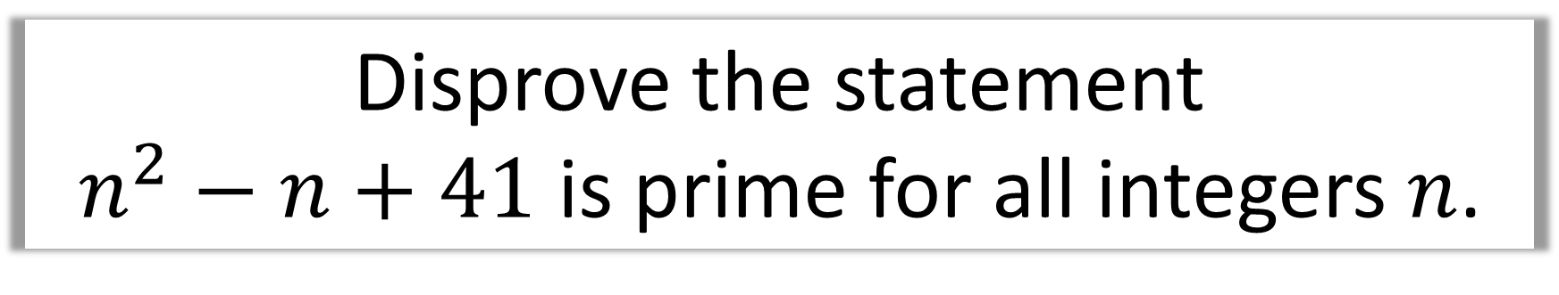
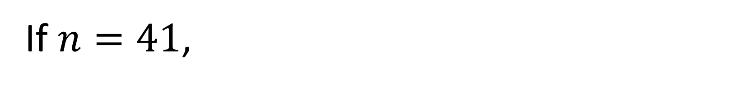

Disprove the statement
$n^{2}−n+41$ is prime for all integers $n$.
If $n=41$,
then ${41}^{2}−41+41={41}^{2}$
Which is not prime as it has a factor of 41.
Thus the statement is not true.

