Slide 1
LO: Writing Algebraic Expressions

Slide 2
Algebra is the use of letters
in place of unknown numbers.
x + 3

Slide 3
What is the algebra asking you to do?
n + 5

Slide 4
What is the algebra asking you to do?
5n

Slide 5
What is the algebra asking you to do?
8 – n

Slide 6
What is the algebra asking you to do?
n ÷ 4

Slide 7
What is the algebra asking you to do?
4n + 5

Slide 8
When writing algebra
there are rules to follow
so you avoid
writing bad algebra.

Slide 9
Good algebra or Bad?
x x 3
Bad

Slide 10
Good algebra or Bad?
x3
Bad

Slide 11
Good algebra or Bad?
3x
Good

Slide 12
Good algebra or Bad?
x x x
Bad

Slide 13
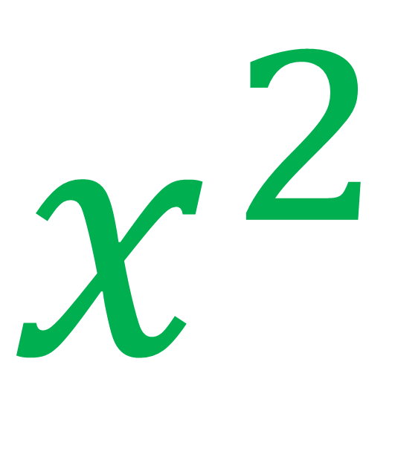
Good algebra or Bad?
$$x^{2}$$
Good

Slide 14
Good algebra or Bad?
x ÷ 2
Bad

Slide 15
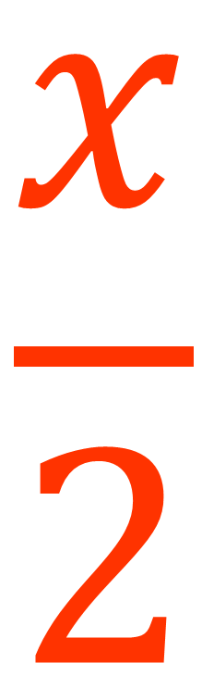
Good algebra or Bad?
$$\frac{x}{2}$$
Good

Slide 16


Rule 1: Don’t write multiplications symbols
x x 3
3x
3 x y
3y
3 x z + 1
3z + 1

Slide 17
Rule 2: Write the numbers first
x3
3x
y x 3
3y
z3 + 1
3z + 1

Slide 18
Rule 3: You don’t need to write 1 in front of a letter
1x
x
y x 1
y
z1 + 5
z + 5

Slide 19
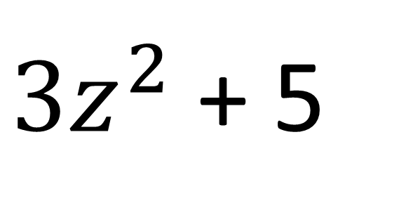
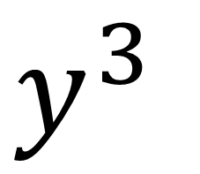
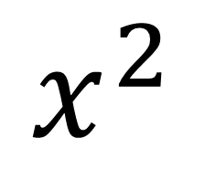
Rule 4: Use powers when you can.
x x x
$$x^{2}$$
y x y x y
$y^{3}$
z x z x 3 + 5
$3z^{2}$ + 5

Slide 20
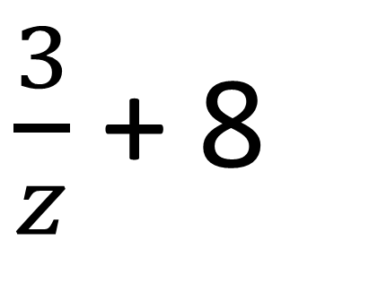
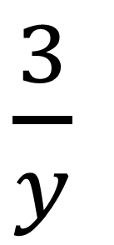
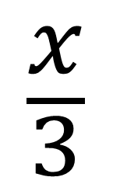
Rule 5: Use a division line instead of a symbol
x ÷ 3
$$\frac{x}{3}$$
$\frac{3}{y}$
3 ÷ y
3 ÷ z + 8
$\frac{3}{z}$ + 8

Slide 21
Rewrite using good algebra.
n6 + 3n
9n

Slide 22
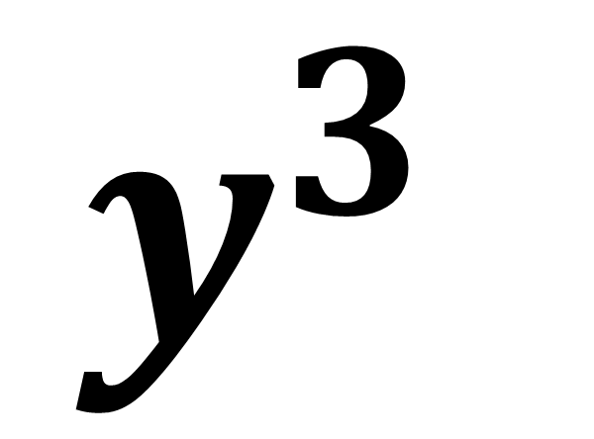
Rewrite using good algebra.
y x y x 1y
$$y^{3}$$

Slide 23
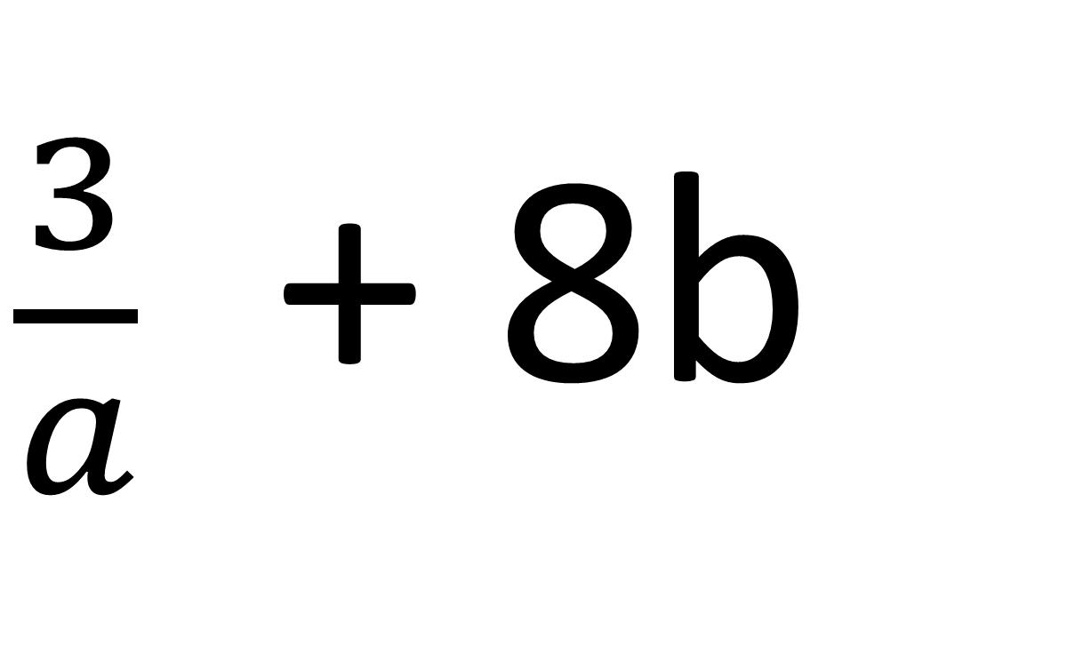
Rewrite using good algebra.
3 ÷ a + b8
$\frac{3}{a}$+ 8b

Slide 24
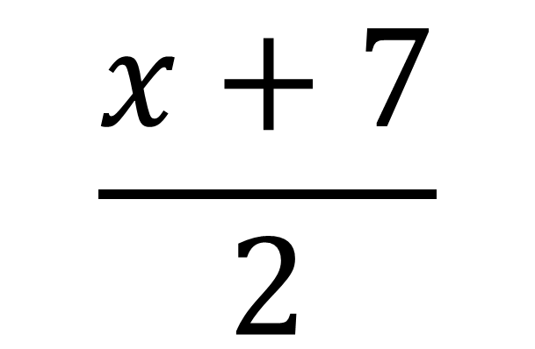
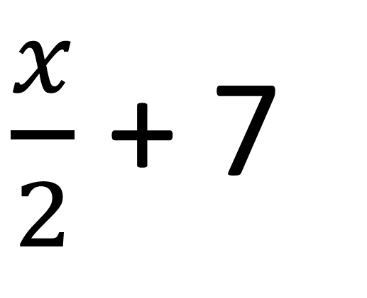
÷ 2
+ 7
$\frac{x}{2}$ + 7
x
+ 7
÷ 2
$$\frac{x+7}{2}$$
x

Slide 25
x 5
+ 3
x
5x + 3
+ 3
x 5
x
5(x + 3)

Slide 26
Write an algebraic expression.
Multiply a number by two
then add seven
2x + 7

Slide 27
Write an algebraic expression.
Multiply a number by four
then subtract three
4x – 3

Slide 28
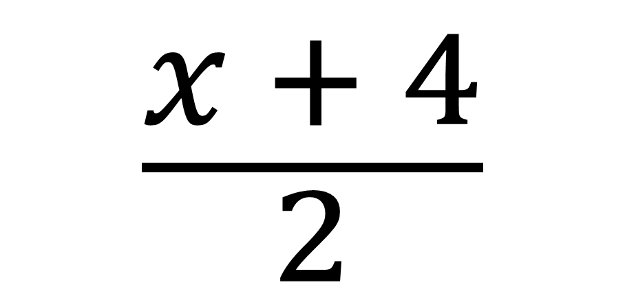
Write an algebraic expression.
A number add 4
then divided by two
$$\frac{x + 4}{2}$$

Slide 29
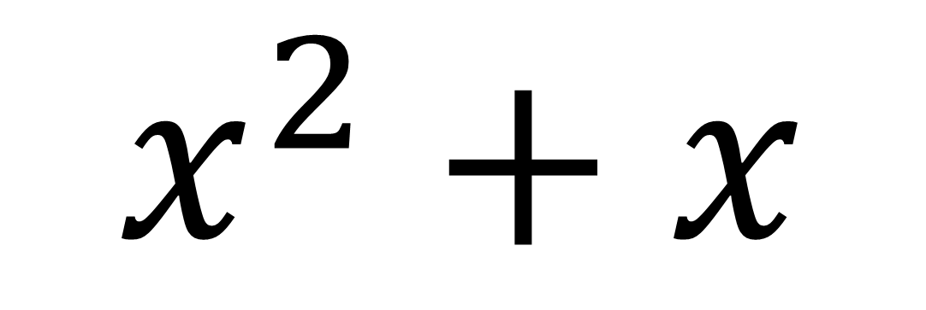
Write an algebraic expression.
A number multiply itself
then add itself
$$x^{2}+x$$

Slide 30
Expressions, Equations
and Formulas
3x + 2 = 9
3x + 2
A = 3x + 2

Slide 31
Expression
Equation
Formula
One or more
unknowns
No equal signs
3x + 2
Only One
unknown
Has an equal signs
3x +2 = 9
More than one unknown
Has an equal signs
A = 3x + 2

Slide 32
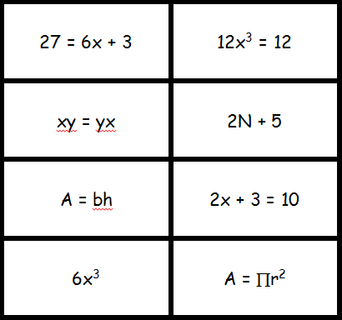
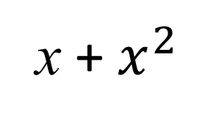
Expression, Equations or Formula
x + $x^{2}$

