Slide 1
LO: Quadrilateral
Properties

Slide 2
Names of Quadrilateral
Parallelogram
Trapezium
Rectangles
Rhombus
Kite
Square

Slide 3
Quadrilaterals Family Tree.
See how they are related.
QUADRILATERAL
KITE
PARALLELOGRAM
TRAPEZIUM
RECTANGLE
RHOMBUS
ISOSCELES
TRAPEZIUM
Arrowhead
SQUARE

Slide 4
How many…… |  |  |  |  | How many…… |  |  |  |  |  | How many……
Sides the same |  |  |  |  | Right angles |  |  |  |  |  | Sides the same
Right angles |  |  |  |  | Lines of symmetry |  |  |  |  |  | Right angles
Lines of symmetry |  |  |  |  | Opposite side are equal (Y or N) |  |  |  |  |  | Lines of symmetry
How many…… |  |  |  |  |  | How many…… |  |  |  |  |  | How many……
Right angles |  |  |  |  |  | Right angles |  |  |  |  |  | Right angles
Lines of symmetry |  |  |  |  |  | Lines of symmetry |  |  |  |  |  | Lines of symmetry
Opposite side are equal (Y or N) |  |  |  |  |  | Opposite side are equal (Y or N) |  |  |  |  |  | Opposite side are equal (Y or N)

Slide 5
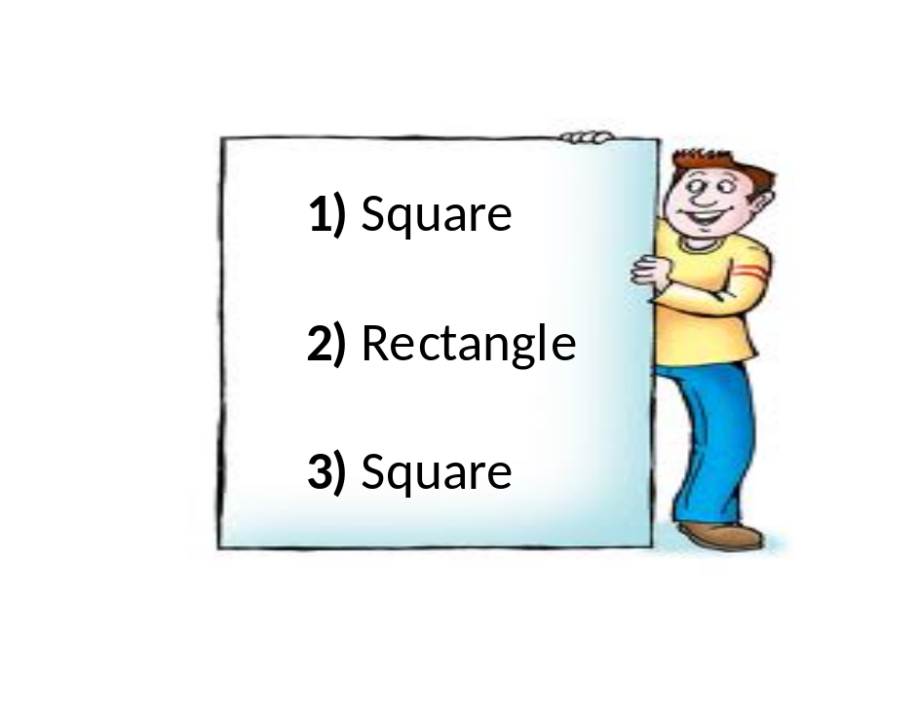
What polygon am I?
You will be given 3 glues, 1 at a time.
After each clue make guess of the polygon.
You score 1 point for every time you wrote down the correct answer.
There are 5 polygons to guess.
The person with the most points wins.

Slide 6

Triangle
Rhombus
Square
Parallelogram
Rectangle
Trapezium
Kite
Pentagon
Heptagon
Octagon
Decagon
Round 1
What polygons am I?
Clue 1: | I like to go quad biking
Clue 2: | All my angles are right angles
Clue 3: | All my sides are equal
Answer: | Square

Slide 7
Triangle
Rhombus
Square
Parallelogram
Rectangle
Trapezium
Kite
Pentagon
Heptagon
Octagon
Decagon
Round 2
What polygons am I?
Clue 1: | I have one line of symmetry
Clue 2: | None of my sides are parallel
Clue 3: | I like it when it is windy
Answer: | Kite

Slide 8
Triangle
Rhombus
Square
Parallelogram
Rectangle
Trapezium
Kite
Pentagon
Heptagon
Octagon
Decagon
Round 3
What polygons am I?
Clue 1: | All my sides are the same length.
Clue 2: | I have 2 lines of symmetry.
Clue 3: | I am a girls best friend.
Answer: | Rhombus

Slide 9
Triangle
Rhombus
Square
Parallelogram
Rectangle
Trapezium
Kite
Pentagon
Heptagon
Octagon
Decagon
Round 4
What polygons am I?
Clue 1: | Your house needs me when it rains.
Clue 2: | I have only one set of parallel sides.
Clue 3: | The parallel sides can not be the same length.
Answer: | Trapezium

Slide 10
Triangle
Rhombus
Square
Parallelogram
Rectangle
Trapezium
Kite
Pentagon
Heptagon
Octagon
Decagon
Round 5
What polygons am I?
Clue 1: | My opposite sides are equal.
Clue 2: | Not all my sides and angles are equal.
Clue 3: | I have two pairs of parallel sides.
Answer: | Parallelogram

Slide 11
What is the missing angle?
85°
110˚ + 90˚ + 85˚ = 285˚
110°
360˚- 285˚ = 75˚
90°
?

Slide 12
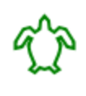
https://www.calormen.com/jslogo/
Use the above website to draw various shapes.
Guide the turtle around the screen to draw the shapes.
Use instructions such as:
Forward 100
Right 90
Left 48

Slide 13
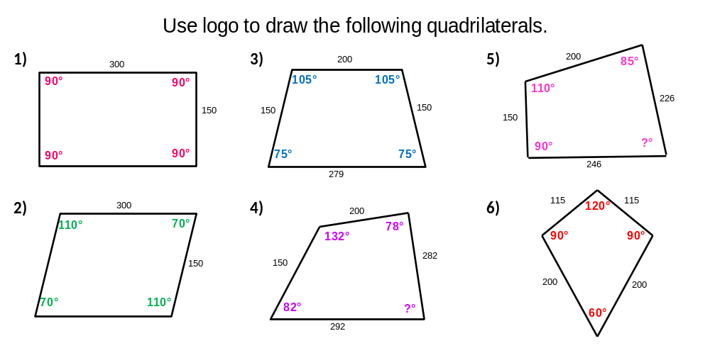
https://www.calormen.com/jslogo/

