Slide 1
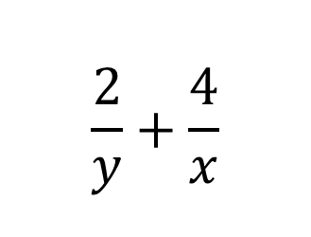
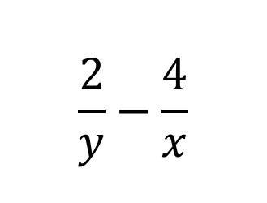

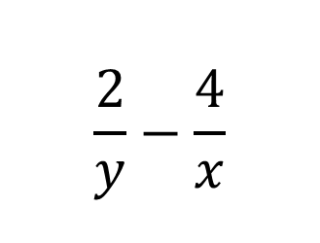
1) Write the following expression as a single fraction.
2) What is the perimeter of the rectangle.
Write your answer as a single fraction.
$$\frac{2}{y}+\frac{4}{x}$$
$$\frac{4}{y}$$
$$\frac{2}{y}$$
3) Write the following expression as a single fraction.
$$\frac{2}{y}−\frac{4}{x}$$
$$\frac{2}{y}−\frac{4}{x}$$
4) Subtract the following fractions.
Then take the reciprocal of the answer.

Slide 2
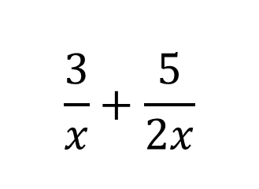
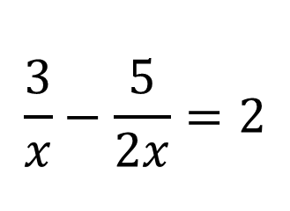
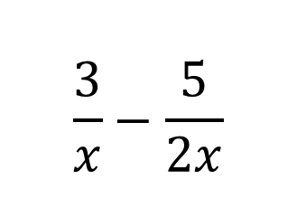

5) Write the following expression as a single fraction. Give your answer in its simplest form.
6) What is the perimeter of the rectangle.
Write your answer as a single fraction.
Give your answer in its simplest form.
$$\frac{3}{x}+\frac{5}{2x}$$
$$\frac{5}{2x}$$
$$\frac{3}{x}$$
7) Write the following expression as a single fraction.
Give your answer in its simplest form.
8) Subtract the fractions and then solve the following equation.
$$\frac{3}{x}−\frac{5}{2x}$$
$$\frac{3}{x}−\frac{5}{2x}=2$$

Slide 3
ANSWERS

Slide 4
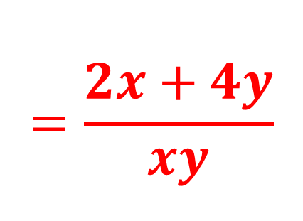
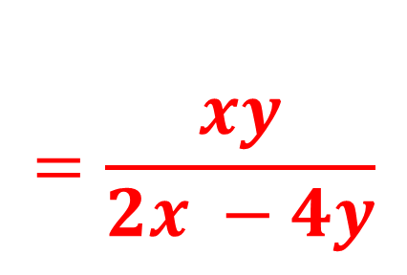
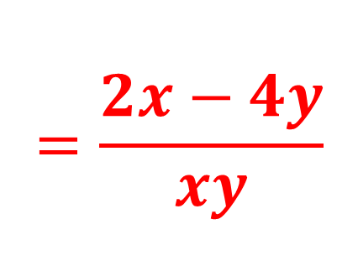
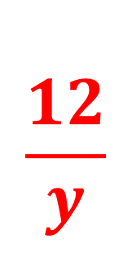
1) Write the following expression as a single fraction.
2) What is the perimeter of the rectangle.
Write your answer as a single fraction.
$$\frac{2}{y}+\frac{4}{x}$$
$$\frac{4}{y}$$
$$\frac{12}{y}$$
$$=\frac{2x+4y}{xy}$$
$$\frac{2}{y}$$
3) Write the following expression as a single fraction.
$$\frac{2}{y}−\frac{4}{x}$$
$$\frac{2}{y}−\frac{4}{x}$$
4) Subtract the following fractions.
Then take the reciprocal of the answer.
$$=\frac{xy}{2x −4y}$$
$$=\frac{2x−4y}{xy}$$

Slide 5
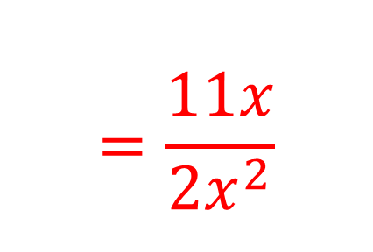
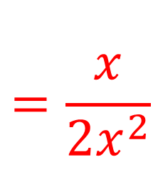
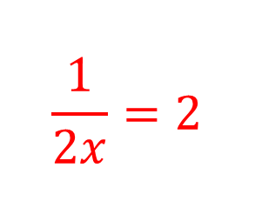
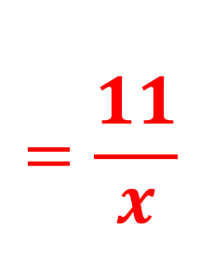
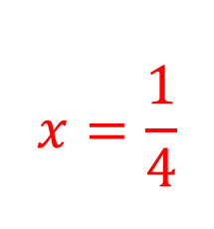
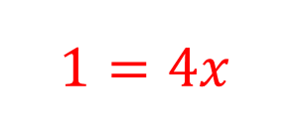
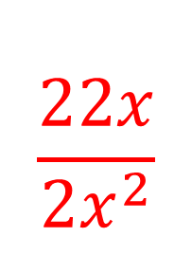
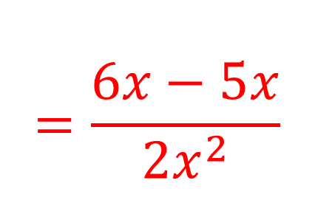
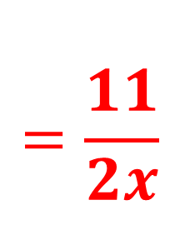
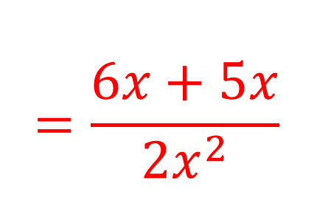
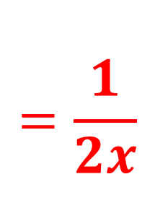
5) Write the following expression as a single fraction. Give your answer in its simplest form.
6) What is the perimeter of the rectangle.
Write your answer as a single fraction.
Give your answer in its simplest form.
$$\frac{3}{x}+\frac{5}{2x}$$
$$\frac{5}{2x}$$
$$\frac{22x}{{2x}^{2}}$$
$$=\frac{11}{x}$$
$$=\frac{6x+5x}{{2x}^{2}}$$
$$=\frac{11x}{{2x}^{2}}$$
$$=\frac{11}{2x}$$
$$\frac{3}{x}$$
7) Write the following expression as a single fraction.
Give your answer in its simplest form.
8) Subtract the fractions and then solve the following equation.
$$\frac{3}{x}−\frac{5}{2x}$$
$$\frac{1}{2x}=2$$
$$\frac{3}{x}−\frac{5}{2x}=2$$
$$=\frac{6x−5x}{{2x}^{2}}$$
$$=\frac{x}{{2x}^{2}}$$
$$=\frac{1}{2x}$$
$$1=4x$$
$$x=\frac{1}{4}$$

