Slide 1
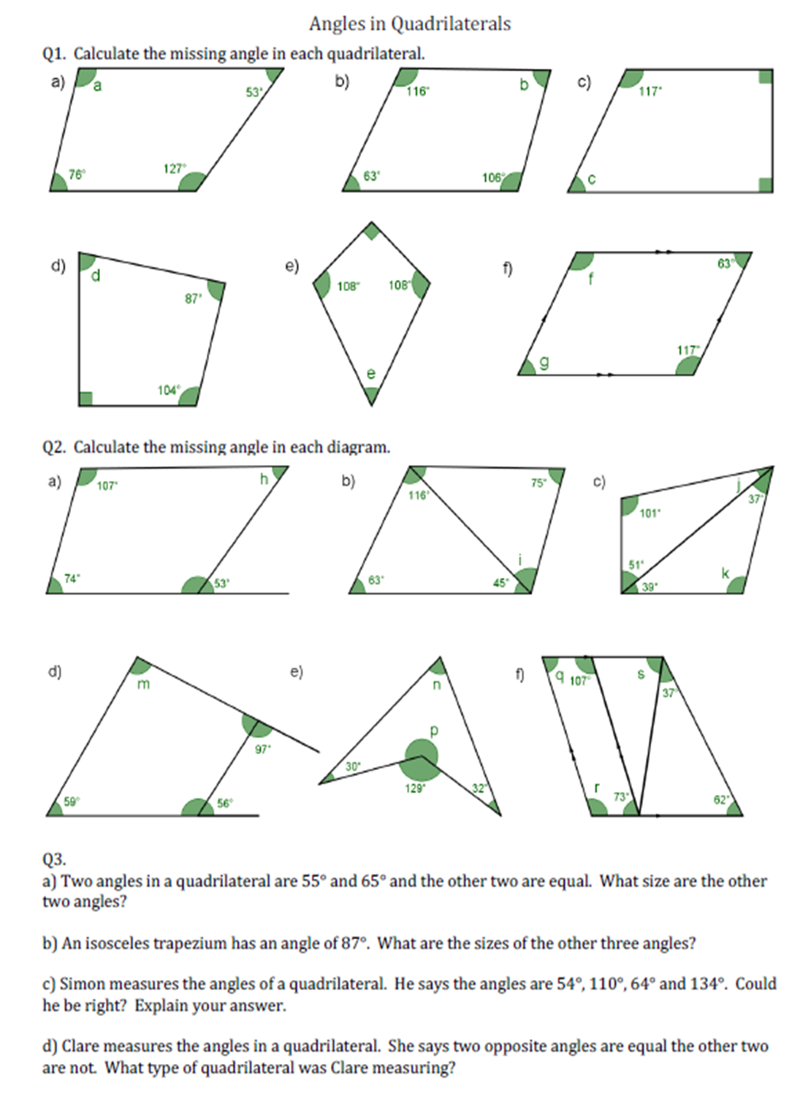

Slide 2
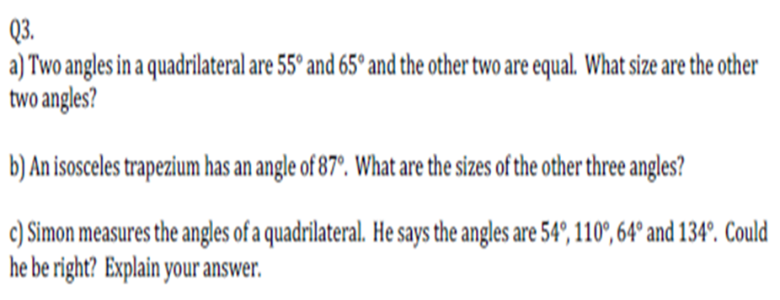
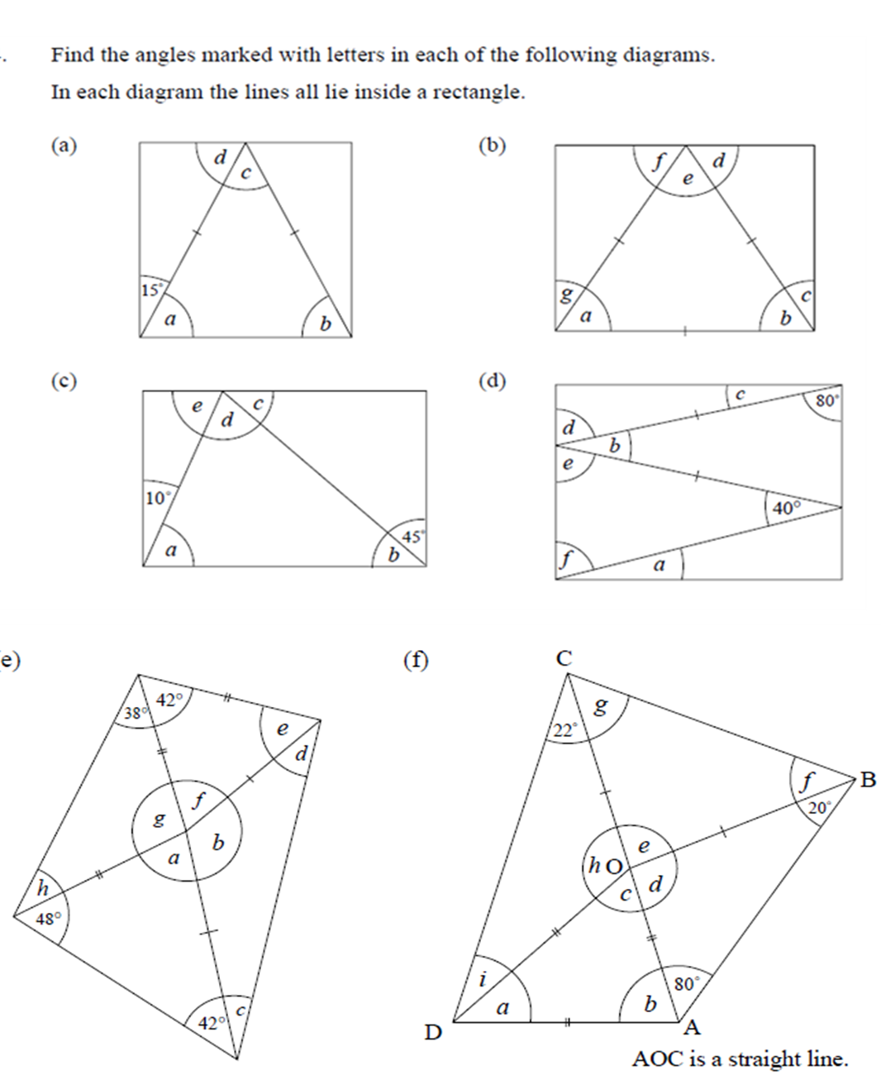


Slide 3
ANSWRES

Slide 4
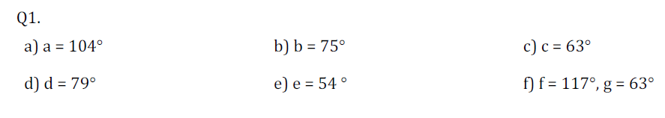

Slide 5
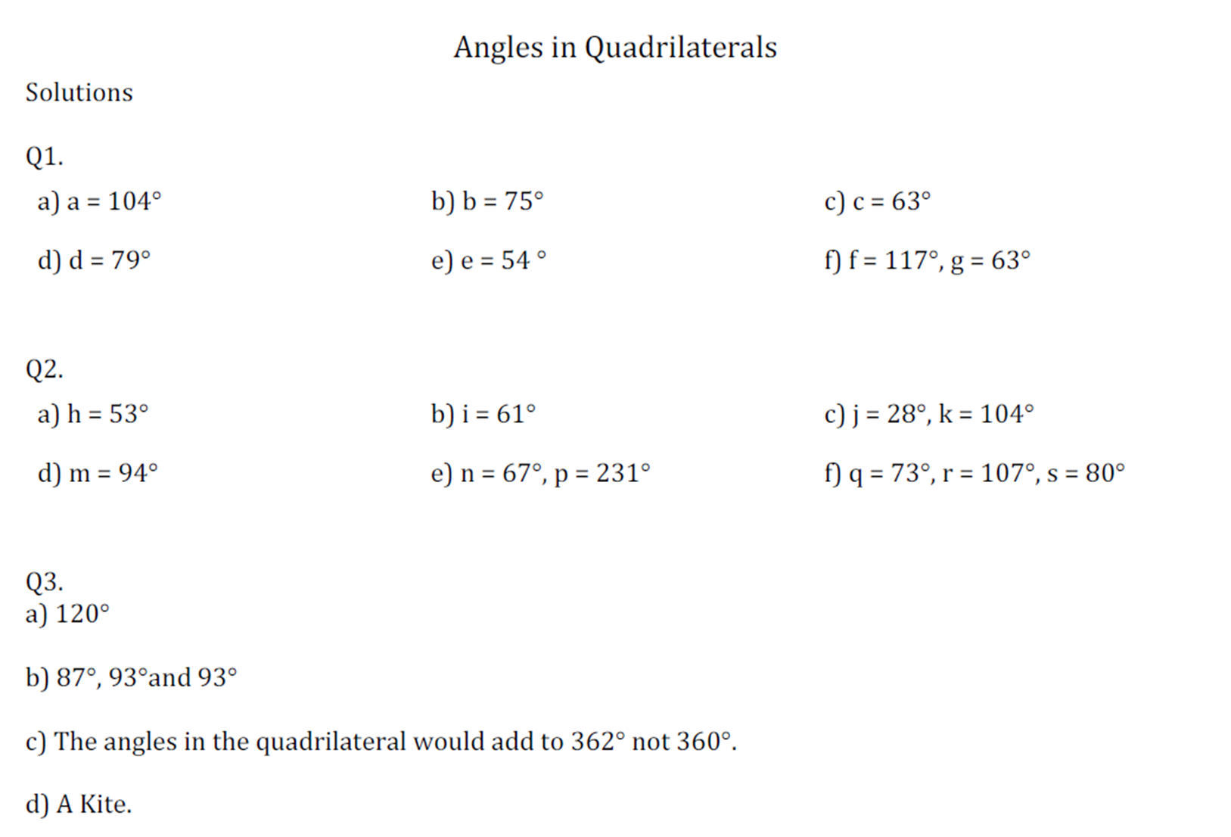

Slide 7
75°
60°
60°
30°
60°
69°
40°
30°
30°
69°
41.5°
40°
75°
75°
60°
60°
104°
100°
38°
120°
90°
97°
80°
80°
10°
60°
80°
45°
38°
20°
41.5°
60°
55°
60°
80°
80°
45°
60°
30°

