Slide 1
Forces and Friction
Resolving Forces
Chapter 1
(Part 1 of 3)

Slide 2
Resolving Forces
The golden rule to dealing
with problems that involve forces
is to deal only with
vertical and horizontal forces
to the ground.

Slide 3

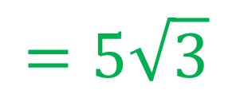


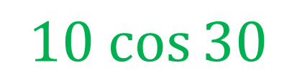
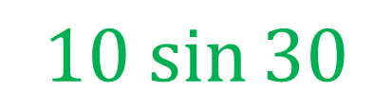
$$10N$$
8 kg
$$10 sin{30}$$
$$=5$$
$$30°$$
$$10 cos{30}$$
$$=5\sqrt{3}$$

Slide 4
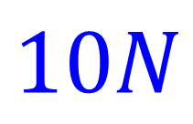

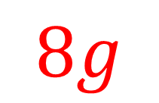


a) what is the value of R?
b) what is the acceleration of the particle?
$$R$$
$$10N$$
$$3N$$
8 kg
$$30°$$
$$8g$$

Slide 5
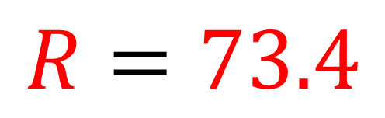

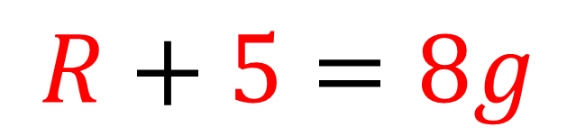
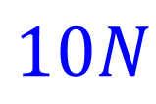

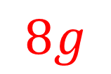
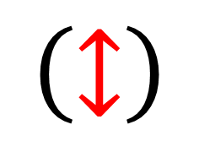


a) what is the value of R of the particle?
$$R$$
$$10N$$
8 kg
$$10\sin{30=5}$$
$$3N$$
$$30°$$
$$8g$$
$$\left(↕\right)$$
$$R+5=8g$$
$$R=73.4$$

Slide 6
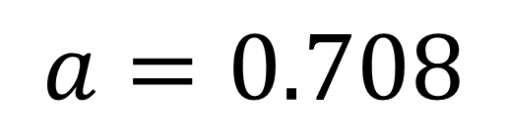
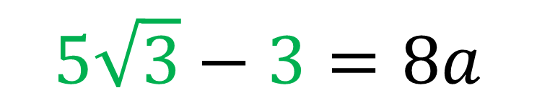

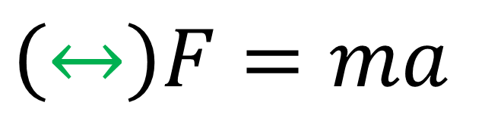

b) what is the acceleration of the particle?
$$R$$
$$10N$$
$$3N$$
8 kg
$$30°$$
$$\left(↔\right)F=ma$$
$$10\cos{30=5\sqrt{3}}$$
$$8g$$
$$5\sqrt{3}−3=8a$$
$$a=0.708$$

Slide 7
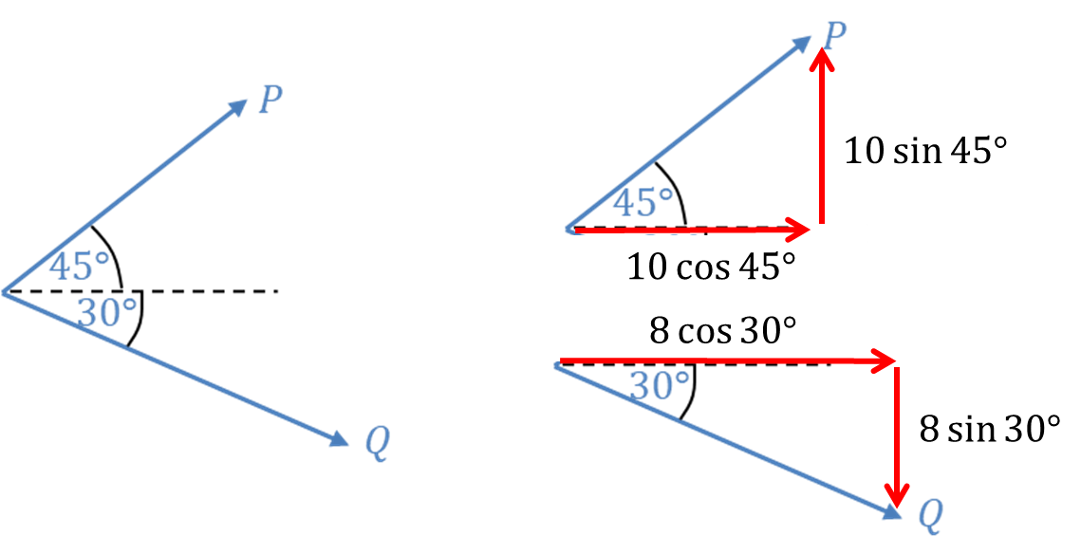
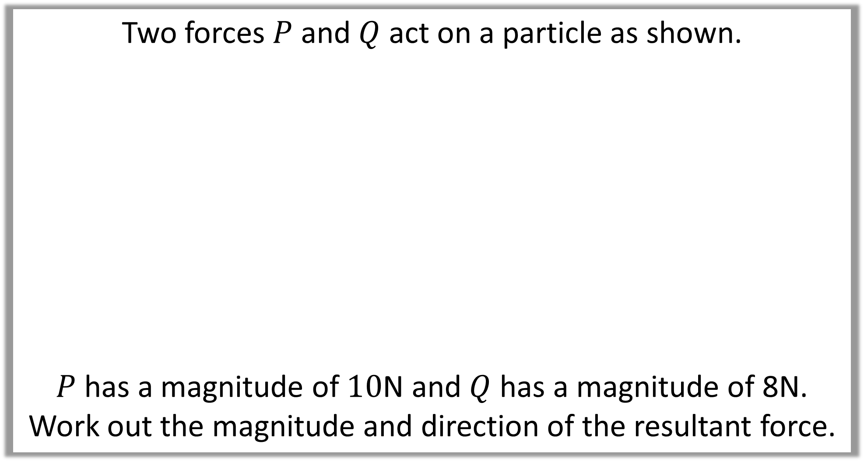
Two forces $P$ and $Q$ act on a particle as shown.
$P$ has a magnitude of $10$N and $Q$ has a magnitude of 8N.
Work out the magnitude and direction of the resultant force.

Slide 8
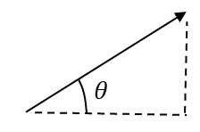

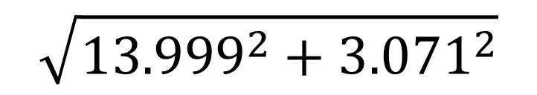

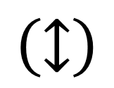
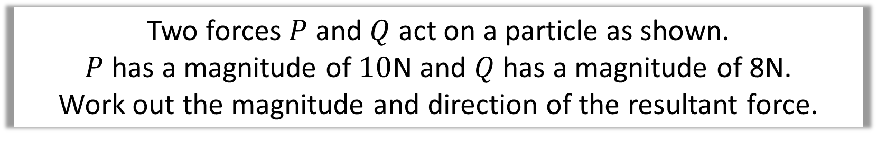

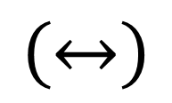
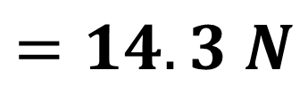

Two forces $P$ and $Q$ act on a particle as shown.
$P$ has a magnitude of $10$N and $Q$ has a magnitude of 8N.
Work out the magnitude and direction of the resultant force.
$$\left(↕\right)$$
$$10 sin 45−8 sin 30=$$
$$3.071$$
$$\left(↔\right)$$
$$10 cos 45+8 cos 30=$$
$$13.999$$
Magnitude
$$\sqrt{{13.999}^{2}+{3.071}^{2}}$$
3.071
$$=14.3 N$$
13.999

Slide 9

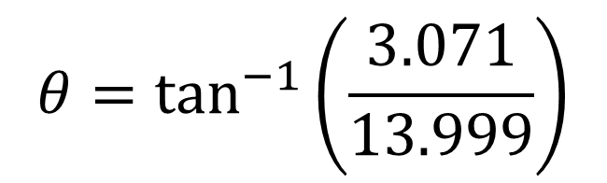
Two forces $P$ and $Q$ act on a particle as shown.
$P$ has a magnitude of $10$N and $Q$ has a magnitude of 8N.
Work out the magnitude and direction of the resultant force.
$$\left(↕\right)$$
$$10 sin 45−8 sin 30=$$
$$3.071$$
$$\left(↔\right)$$
$$10 cos 45+8 cos 30=$$
$$13.999$$
Direction
$$θ=\tan^{−1}\left(\frac{3.071}{13.999}\right)$$
3.071
$$θ=12.4°$$
13.999

Slide 10
Horizontal Forces
Resultant Horizontal Force
+

Slide 11
Vertical Forces
Resultant Vertical Force
-

Slide 12
Resultant Force

