Slide 1
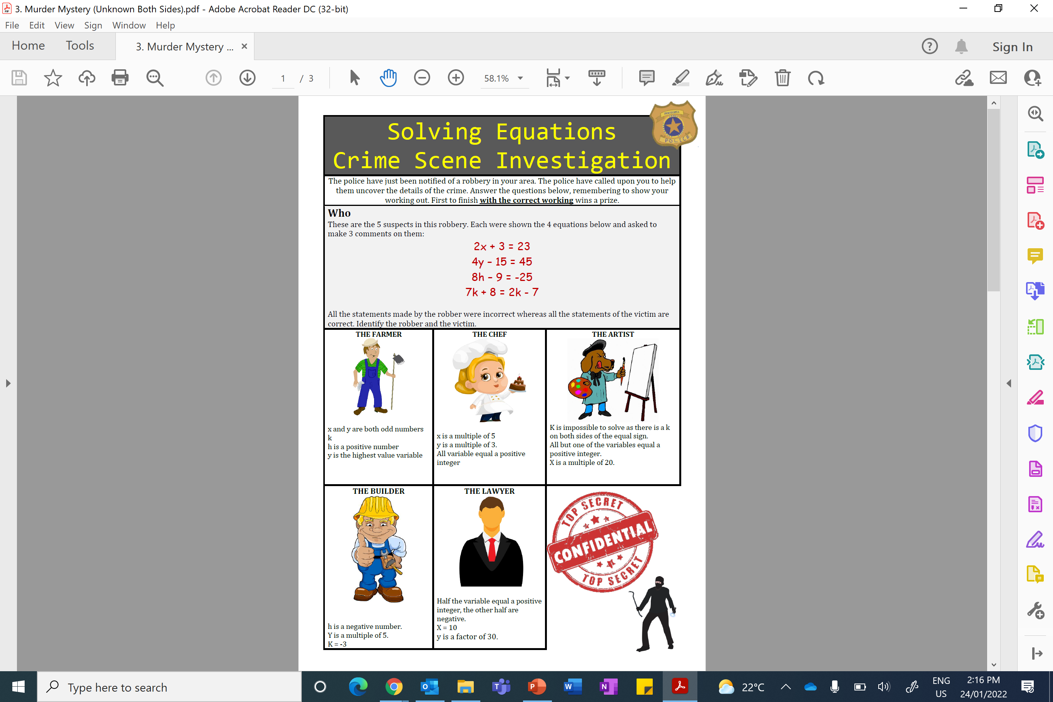
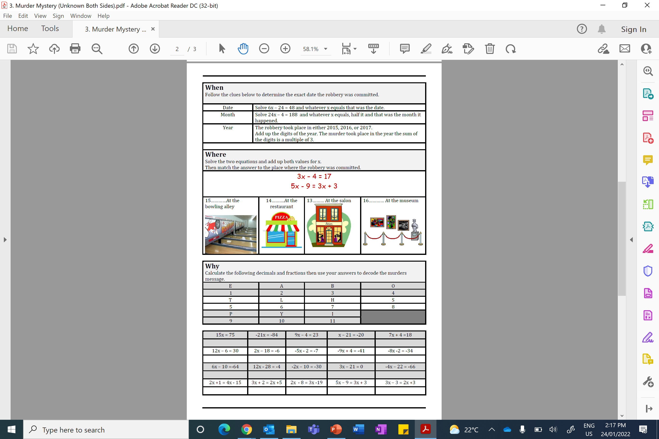

Slide 2
ANSWERS

Slide 3
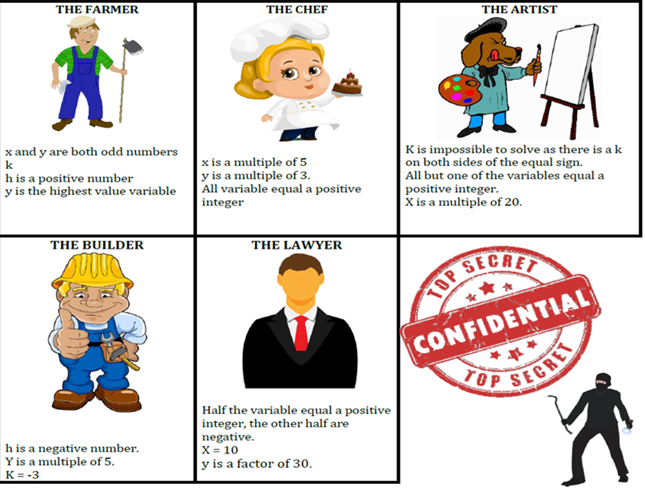
Robber: Artist
Lawyer: Victim

Slide 4
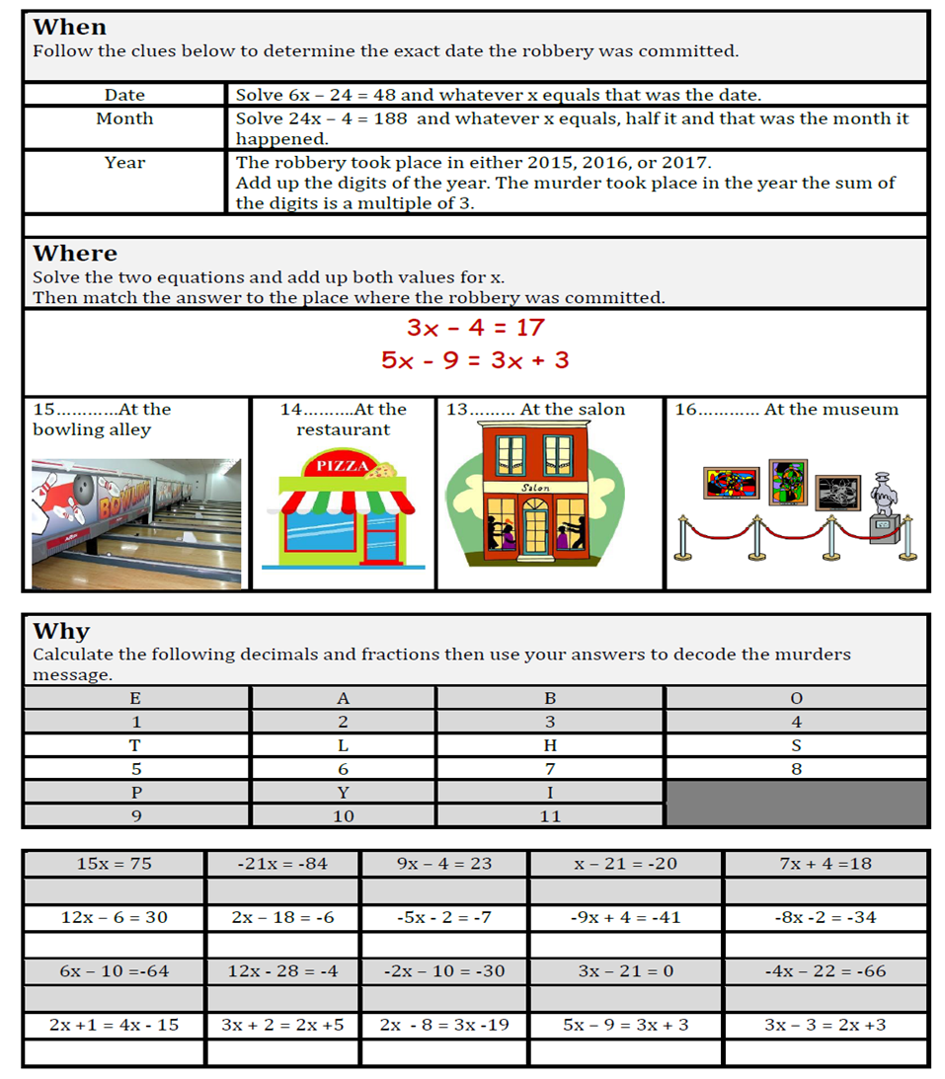
12/04/2016

Slide 5
Salon

Slide 6
T
o
B
e
A
b
l
e
T
o
P
a
y
H
i
s
B
i
l
l

