Slide 1

The Open Box Problem
The managing director has asked you, as design manager,
to design an open box that will give maximum volume.

Slide 2
How can you turn the piece of card
into a net of an open box?

Slide 3
Cut squares off each corner.

Slide 4
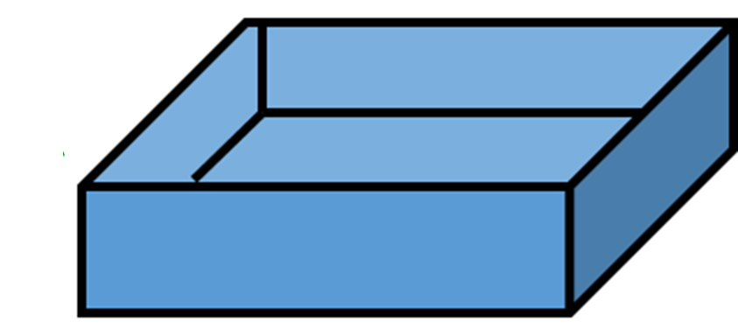
Fold to make an open box.

Slide 5
20cm
width
length
height
20cm
The MD has asked you to make the box from a 20cm square card.
The factory machinery is only able to cut squares
to the nearest whole number (1cm, 2cm, 3cm…etc.)

Slide 6
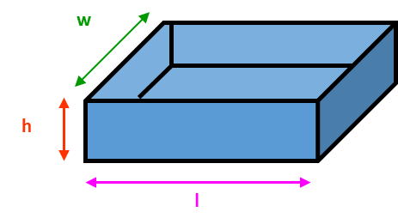
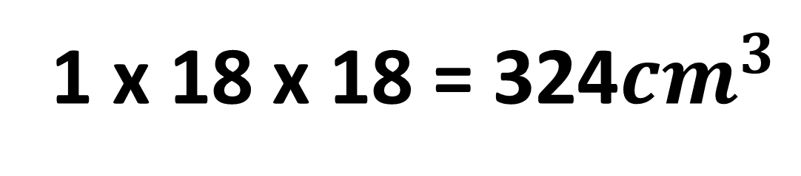
You cut a 1cm square from each corner.
What will be the volume of the box?
1 x 18 x 18 = 324${cm}^{3}$

Slide 7
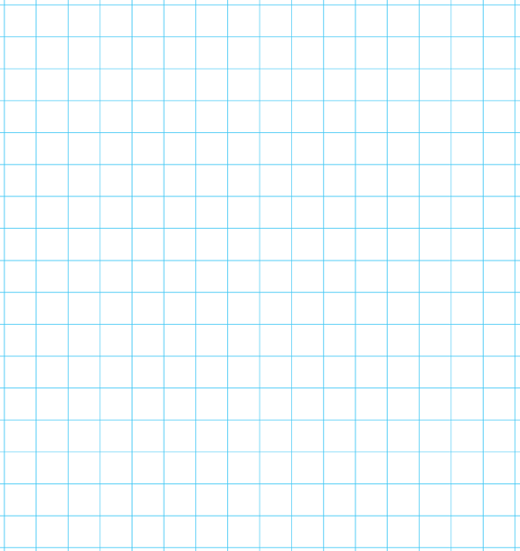

Height | Width | Length | Volume
1
2
3
4
5
6
7
8
9
10
18 | 18 | 324
16 | 16 | 512
14 | 14 | 588
12 | 12 | 576
10 | 10 | 500
8 | 8 | 384
6 | 6 | 252
4 | 4 | 128
2 | 2 | 36
0 | 0 | 0
610
600
590
Volume (${cm}^{3}$)
580
570
560
0
2
3
4
6
8
10
Height (cm)

Slide 8
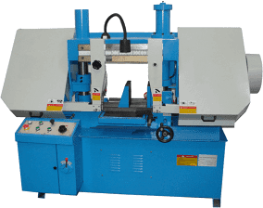
The machinery that cuts the squares
is upgraded and can now cut to
the nearest tenth.
What should the
new dimensions
of the box be now?

Slide 9
Height | Width | Length | Volume
2.6
2.7
2.8
2.9
3.0
3.1
3.2
3.3
3.4
3.5
14.8 | 14.8 | 569.5
14.6 | 14.6 | 575.5
14.4 | 14.4 | 580.6
14.2 | 14.2 | 584.7
14.0 | 14.0 | 588
13.8 | 13.8 | 590.4
13.6 | 13.6 | 591.9
13.4 | 13.4 | 592.5
13.2 | 13.2 | 592.4
13 | 13 | 591.5
610
600
590
Volume (${cm}^{3}$)
580
570
560
2.4
2.6
2.8
3
3.2
3.4
3.6
Height (cm)

Slide 10
Can you write a formula for calculating Length using only the letters L, C and H.
Height = H
Length = L
Volume = V
Card Size = C
L = C – 2H
Can you write a formulae for calculating Volume, using only the letters V, C and H.
V = (C – 2H)(C – 2H)H

