Slide 1
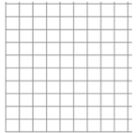
1a) Draw a histogram.
1b) How many times were over 20 seconds?
Time (Seconds) | Frequency
0 < t ≤ 10 | 6
10 < t ≤ 15 | 5
15 < t ≤ 25 | 8
25 < t ≤ 40 | 6
1c) What percentage of times were over 20 seconds?
2) Draw a
frequency diagram.
3) Draw a
frequency polygon
Time (Seconds) | Frequency
0 < t ≤ 20 | 6
20 < t ≤ 40 | 5
40 < t ≤ 60 | 8
60 < t ≤ 80 | 6
Time (Seconds) | Frequency
0 < t ≤ 10 | 6
10 < t ≤ 15 | 5
15 < t ≤ 25 | 8
25 < t ≤ 40 | 6

Slide 2
4a) Draw a cumulative frequency graph
4b) What is the median time?
Time (Seconds) | Frequency | Cumulative Frequency
0 < t ≤ 10 | 6
10 < t ≤ 15 | 5
15 < t ≤ 25 | 8
25 < t ≤ 40 | 6
4c) What is the interquartile range?
5a) Calculate the mean time
5b) What is the modal group?
Time (Seconds) | Frequency
0 < t ≤ 10 | 6
10 < t ≤ 15 | 5
15 < t ≤ 25 | 8
25 < t ≤ 40 | 6
5c) What group contains the median?

Slide 3
ANSWERS

Slide 4
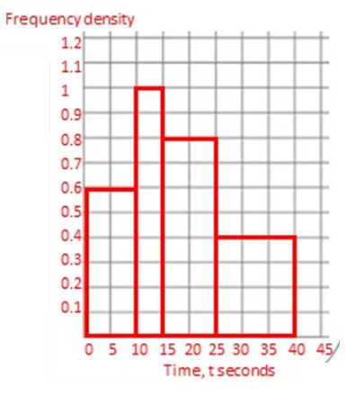
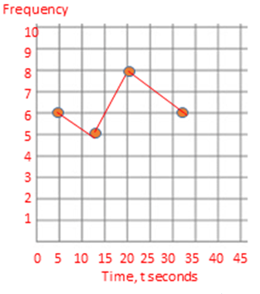
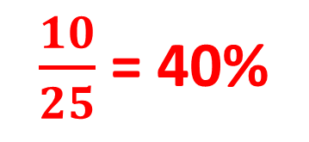
1a) Draw a histogram.
1b) How many times were over 20 seconds?
Time (Seconds) | Frequency
0 < t ≤ 10 | 6
10 < t ≤ 15 | 5
15 < t ≤ 25 | 8
25 < t ≤ 40 | 6
10
1c) What percentage of times were over 20 seconds?
$\frac{10}{25}$ = 40%
2) Draw a
frequency diagram.
3) Draw a
frequency polygon
8
7
Time (Seconds) | Frequency
0 < t ≤ 10 | 6
10 < t ≤ 15 | 5
15 < t ≤ 25 | 8
25 < t ≤ 40 | 6
Time (Seconds) | Frequency
0 < t ≤ 20 | 6
20 < t ≤ 40 | 5
40 < t ≤ 60 | 8
60 < t ≤ 80 | 6
6
5
4
3
2
1
0
0
20
40
60
80

Slide 5
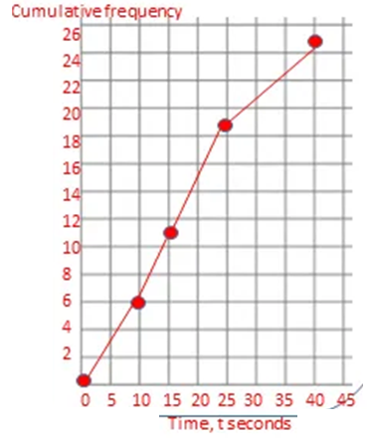
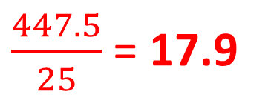
4a) Draw a cumulative frequency graph
4b) What is the median time?
16
Time (Seconds) | Frequency | Cumulative Frequency
0 < t ≤ 10 | 6 | 6
10 < t ≤ 15 | 5 | 11
15 < t ≤ 25 | 8 | 19
25 < t ≤ 40 | 6 | 25
6
11
19
25
4c) What is the interquartile range?
25 – 11 = 14
5a) Calculate the mean time
5b) What is the modal group?
Time (Seconds) | Frequency
0 < t ≤ 10 | 6
10 < t ≤ 15 | 5
15 < t ≤ 25 | 8
25 < t ≤ 40 | 6
15 < t ≤ 25
5 x 6 = 30
12.5 x 5 = 62.5
20 x 8 = 160
32.5 x 6 = 195
5c) What group contains the median?
15 < t ≤ 25
$\frac{447.5}{25}$ = 17.9

