Slide 1
Variable Acceleration
Using Differentiation
Chapter 11
(Part 2 of 3)

Slide 2
Variable Acceleration: Using Differentiation

Slide 3
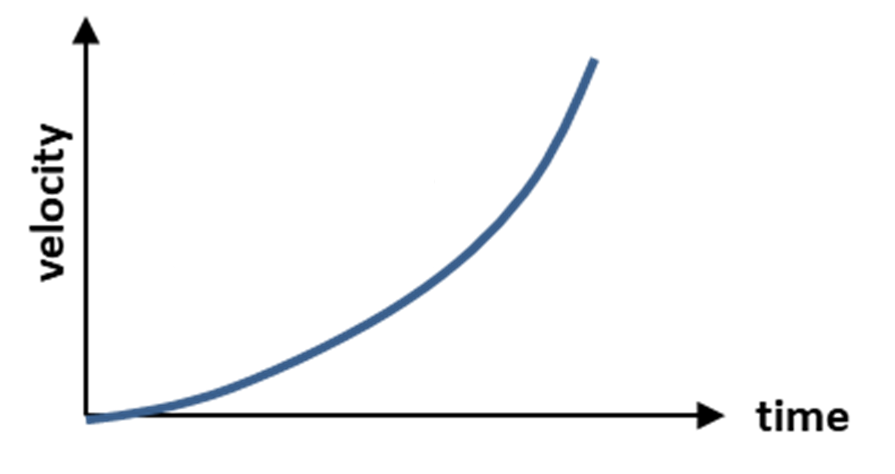
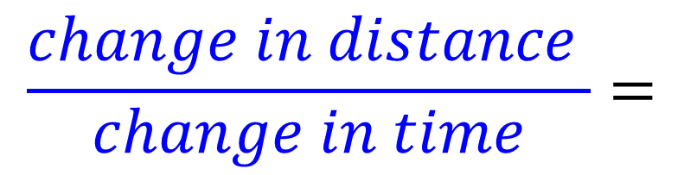
What does the gradient of the tangent tell you?
s
displacement
t
$$\frac{change in distance }{change in time}=$$
Velocity

Slide 4
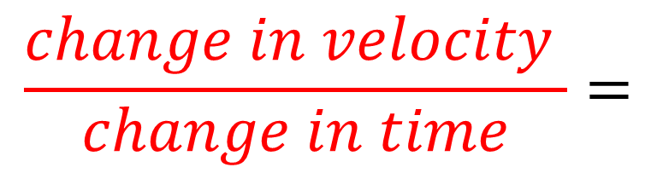
What does the gradient of the tangent tell you?
v
Velocity
t
$$\frac{change in velocity }{change in time}=$$
Acceleration

Slide 5
Variable Acceleration - Using Calculus
Displacement (s)
differentiate
integration
Velocity (v)
differentiate
integration
Acceleration (a)

Slide 6
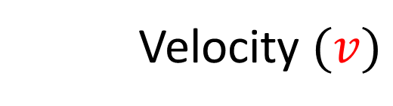
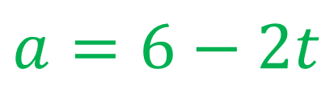
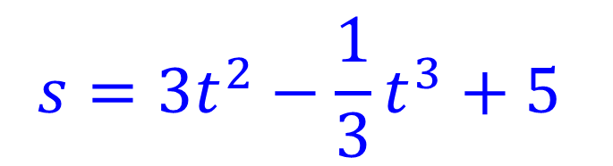
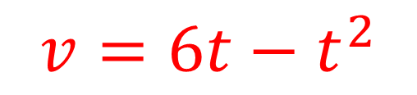
Find an equation for the acceleration.
$$s=3t^{2}−\frac{1}{3}t^{3}+5$$
Displacement $(s)$
Velocity $(v)$
$$v=6t−t^{2}$$
Acceleration $(a)$
$$a=6−2t$$

Slide 7
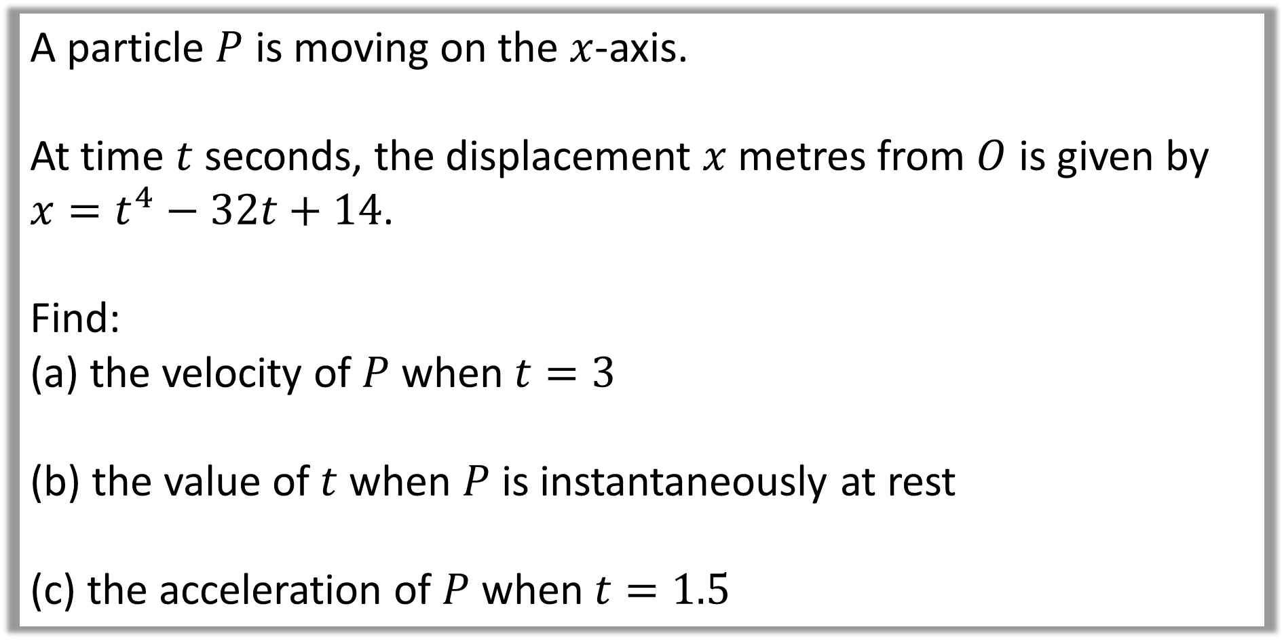
Question A
A particle $P$ is moving on the $x$-axis.
At time $t$ seconds, the displacement $x$ metres from $O$ is given by
$x=t^{4}−32t+14$.
Find:
the velocity of $P$ when $t=3$
the value of $t$ when $P$ is instantaneously at rest
the acceleration of $P$ when $t=1.5$

Slide 8

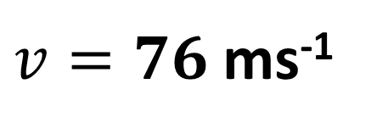


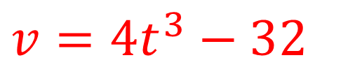

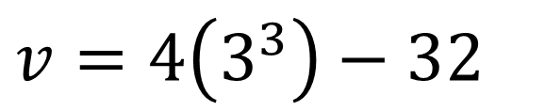
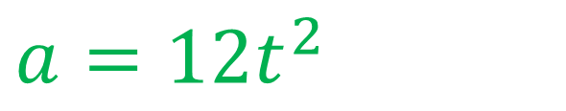
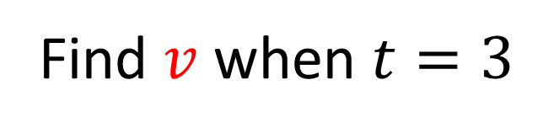
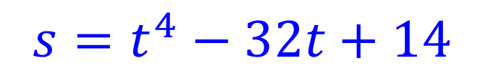
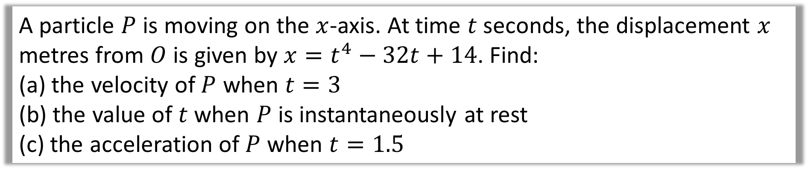

A particle $P$ is moving on the $x$-axis. At time $t$ seconds, the displacement $x$ metres from $O$ is given by $x=t^{4}−32t+14$. Find:
the velocity of $P$ when $t=3$
the value of $t$ when $P$ is instantaneously at rest
the acceleration of $P$ when $t=1.5$
$(s)$
$$s=t^{4}−32t+14$$
a.
Find $v$ when $t=3$
$$v=4\left(3^{3}\right)−32$$
$$(v)$$
$$v={4t}^{3}−32$$
$v=76$ ms⁻¹
$(a)$
$$a={12t}^{2}$$
$$∫a dt$$
$$\frac{d}{dt}$$

Slide 9
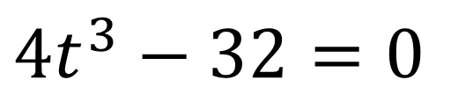

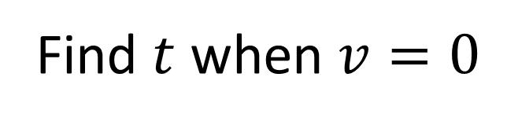

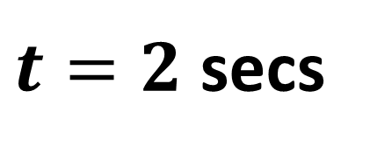
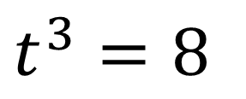
A particle $P$ is moving on the $x$-axis. At time $t$ seconds, the displacement $x$ metres from $O$ is given by $x=t^{4}−32t+14$. Find:
the velocity of $P$ when $t=3$
the value of $t$ when $P$ is instantaneously at rest
the acceleration of $P$ when $t=1.5$
$$s=t^{4}−32t+14$$
Find $t$ when $v=0$
$(s)$
b.
$$∫a dt$$
$$\frac{d}{dt}$$
$$4t^{3}−32=0$$
$$(v)$$
$$v={4t}^{3}−32$$
$$t^{3}=8$$
$(a)$
$$a={12t}^{2}$$
$t=2$ secs

Slide 10
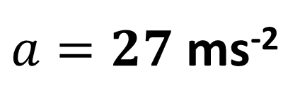

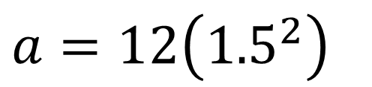
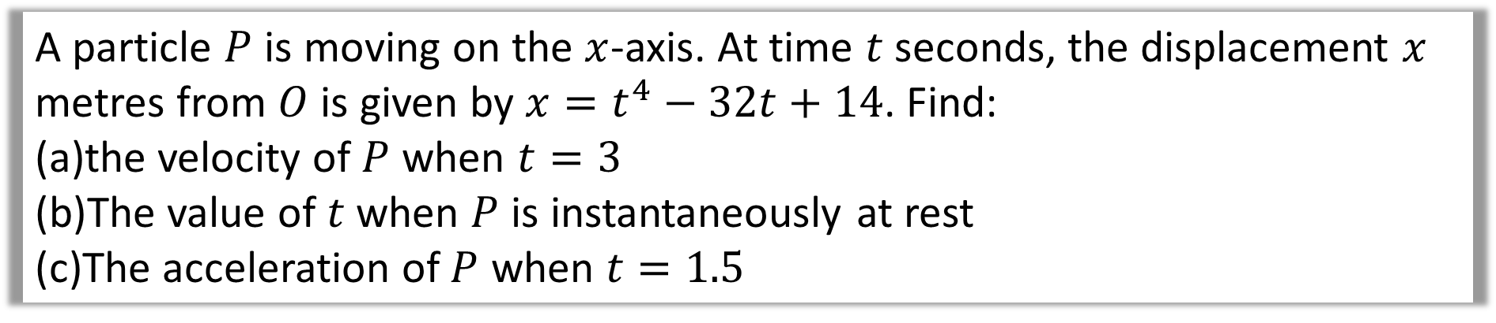
A particle $P$ is moving on the $x$-axis. At time $t$ seconds, the displacement $x$ metres from $O$ is given by $x=t^{4}−32t+14$. Find:
the velocity of $P$ when $t=3$
The value of $t$ when $P$ is instantaneously at rest
The acceleration of $P$ when $t=1.5$
$(s)$
$$s=t^{4}−32t+14$$
c.
Find $a$ when $t=1.5$
$$a=12\left({1.5}^{2}\right)$$
$$(v)$$
$$v={4t}^{3}−32$$
$a=27$ ms⁻²
$(a)$
$$a={12t}^{2}$$

Slide 11
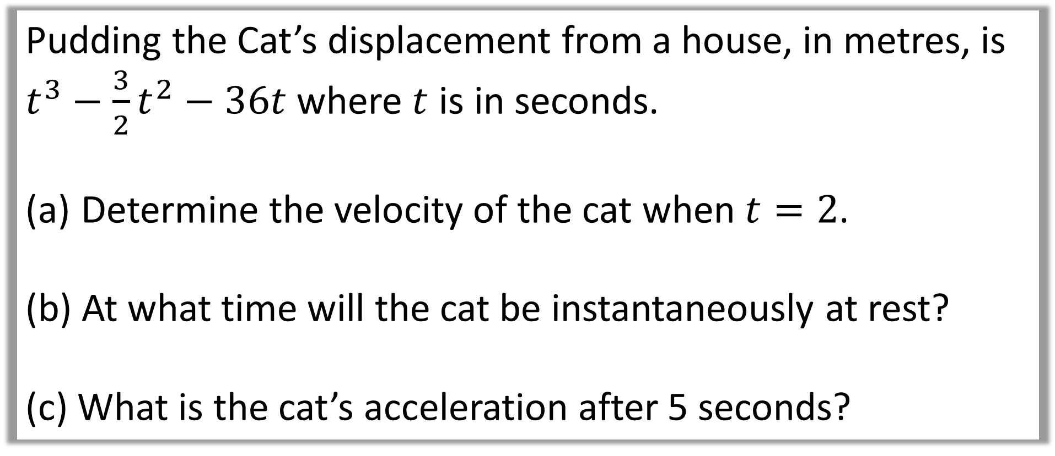
Question B
Pudding the Cat’s displacement from a house, in metres, is
$t^{3}−\frac{3}{2}t^{2}−36t$ where $t$ is in seconds.
Determine the velocity of the cat when $t=2$.
(b) At what time will the cat be instantaneously at rest?
(c) What is the cat’s acceleration after 5 seconds?

Slide 12

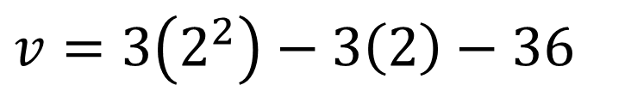

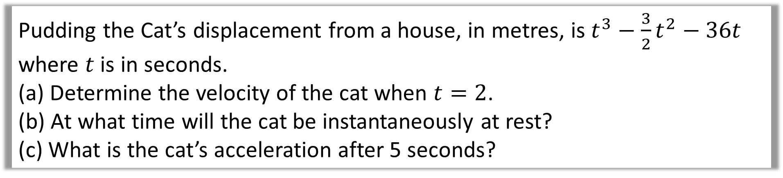

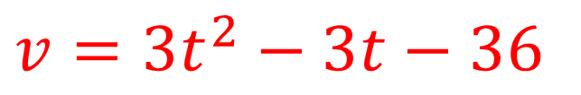
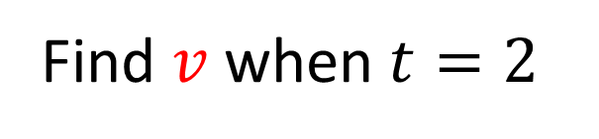
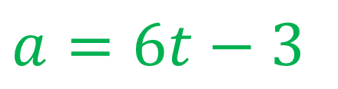
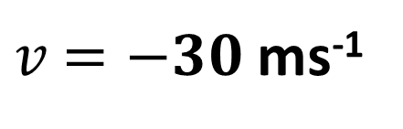
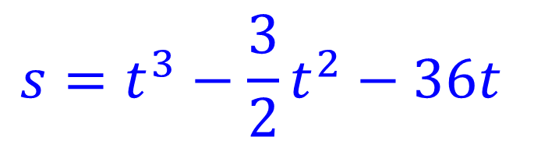
Pudding the Cat’s displacement from a house, in metres, is $t^{3}−\frac{3}{2}t^{2}−36t$ where $t$ is in seconds.
(a) Determine the velocity of the cat when $t=2$.
(b) At what time will the cat be instantaneously at rest?
(c) What is the cat’s acceleration after 5 seconds?
$$s=t^{3}−\frac{3}{2}t^{2}−36t$$
$(s)$
a)
Find $v$when $t=2$
$$v=3\left(2^{2}\right)−3\left(2\right)−36$$
$$(v)$$
$$v=3t^{2}−3t−36$$
$v$ $=−30$ ms⁻¹
$(a)$
$$a=6t−3$$

Slide 13

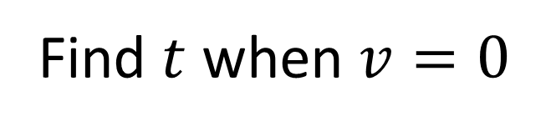


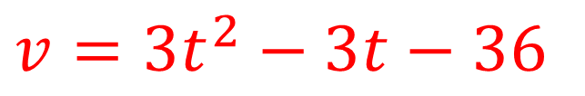
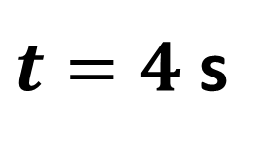
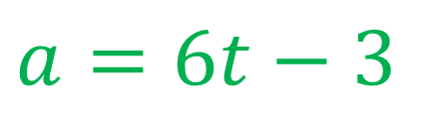
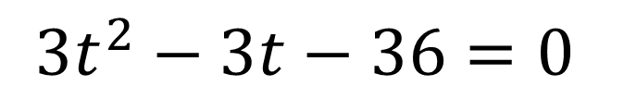
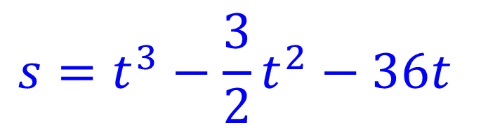
Pudding the Cat’s displacement from a house, in metres, is $t^{3}−\frac{3}{2}t^{2}−36t$ where $t$ is in seconds.
(a) Determine the velocity of the cat when $t=2$.
(b) At what time will the cat be instantaneously at rest?
(c) What is the cat’s acceleration after 5 seconds?
$$s=t^{3}−\frac{3}{2}t^{2}−36t$$
$(s)$
b)
Find $t$ when $v=0$
$$3t^{2}−3t−36=0$$
$$(v)$$
$$v=3t^{2}−3t−36$$
$t=4$ s
$(a)$
$$a=6t−3$$

Slide 14
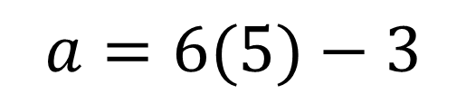
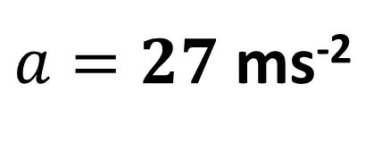
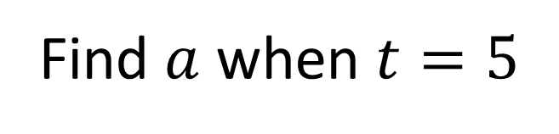
Pudding the Cat’s displacement from a house, in metres, is $t^{3}−\frac{3}{2}t^{2}−36t$ where $t$ is in seconds.
(a) Determine the velocity of the cat when $t=2$.
(b) At what time will the cat be instantaneously at rest?
(c) What is the cat’s acceleration after 5 seconds?
$$s=t^{3}−\frac{3}{2}t^{2}−36t$$
c)
Find $a$ when $t=5$
$(s)$
$$a=6(5)−3$$
$$(v)$$
$$v=3t^{2}−3t−36$$
$a=27$ ms⁻²
$(a)$
$$a=6t−3$$

Slide 15
Maximum and Minimum values of displacement,
velocity and acceleration

Slide 16
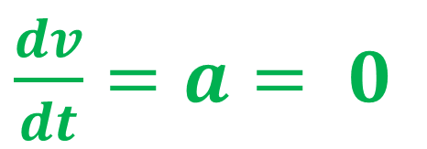
What value will acceleration be
at the turn point of the graph?
Velocity
$\frac{dv}{dt}=a= 0$
0
Time

Slide 17

What value will acceleration be
at the turn point of the graph?
Velocity
0
Time
$\frac{dv}{dt}=a=0$

Slide 18
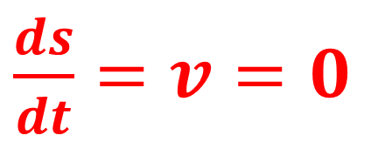
What value will velocity be
at the turn point of the graph?
displacement
$\frac{ds}{dt}=v=0$
0
Time

Slide 19
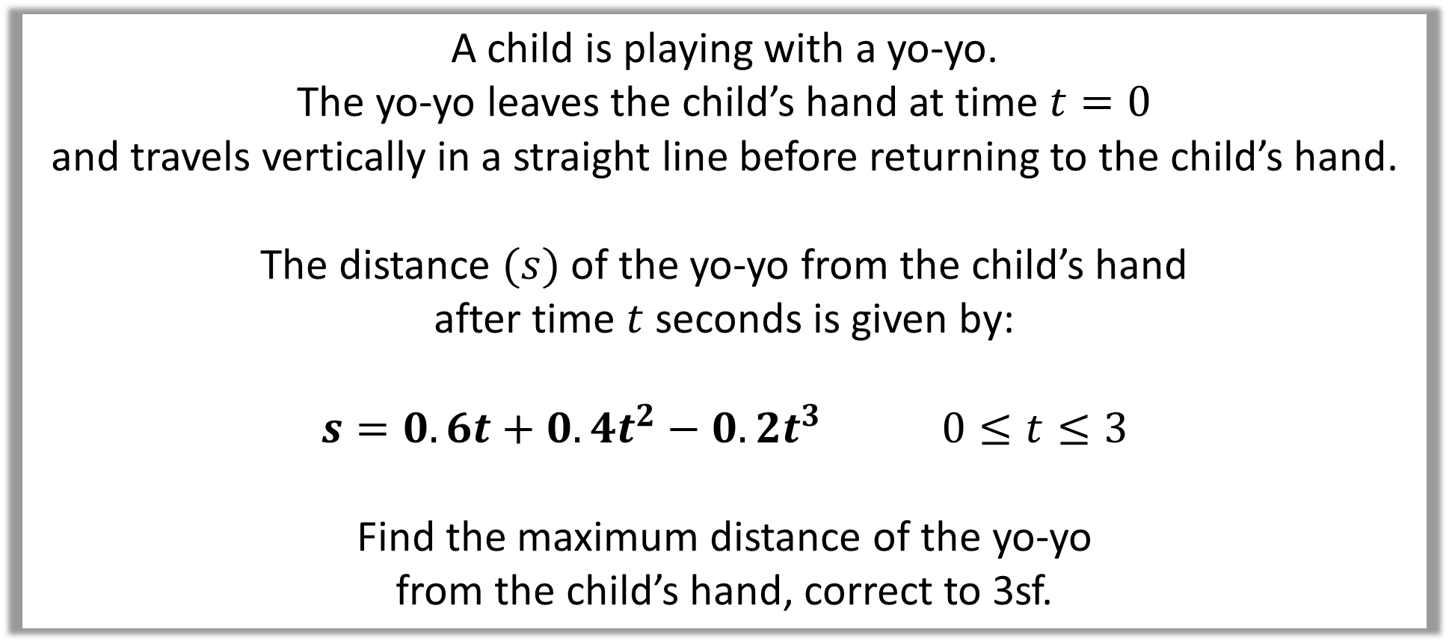
Questions C
A child is playing with a yo-yo.
The yo-yo leaves the child’s hand at time $t=0$
and travels vertically in a straight line before returning to the child’s hand.
The distance $(s)$ of the yo-yo from the child’s hand
after time $t$ seconds is given by:
$$s=0.6t+0.4t^{2}−0.2t^{3} 0≤t≤3$$
Find the maximum distance of the yo-yo
from the child’s hand, correct to 3sf.

Slide 20


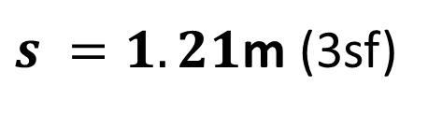

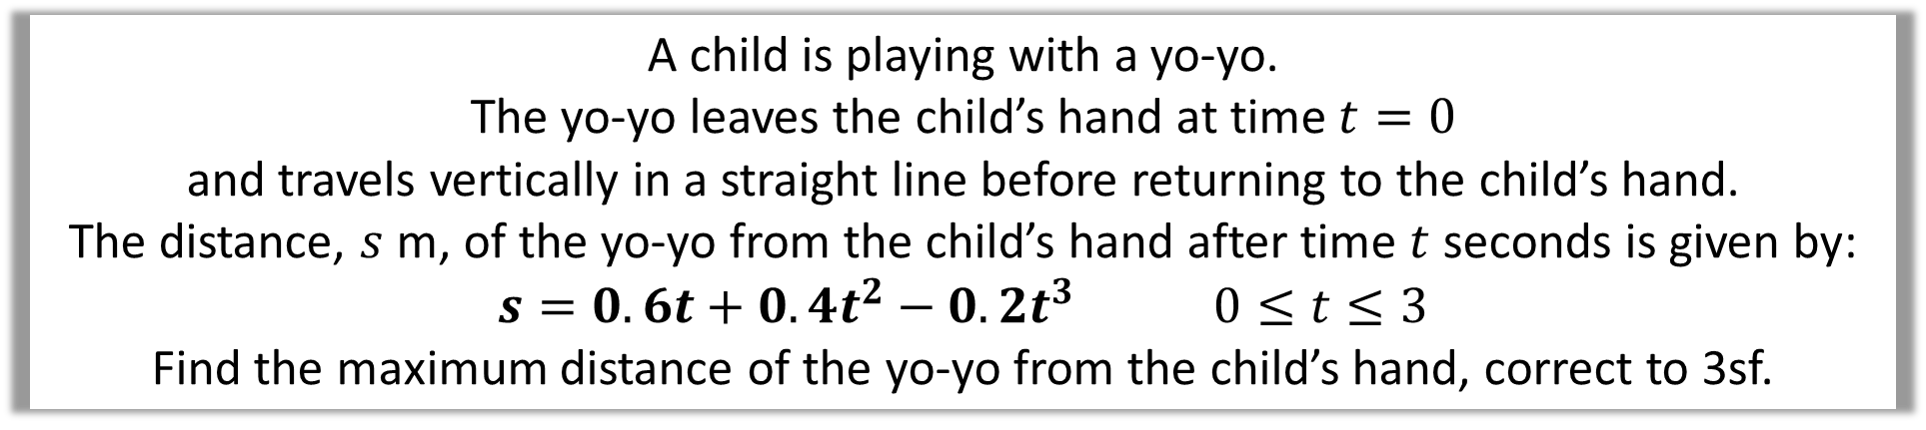


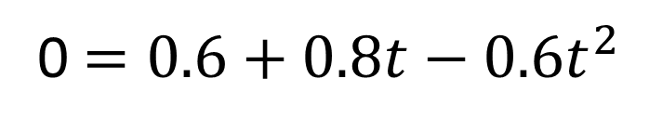

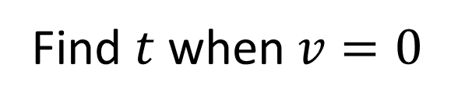

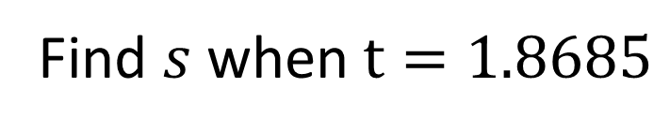
A child is playing with a yo-yo.
The yo-yo leaves the child’s hand at time $t=0$
and travels vertically in a straight line before returning to the child’s hand.
The distance, $s$ m, of the yo-yo from the child’s hand after time $t$ seconds is given by:
$$s=0.6t+0.4t^{2}−0.2t^{3} 0≤t≤3$$
Find the maximum distance of the yo-yo from the child’s hand, correct to 3sf.
Find $t$ when $v=0$
$(s)$
$$s=0.6t+0.4t^{2}−0.2t^{3}$$
0 $=0.6+0.8t−0.6t^{2}$
$$(v)$$
$$v=0.6+0.8t−0.6t^{2}$$
$$t=1.8685 or −0.5351$$
Find $s$ when $t=1.8685$
$(a)$
$$a=0.9−1.2t$$
$s=0.6\left(1.8685\right)+$ $0.4\left(1.8685\right)2−0.2\left(1.8685\right)$³
$s =1.21$m (3sf)

