Slide 1
LO: Probability
Equations

Slide 2
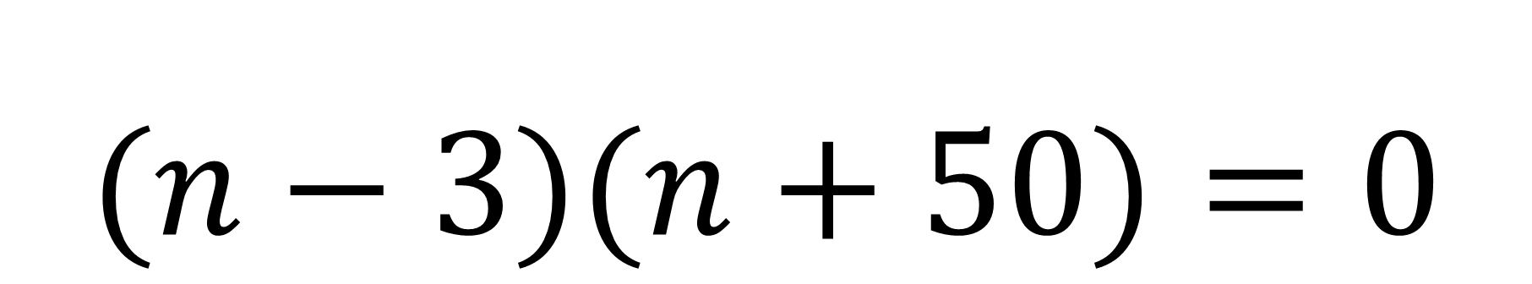
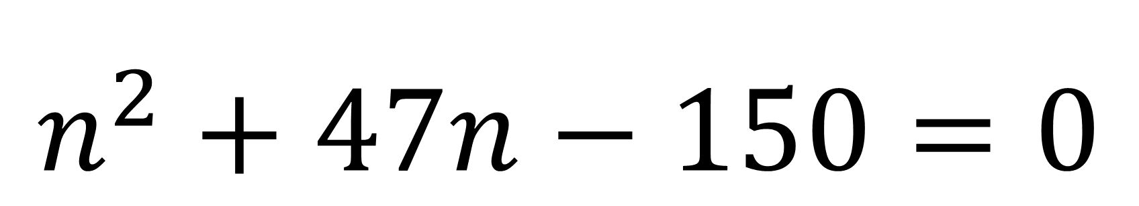
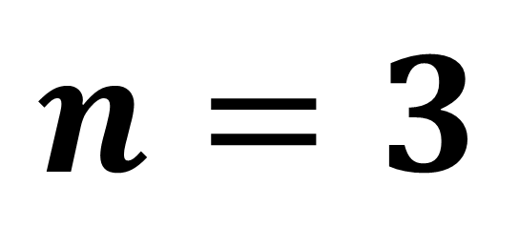
Solve for n. n is positive answer.
$n^{2}+47n−150=0$
$(n−3)(n+50)=0$
$$n=3$$

Slide 3



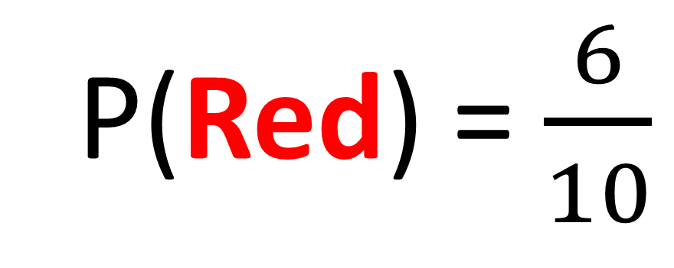
Hannah takes a sweet from the bag. What is the probability of getting a red?
P(Red) = $\frac{6}{10}$
= 6
= 4

Slide 4
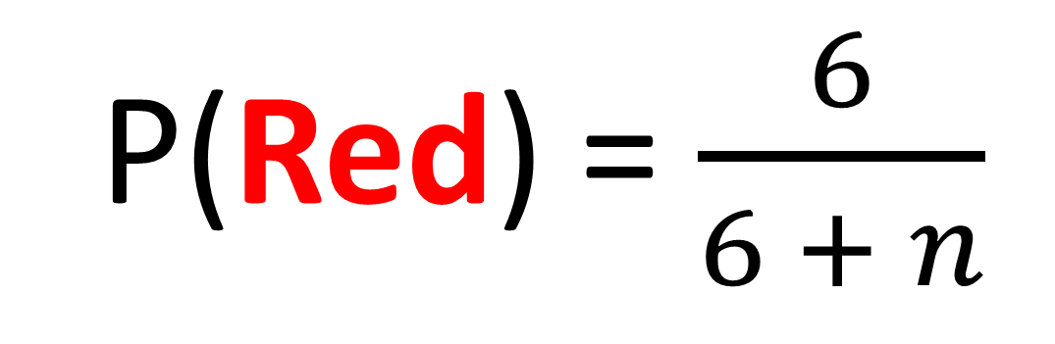
Hannah takes a sweet from the bag. What is the probability of getting a red?
P(Red) = $\frac{6}{6 + n}$
= 6
= n

Slide 5
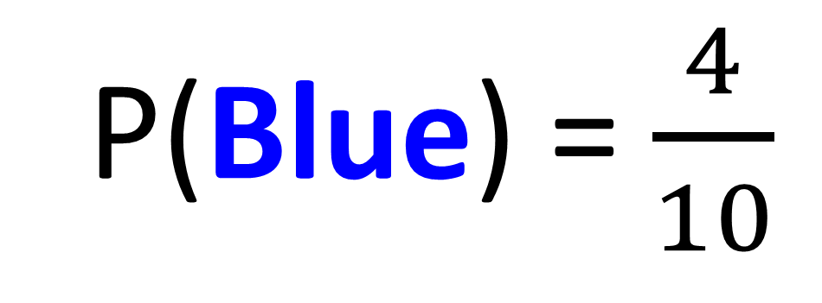
Hannah takes a sweet from the bag.
What is the probability of getting a blue?
P(Blue) = $\frac{4}{10}$
= 6
= 4

Slide 6
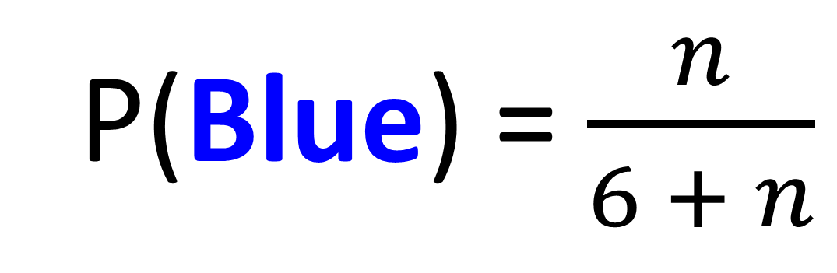
Hannah takes a sweet from the bag. What is the probability of getting a blue?
P(Blue) = $\frac{n}{6 + n}$
= 6
= n

Slide 7
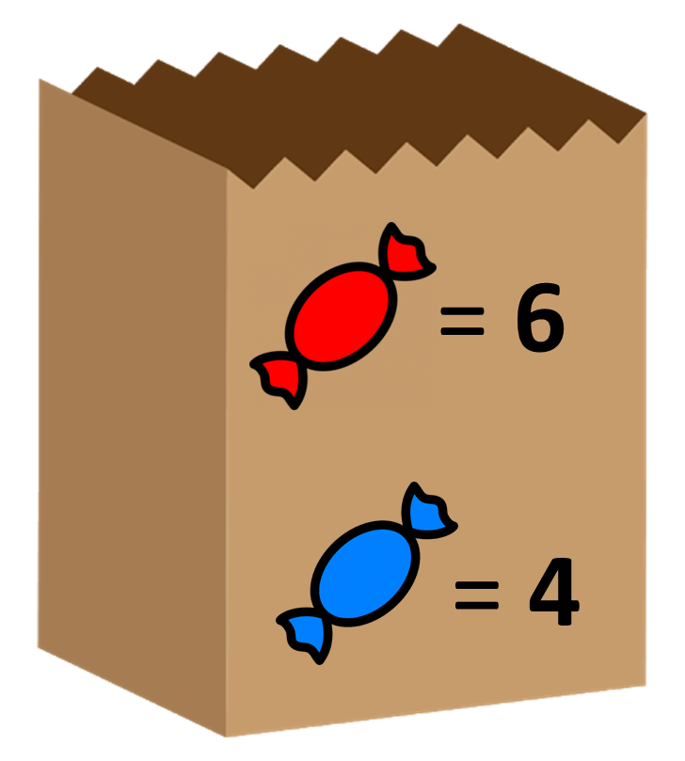


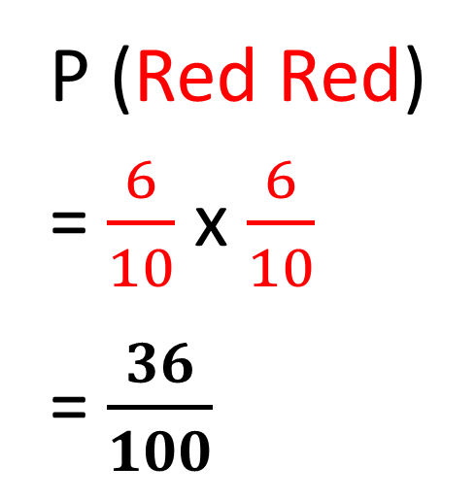
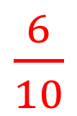
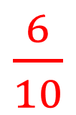
Hannah takes a sweet from the bag then
replaces it. She then takes a second sweet.
What is the chance of her picking two red sweets?
= 6
P(Red)
= 6
P(Red)
P (Red Red)
= $\frac{6}{10}$ x $\frac{6}{10}$
= $\frac{36}{100}$
$\frac{6}{10}$
$\frac{6}{10}$
= 4
= 4

Slide 8

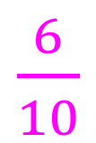
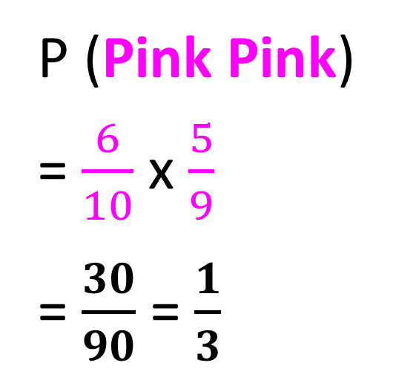

Hannah takes a sweet from the bag and then
does not replace it. She then takes a second sweet.
What is the chance of her picking two pink sweets?
= 6
P(Pink)
= 5
P(Pink)
P (Pink Pink)
= $\frac{6}{10}$ x $\frac{5}{9}$
= $\frac{30}{90}$ = $\frac{1}{3}$
$\frac{6}{10}$
$\frac{5}{9}$
= 4
= 4

Slide 9
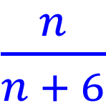
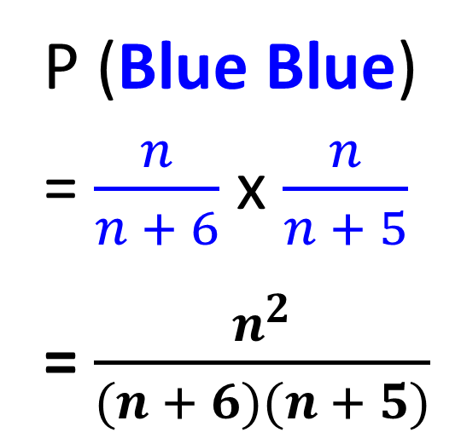
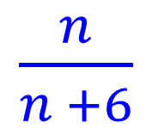
Hannah takes a sweet from the bag and then replaces it. She then takes a second sweet.
What is the chance of her picking two blue sweets?
= 6
P(Blue)
= 6
P(Blue)
P (Blue Blue)
= $\frac{n}{n + 6}$ x $\frac{n}{n + 5}$
= $\frac{n^{2}}{(n + 6)(n + 5)}$
$\frac{n}{n + 6}$
$\frac{n}{n +6}$
= n
= n

Slide 10
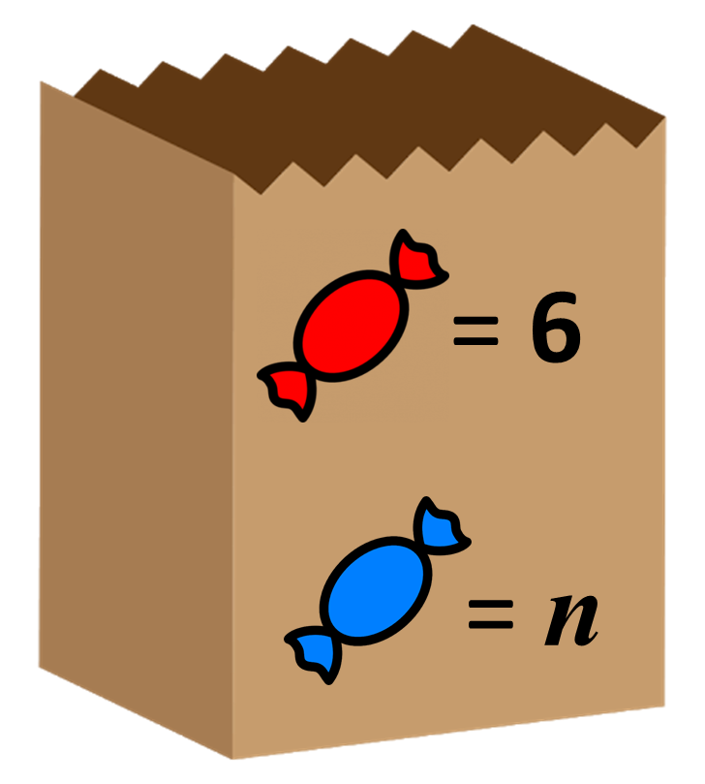
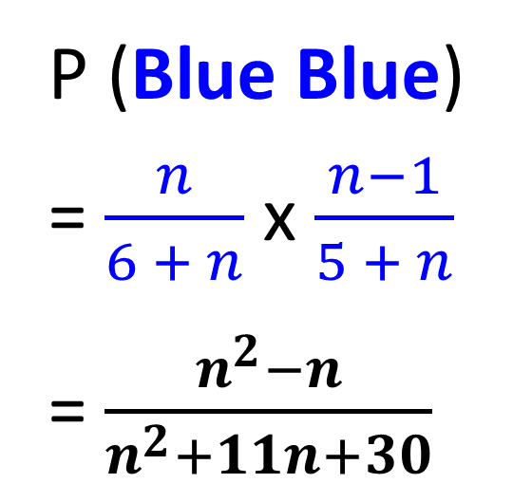
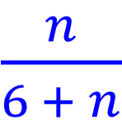
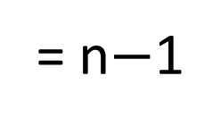
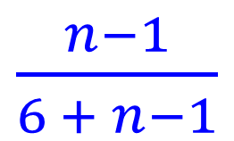
Hannah takes a sweet from the bag but does
not replace it. She then takes a second sweet.
What is the chance of her picking two blue sweets?
= 6
P(Blue)
= 6
P(Blue)
P (Blue Blue)
= $\frac{n}{6 + n}$ x $\frac{n−1}{5 + n}$
= $\frac{n^{2}−n}{n^{2}+11n+30}$
$\frac{n}{6 + n}$
$\frac{n−1}{6 + n−1}$
= n
= n$−$1

Slide 11

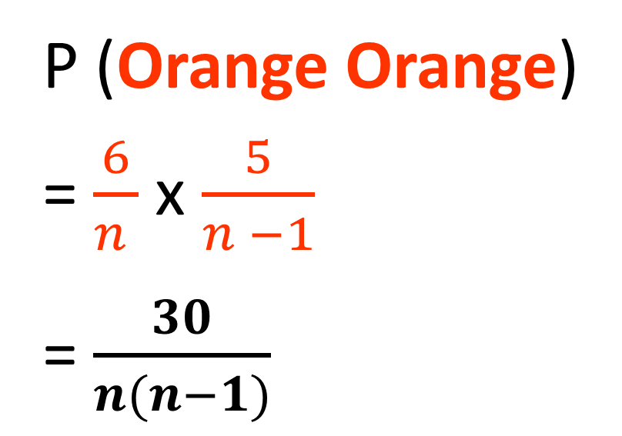
There are n sweets in a bag. 6 of the sweets are orange.
The rest of the sweets are green.
Hannah takes at random a sweet from the bag. She eats the sweet.
Hannah then takes another sweet from the bag. She eats the sweet.
Given that the probability that Hannah eats two orange sweets is 1/3. Find the value of 𝑛.
P (Orange Orange)
= $\frac{6}{n }$ x $\frac{5}{n −1}$
= $\frac{30}{n(n−1)}$
= 6
Total Sweets = n

Slide 12
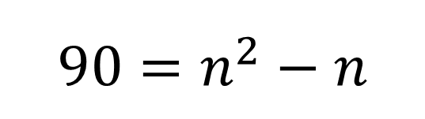
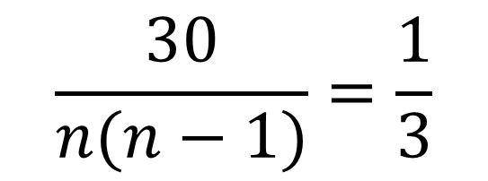
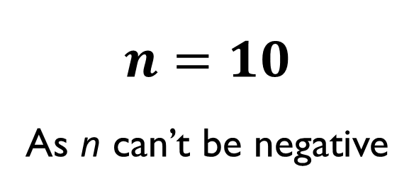
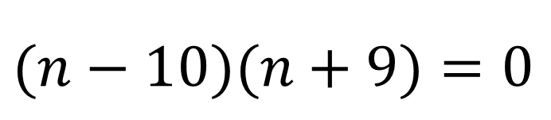
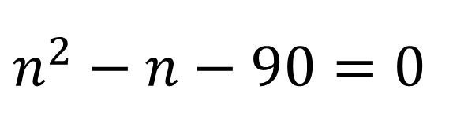
$$\frac{30}{n(n−1)}=\frac{1}{3}$$
= 6
$$90=n^{2}−n$$
Total Sweets = n
$n^{2}−n−90=0$
$(n−10)(n+9)=0$
$$n=10$$
As n can’t be negative

Slide 13
There are some red counters and some blue counters in a bag.
The ratio of red counters to blue counters is 3:1
Write an express in terms of x for the number of blue counters.
Blue Counters = x
Write an express in terms of x for the number of red counters.
Red Counters = 3x
Write an express in terms of x for the total number of counters.
Total Counters = 4x

Slide 14
There are some red counters and some blue counters in a bag.
The ratio of red counters to blue counters is 3:2
Write an express in terms of x for the number of blue counters.
Blue Counters = 2x
Write an express in terms of x for the number of red counters.
Red Counters = 3x
Write an express in terms of x for the number of total number of counters.
Total Counters = 5x

