Slide 1
Integration
Limits
Chapter 13
(Part 2 of 3)

Slide 2
Integration – Area Under a Graph
The most helpful use of integration is that it can help
find the area under a graph.

Slide 3

Finding the area of under a speed-time graph would help you find what?
speed
$$Area=distance$$
time

Slide 4
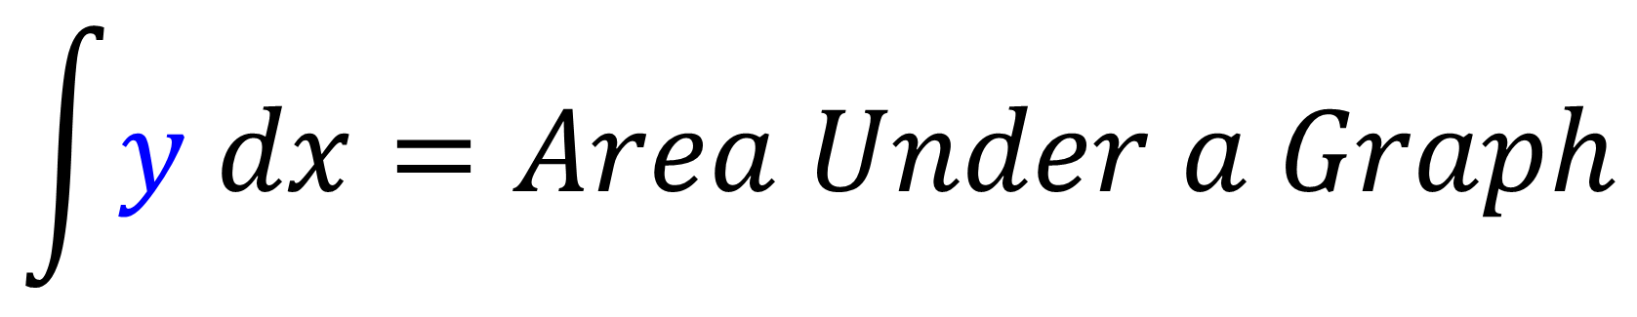
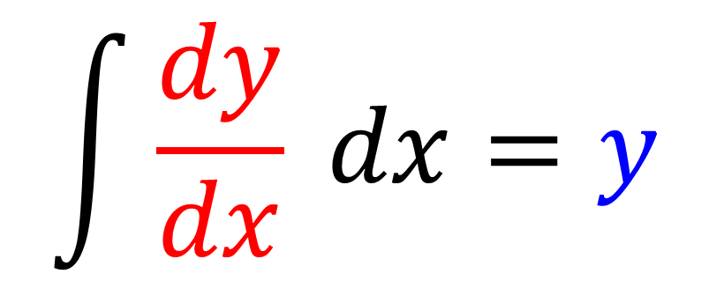
$$\int{\frac{dy}{dx} dx=y}$$
$$\int{y dx}=Area Under a Graph$$

Slide 5
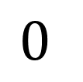



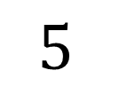
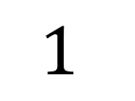
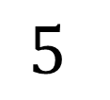
You need to know the limits
over which you wish to find the area .
$$y$$
$$y$$
$$Area=distance$$
$$Area=distance$$
$$x$$
$$x$$
$$1$$
$$5$$
$$0$$
$$5$$

Slide 6

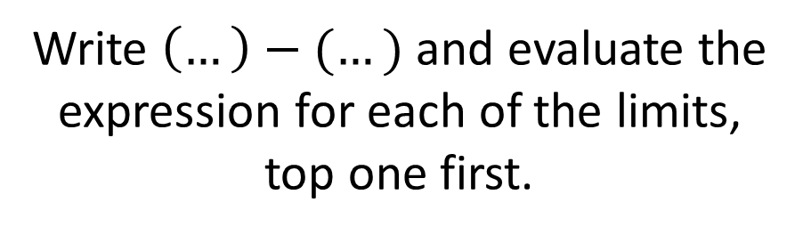
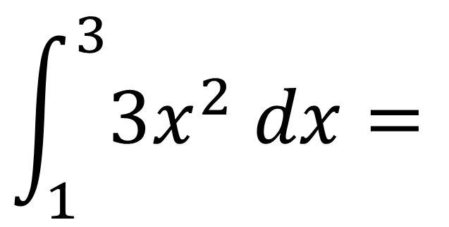
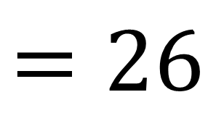
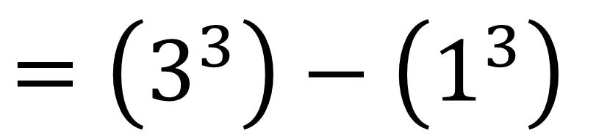
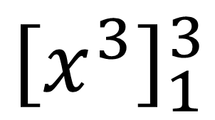
These are known as limits, which give the values of $x$ we’re finding the area between.
Integrate as normal,
but put expression in
square brackets, meaning you still need to evaluate the integrated expression using the limits
$$\int_{1}^{3}{{3x}^{2} dx}=$$
$${\left[x^{3}\right]}_{1}^{3}$$
$$=\left(3^{3}\right)−\left(1^{3}\right)$$
$$=26$$
Write $\left(…\right)−(…)$ and evaluate the expression for each of the limits, top one first.

Slide 7
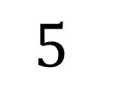
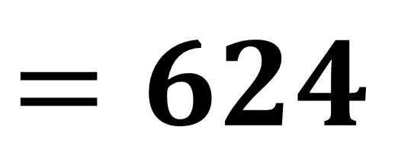

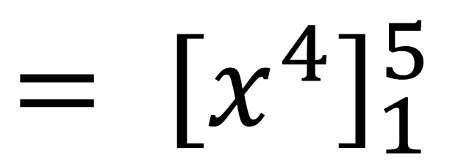

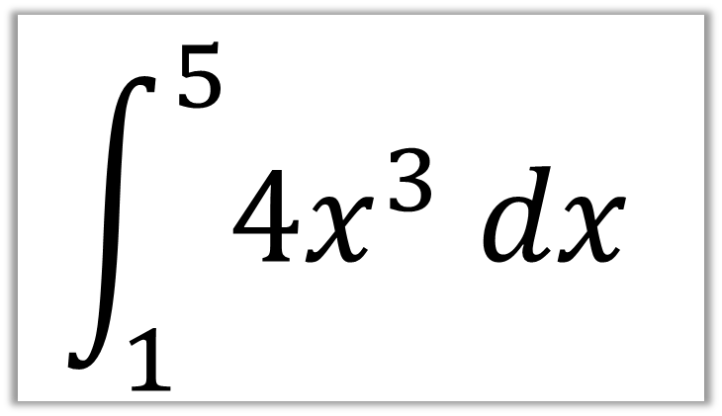
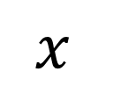
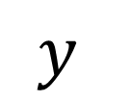
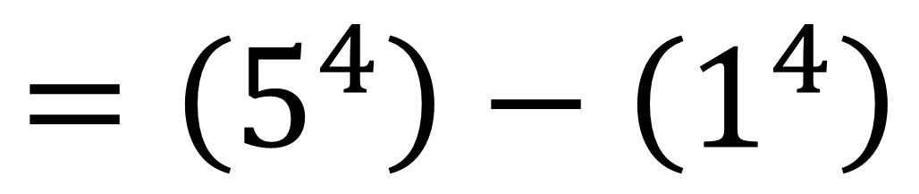

$$\int_{1}^{5}{4x^{3} dx}$$
$${= \left[x^{4}\right]}_{1}^{5}$$
$$=\left(5^{4}\right)−\left(1^{4}\right)$$
$$y$$
$$=624$$
$$?$$
$$Area=distance$$
$$x$$
$$1$$
$$5$$

Slide 8
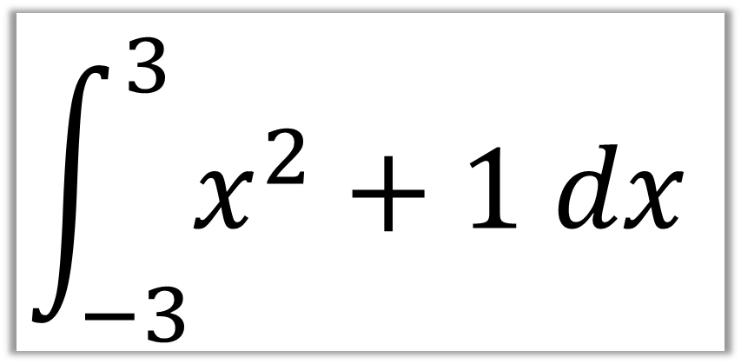
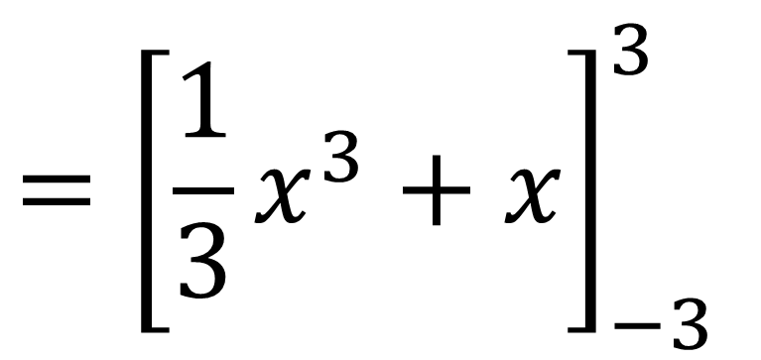
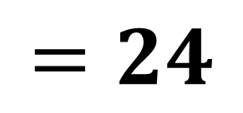
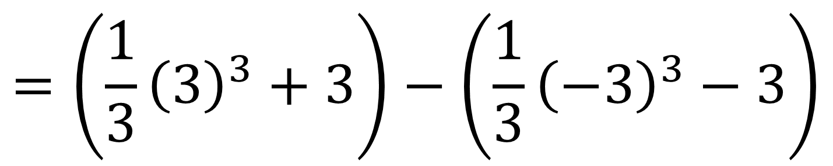
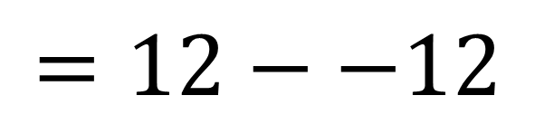
$$\int_{−3}^{3}{x^{2}+1 dx}$$
$${=\left[\frac{1}{3}x^{3}+x\right]}_{−3}^{3}$$
$$=\left(\frac{1}{3}{\left(3\right)}^{3}+3\right)−\left(\frac{1}{3}{\left(−3\right)}^{3}−3\right)$$
$$=12−−12$$
$$=24$$

Slide 9
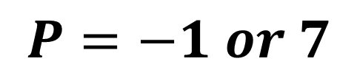
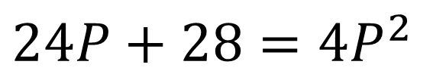
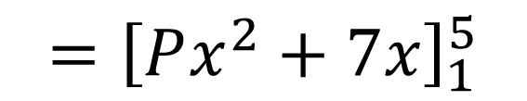
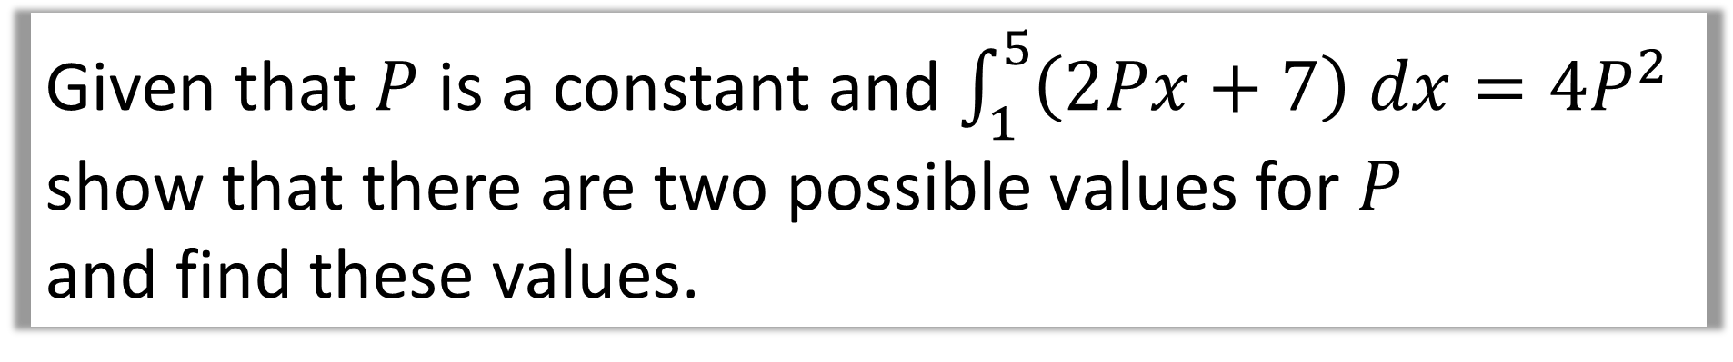
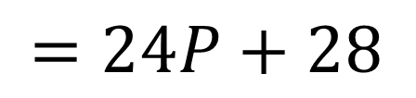
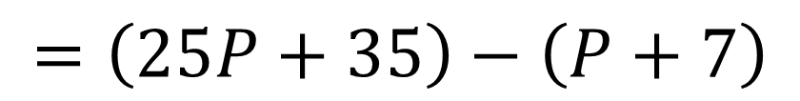
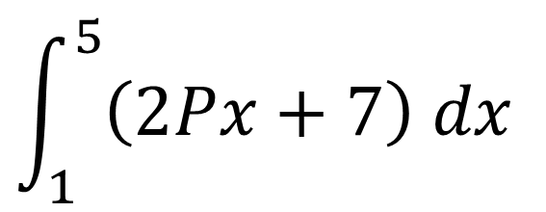
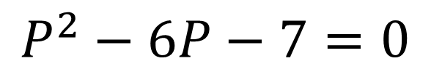
Given that $P$ is a constant and $\int_{1}^{5}{\left(2Px+7\right) dx}=4P^{2}$
show that there are two possible values for $P$
and find these values.
$$\int_{1}^{5}{\left(2Px+7\right) dx}$$
$$24P+28=4P^{2}$$
$${=\left[Px^{2}+7x\right]}_{1}^{5}$$
$$P^{2}−6P−7=0$$
$$=\left(25P+35\right)−\left(P+7\right)$$
$$P=−1 or 7$$
$$=24P+28$$

Slide 10
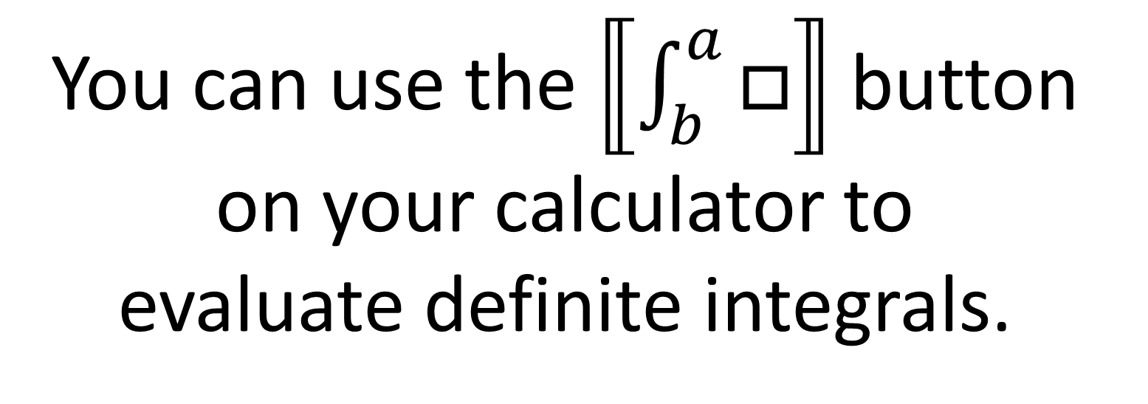
Integration – Limits
You can use the $⟦\int_{b}^{a}{□}⟧$ button
on your calculator to
evaluate definite integrals.
But only use it to check your answer.

Slide 11
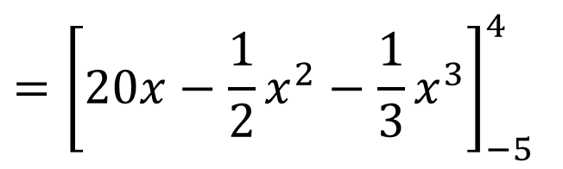
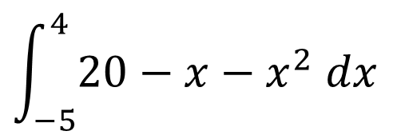

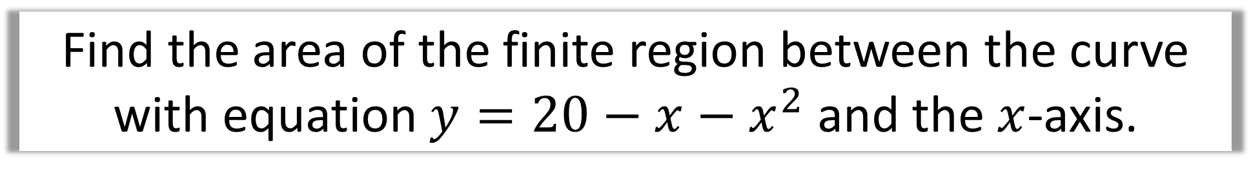

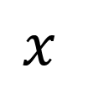
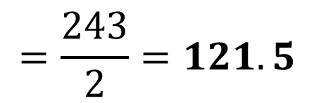

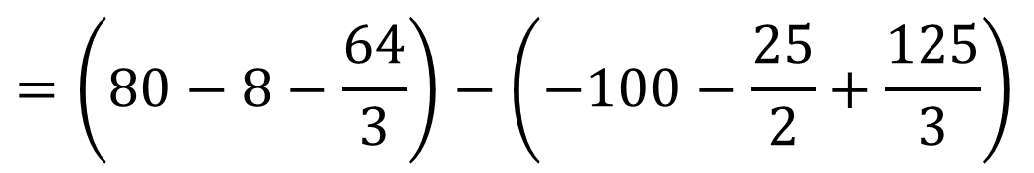
Find the area of the finite region between the curve
with equation $y=20−x−x^{2}$ and the $x$-axis.
$$\int_{−5}^{4}{20−x−x^{2} dx}$$
$$y$$
$$={\left[20x−\frac{1}{2}x^{2}−\frac{1}{3}x^{3}\right]}_{−5}^{4}$$
$$=\left(80−8−\frac{64}{3}\right)−\left(−100−\frac{25}{2}+\frac{125}{3}\right)$$
$$x$$
$$−5$$
$$4$$
$$=\frac{243}{2}=121.5$$

Slide 12
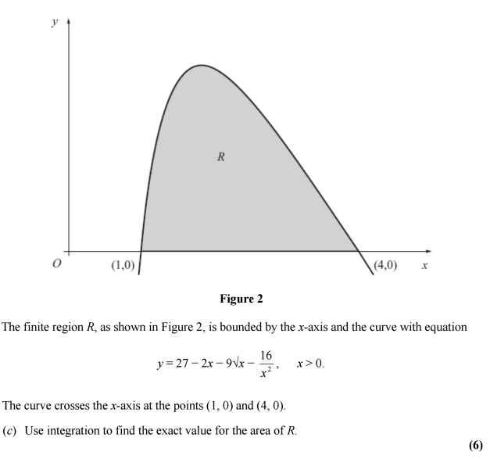
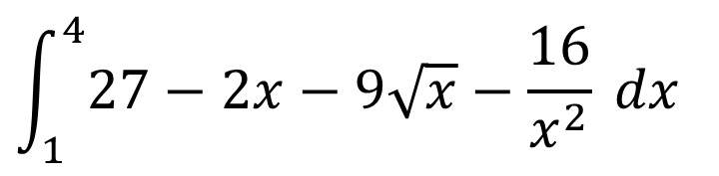

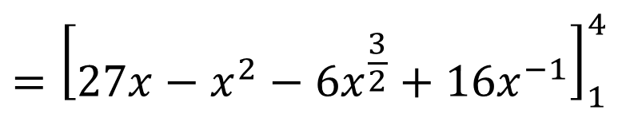

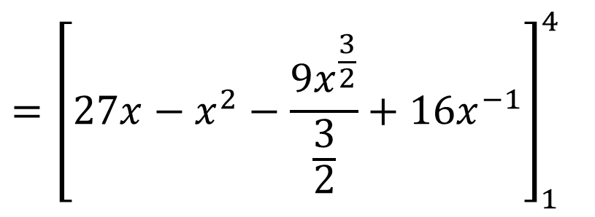
Solution: 12
$$\int_{1}^{4}{27−2x−9\sqrt{x}}−\frac{16}{x^{2}} dx$$
$$={\left[27x−x^{2}−\frac{{9x}^{\frac{3}{2}}}{\frac{3}{2}}+{16x}^{−1}\right]}_{1}^{4}$$
$$={\left[27x−x^{2}−{6x}^{\frac{3}{2}}+{16x}^{−1}\right]}_{1}^{4}$$
$$=\left(48\right)−\left(36\right)$$
$$=12$$

Slide 13
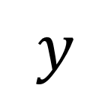
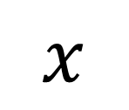


Area under the axis will show a
negative value.
$$y$$
$$x$$
$$1$$
$$2$$

Slide 14
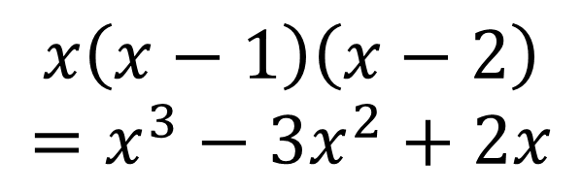
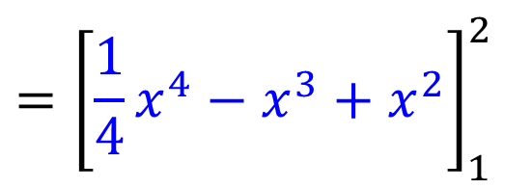

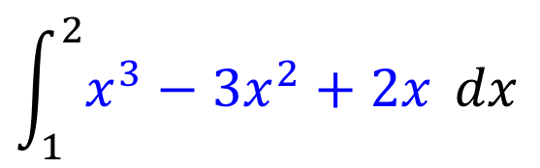
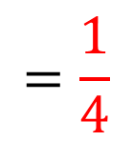


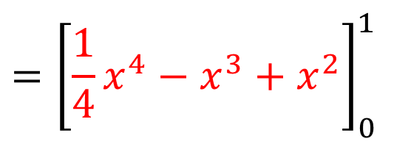

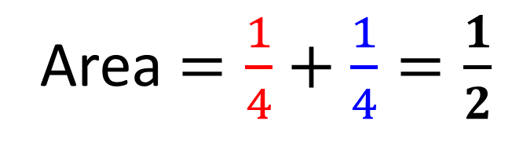



Find the total area bound between the curve $y=x(x−1)(x−2)$ and the $x$-axis.
$$x\left(x−1\right)\left(x−2\right)$$
$$=x^{3}−3x^{2}+2x$$
$$\int_{0}^{1}{x^{3}−3x^{2}+2x} dx$$
$$\int_{1}^{2}{x^{3}−3x^{2}+2x} dx$$
$$={\left[\frac{1}{4}x^{4}−x^{3}+x^{2}\right]}_{0}^{1}$$
$$={\left[\frac{1}{4}x^{4}−x^{3}+x^{2}\right]}_{1}^{2}$$
$$y$$
$$=\frac{1}{4}$$
$$=−\frac{1}{4}$$
$$1$$
$$2$$
$$x$$
Area $=\frac{1}{4}+\frac{1}{4}=\frac{1}{2}$

Slide 15


a)
$$\left(−4,0\right) and (2,0)$$

Slide 16










$$\int_{−4}^{0}{x^{3}+{2x}^{2}−8x dx}$$
$$\int_{0}^{2}{x^{3}+{2x}^{2}−8x dx}$$
b)
$$y= x(x+ 4)(x−2)$$
$${y=(x}^{2}+ 4x)(x−2)$$
$${=\left[\frac{x^{4}}{4}+\frac{{2x}^{3}}{3}−{4x}^{2}\right]}_{−4}^{0}$$
$$={\left[\frac{x^{4}}{4}+\frac{{2x}^{3}}{3}−{4x}^{2}\right]}_{0}^{2}$$
$${y=x}^{3}− {2x}^{2}+{4x}^{2}−8x$$
$$42\frac{2}{3}+6\frac{2}{3}=$$
$${y=x}^{3}+ {2x}^{2}−8x$$
$$49\frac{1}{3}$$

Slide 17

Just for your interest…
Why does integrating a function
give you the area under the graph?
So, to draw a shaded circle (which has area!), it’s a bit like repeatedly drawing the circumference of a circle with gradually increasing radius.
Since the circumference is what the area is increasing by each time, the circumference is the gradient of the area of the circle, and conversely (by the definition of integration being the opposite of differentiation), the area is the integral of the circumference.

