Slide 1

Diagnostic Assessment .Delta 3
Unit 3
Inequalities
Solving Equations involving Fractions
Changing the subject of the formula
Algebraic Fractions

Slide 2
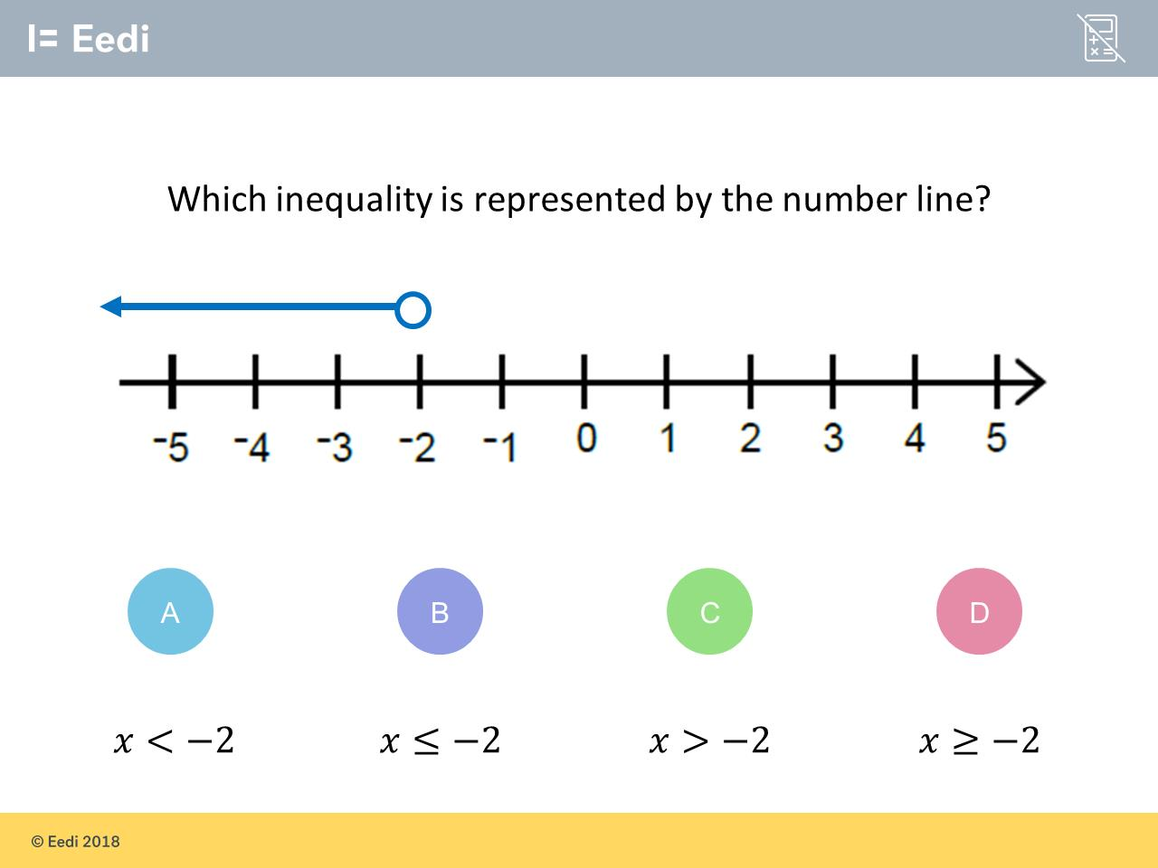
Question 1 – Inequalities

Slide 3
Answer 1 – Inequalities
CORRECT ANSWER | CORRECT EXPLANATION
x < -2 | The student has correctly noted that line is above numbers that are less than the number with the circle above it. The fact that the circle is open means that -2 is not included
COMMON MISTAKES | WHAT MIGHT BE YOUR MISTAKE
x ≤ -2 | The student has correctly identified that it is less than, but the coloured circle means that the number below it is also included.
x > -2 | This represents 𝑥 is greater than -2, in which case the line would be over the numbers that are greater than -2, so would point to the right
x ≥ -2 | This represents 𝑥 is greater than or equal to -2, so the circle would be coloured and the line would be above numbers that are greater than -2.

Slide 4
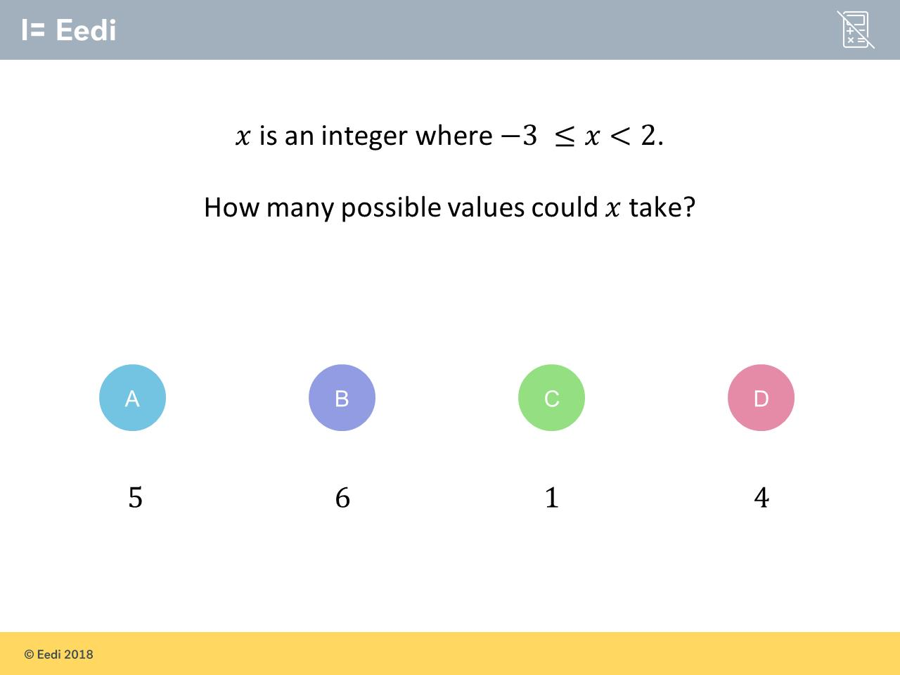
Question 2 – Inequalities

Slide 5
Answer 2 – Inequalities
CORRECT ANSWER | CORRECT EXPLANATION
5 | The whole numbers or integers which are greater than or equal to -2, and less than 2 are -3. -2. -1. 0 and 1. 2 is not included so there are 5 valid numbers
COMMON MISTAKES | WHAT MIGHT BE YOUR MISTAKE
6 | The student has included the 2
1 | The student may believe integers have to be positive numbers, in this case just number 1
4 | The student may have omitted 0, or the 3 both of which should be included

Slide 6
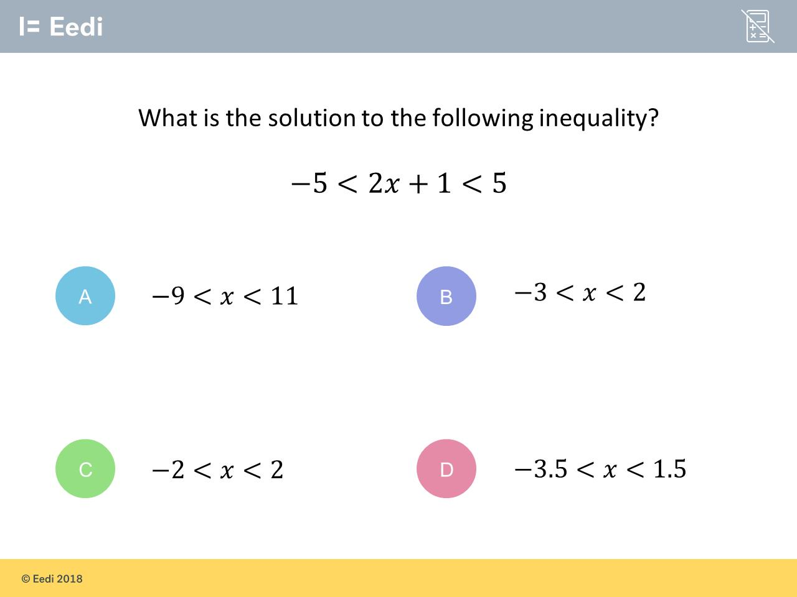
Question 3 – Inequalities

Slide 7
Answer 3 – Inequalities
CORRECT ANSWER | CORRECT EXPLANATION
-3 < x < 2 | Solve like it is an equation, doing the same to the left, centre and right of the inequality. First -1 to give -6 < 2𝑥 < 4. Now divide by 2 to give -3 < 𝑥 < 2
COMMON MISTAKES | WHAT MIGHT BE YOUR MISTAKE
-9 < x < 11 | The student has multiplied the outside numbers by 2 and then added 1, almost treating this like a substitution question rather than using the inverses to get the 𝑥 on its own.
-2 < x < 2 | The student has made a mistake when subtracting 1 from the -5, getting -4 instead of -6.
-3.5 < x < 1.5 | The student has divided by 2 first and then subtracted 1, which is the wrong order when doing the inverse.

Slide 8
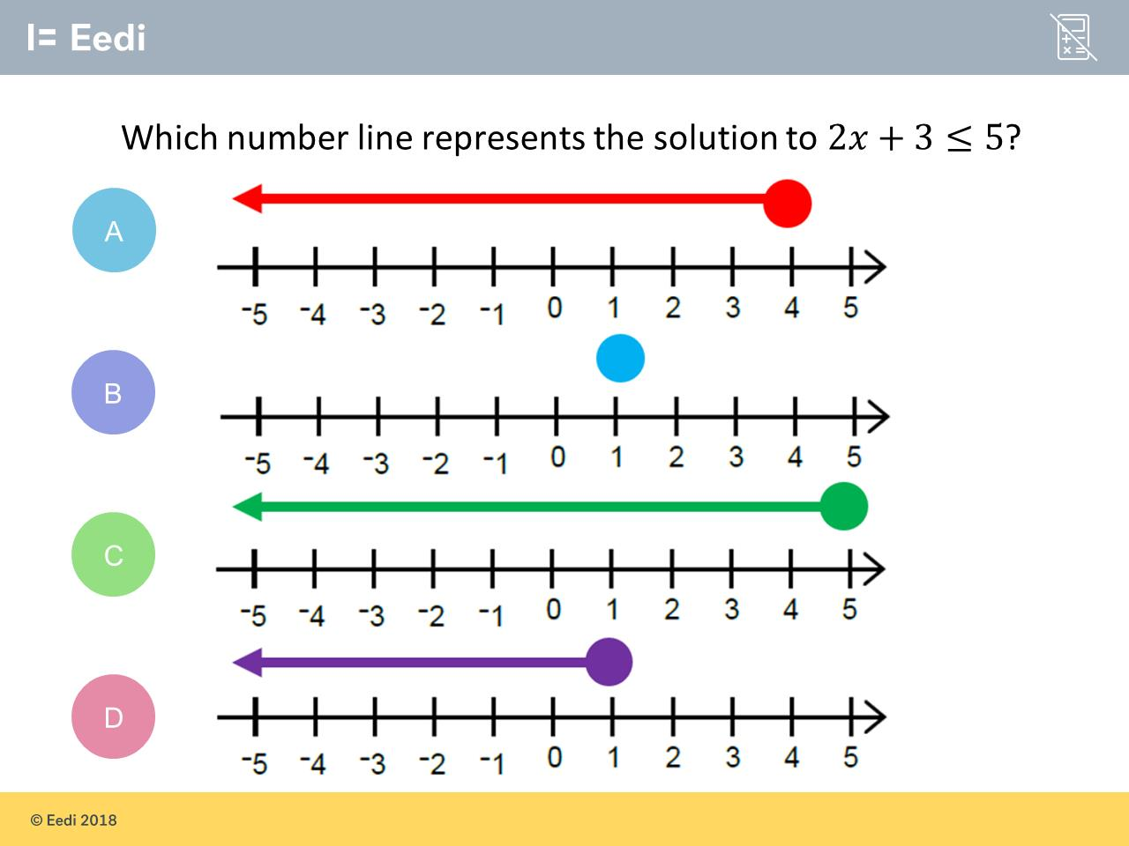
Question 4 – Inequalities

Slide 9
Answer 4 – Inequalities
CORRECT ANSWER | CORRECT EXPLANATION
D | Solve the inequality in the same way as in an equation and do not change any inequality signs. This will give 2𝑥 ≤ 2, and dividing by 2 gives 𝑥 ≤ 1. Represent this with a closed circle over the 1, and the line going over the numbers that are less than 1.
COMMON MISTAKES | WHAT MIGHT BE YOUR MISTAKE
A | The student has added 3 rather than subtracting to give 2𝑥 ≤ 8. They have then found 𝑥 ≤ 4.
B | The student has solved the inequality as an equation, replacing the ≤ with an =
C | The student has not solved the inequality, but has instead represented 𝑥 ≤ 5

Slide 10
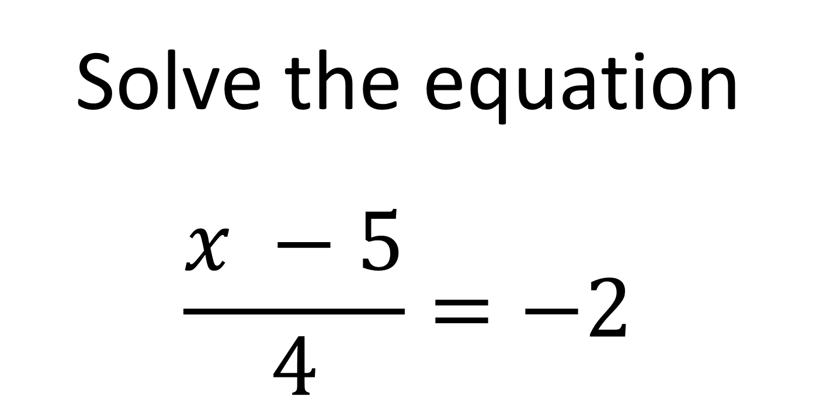
Question 5 – Solving Equations involving Fractions
Solve the equation
$$\frac{x −5}{4}=−2$$

Slide 11
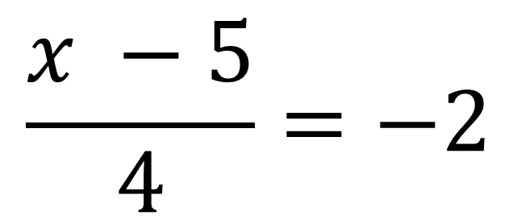
Answer 5 – Solving Equations involving Fractions
$$\frac{x −5}{4}=−2$$
Solve the equation
CORRECT ANSWER | CORRECT EXPLANATION
x = -3 | -2 x 4 = -8 then add 5
COMMON MISTAKES | WHAT MIGHT BE YOUR MISTAKE
x = -13 | The student got -8 but then subtracted 5.
x = 3 | The student forgot the negative.
x = 12 | The student added 5 first then multiplied by 4.

Slide 12
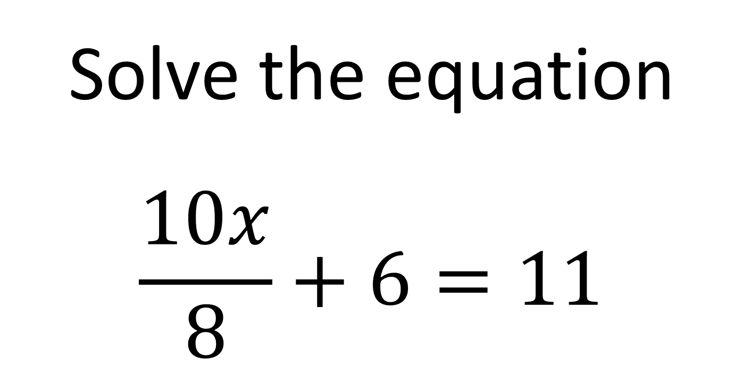
Question 6 – Solving Equations involving Fractions
Solve the equation
$$\frac{10x}{8}+6=11$$

Slide 13
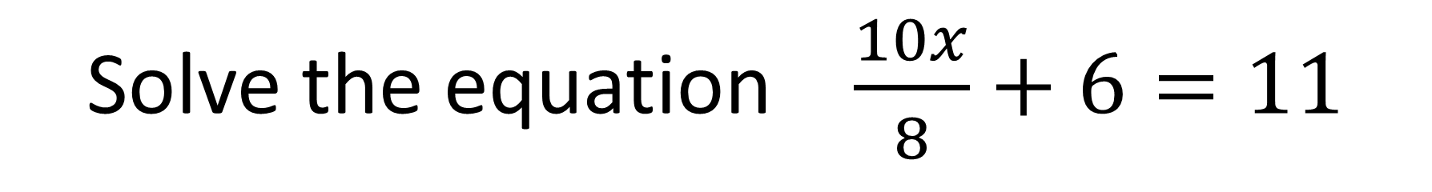
Answer 6 – Solving Equations involving Fractions
Solve the equation $\frac{10x}{8}+6=11$
CORRECT ANSWER | CORRECT EXPLANATION
x = 4 | 11 – 6 = 5 then 5 x 8 = 40 then 40 ÷ 10 = 4
COMMON MISTAKES | WHAT MIGHT BE YOUR MISTAKE
x = 13.6 | The student add 6 instead of subtracting.
x = 8.2 | Then student multiplied by 8 first instead of subtracting 6
x = 400 | Then student multiplied by 10 instead of dividing by 10

Slide 14
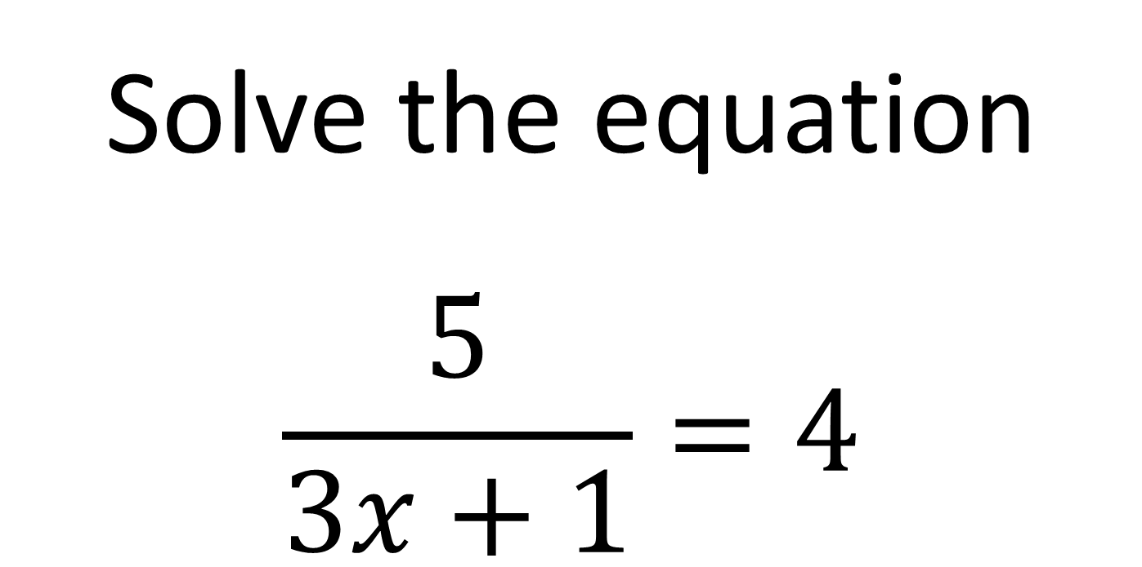
Question 7 – Solving Equations involving Fractions
Solve the equation
$$\frac{5}{3x+1}=4$$

Slide 15
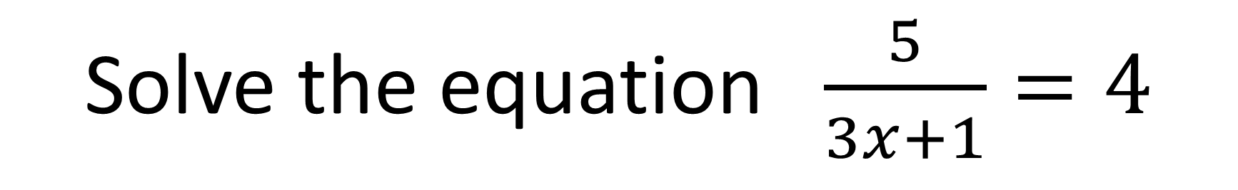
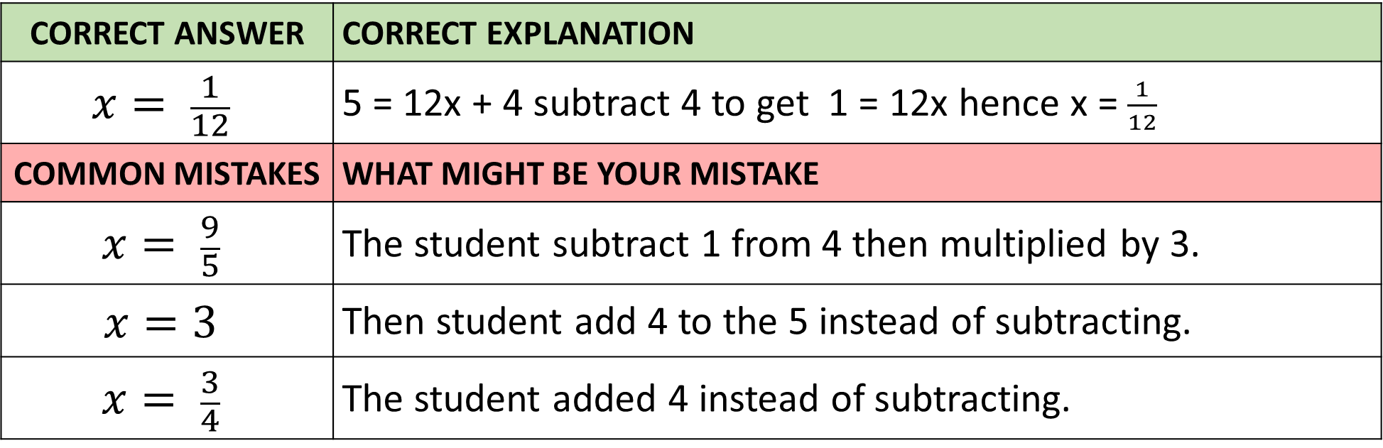
Answer 7 – Solving Equations involving Fractions
Solve the equation $\frac{5}{3x+1}=4$
CORRECT ANSWER | CORRECT EXPLANATION
$$x= \frac{1}{12}$$ | 5 = 12x + 4 subtract 4 to get 1 = 12x hence x = $\frac{1}{12}$
COMMON MISTAKES | WHAT MIGHT BE YOUR MISTAKE
$$x= \frac{9}{5}$$ | The student subtract 1 from 4 then multiplied by 3.
$$x=3$$ | Then student add 4 to the 5 instead of subtracting.
$$x= \frac{3}{4}$$ | The student added 4 instead of subtracting.

Slide 16
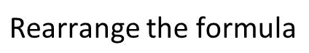
Question 8 – Changing the subject of the formula

Slide 17
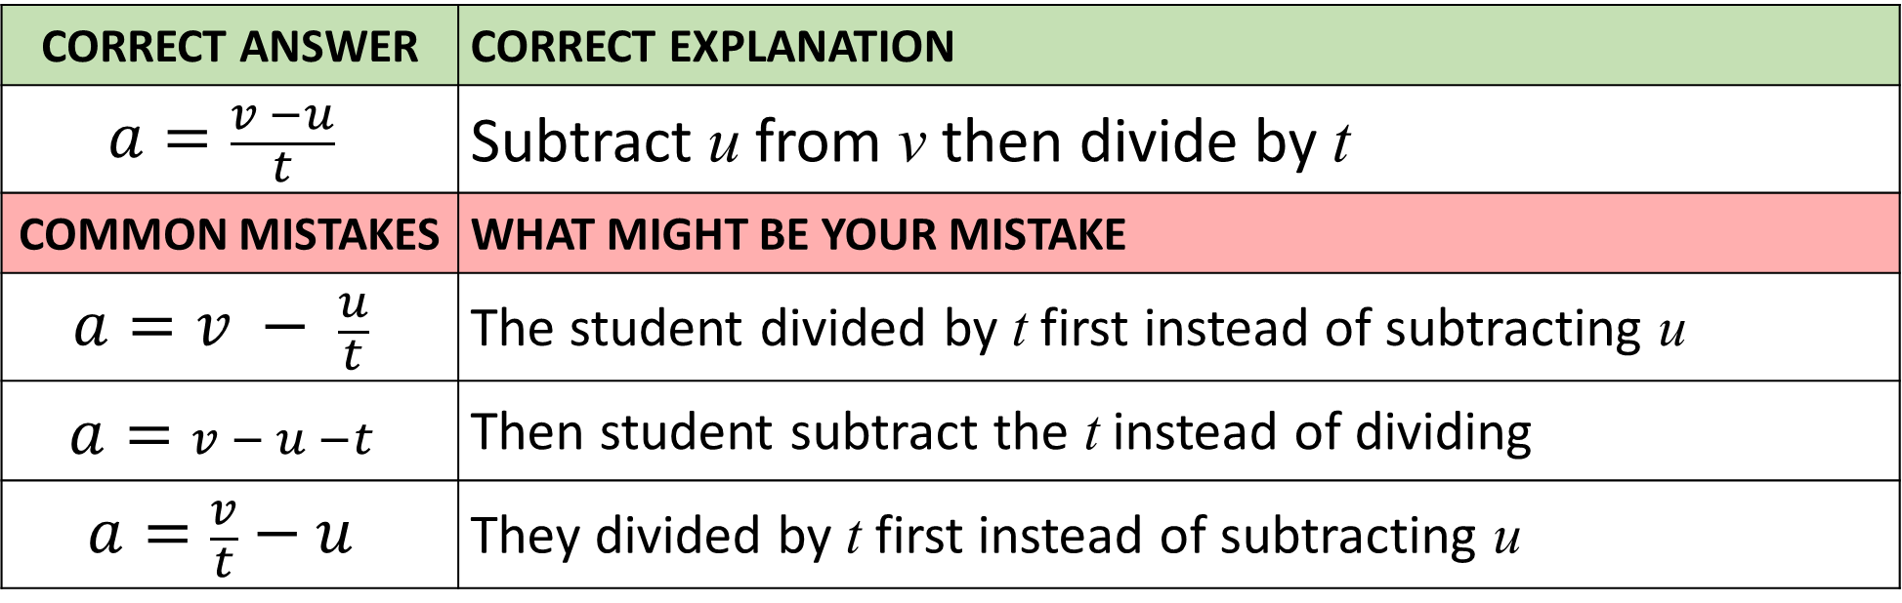
Answer 8 – Changing the subject of the formula
CORRECT ANSWER | CORRECT EXPLANATION
$$a=\frac{v −u}{t}$$ | Subtract u from v then divide by t
COMMON MISTAKES | WHAT MIGHT BE YOUR MISTAKE
$$a=v − \frac{u}{t}$$ | The student divided by t first instead of subtracting u
$$a=v − u −t$$ | Then student subtract the t instead of dividing
$$a=\frac{v}{t}−u$$ | They divided by t first instead of subtracting u

Slide 18
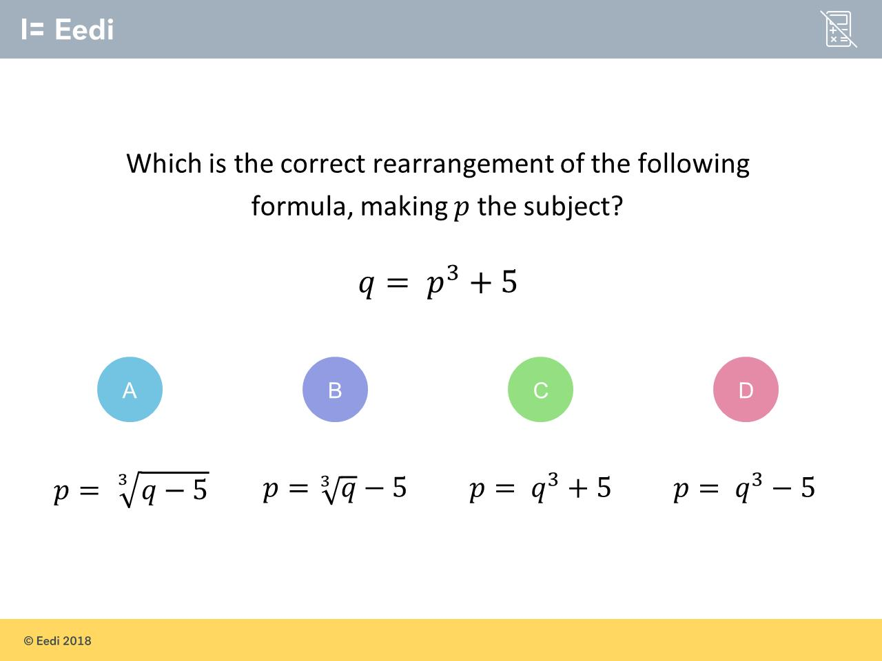
Question 9 – Changing the subject of the formula

Slide 19
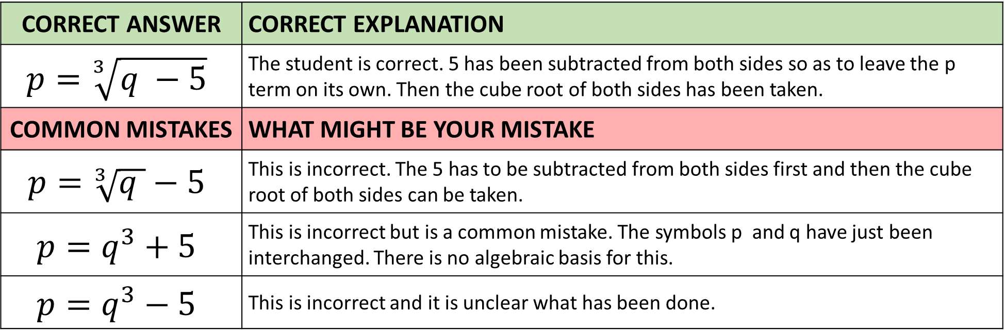
Answer 9 – Changing the subject of the formula
CORRECT ANSWER | CORRECT EXPLANATION
$$p=\sqrt[3]{q −5}$$ | The student is correct. 5 has been subtracted from both sides so as to leave the p term on its own. Then the cube root of both sides has been taken.
COMMON MISTAKES | WHAT MIGHT BE YOUR MISTAKE
$$p=\sqrt[3]{q }−5$$ | This is incorrect. The 5 has to be subtracted from both sides first and then the cube root of both sides can be taken.
$$p=q^{3}+5$$ | This is incorrect but is a common mistake. The symbols p and q have just been interchanged. There is no algebraic basis for this.
$$p=q^{3}−5$$ | This is incorrect and it is unclear what has been done.

Slide 20
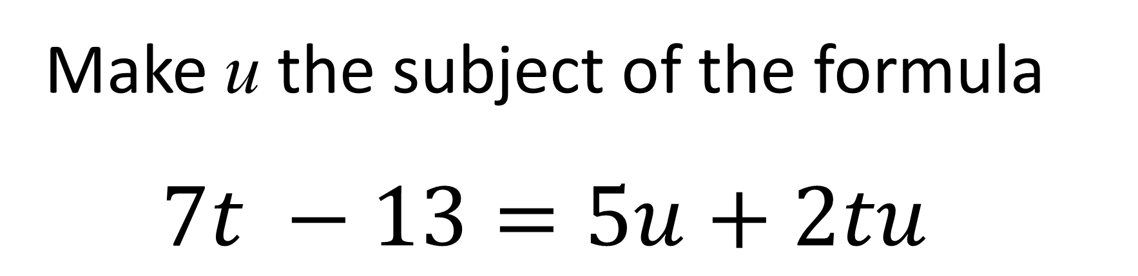
Question 10 – Changing the subject of the formula
Make u the subject of the formula
$$7t −13=5u+2tu$$

Slide 21
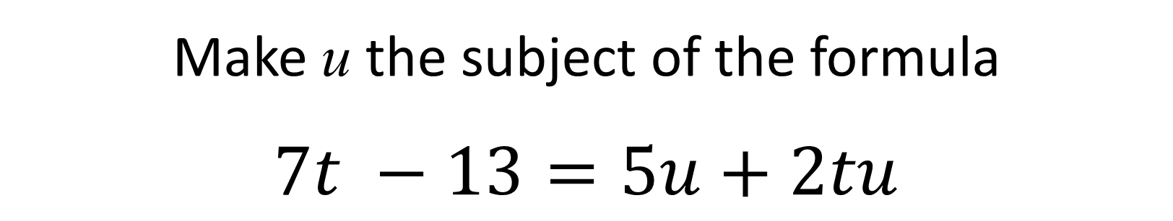
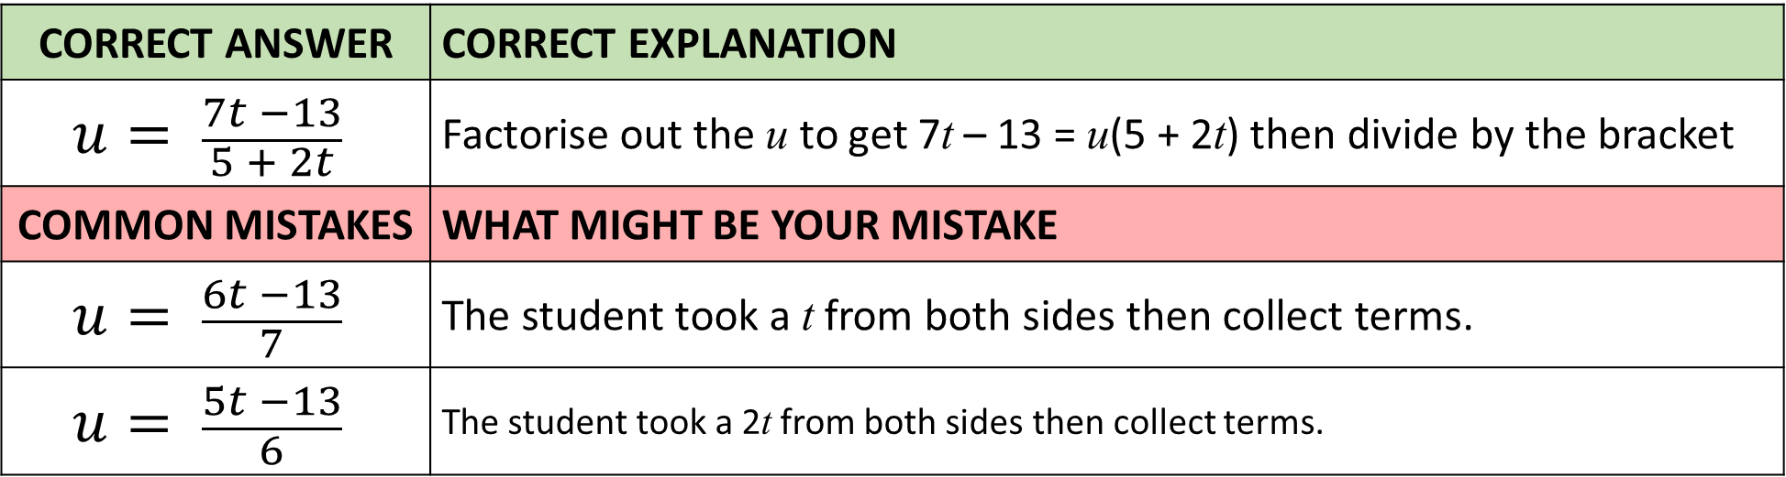
Answer 10 – Two Way Tables
Make u the subject of the formula
$$7t −13=5u+2tu$$
CORRECT ANSWER | CORRECT EXPLANATION
$$u= \frac{7t −13}{5 + 2t}$$ | Factorise out the u to get 7t – 13 = u(5 + 2t) then divide by the bracket
COMMON MISTAKES | WHAT MIGHT BE YOUR MISTAKE
$$u= \frac{6t −13}{7}$$ | The student took a t from both sides then collect terms.
$$u= \frac{5t −13}{6}$$ | The student took a 2t from both sides then collect terms.

Slide 22
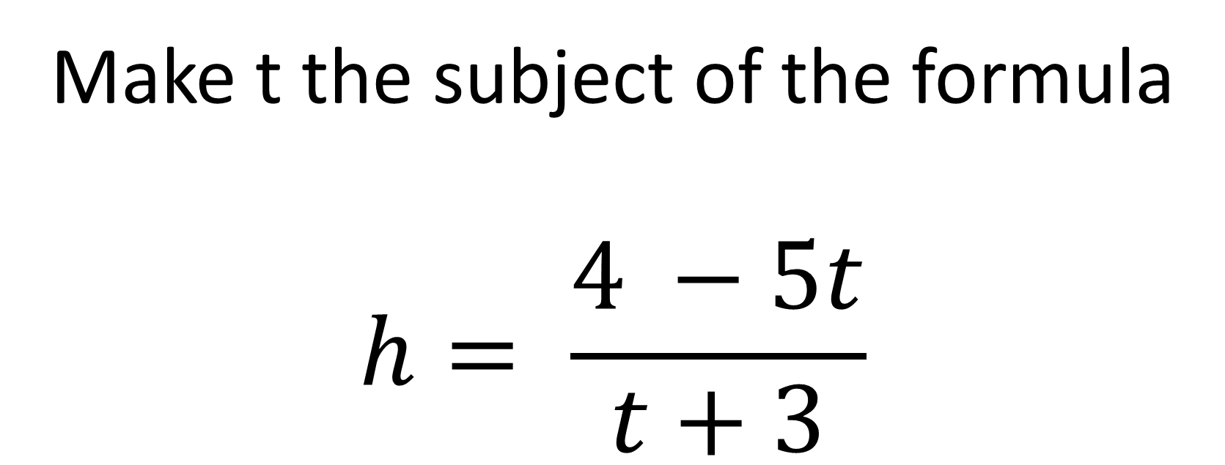
Question 11 – Changing the subject of the formula
Make t the subject of the formula
$$h= \frac{4 −5t}{t+3}$$

Slide 23
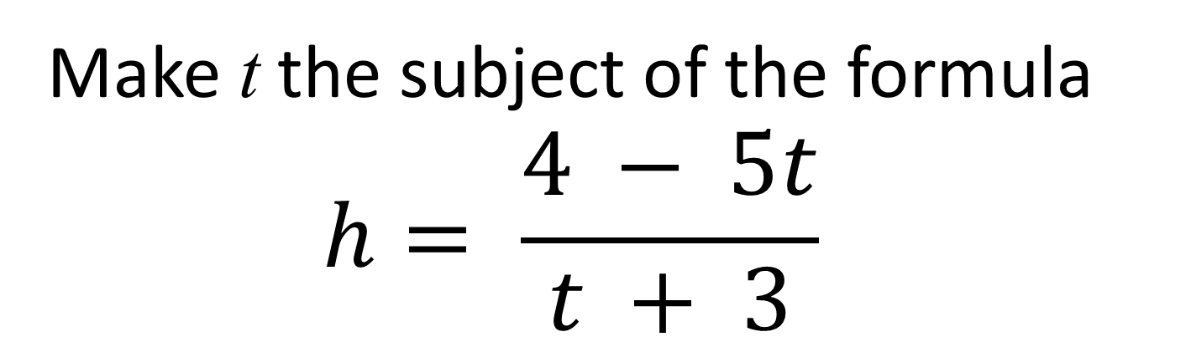
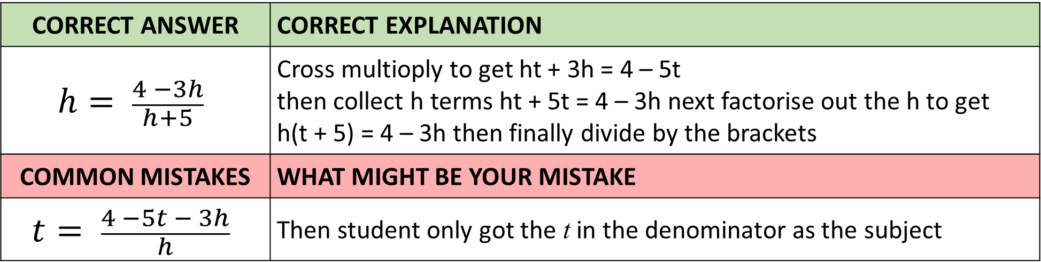
Answer 11 – Changing the subject of the formula
Make t the subject of the formula
$$h= \frac{4 − 5t}{t + 3}$$
CORRECT ANSWER | CORRECT EXPLANATION
$$h= \frac{4 −3h}{h+5}$$ | Cross multioply to get ht + 3h = 4 – 5t then collect h terms ht + 5t = 4 – 3h next factorise out the h to get h(t + 5) = 4 – 3h then finally divide by the brackets
COMMON MISTAKES | WHAT MIGHT BE YOUR MISTAKE
$$t= \frac{4 −5t − 3h}{h}$$ | Then student only got the t in the denominator as the subject

Slide 24
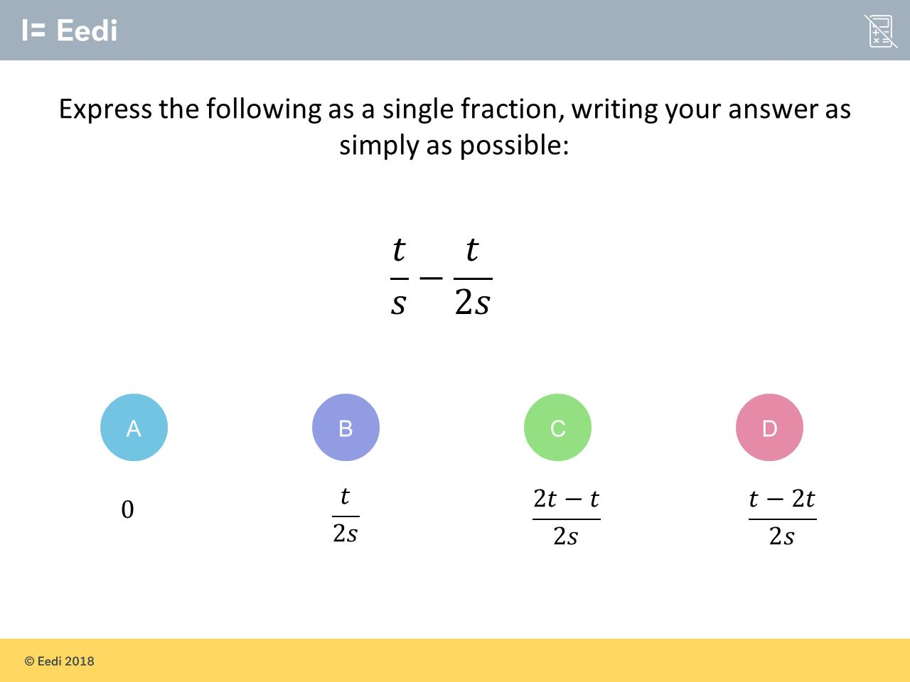
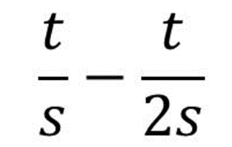
Question 12 – Algebraic Fractions

Slide 25
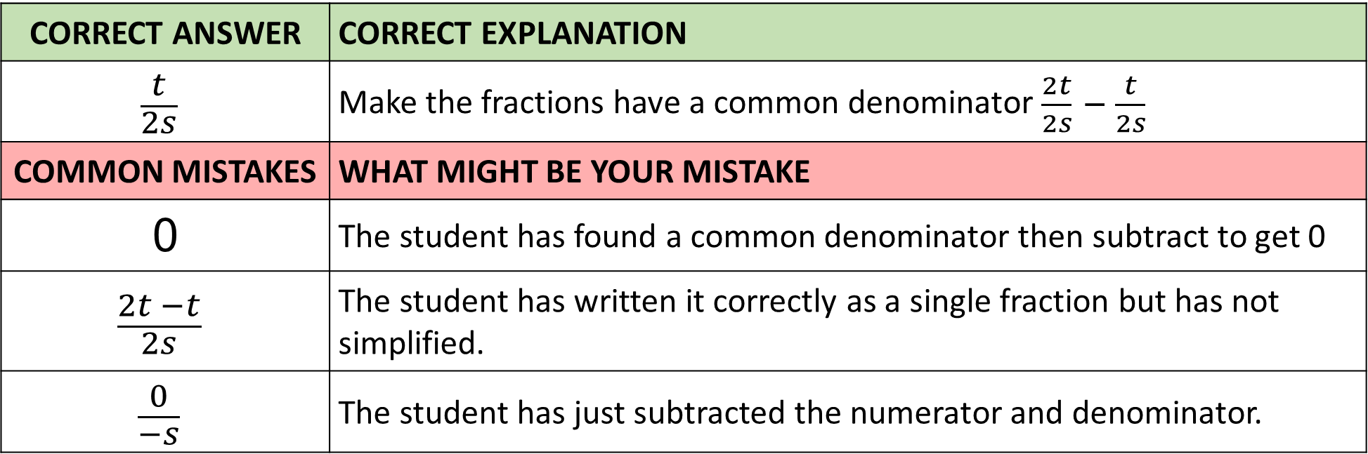
Answer 12 – Algebraic Fractions
CORRECT ANSWER | CORRECT EXPLANATION
$$\frac{t}{2s}$$ | Make the fractions have a common denominator $\frac{2t}{2s}− \frac{t}{2s}$
COMMON MISTAKES | WHAT MIGHT BE YOUR MISTAKE
0 | The student has found a common denominator then subtract to get 0
$$\frac{2t −t}{2s}$$ | The student has written it correctly as a single fraction but has not simplified.
$$\frac{0}{−s}$$ | The student has just subtracted the numerator and denominator.

Slide 26
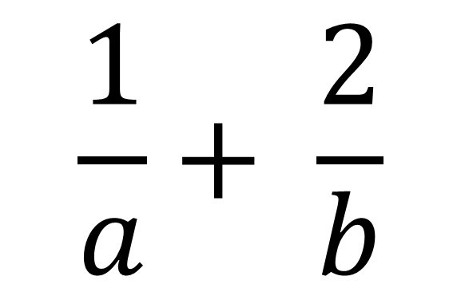
Question 13 – Algebraic Fractions
$$\frac{1}{a}+ \frac{2}{b}$$

Slide 27
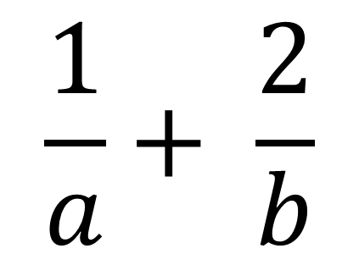
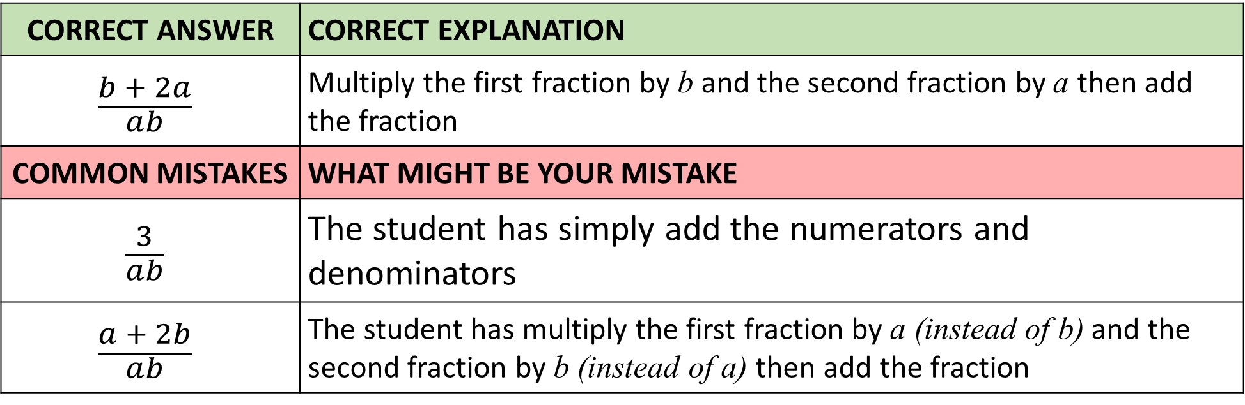
Answer 13 – Algebraic Fractions
$$\frac{1}{a}+ \frac{2}{b}$$
CORRECT ANSWER | CORRECT EXPLANATION
$$\frac{b + 2a}{ab}$$ | Multiply the first fraction by b and the second fraction by a then add the fraction
COMMON MISTAKES | WHAT MIGHT BE YOUR MISTAKE
$$\frac{3}{ab}$$ | The student has simply add the numerators and denominators
$$\frac{a + 2b}{ab}$$ | The student has multiply the first fraction by a (instead of b) and the second fraction by b (instead of a) then add the fraction

Slide 28
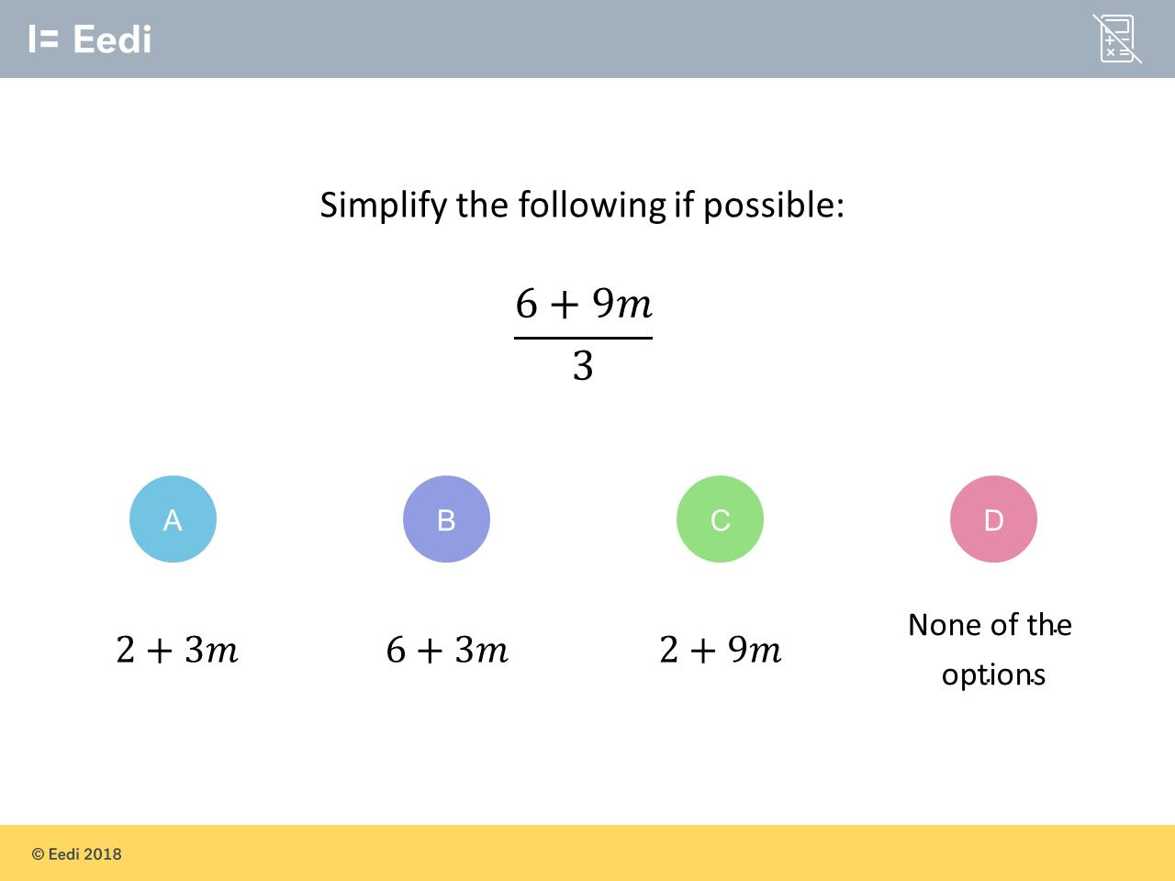
Question 14 – Algebraic Fractions

Slide 29
Answer 14 – Algebraic Fractions
CORRECT ANSWER | CORRECT EXPLANATION
2 + 3m | Because 6 + 9m is all over 3, each term must be divided by 3. So 6 ÷ 3 = 2 and 9m ÷ 3 = 3m, giving a complete answer of 2 + 3m.
COMMON MISTAKES | WHAT MIGHT BE YOUR MISTAKE
6 + 3m | The student has divided the second term only.
2 + 9m | The student has divided the first term only

