Slide 1
LO: Trigonometry
(Missing Sides)

Slide 2
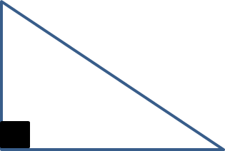
Trigonometry can be used to
find a missing side
of a right angle triangle.

Slide 3
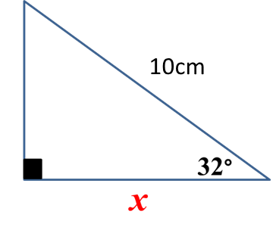
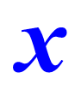
Information needed
- Right Angle
- One Angle
- One Side

Slide 4
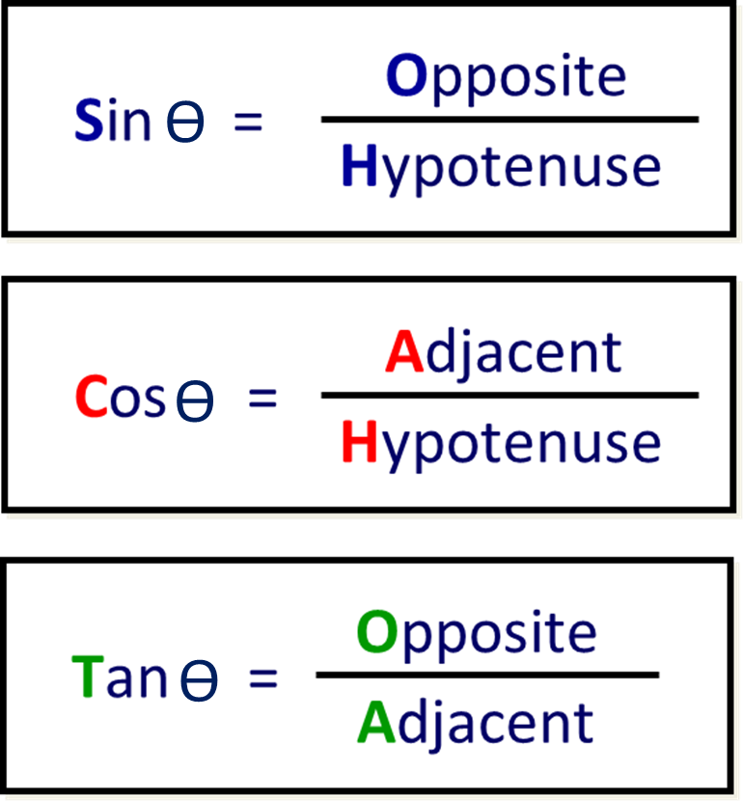
ϴ = angle
SOHCAHTOA

Slide 5
To find the length of the side
you need to follow 4 steps.
Step 1: Label the sides
Step 2: Choose a rule
Step 3: Substitute in your values
Step 4: Calculate the missing side

Slide 6
STEP 1

Slide 7
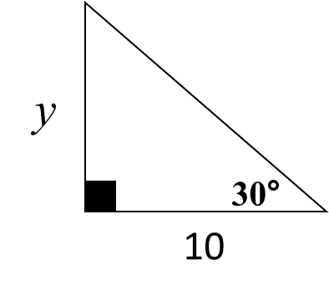
Step 1: Label the two sides needed
OPP
ADJ
Notes:
Use this activity to practice labelling the sides of a right-angled triangle with respect to angle θ.
Ask volunteers to come to the board to complete the activity.

Slide 8
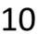
Step 1: Label the two sides needed
HYP
y
ADJ
Notes:
Use this activity to practice labelling the sides of a right-angled triangle with respect to angle θ.
Ask volunteers to come to the board to complete the activity.

Slide 9
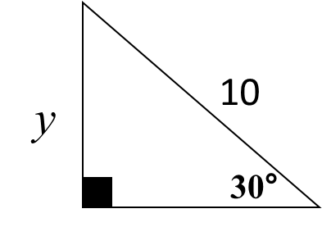
Step 1: Label the two sides needed
HYP
OPP
Notes:
Use this activity to practice labelling the sides of a right-angled triangle with respect to angle θ.
Ask volunteers to come to the board to complete the activity.

Slide 10
STEP 2

Slide 11
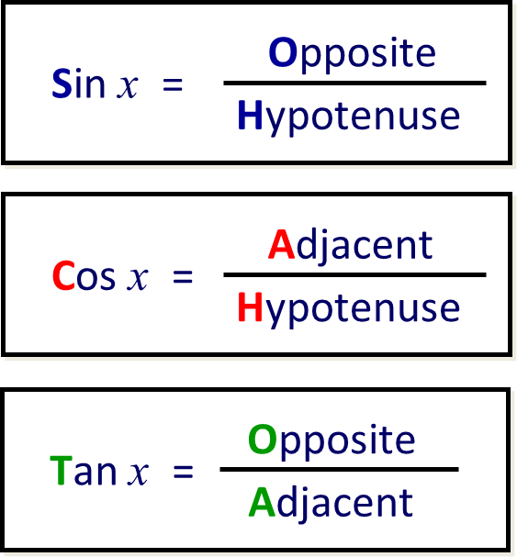
Step 2: Choose a rule
ϴ
OPP
ϴ
ϴ
ADJ

Slide 12
Step 2: Choose a rule
ϴ
HYP
OPP
ϴ
ϴ

Slide 13
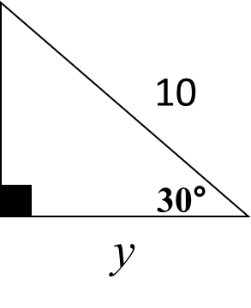
Step 2: Choose a rule
ϴ
HYP
ϴ
ϴ
ADJ

Slide 14
STEP 3

Slide 15
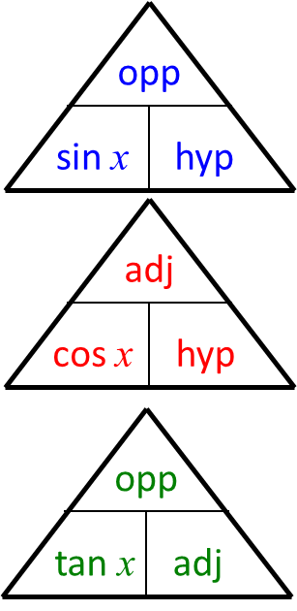
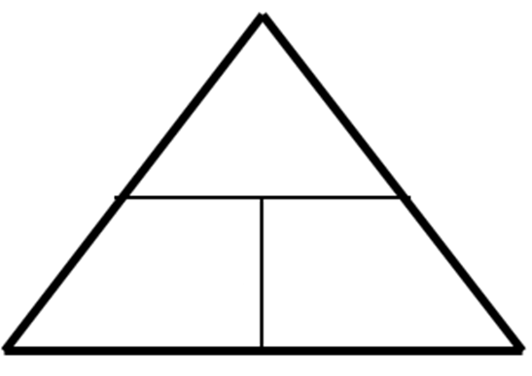
Step 3: Substitute in you values
y
OPP
y
ϴ
tan 30
10
30°
ϴ
10
ADJ

Slide 16
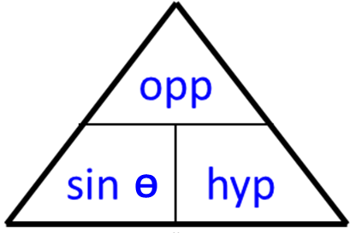
Step 3: Substitute in you values
HYP
OPP
y
8
8
y
30°
sin 30

Slide 17
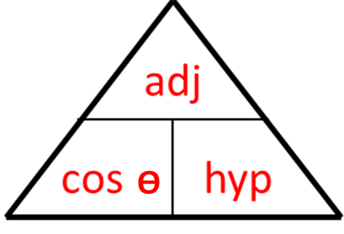
Step 3: Substitute in you values
HYP
y
10
cos 30
10
30°
y
ADJ

Slide 18
STEP 4

Slide 19
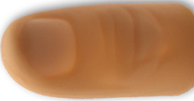
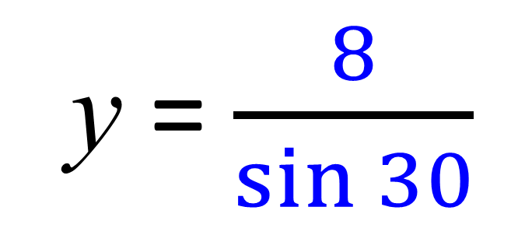
Step 4: Calculate the side
HYP
y
y = $\frac{8}{\sin{30}}$
OPP
8
8
y
30°
sin 30
y = 16

Slide 20
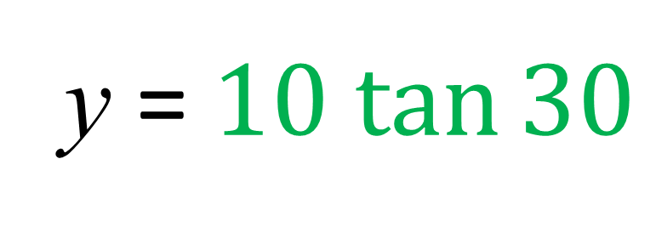
Step 4: Calculate the side
y
OPP
y
y = $10 tan{30}$
tan 30
10
30°
10
y = 5.8
ADJ

Slide 21
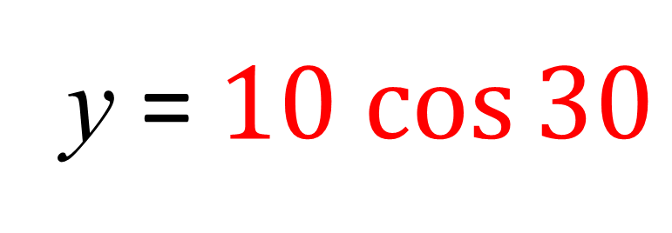
Step 4: Calculate the side
HYP
y
10
y = $10 cos{30}$
cos 30
10
30°
y
y = 8.7
ADJ

Slide 22
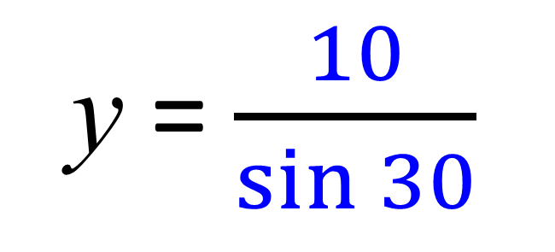
HYP
30°
y
10
y
sin 30
10
OPP
y = $\frac{10}{\sin{30}}$
y = 20

Slide 23
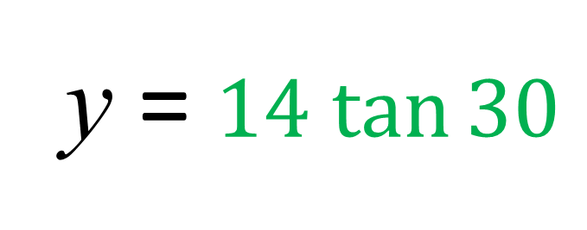
y
ADJ
30°
14
ϴ
tan 30
14
y
OPP
y = $14 tan{30}$
y = 8.08 (2dp)

