Slide 1
FM: Tangents
and Normal

Slide 2
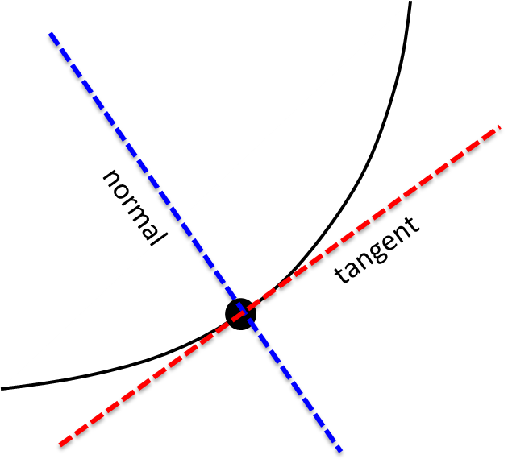
The normal is perpendicular
to the tangent.

Slide 3
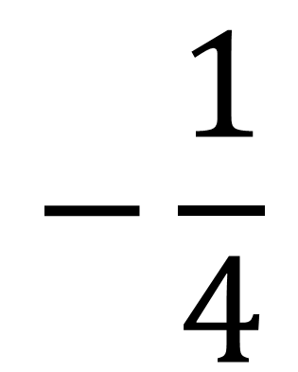
Tangent Gradient = 4
$$−\frac{1}{4}$$
Normal Gradient =

Slide 4
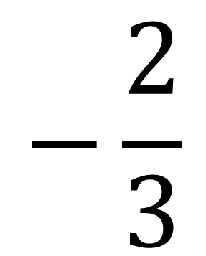
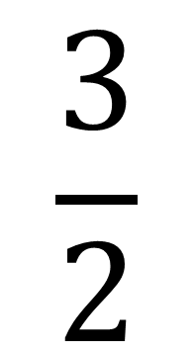
$$−\frac{2}{3}$$
Tangent Gradient =
$$\frac{3}{2}$$
Normal Gradient =

Slide 5
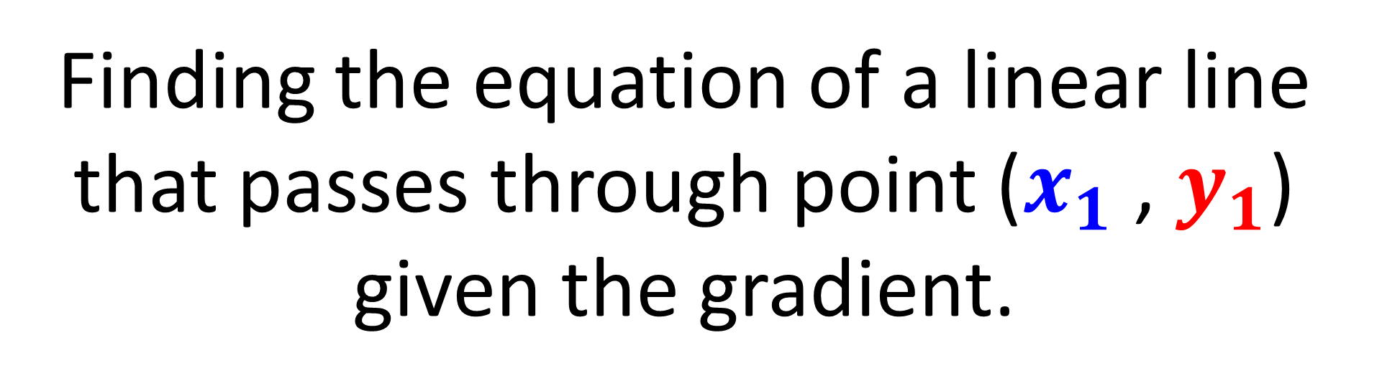
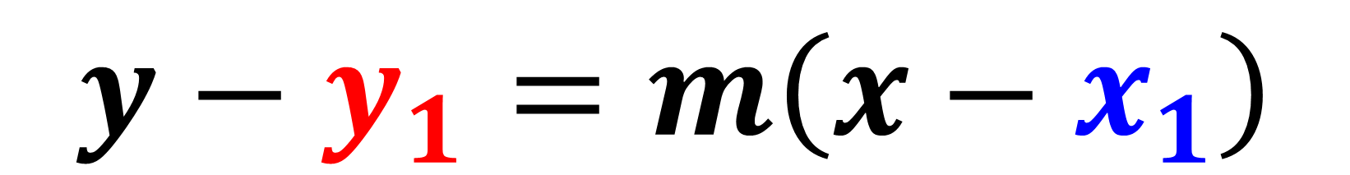
Finding the equation of a linear line that passes through point ($x_{1}$ , $y_{1}$) given the gradient.
$y−y_{1}=m\left(x−x_{1}\right)$

Slide 6
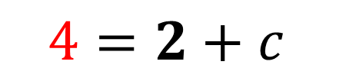
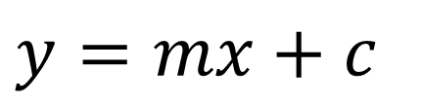
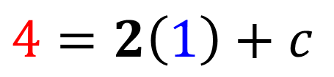
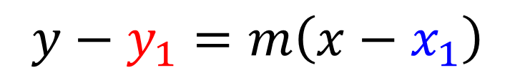
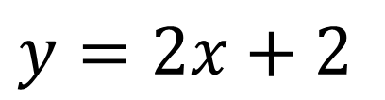
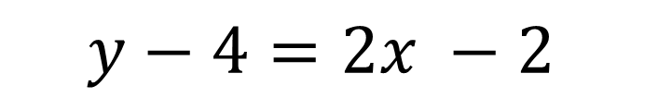
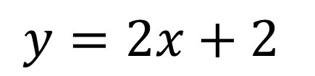
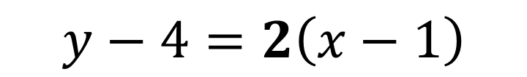
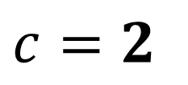
A linear graph has a gradient of 2
and passes through (1,4).
Find the equation of the graph.
$$y=mx+c$$
$y−y_{1}=m\left(x−x_{1}\right)$
$$4=2\left(1\right)+c$$
$y−4=2\left(x−1\right)$
OR
$$4=2+c$$
$y−4=2x −2$
$$c=2$$
$y=2x+2$
$$y=2x+2$$

Slide 7

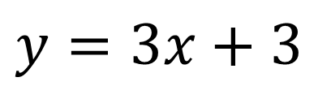
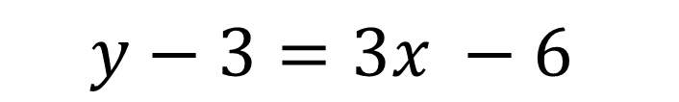
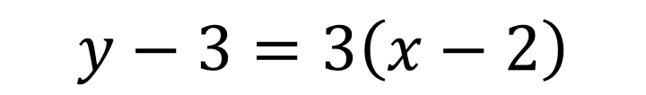
A linear graph has a gradient of 3
and passes through (2,3).
Find the equation of the graph.
$y−y_{1}=m\left(x−x_{1}\right)$
$y−3=3\left(x−2\right)$
$y−3=3x −6$
$y=3x+3$

Slide 8
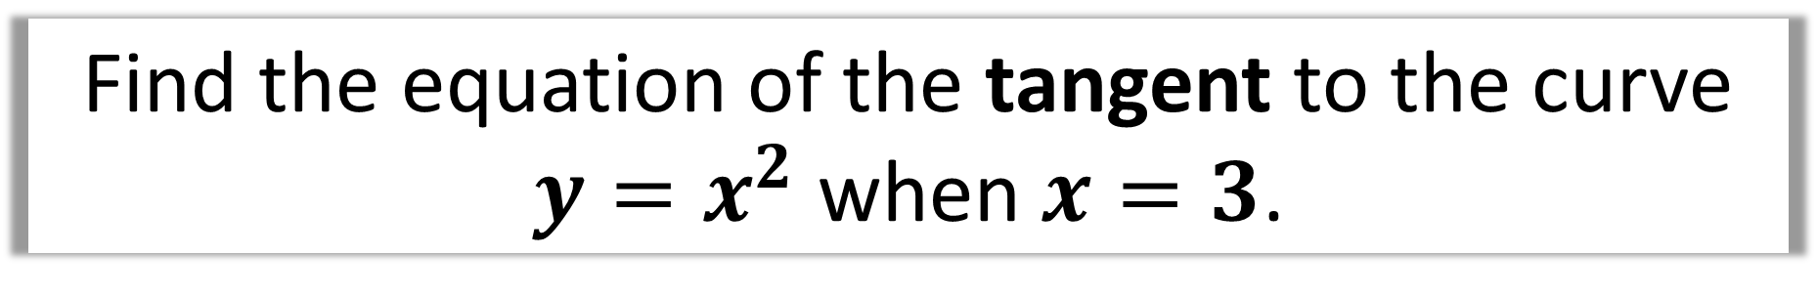
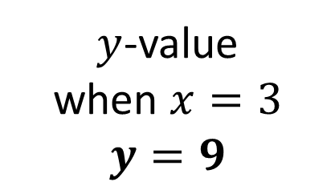

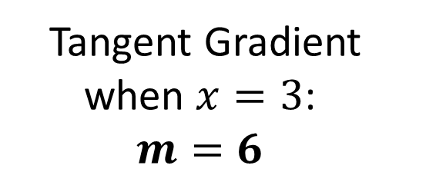
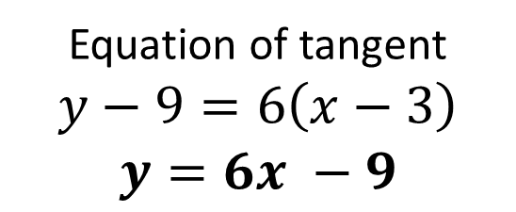
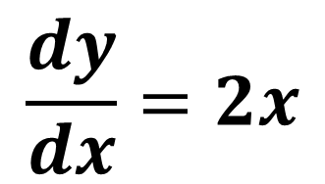
Find the equation of the tangent to the curve
$y=x^{2}$ when $x=3$.
Tangent Gradient
when $x=3$:
$$m=6$$
tangent
$y$-value
when $x=3$
$$y=9$$
$$(3,?)$$
$$\frac{dy}{dx}=2x$$
Equation of tangent
$$y−9=6\left(x−3\right)$$
$$y=6x −9$$

Slide 9
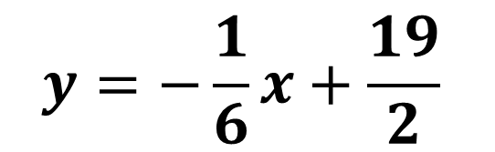

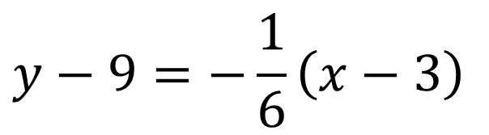
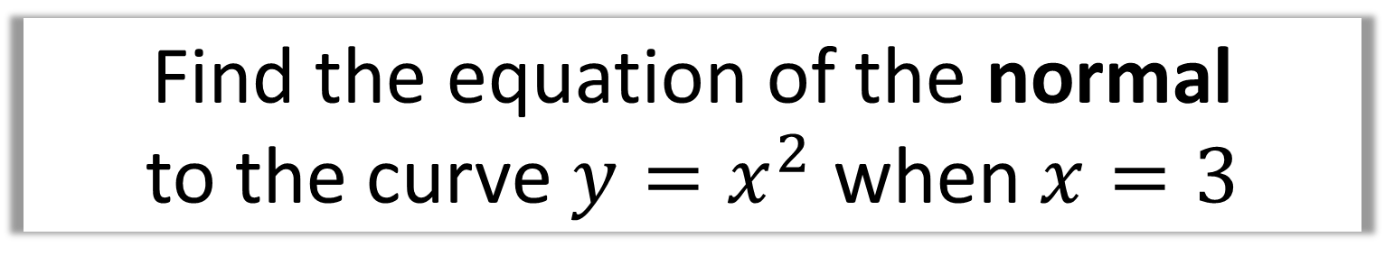


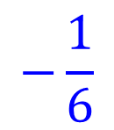


Find the equation of the normal
to the curve $y=x^{2}$ when $x=3$
$$Tangent Gradient=$$
$$6$$
$$−\frac{1}{6}$$
$$Normal Gradient=$$
normal
tangent
$$y−9=−\frac{1}{6}\left(x−3\right)$$
$$(3,9)$$
$$y=−\frac{1}{6}x+\frac{19}{2}$$
$$y=6x−9$$

Slide 10
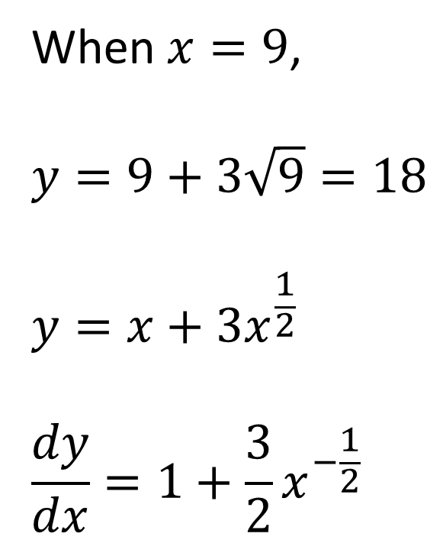
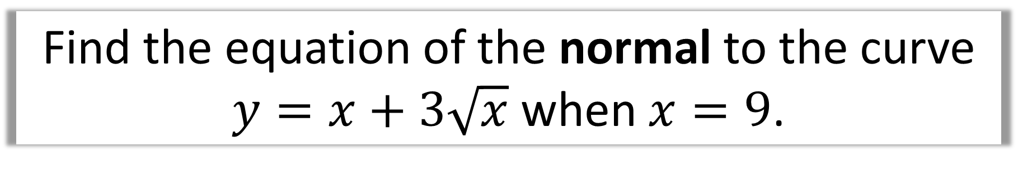
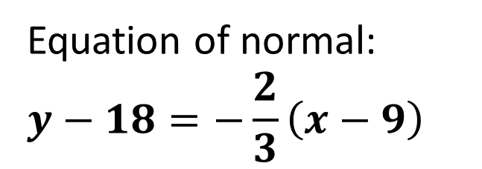
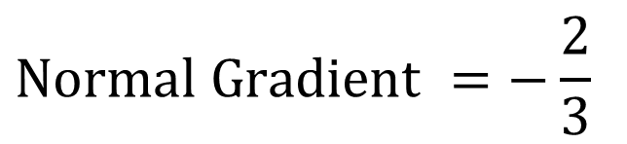
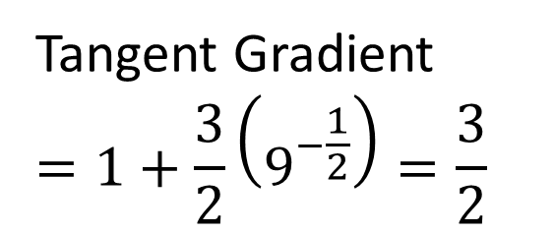
Find the equation of the normal to the curve
$y=x+3\sqrt{x}$ when $x=9$.
When $x=9$,
$$y=9+3\sqrt{9}=18$$
$$y=x+3x^{\frac{1}{2}}$$
$$\frac{dy}{dx}=1+\frac{3}{2}x^{−\frac{1}{2}}$$
Tangent Gradient
$$=1+\frac{3}{2}\left(9^{−\frac{1}{2}}\right)=\frac{3}{2}$$
$$Normal Gradient =−\frac{2}{3}$$
Equation of normal:
$$y−18=−\frac{2}{3}\left(x−9\right)$$

