Slide 1
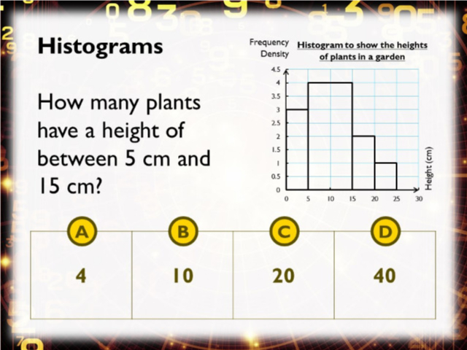
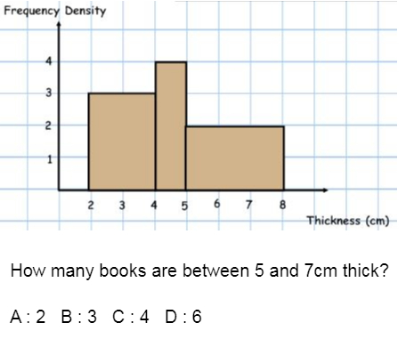
Worst answered question?
Most common wrong answer?

Slide 2
ANSWERS

Slide 3
Worst answered question?

Slide 4
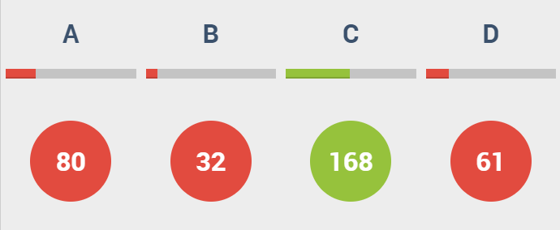
A
They gave the height
and when the area was needed.

Slide 5
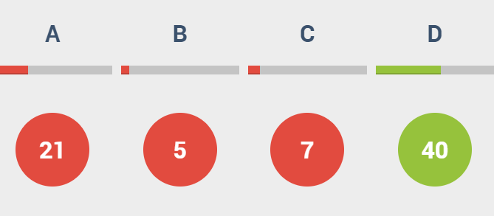
A
They gave the height
and when the area was needed.

