Slide 1
Trigonometry and Modelling
a sin x + b cos x
Max and Min
Chapter 7
(Part 5 of 5)

Slide 2
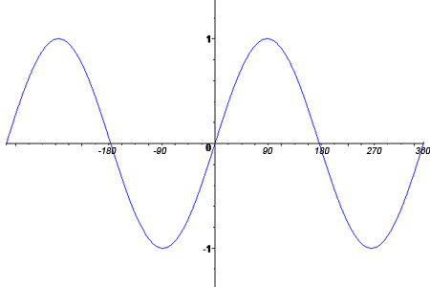

What is the maximum value of
$$y= sin{x}?$$
1

Slide 3


What is the minimum value of
$$y= sin{x}?$$
$$−1$$

Slide 4
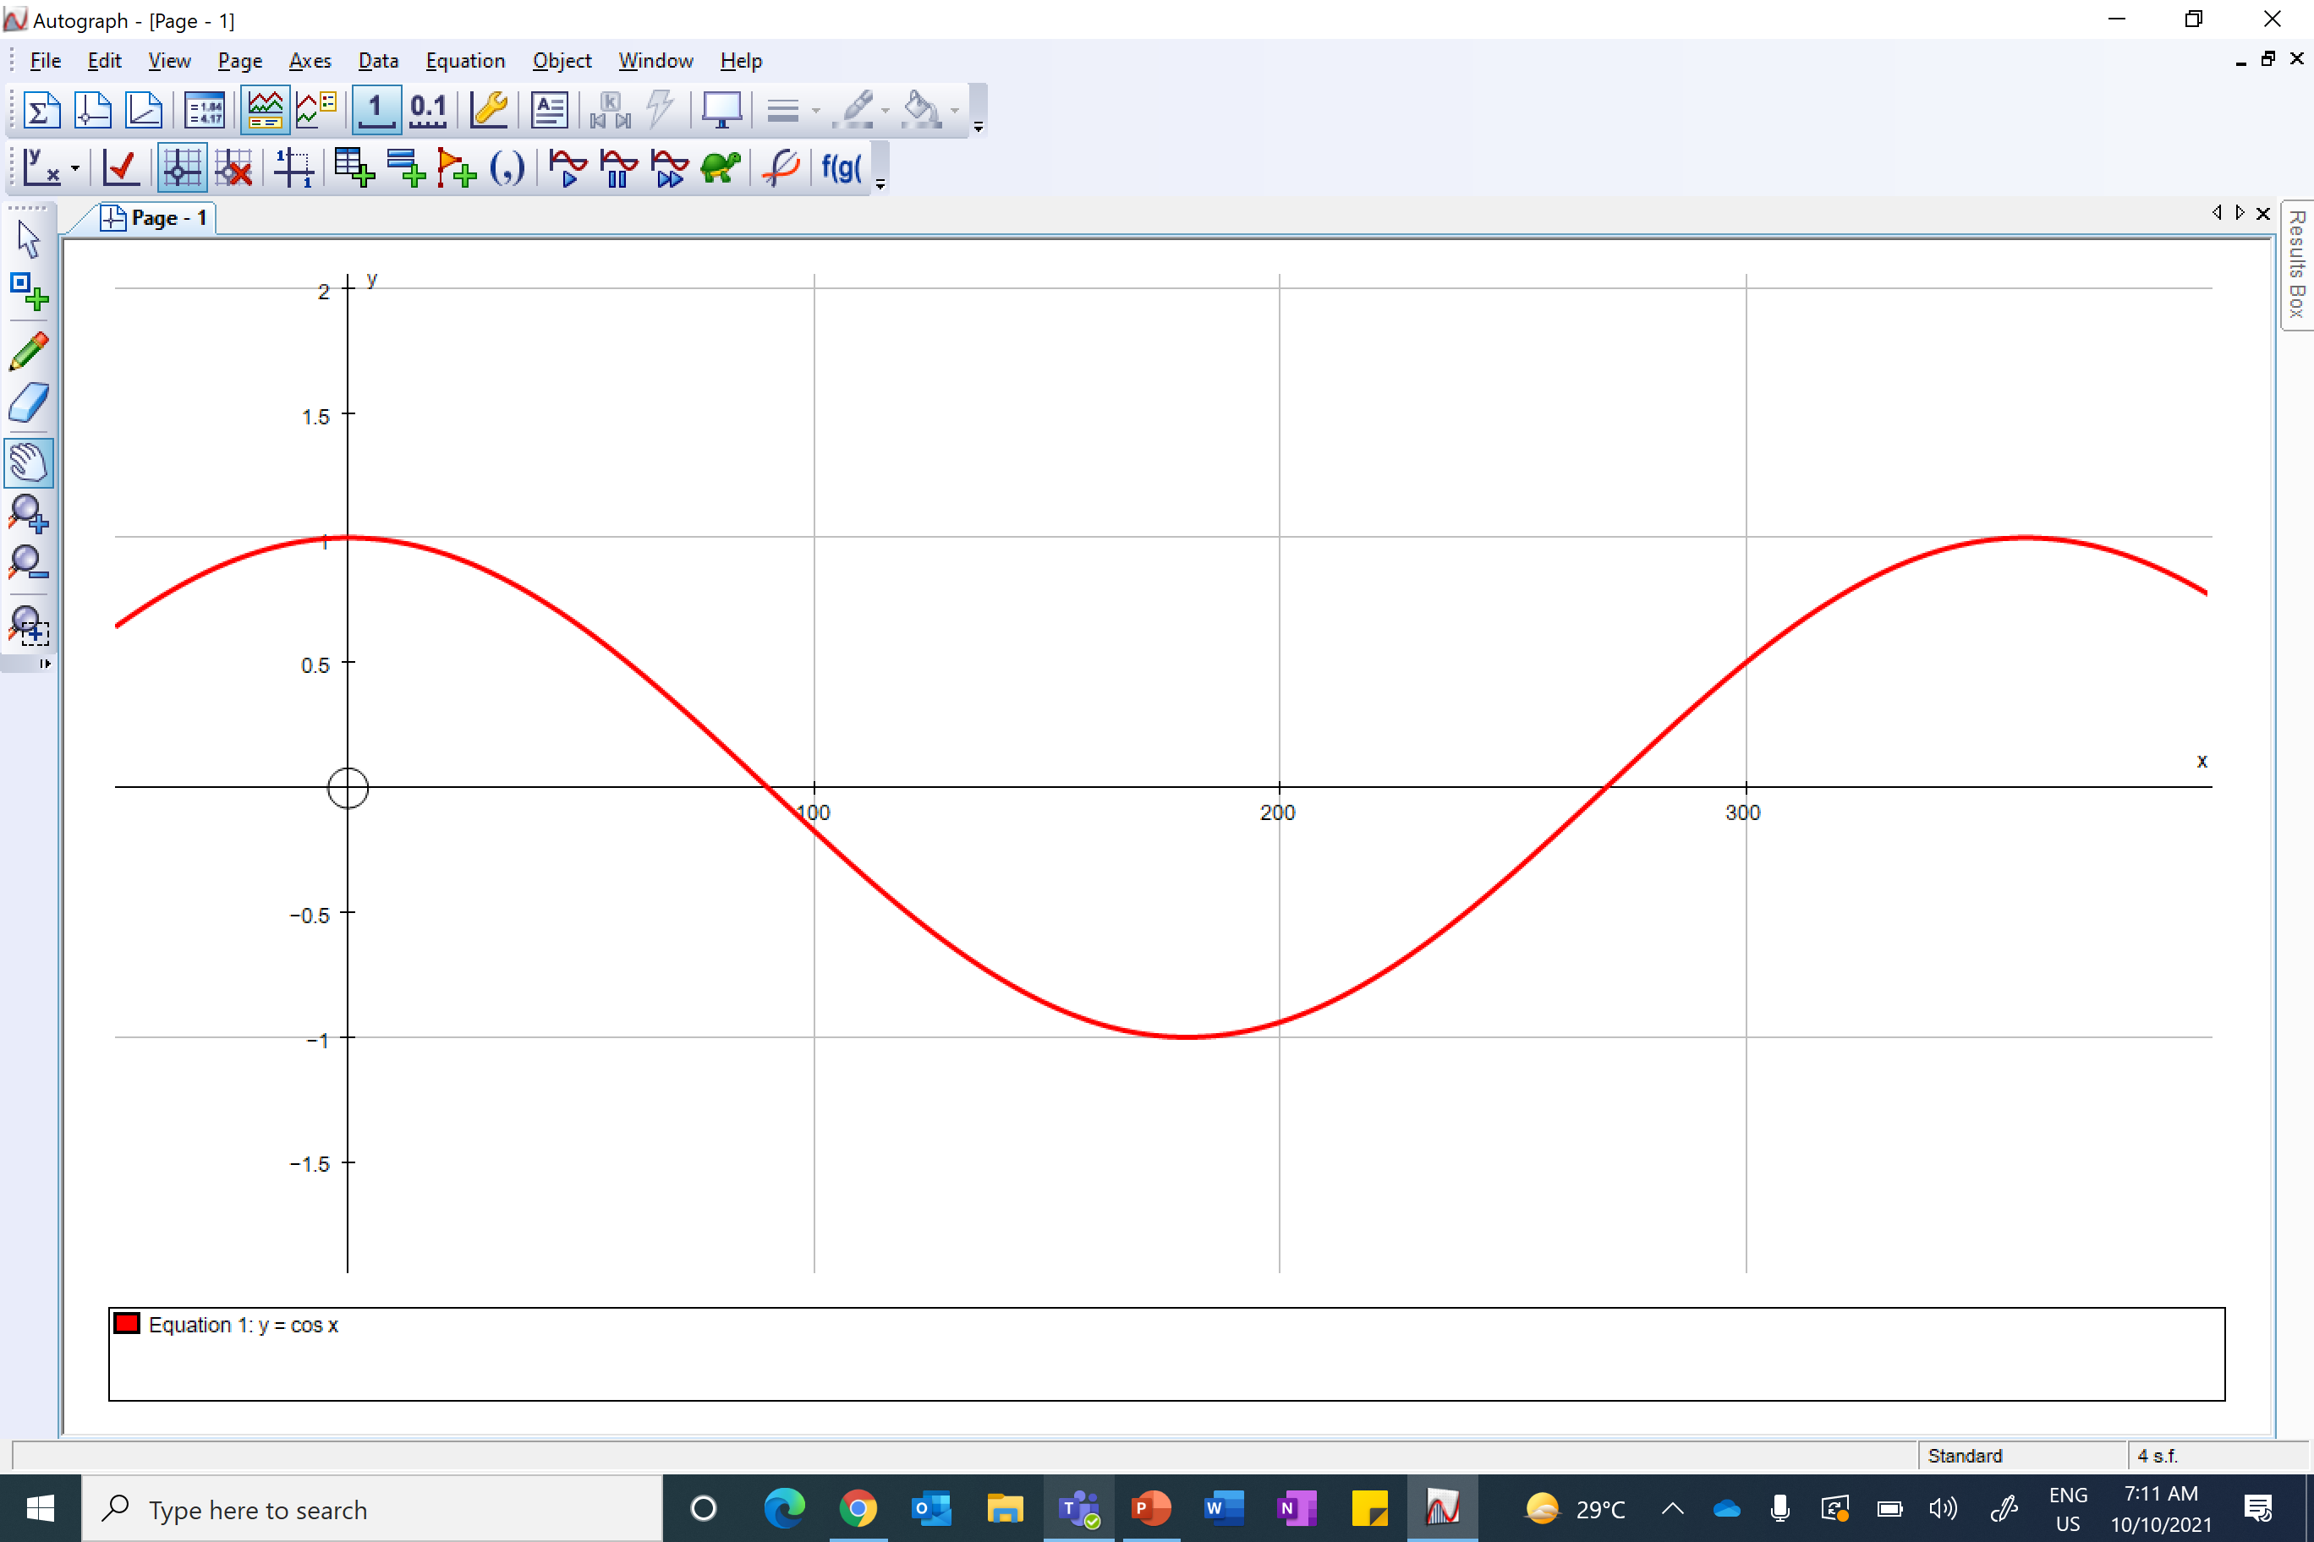

What is the maximum value of
$$y=cos{x}?$$
1

Slide 5

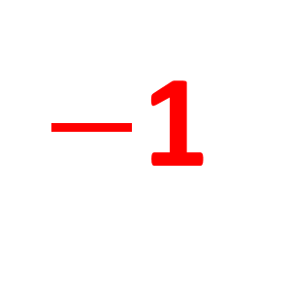
What is the minimum value of
$$y=cos{x}?$$
$−$1

Slide 6

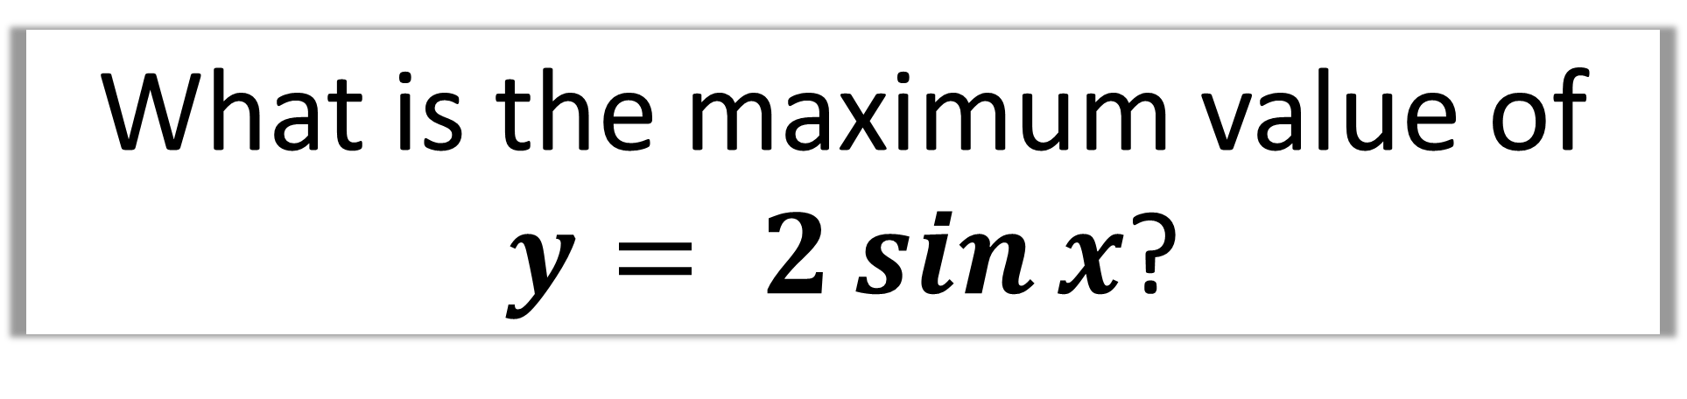
What is the maximum value of
$y= 2\sin{x}$?
Maximum value for $\sin{x}$ is 1
2(1) = 2

Slide 7

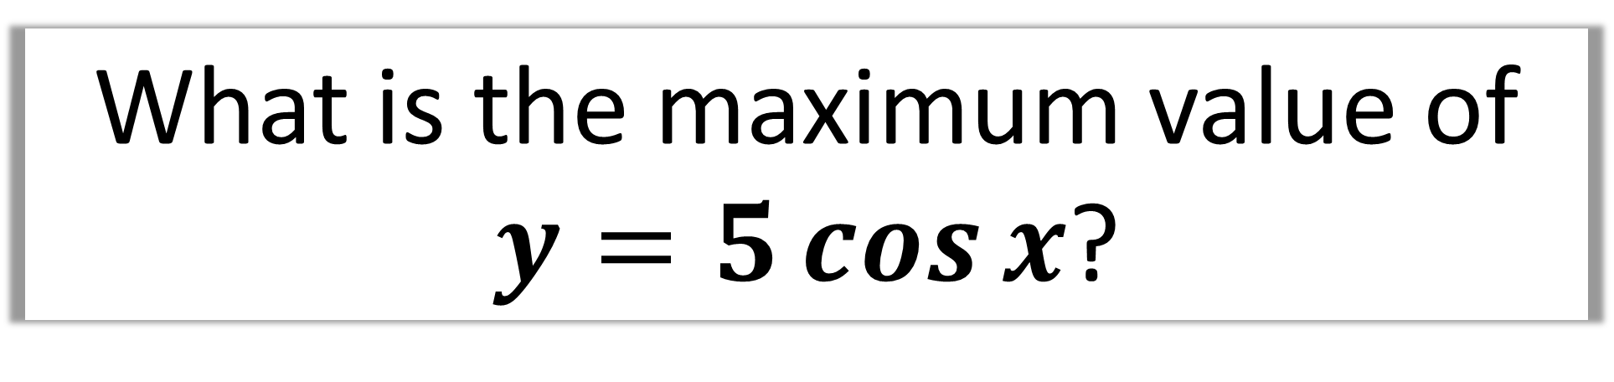
What is the maximum value of
$y=5\cos{x}$?
Maximum value for $\cos{x}$ is 1
5(1) = 5

Slide 8
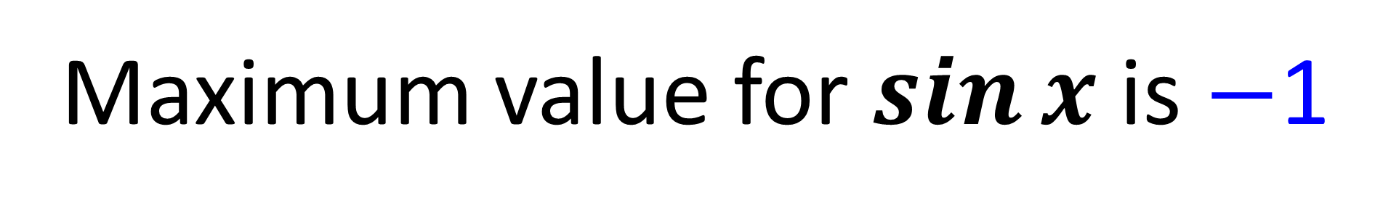
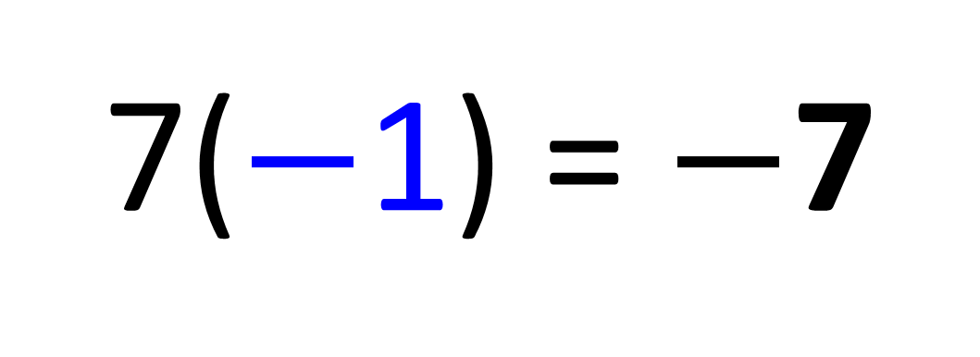
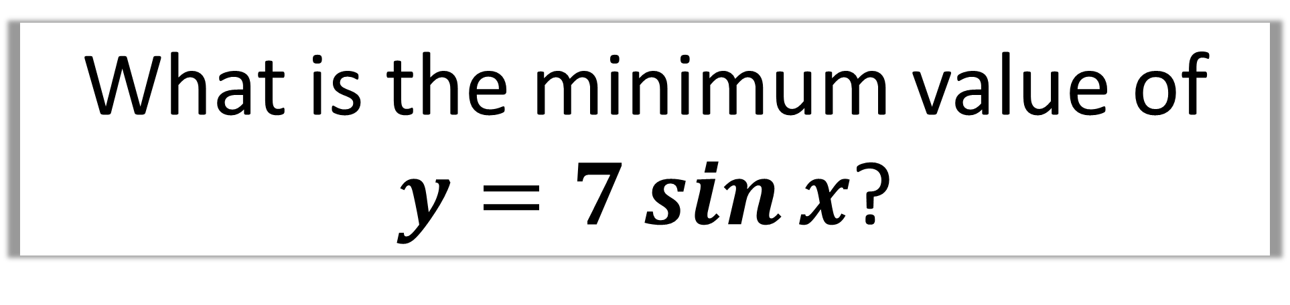
What is the minimum value of
$y=7\sin{x}$?
Maximum value for $\sin{x}$ is $−$1
7($−$1) = $−$7

Slide 9

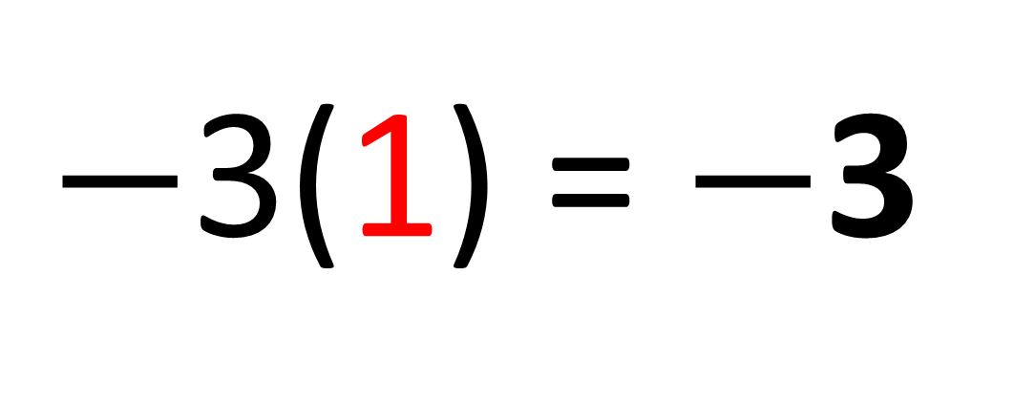
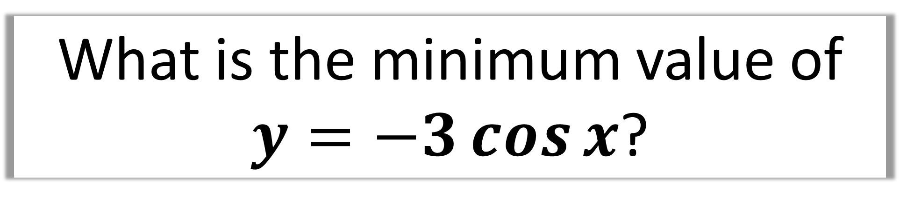
What is the minimum value of
$y=−3\cos{x}$?
Maximum value of $\cos{x}$ is 1
$−$3(1) = $−$3

Slide 10
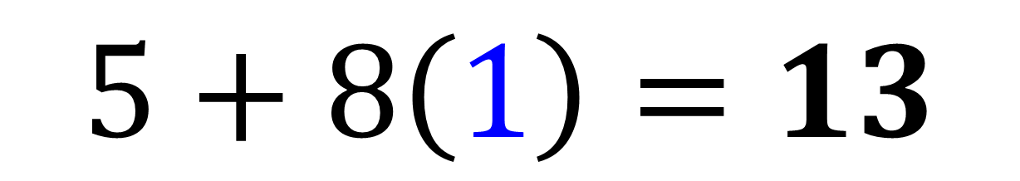

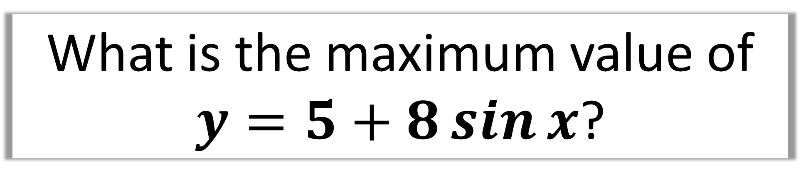
What is the maximum value of
$y=5+8\sin{x}$?
Maximum value for $\sin{x}$ is 1
$$5+8\left(1\right)=13$$

Slide 11
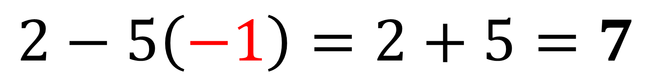
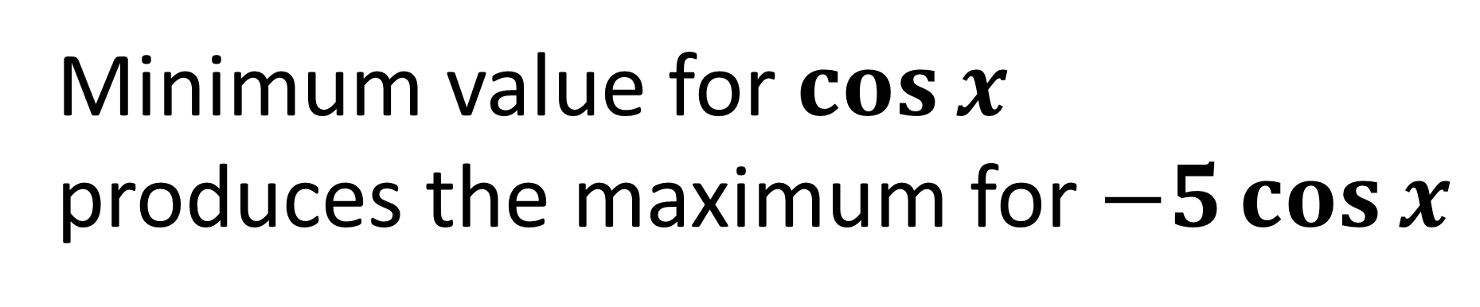
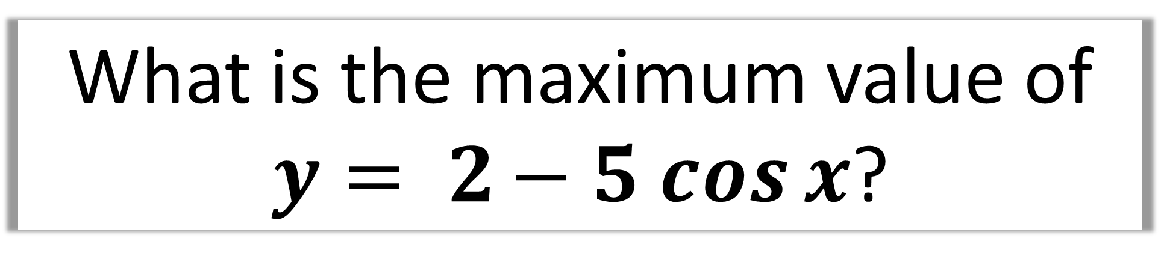
What is the maximum value of
$y= 2− 5 cos{x}$?
Minimum value for $\cos{x}$
produces the maximum for $−5\cos{x}$
$$2−5\left(−1\right)=2+5=7$$

Slide 12
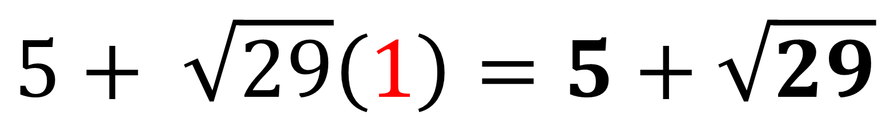
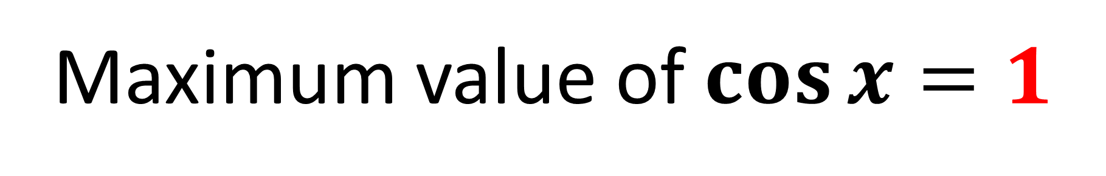
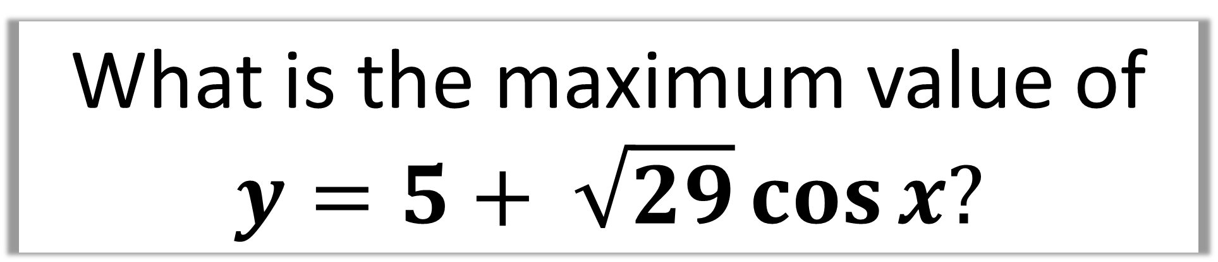
What is the maximum value of
$$y=5+ \sqrt{29}\cos{x?}$$
Maximum value of $\cos{x}=1$
$$5+ \sqrt{29}\left(1\right)=5+\sqrt{29}$$

Slide 13
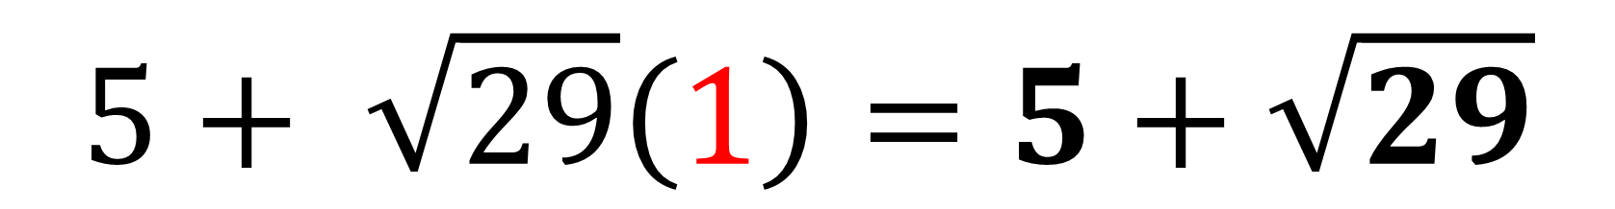
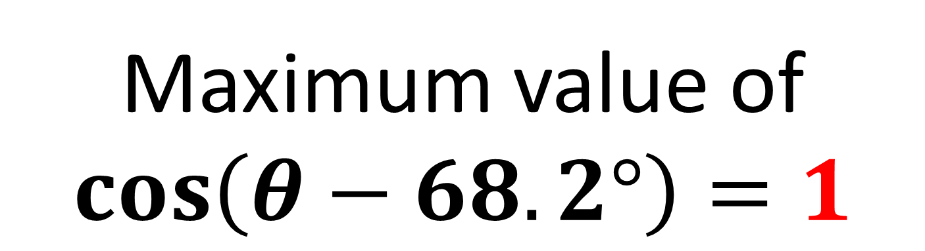
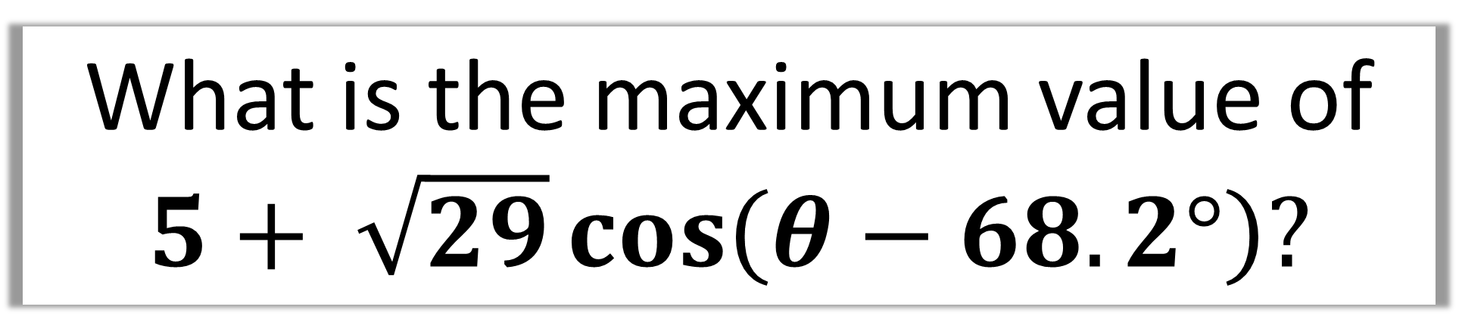
What is the maximum value of
$5+ \sqrt{29}\cos\left(θ−68.2°\right)?$
Maximum value of
$\cos\left(θ−68.2°\right)=1$
$$5+ \sqrt{29}\left(1\right)=5+\sqrt{29}$$

Slide 14



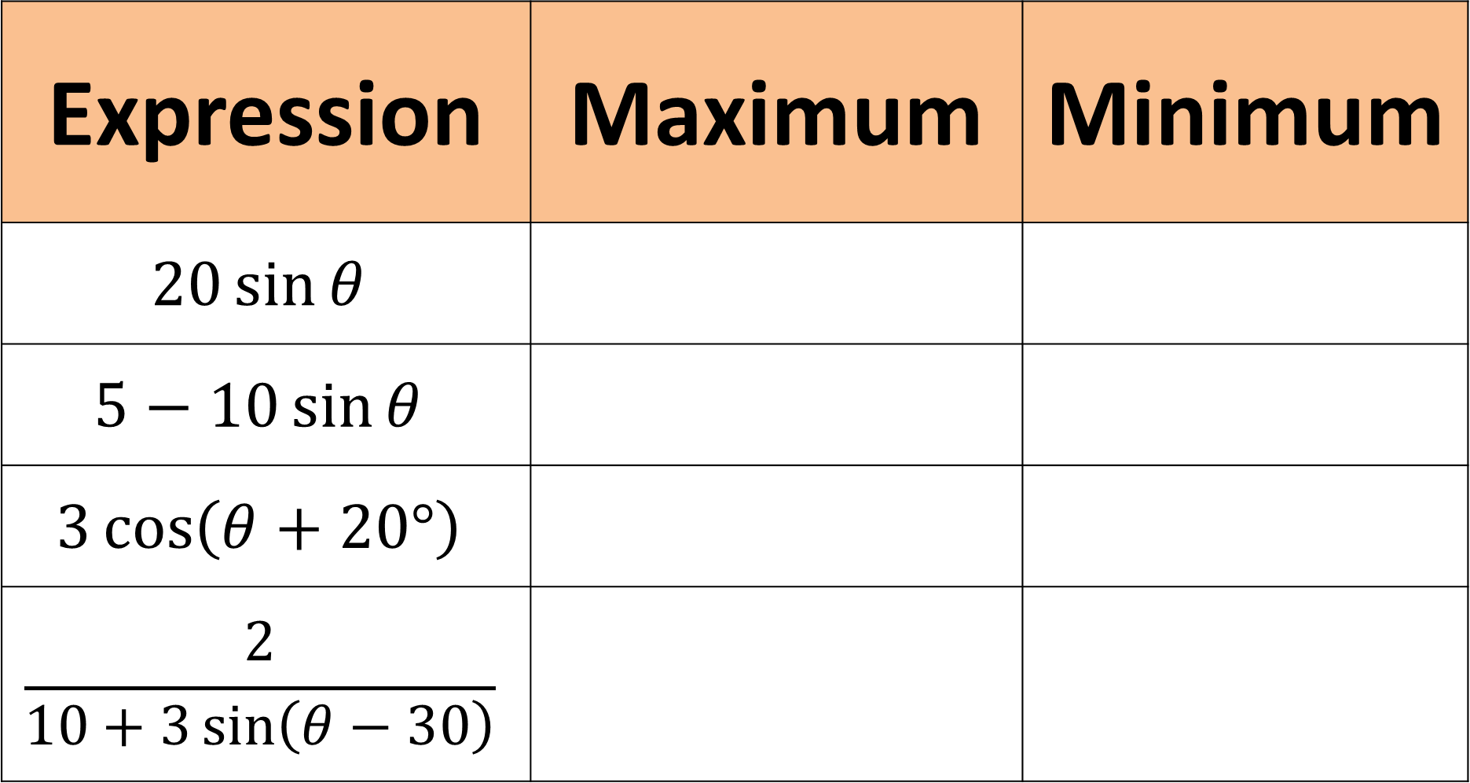





Expression | Maximum | Minimum
$$20\sin{θ}$$
$$5−10\sin{θ}$$
$$3\cos\left(θ+20°\right)$$
$$\frac{2}{10+3\sin\left(θ−30\right)}$$
$$20$$
$$−20$$
$$15$$
$$−5$$
$$3$$
$$−3$$
$$\frac{2}{7}$$
$$\frac{2}{13}$$

Slide 15
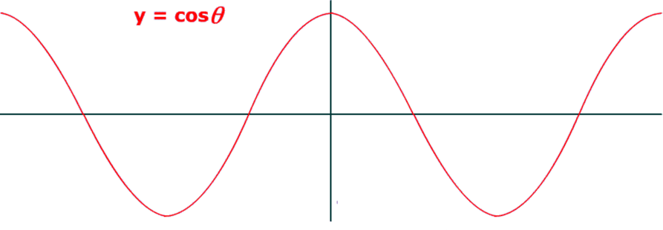
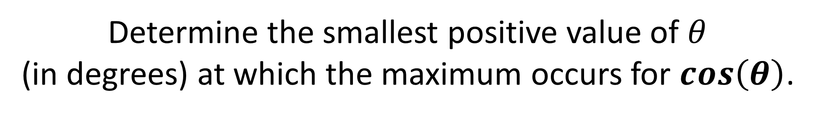
When does it occur?
Determine the smallest positive value of $θ$
(in degrees) at which the maximum occurs for $\cos\left(θ\right)$.
360˚
360˚

Slide 16
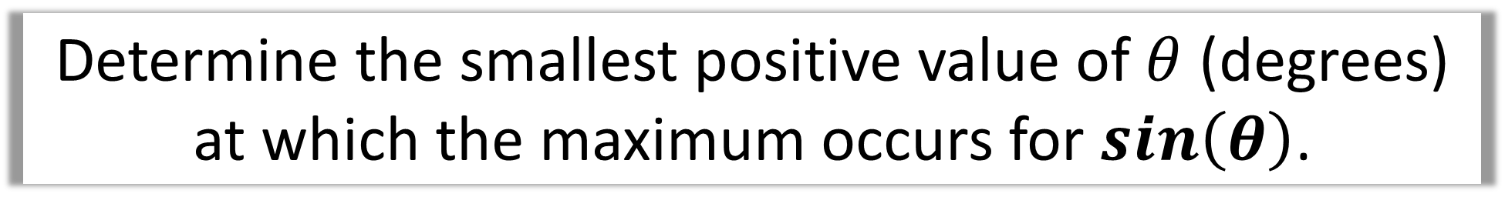
Determine the smallest positive value of $θ$ (degrees)
at which the maximum occurs for $\sin\left(θ\right)$.
90˚

Slide 17
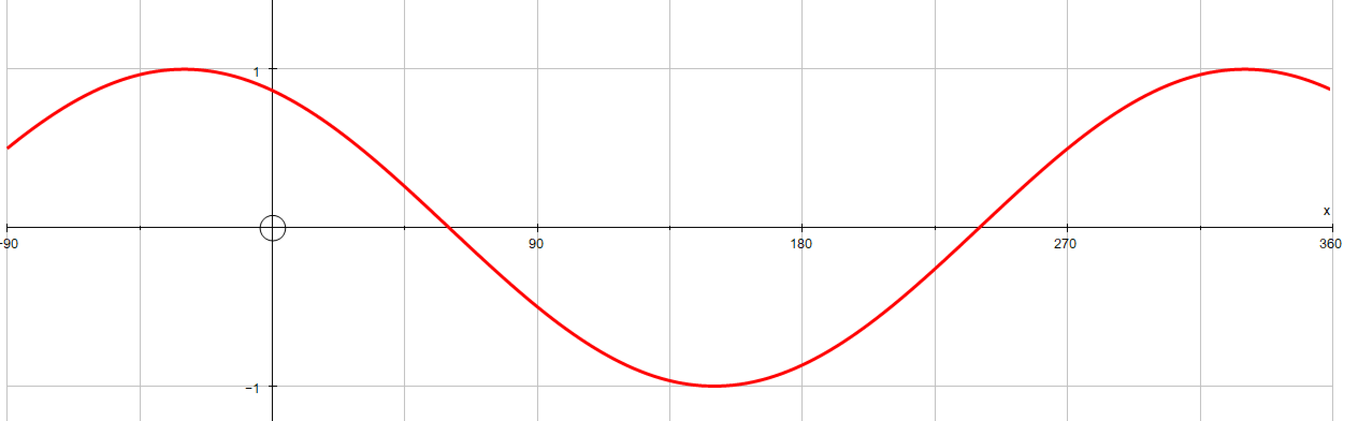
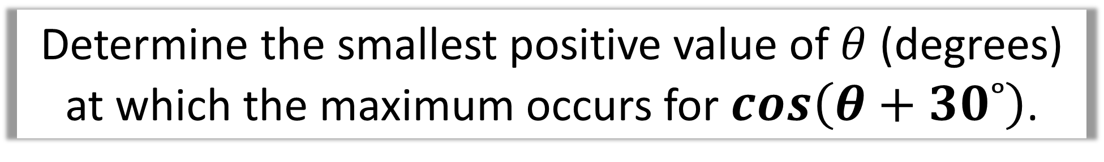
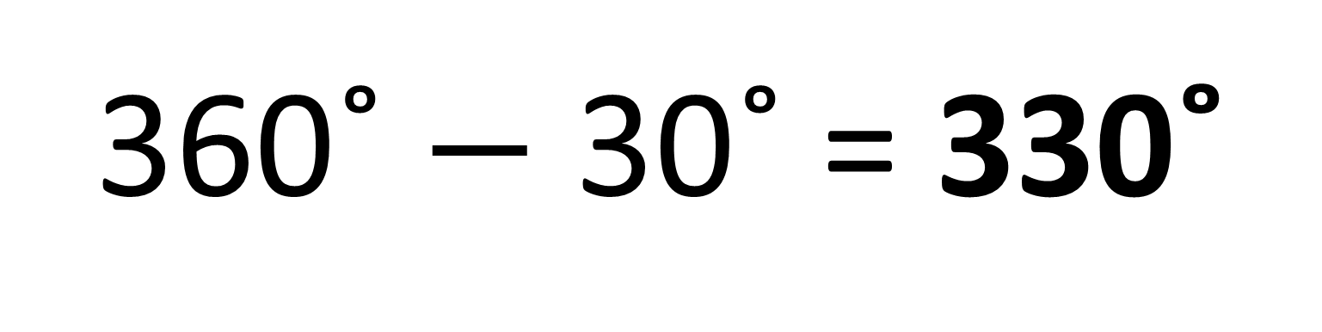
Determine the smallest positive value of $θ$ (degrees)
at which the maximum occurs for $\cos\left(θ+30˚\right)$.
360˚ $−$ 30˚ = 330˚

Slide 18
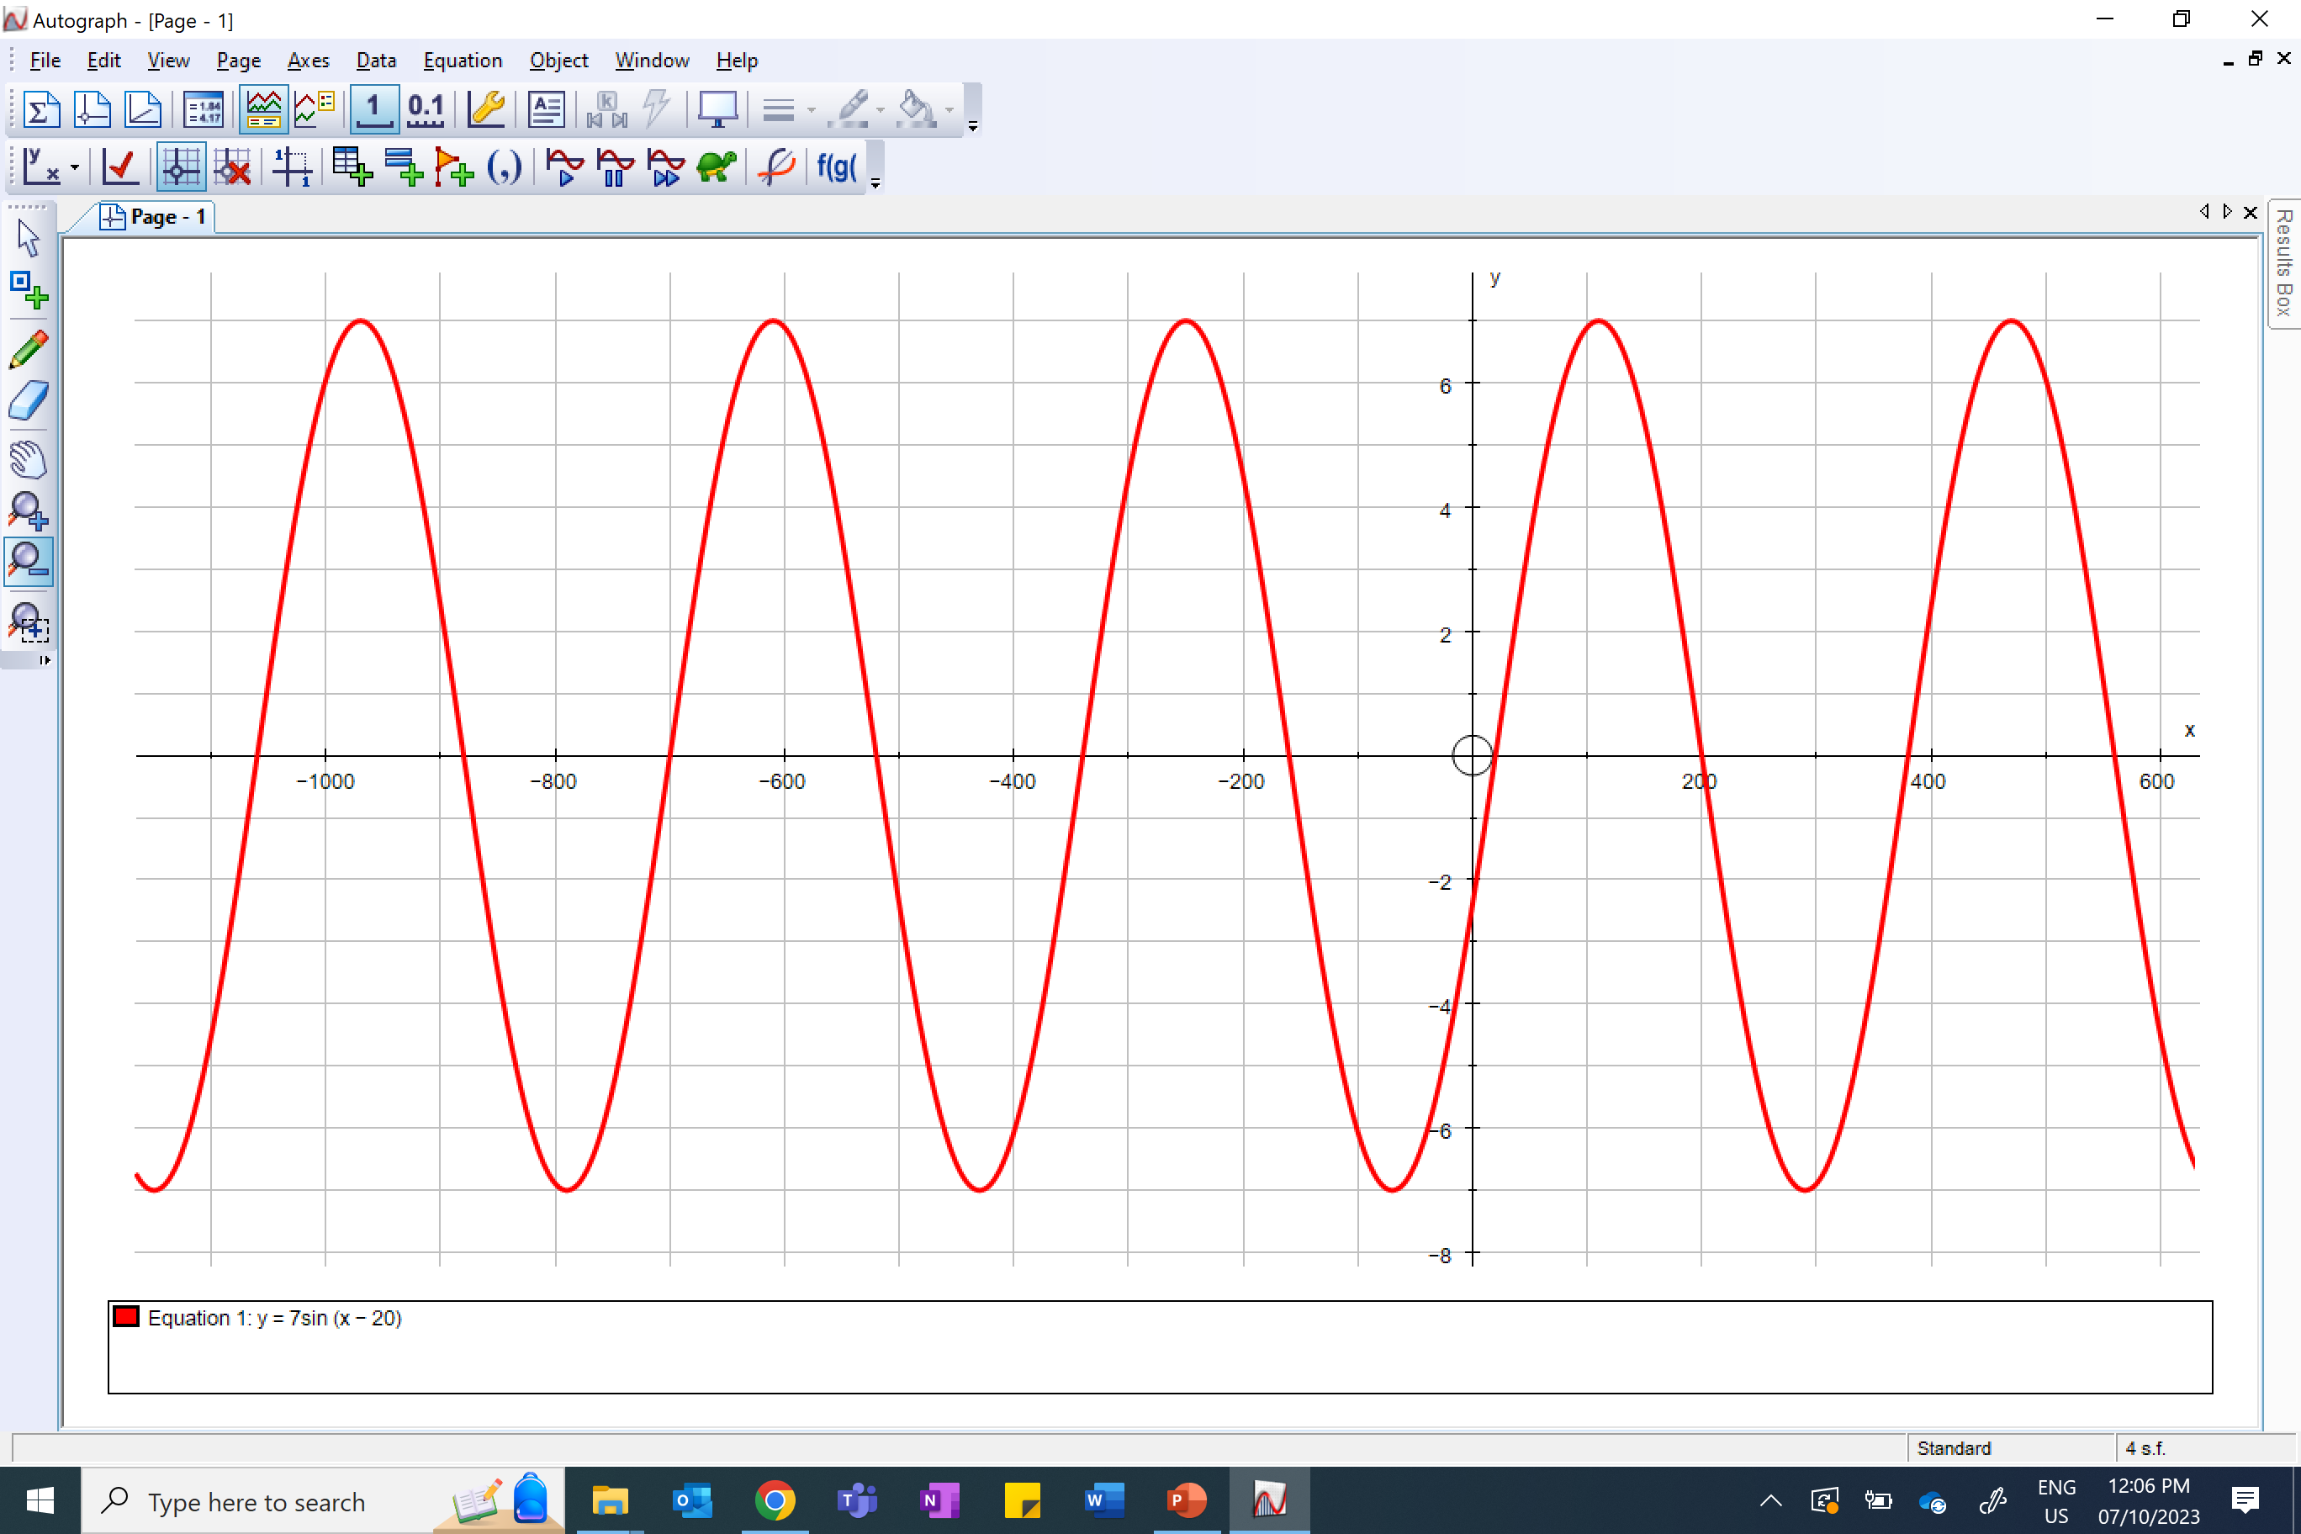
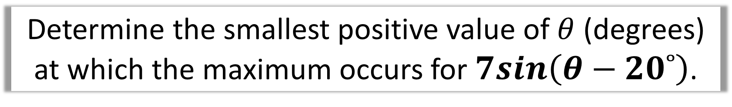
Determine the smallest positive value of $θ$ (degrees)
at which the maximum occurs for $7sin\left(θ−20˚\right)$.
90˚+ 20˚ = 110˚

Slide 19
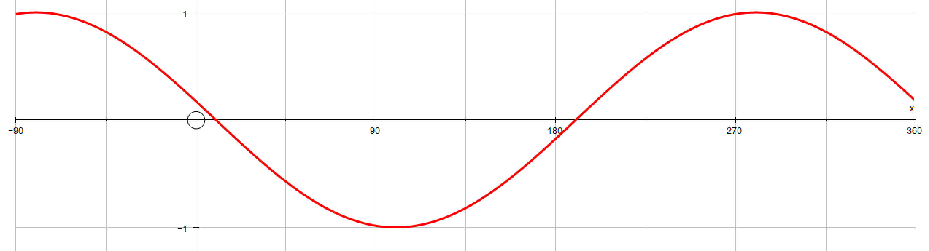
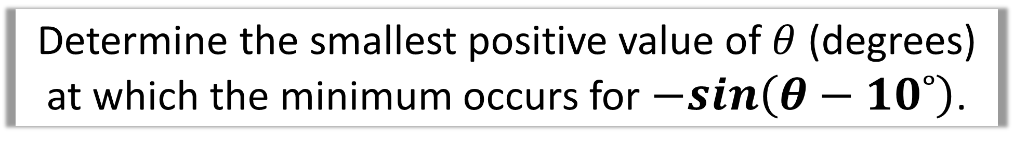
Determine the smallest positive value of $θ$ (degrees)
at which the minimum occurs for $−sin\left(θ−10˚\right)$.
90˚+ 10˚ = 100˚

Slide 20

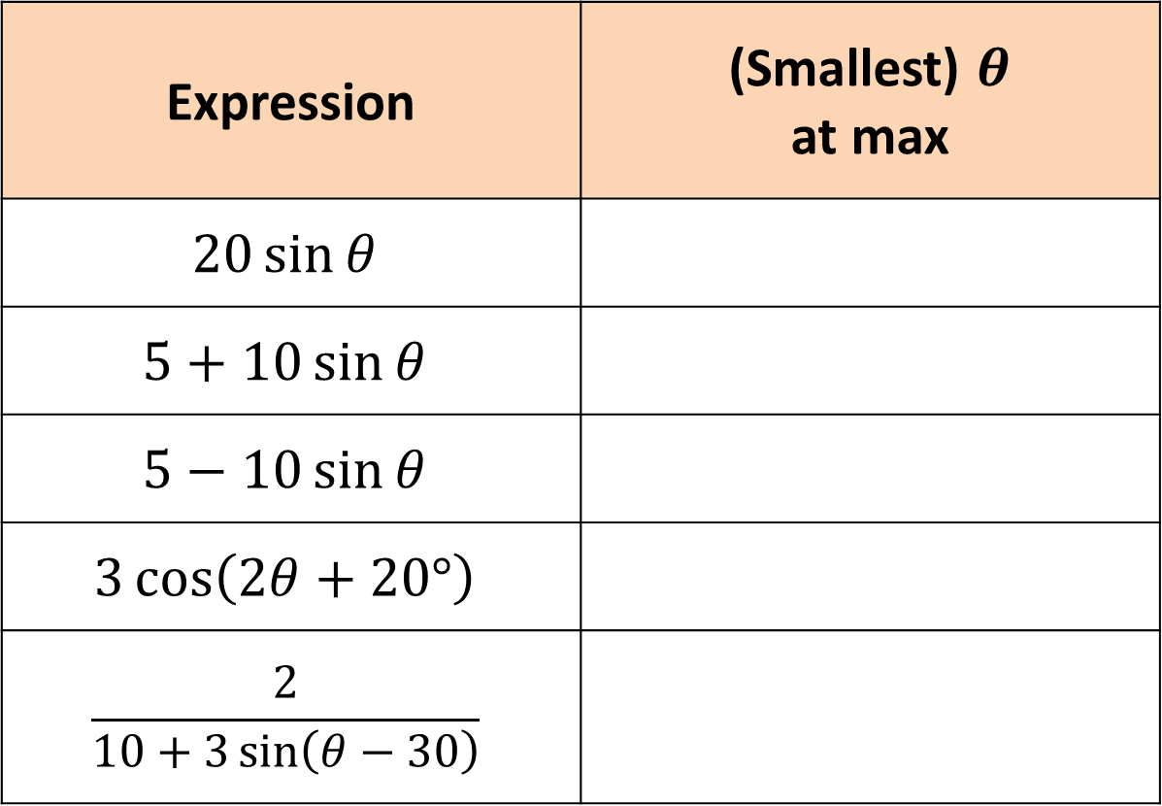

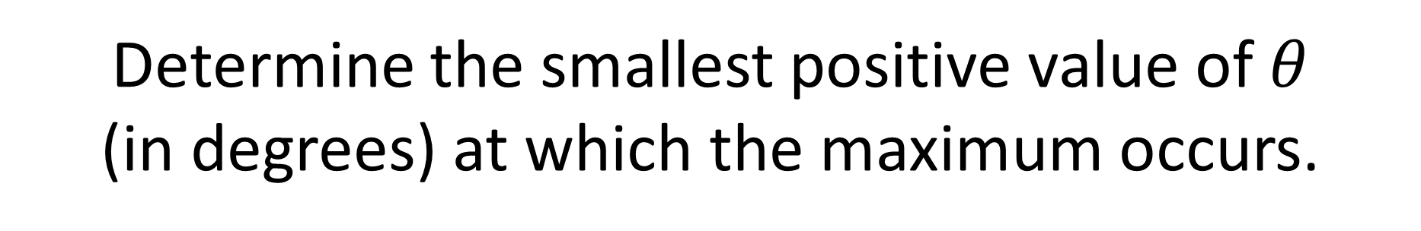



Determine the smallest positive value of $θ$
(in degrees) at which the maximum occurs.
Expression | (Smallest) $θ$ at max
$$20\sin{θ}$$
$$5+10\sin{θ}$$
$$5−10\sin{θ}$$
$$3\cos\left(2θ+20°\right)$$
$$\frac{2}{10+3\sin\left(θ−30\right)}$$
$$90°$$
$$90°$$
$$270°$$
$$170°$$
$$300°$$

Slide 21
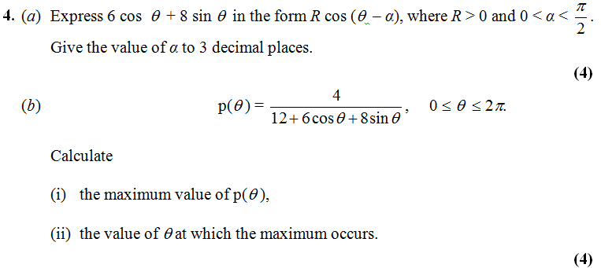

Slide 22
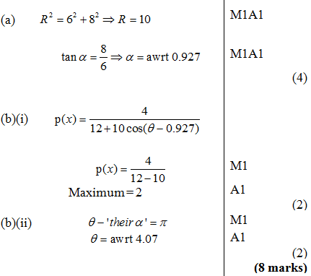

Slide 25
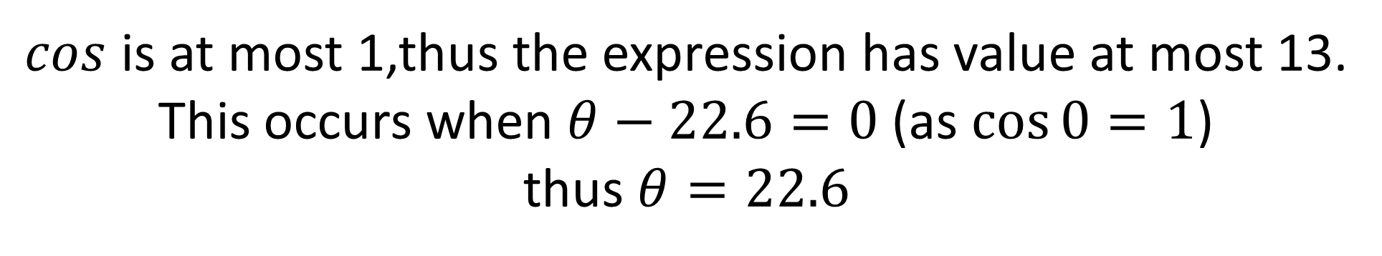
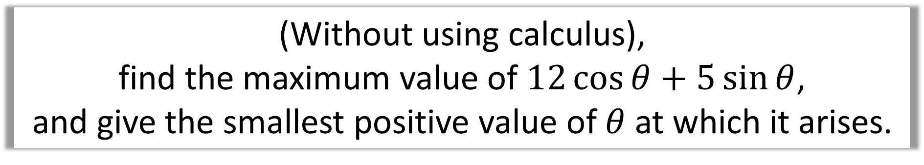

(Without using calculus),
find the maximum value of $12\cos{θ}+5\sin{θ}$,
and give the smallest positive value of $θ$ at which it arises.
Use either $R\sin{(θ+α)}$ or $R\cos{(θ−α})$
before that way the + sign in the middle matches up.
$$≡13\cos\left(θ−22.6°\right)$$
$cos$ is at most 1,thus the expression has value at most 13.
This occurs when $θ−22.6=0$ (as $\cos{0}=1$)
thus $θ=22.6$

