Slide 1

Junior Challenge 1
GOLD

Slide 2
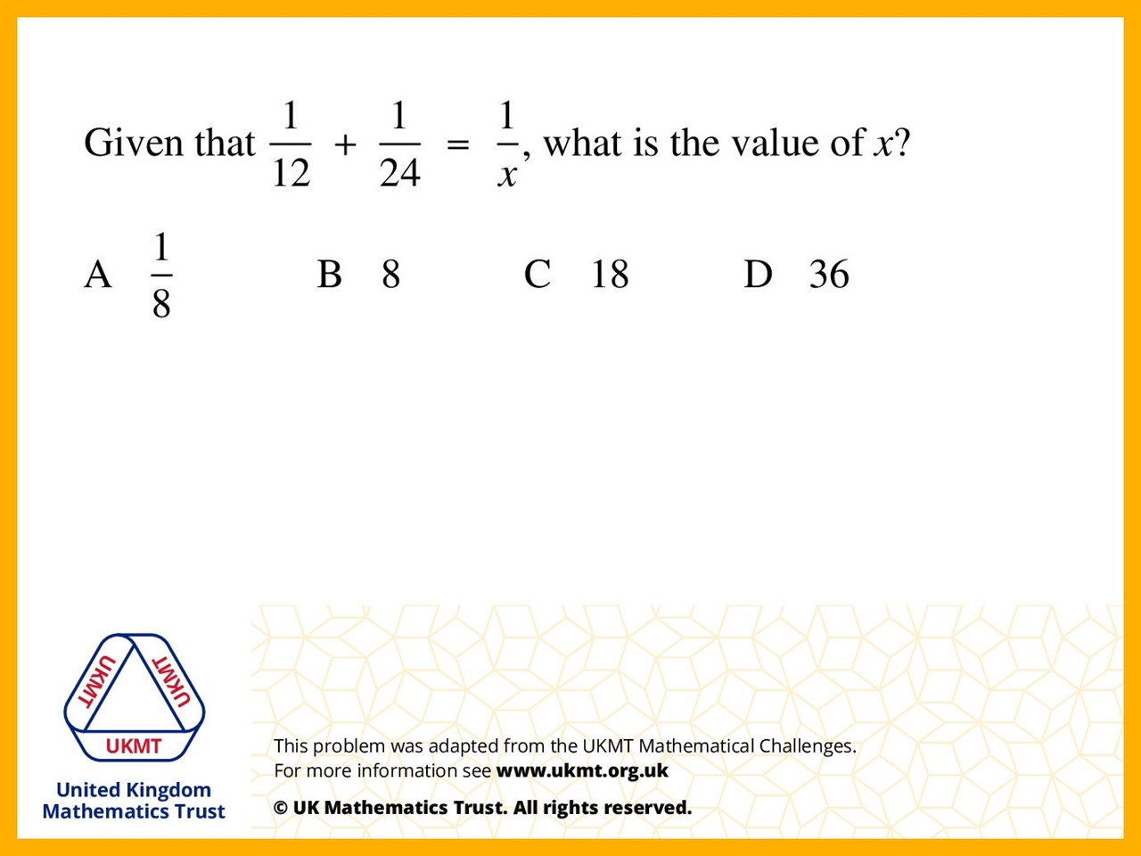
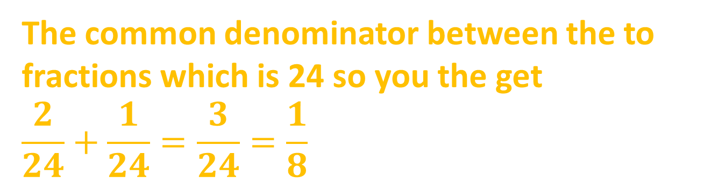
Q1.
The common denominator between the to fractions which is 24 so you the get
$$\frac{2}{24}+\frac{1}{24}=\frac{3}{24}=\frac{1}{8}$$

Slide 3
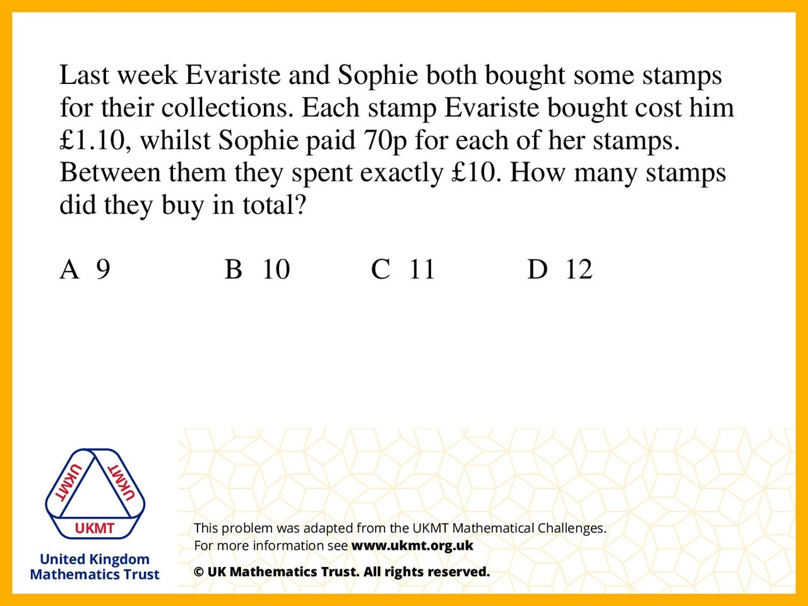
Q2.
There are only 9 different possibilities of what Evariste could have paid: £1.10 £2.20 £3.30 £4.40 £5.50 £6.60 £7.70 £8.80 £9.90. If Evariste pays £4.40, that means Sophie will have paid £5.60, which is divisible by 70p. Therefore Sophie buys 8, and Evariste buys 4. Altogether they buy 12.

Slide 4
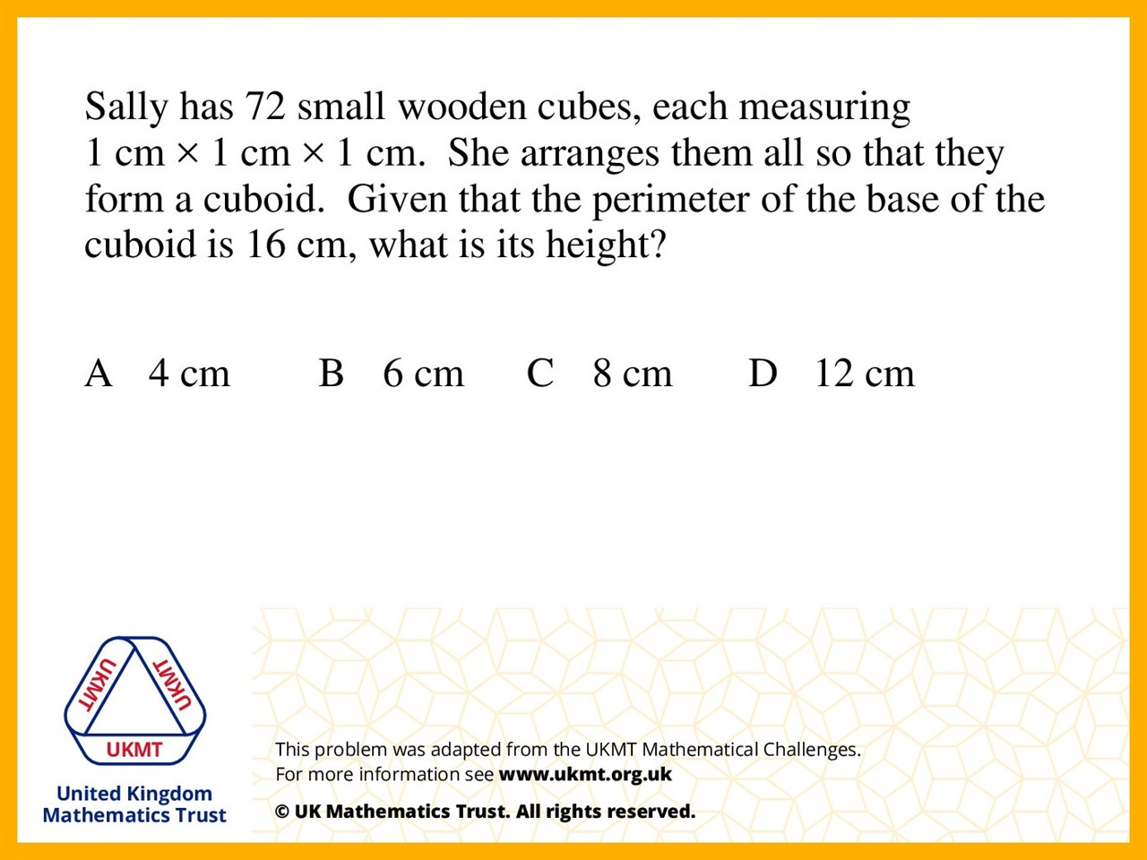
Q3.
If the perimeter is 16, then the two sides of the base can be 6cm x 2cm, 4cm x 4cm, 7cm x 1cm or 5cm x 3cm. Only if the base is 6cm x 2cm will Sally be able to use all the remaining cubes to make a cuboid, so this must be the correct length of sides. Therefore the height is 6cm

Slide 5
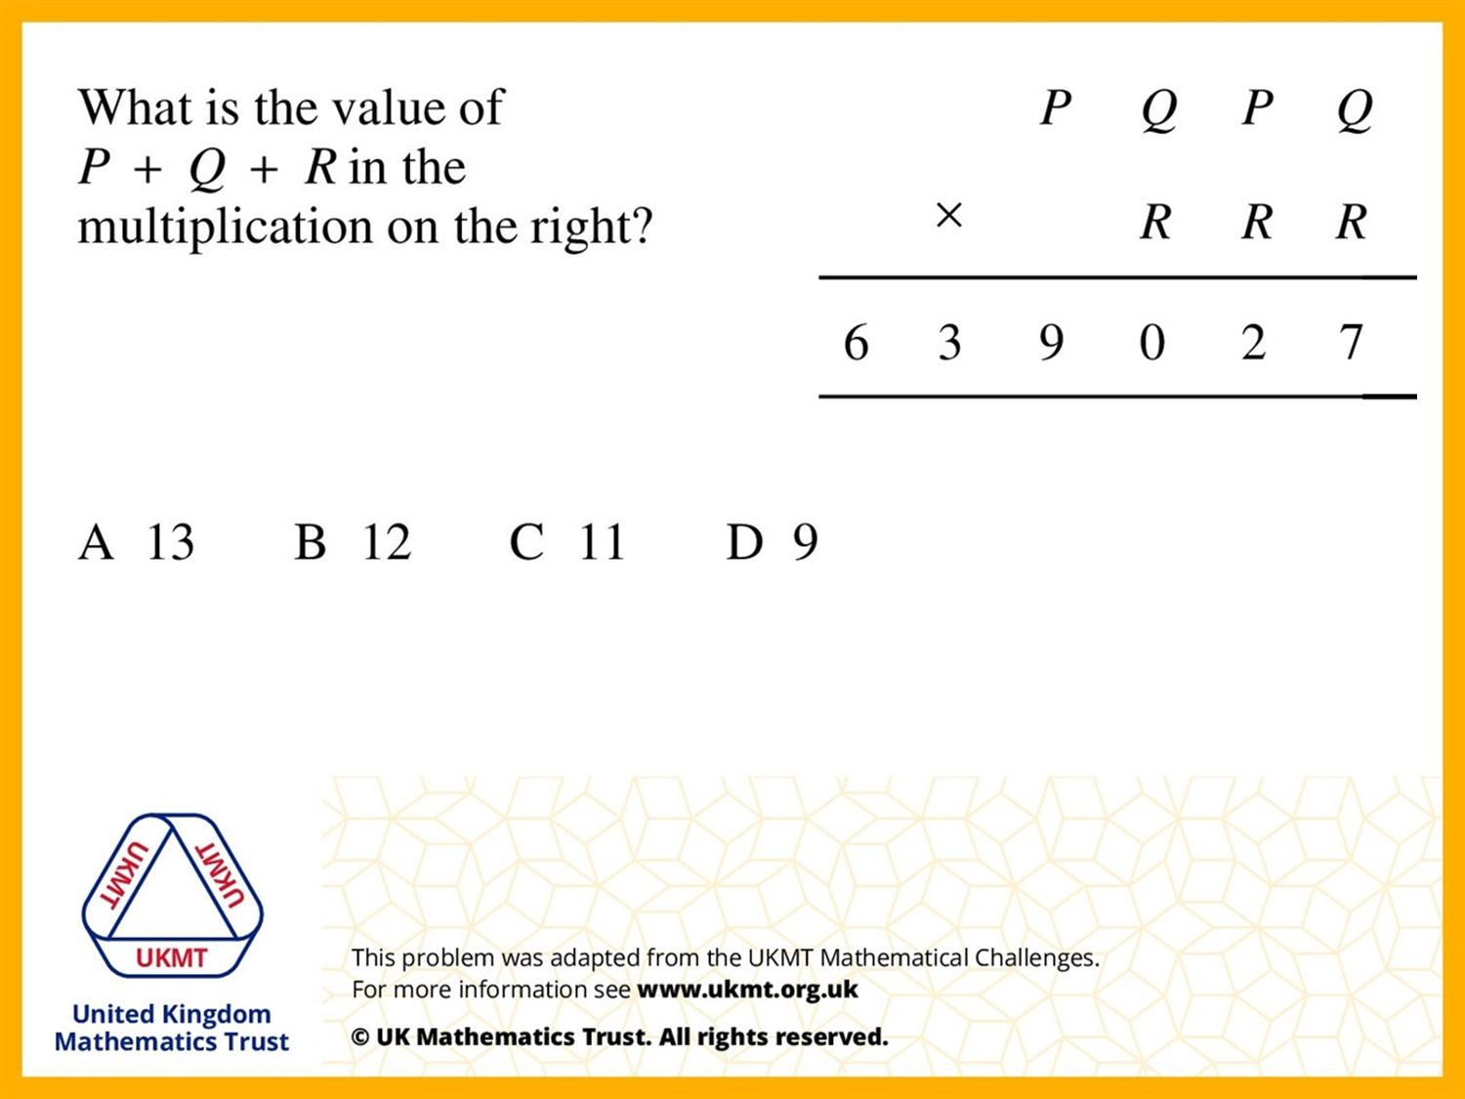
Q4.
27 is the only number ending in 7 that is not prime and can be done with two single digits. 9 and 3 are the only possible numbers for the first multiplication. The question asks for P + Q + R, we know that 9 and 3 must be in there so the only number greater than 12 is 13.

Slide 6
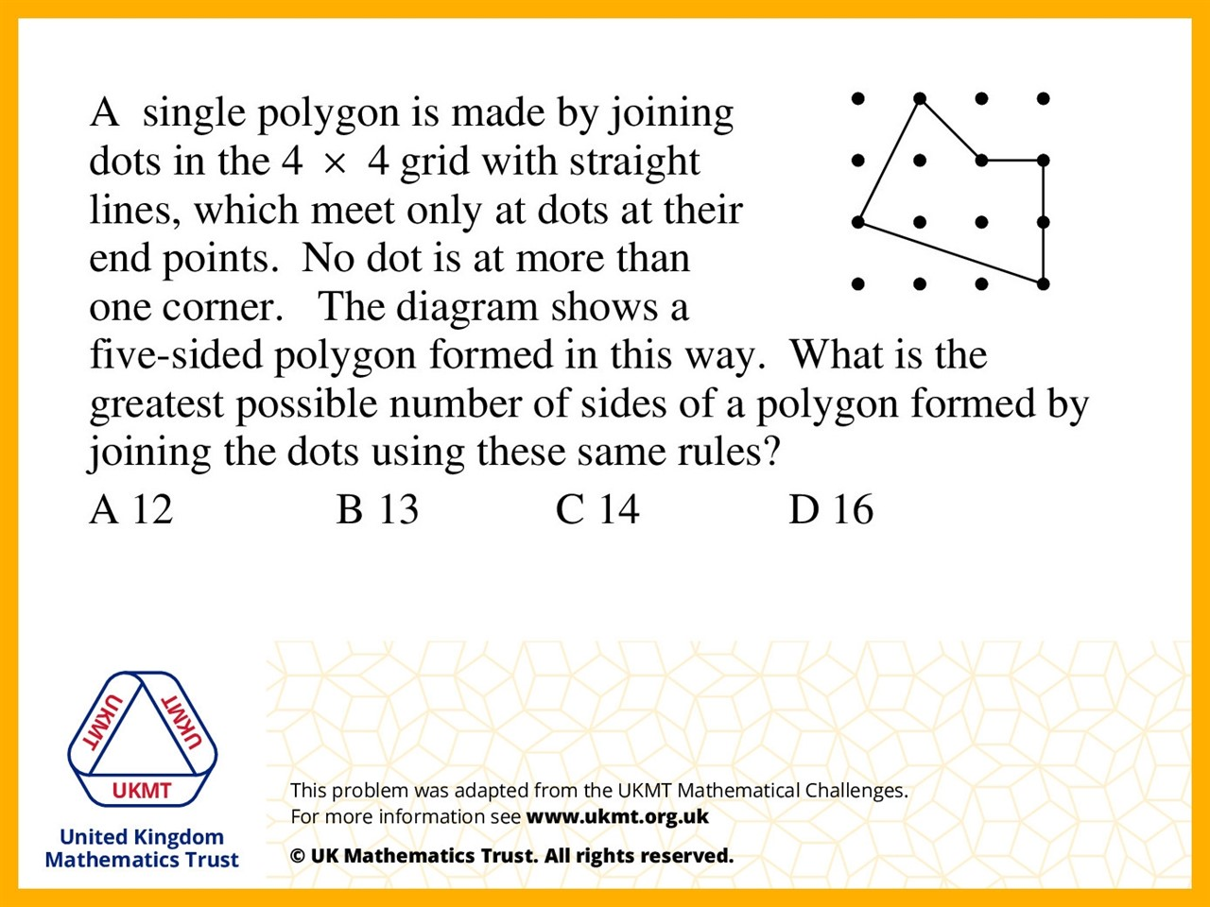
Q5.
Call the columns A,B,C,D (L to R) and the rows 1,2,3,4 (Top down). Join the points as follows: B2, B1, A1, A2, B3, A3, A4, B4, C3, C4, D4, D3, C2, D2, D1, C1, B2. This forms a 16 sided quadrilateral with points on each corner.

