Slide 1
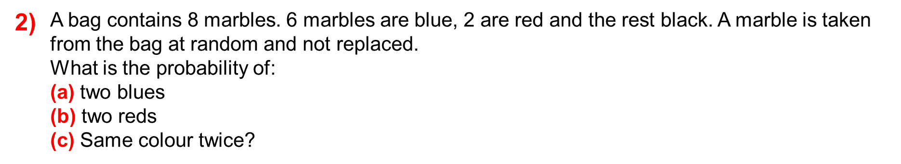

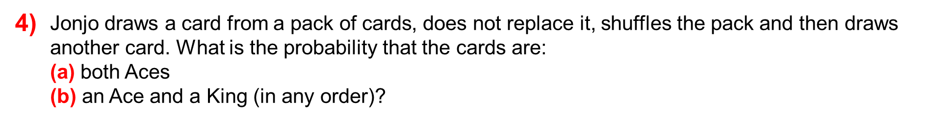

Slide 2
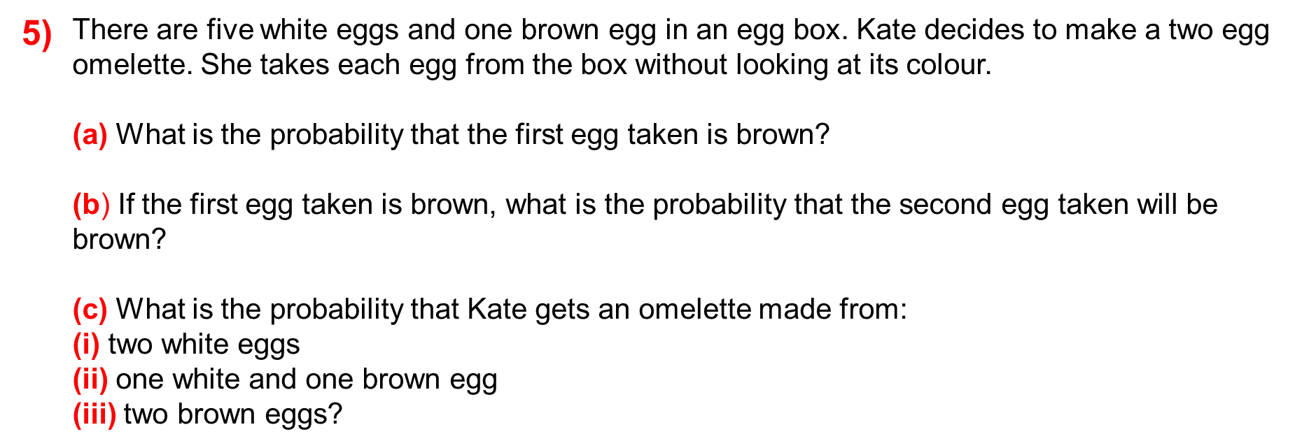

Slide 3
ANSWERS

Slide 4
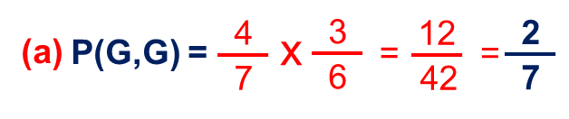
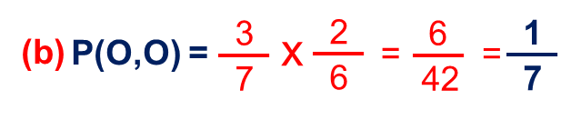
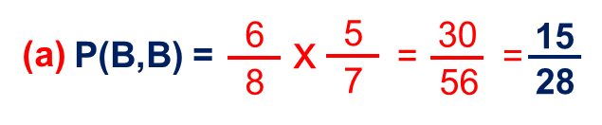
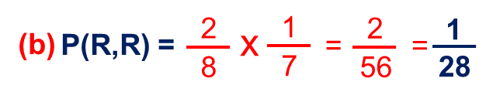
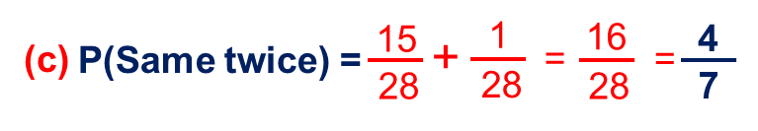
1)
A bag contains 7 beads. Four beads are green and the rest orange. A bead is taken from the bag at random and not replaced. What is the probability of: (a) two greens (b) two oranges?
2)
A bag contains 8 marbles. 6 marbles are blue, 2 are red. A marble is taken from the bag at random and not replaced.
What is the probability of:
(a) two blues
(b) two reds
(c) Same colour twice?
P(W,B) =
Notes:
4

Slide 5
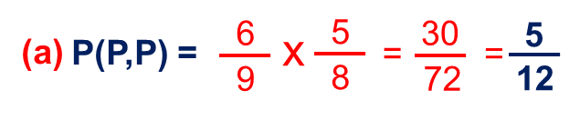
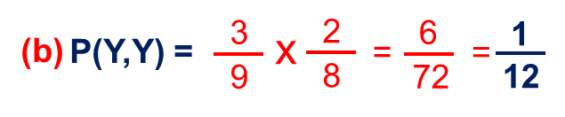
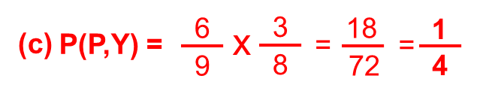
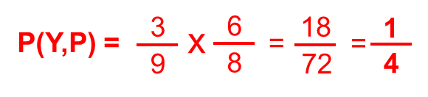
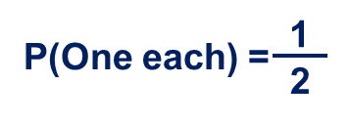
3)
A bag contains 9 counters. Two-thirds of the counters of purple and the rest yellow. A counter is taken from the bag at random and not replaced.
What is the probability of:
(a) two purples
(b) two yellows
(c) One of each in any order?
P(W,B) =
Notes:
5

Slide 6
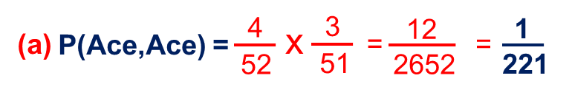
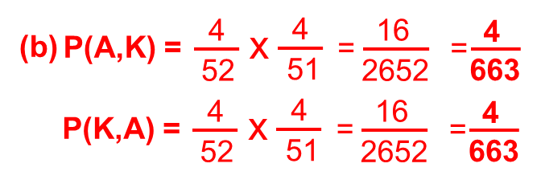
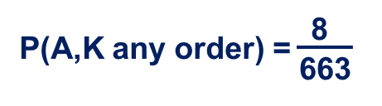
4)
Jonjo draws a card from a pack of cards, does not replace it, shuffles the pack and then draws another card. What is the probability that the cards are:
(a) both Aces
(b) an Ace and a King (in any order)?
P(W,B) =
Notes:
6

Slide 7

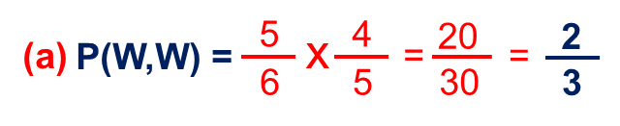
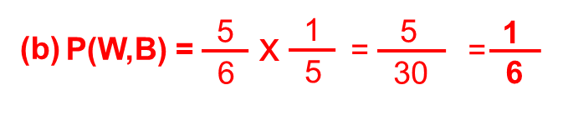
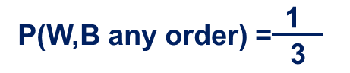
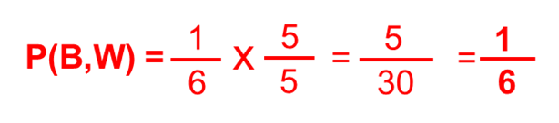
5)
There are five white eggs and one brown egg in an egg box. Kate decides to make a two egg omelette. She takes each egg from the box without looking at its colour.
(a) What is the probability that the first egg taken is brown?
(b) If the first egg taken is brown, what is the probability that the second egg taken will be brown?
(c) What is the probability that Kate gets an omelette made from:
(i) two white eggs
(ii) one white and one brown egg
(iii) two brown eggs?
0
0
P(W,B) =
Notes:
7

