Slide 1
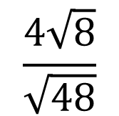
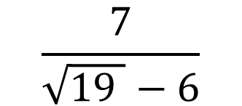
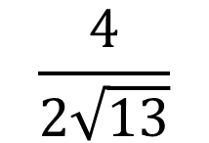
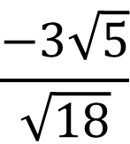
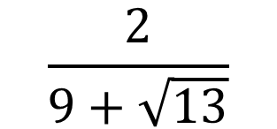
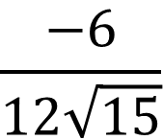
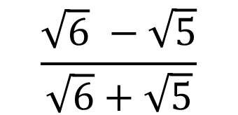
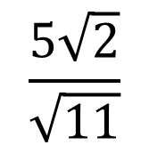
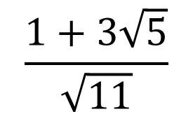
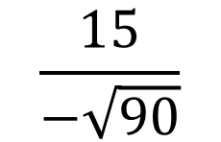
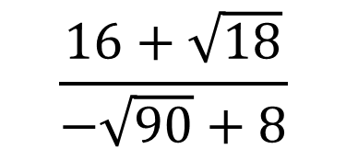
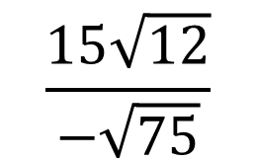
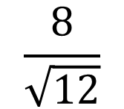
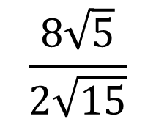
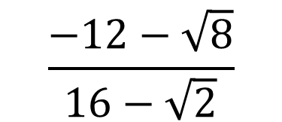
Rationalise the denominators and simplify these fractions.
$$\frac{4}{2\sqrt{13}}$$
a)
$$\frac{4\sqrt{8}}{\sqrt{48}}$$
a)
$$\frac{2}{9+\sqrt{13}}$$
a)
$$\frac{−6}{12\sqrt{15}}$$
b)
$$\frac{−3\sqrt{5}}{\sqrt{18}}$$
b)
$$\frac{7}{\sqrt{19 }−6}$$
b)
c)
$$\frac{8}{\sqrt{12}}$$
c)
$$\frac{8\sqrt{5}}{2\sqrt{15}}$$
c)
$$\frac{−12−\sqrt{8}}{16−\sqrt{2}}$$
d)
$$\frac{15}{−\sqrt{90}}$$
d)
$$\frac{15\sqrt{12}}{−\sqrt{75}}$$
d)
$$\frac{16+\sqrt{18}}{−\sqrt{90}+8}$$
e)
$$\frac{5\sqrt{2}}{\sqrt{11}}$$
e)
$$\frac{1+3\sqrt{5}}{\sqrt{11}}$$
e)
$$\frac{\sqrt{6} −\sqrt{5}}{\sqrt{6}+\sqrt{5}}$$

Slide 2
ANSWERS

Slide 3
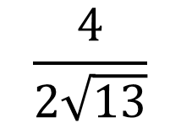
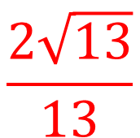
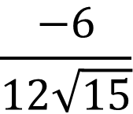
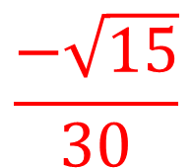
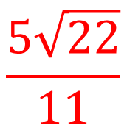
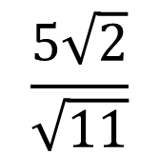
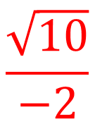
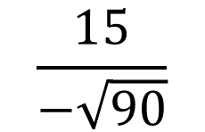
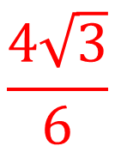
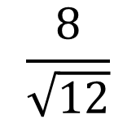
$$\frac{2\sqrt{13}}{13}$$
a)
$$\frac{4}{2\sqrt{13}}$$
b)
$$\frac{−6}{12\sqrt{15}}$$
$$\frac{−\sqrt{15}}{30}$$
c)
$$\frac{8}{\sqrt{12}}$$
$$\frac{4\sqrt{3}}{6}$$
d)
$$\frac{15}{−\sqrt{90}}$$
$$\frac{\sqrt{10}}{−2}$$
e)
$$\frac{5\sqrt{2}}{\sqrt{11}}$$
$$\frac{5\sqrt{22}}{11}$$

Slide 4
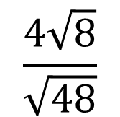
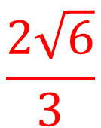
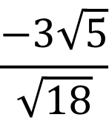
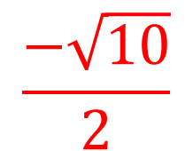
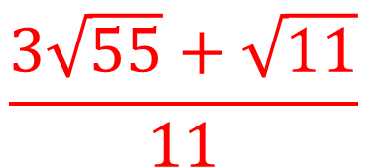
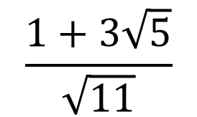

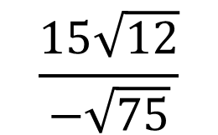
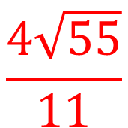
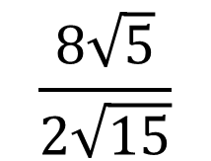
a)
$$\frac{2\sqrt{6}}{3}$$
$$\frac{4\sqrt{8}}{\sqrt{48}}$$
b)
$$\frac{−3\sqrt{5}}{\sqrt{18}}$$
$$\frac{−\sqrt{10}}{2}$$
c)
$$\frac{8\sqrt{5}}{2\sqrt{15}}$$
$$\frac{4\sqrt{55}}{11}$$
d)
$$\frac{15\sqrt{12}}{−\sqrt{75}}$$
$$6$$
e)
$$\frac{1+3\sqrt{5}}{\sqrt{11}}$$
$$\frac{3\sqrt{55}+\sqrt{11}}{11}$$

Slide 5
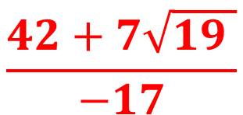
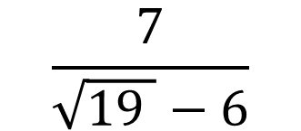
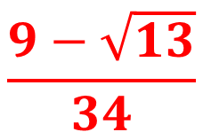
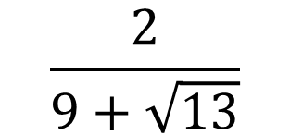
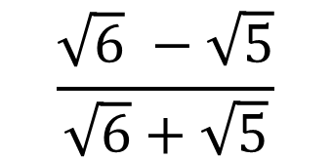
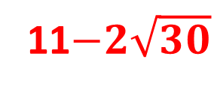
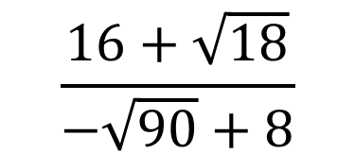
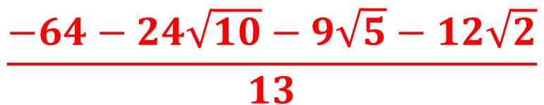
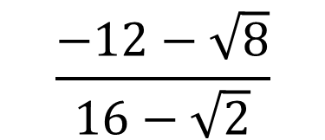
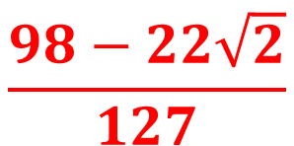
a)
$$\frac{2}{9+\sqrt{13}}$$
$$\frac{9−\sqrt{13}}{34}$$
b)
$$\frac{7}{\sqrt{19 }−6}$$
$$\frac{42+7\sqrt{19 }}{−17}$$
c)
$$\frac{−12−\sqrt{8}}{16−\sqrt{2}}$$
$$\frac{98−22\sqrt{2}}{127}$$
d)
$$\frac{16+\sqrt{18}}{−\sqrt{90}+8}$$
$$\frac{−64−24\sqrt{10}−9\sqrt{5}−12\sqrt{2}}{13}$$
e)
$$\frac{\sqrt{6} −\sqrt{5}}{\sqrt{6}+\sqrt{5}}$$
11$−2\sqrt{30}$

