Slide 1
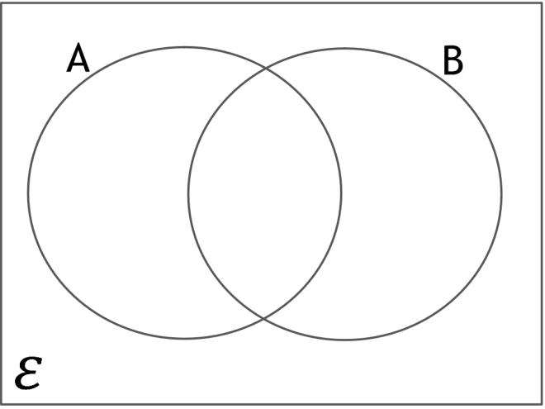
Questions 1
Fill in the Venn Diagram
Write the sub sets for:
A ∩ B =
A U B =
A ∩ B' =
A‘ ∩ B' =
ε = {all animals}
A = {cat, dog, pig, mouse, hamster}
B = {dog, pig, rat, lizard, mouse}

Slide 2
Question 2
Fill in the Venn Diagram
Write the sub sets for:
A ∩ B =
A U B =
A ∩ B' =
A‘ ∩ B =
ε = {integers less than 29}
A = {5, 10, 15, 20, 25}
B = {4, 8, 12, 16, 20, 24, 28}

Slide 3
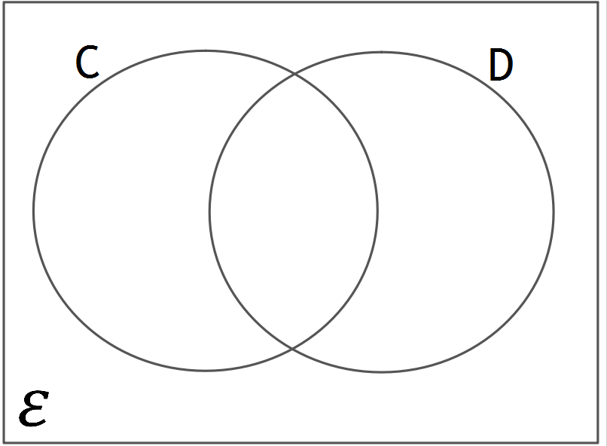
Question 3
Fill in the Venn Diagram
Write the sub sets for:
C ∩ D =
C U D =
C ∩ D' =
C‘ ∩ D =
ε = {integers less than 13}
C = {1, 3, 5, 7, 9}
D = {3, 6, 9, 12}

Slide 4
Question 4
Produce a Venn Diagram
Write the sub sets for:
A U B =
B U C =
A U B U C =
A = {1, 2, 3, 5, 6, 10, 15, 30}
B = {1, 2, 4, 5, 8, 10, 20, 40}
C = {1, 2, 4, 5, 10, 20, 25, 50, 100}

Slide 5
ANSWERS

Slide 6
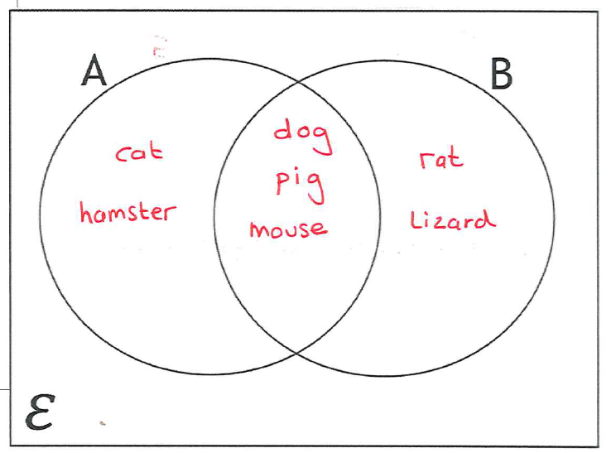
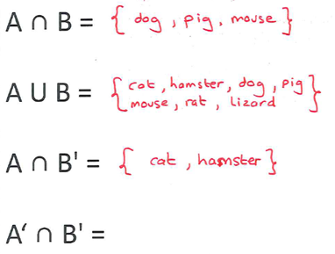
Questions 1
Fill in the Venn Diagram
Write the sub sets for:
A ∩ B =
A U B =
A ∩ B' =
A‘ ∩ B' =
ε = {all animals}
A = {cat, dog, pig, mouse, hamster}
B = {dog, pig, rat, lizard, mouse}

Slide 7


Question 2
Fill in the Venn Diagram
Write the sub sets for:
A ∩ B =
A U B =
A ∩ B' =
A‘ ∩ B =
ε = {integers less than 29}
A = {5, 10, 15, 20, 25}
B = {4, 8, 12, 16, 20, 24, 28}
{5, 10, 15, 25}

Slide 8
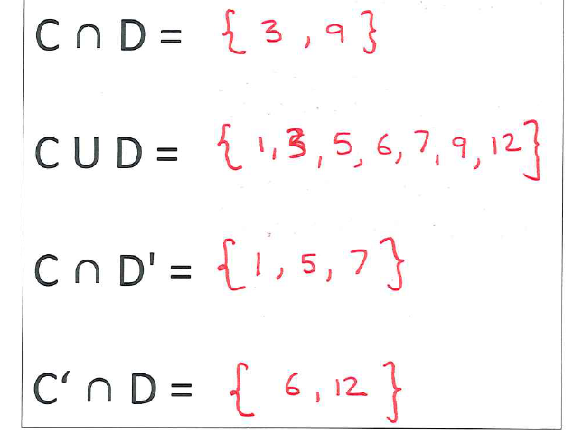
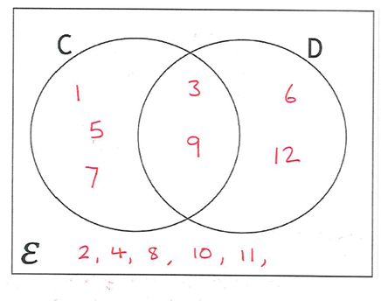
Question 3
Fill in the Venn Diagram
Write the sub sets for:
C ∩ D =
C U D =
C ∩ D' =
C‘ ∩ D =
ε = {integers less than 13}
C = {1, 3, 5, 7, 9}
D = {3, 6, 9, 12}

Slide 9
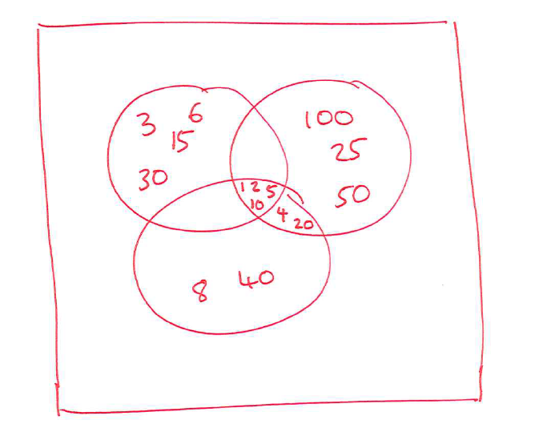
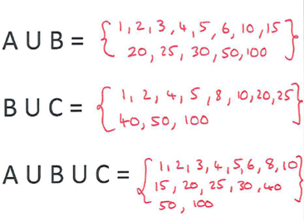
Question 4
Produce a Venn Diagram
Write the sub sets for:
A U B =
B U C =
A U B U C =
A = {1, 2, 3, 5, 6, 10, 15, 30}
B = {1, 2, 4, 5, 8, 10, 20, 40}
C = {1, 2, 4, 5, 10, 20, 25, 50, 100}
{1,2,3,4,5,6,8,10,
15,20,30,40}

